Slide 1
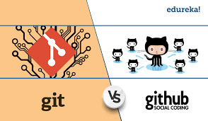
Intro
what is the difference between git and git hub?
Git is a distributed version control system that allows multiple contributors to work on a project while providing us to manage and track changes along the way. GitHub, on the other hand, is a web-based platform that provides hosting for Git repositories. It allows us to store our code in the cloud and provides tools for managing and collaborating on projects. While Git is the underlying technology, GitHub provides a user-friendly interface for working with Git repositories and adds additional features such as issue tracking, project management, and code review tools.

Slide 2
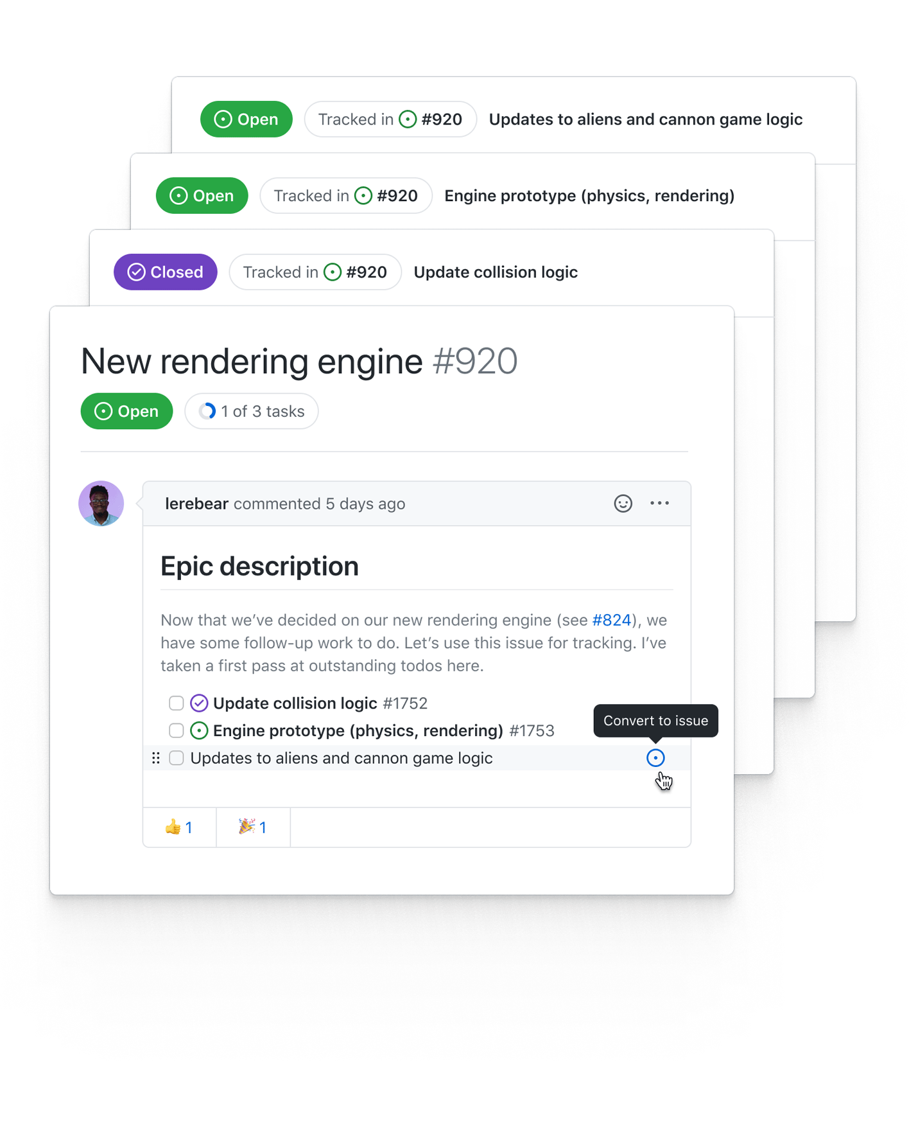
Defining tasks
ISSUES
Issue can be created by any member of the team and mainly used for tracking tasks, bugs and enhancement in the repository. We can add description, assignees, labels and milestones we can promise categorizing the issues by type(bug, feature etc.), group issues together based on a release date. It allows us to assign issues to members of the team set priorities and tracking our progress

Slide 3
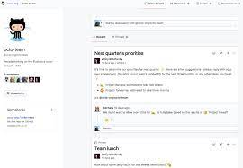
Team management and task assignment
TEAMS
GITHUB provides several tools for dealing with team management and task assignment. Team members can be added to the project and assigned a specific issues or milestones. Additionally, teams can be given access to a specific repositories, branches or files which ensure that each team member has access to the resources they need to complete their mission.

Slide 4

Tracking the progress
Milestones and Branches
Both tools are great for tracking progress- Milestones are used to group issues together based on a specific timeline while branches are used to create a different versions of the code base that can be worked independently. Branches can be merged to the main branch and using commits with detailed messages can help us to understand every change along the way. By using milestones and branches in GitHub, teams can collaborate more effectively and ensure that projects are completed on time and on budget.

Slide 5
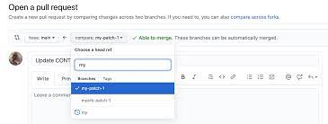
Traceability
Pull requests, issue tracking system
Code reviews tools such as pull requests can be used to unsure that code changes are reviewed before merging. Github’s issues tacking system can be used to create requirements and then link them together to specific code changes. This features helps to ensure traceability and helps us understand the rationale behind code changes.

Slide 6
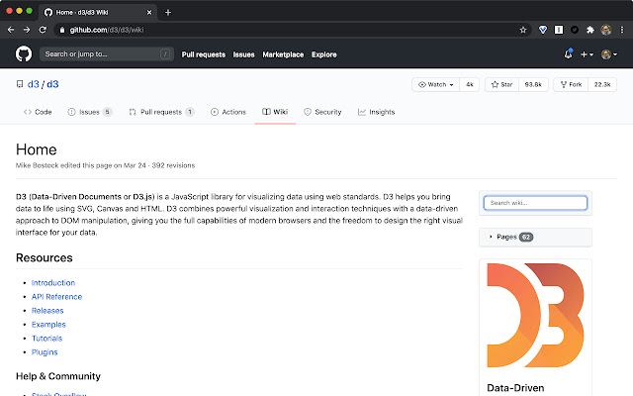
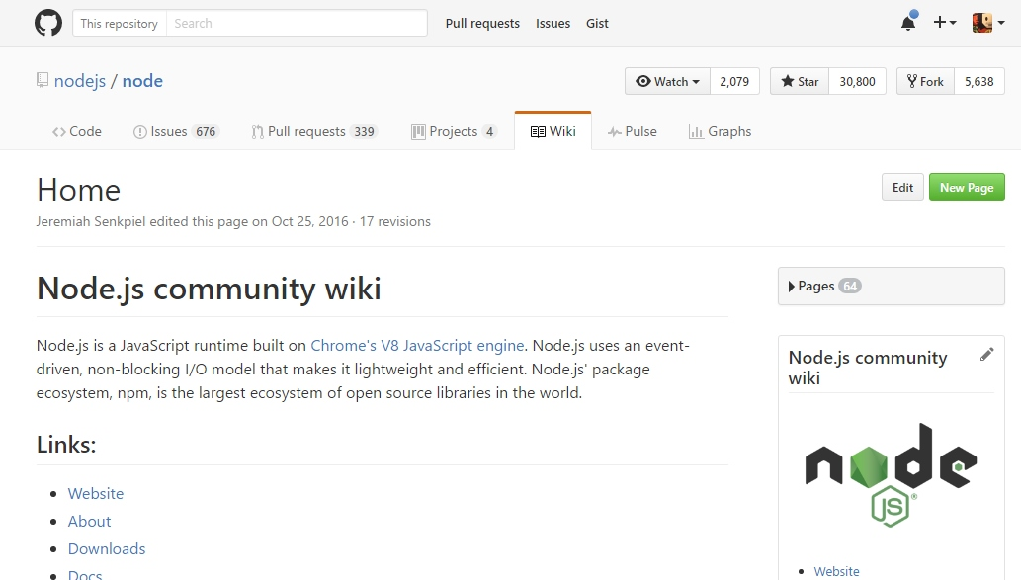
Documentation
Wiki
Every git hub repository comes with a section for hosting docs called wiki. It can be used to provide detailed information about the project- designs and goals in addition to other docs that will help others use and contribute to the project. Wikis in GitHub are a powerful tool for improving collaboration and knowledge sharing within a team and can help to ensure that everyone is on the same page when it comes to project documentation and information.

Slide 7
Code flow
Create a branch: Create a branch with a short and descriptive name. By creating a branch, you create a space to work without affecting the default branch. Additionally, you give your collaborators a chance to review your work
1
Make changes: On your branch, make changes to the repository. Your branch is a safe place to make changes. If you make a mistake, you can revert your changes or push additional changes to fix it. Add, commit (with a meaningful comment) and push your changes. Repeat until finish
2
Create a PR (pull request): Create a PR to ask for your collaborators for feedback. You can also require an approving review before PR can be merged. If you want it to be quick, you can mark it as draft. PR includes summary, the problem it solves, images, tables and even linked issues
3
Address review comments: Reviewers should leave questions, comments, and suggestions. You can continue to commit and push changes in response to the reviews. Your pull request will update automatically
4
Merge your PR: Once your pull request is approved, merge your pull request. This will merge your branch to the default branch. GitHub retains the history of comments and commits in the PR to help future contributors understand your changes.
5
Delete your branch: After you merge your pull request, delete your branch. This indicates that the work on the branch is complete and prevents you or others from accidentally using old branches.
6

