Slide 1
Object Oriented Programming in JAVA
(Practical#-11)

Slide 2
Objective: To become Layout Managers
Layout managers are provided to arrange GUI components on a container for presentation purposes.
The layout managers provide basic layout capabilities that are easier to use than determining the exact position and size of every GUI component.

Slide 3
Layout Managers
FlowLayout :
GUI components are placed on a container from left to right in the order in which they are added to the container. When the edge of the container is reached, components are continued on the next line.
Places components sequentially (left to right) in the order they were added.
Class FlowLayout allows GUI components to be left-aligned, centered (the default) and right-aligned.

Slide 4
Layout Managers
BorderLayout
The BorderLayout layout manager arranges components into five regions: NORTH, SOUTH, EAST, WEST and CENTER (North corresponds to the top of the container).
BorderLayout(): creates a border layout but with no gaps between the components.
JBorderLayout(int hgap, int vgap): creates a border layout with the given horizontal and vertical gaps between the components.
The borderlayout arranges the components to fit in the five regions: east, west, north, south, and center.

Slide 5
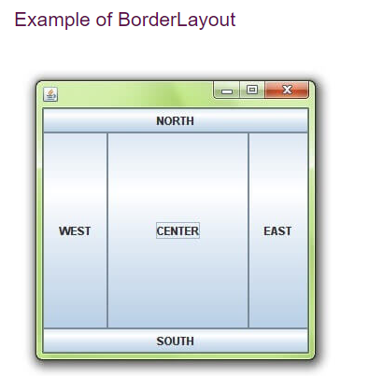

Slide 6
Layout Managers
Layout Managers: GridLayout
The GridLayoutmanager divides the container up into a given number of rows and columns:
new GridLayout(rows,columns)
All sections of the grid are equally sized and as large as possible
The GridLayout manages the components in the form of a rectangular grid.

Slide 7
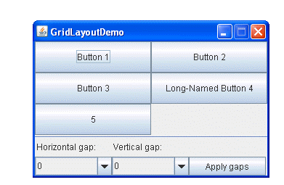

Slide 8
A GridLayout object places components in a grid of cells.
Each component takes all the available space within its cell, and each cell is exactly the same size.
GridLayout experimentLayout = new GridLayout(0,2); ...
compsToExperiment.setLayout(experimentLayout);
compsToExperiment.add(new JButton("Button 1"));
compsToExperiment.add(new JButton("Button 2"));
compsToExperiment.add(new JButton("Button 3"));
The constructor of the GridLayout class creates an instance that has two columns and as many rows as necessary.

Slide 9
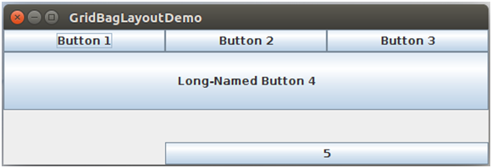
Layout Managers
Layout Managers: GridBagLayout
This layout manager is similar to GridLayout in that it arranges components in a grid.
However, in GridBagLayout the components can vary in size (i.e. they can occupy multiple rows and columns).

Slide 10
GridBagLayout is a sophisticated, flexible layout manager. It aligns components by placing them within a grid of cells, allowing components to span more than one cell. The rows in the grid can have different heights, and grid columns can have different widths.
The Java GridBagLayout class is used to align components vertically, horizontally.
The components may not be of same size. Each GridBagLayout object maintains a dynamic, rectangular grid of cells. Each component occupies one or more cells known as its display area. Each component associates an instance of GridBagConstraints.

Slide 11
Layout Managers
A GridBagConstraints object describes how a component is placed in a GridBagLayout.
Grid-BagConstraints instance variables.
fill field defines how the component grows if the area in which it can be displayed is larger than the component

Slide 12
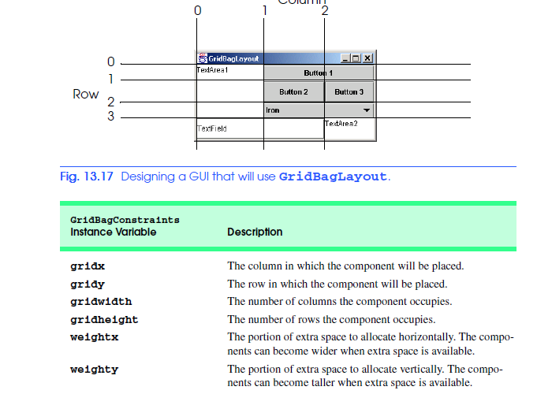

Slide 13
Layout Managers
Layout Managers: BoxLayout
The BoxLayout is used to arrange the components either vertically or horizontally. For this purpose, BoxLayout provides four constants. They are as follows:
Fields of BoxLayout class
public static final int X_AXIS
public static final int Y_AXIS
Constructor of BoxLayout class
BoxLayout(Container c, int axis): creates a box layout that arranges the components with the given axis.
BoxLayout class puts components in a single row or column. It respects the components' requested maximum sizes and also lets you align components

Slide 14
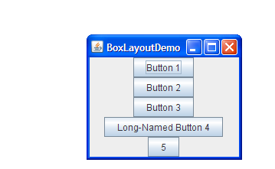

Slide 15
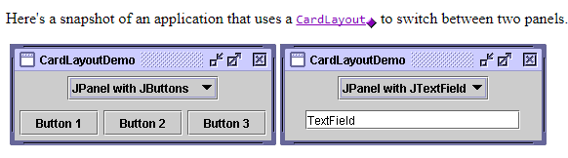
Layout Managers
Layout Managers: CardLayout
The CardLayout class manages the components in such a manner that only one component is visible at a time. It treats each component as a card that is why it is known as CardLayout.

Slide 16
Layout Managers
Commonly used methods of CardLayout class
public void next(Container parent): is used to flip to the next card of the given container.
public void previous(Container parent): is used to flip to the previous card of the given container.
public void first(Container parent): is used to flip to the first card of the given container.
public void last(Container parent): is used to flip to the last card of the given container.
public void show(Container parent, String name): is used to flip to the specified card with the given name.

Slide 17
GroupLayout groups its components and places them in a Container hierarchically.
GroupLayout is a LayoutManager that hierarchically group the components and arranges them in a Container
The grouping is done by instances of the Group class.
Group is an abstract class and two concrete classes which implement this Group class are SequentialGroup and ParallelGroup.
SequentialGroup positions its child sequentially one after another where as ParallelGroup aligns its child on top of each other.
The GroupLayout class provides methods such as createParallelGroup() and createSequentialGroup() to create groups.

Slide 18
Layout Managers
Layout Managers: GroupLayout
GroupLayout treats each axis independently. That is, there is a group representing the horizontal axis, and a group representing the vertical axis. Each component must exists in both a horizontal and vertical group, otherwise an IllegalStateException is thrown during layout, or when the minimum, preferred or maximum size is requested.

Slide 19
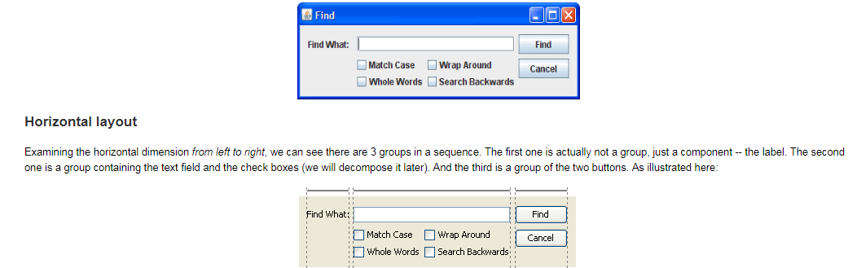
Layout Managers

Slide 20
Layout Managers
Layout Managers: SpringLayout
A SpringLayout arranges the children of its associated container according to a set of constraints.Constraints are nothing but horizontal and vertical distance between two component edges. Every constrains are represented by a SpringLayout.Constraint object.
Each child of a SpringLayout container, as well as the container itself, has exactly one set of constraints associated with them.
Each edge position is dependent on the position of the other edge. If a constraint is added to create new edge than the previous binding is discarded. SpringLayout doesn't automatically set the location of the components it manages.

Slide 21
Layout Managers
Layout Managers: ScrollPaneLayout
The layout manager used by JScrollPane. JScrollPaneLayout is responsible for nine components: a viewport, two scrollbars, a row header, a column header, and four "corner" components.
Adds the specified component to the layout. The layout is identified using one of:ScrollPaneConstants.VIEWPORT
ScrollPaneConstants.VERTICAL_SCROLLBAR
ScrollPaneConstants.HORIZONTAL_SCROLLBAR
ScrollPaneConstants.ROW_HEADER
ScrollPaneConstants.COLUMN_HEADER
ScrollPaneConstants.LOWER_LEFT_CORNER
ScrollPaneConstants.LOWER_RIGHT_CORNER
ScrollPaneConstants.UPPER_LEFT_CORNER
ScrollPaneConstants.UPPER_RIGHT_CORNER

Slide 22
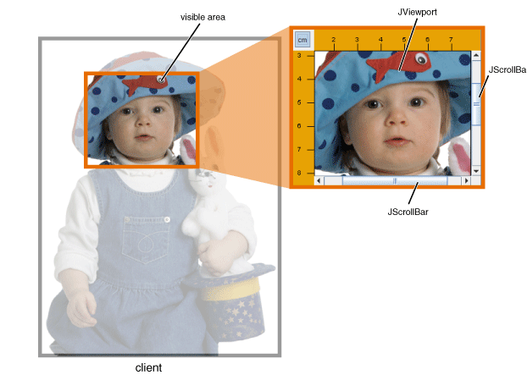
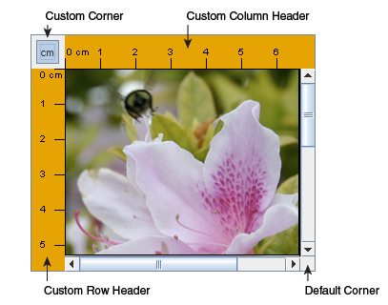

Slide 23
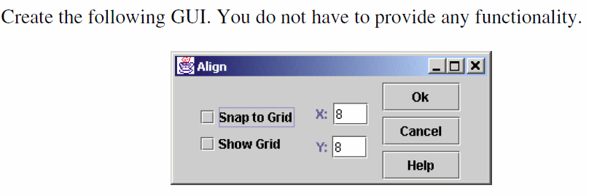
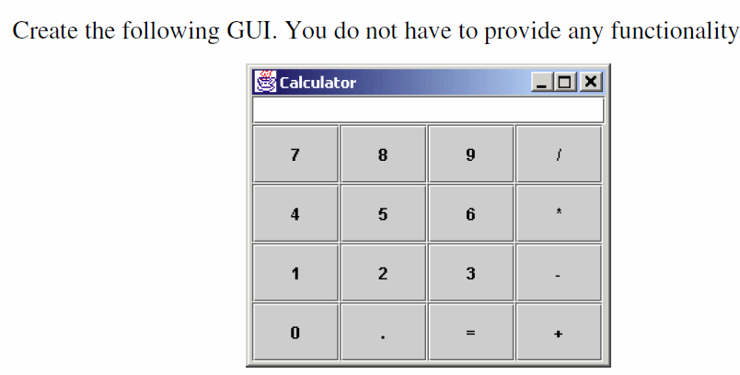
Tasks For Lab # 7
Task # 1
Task # 2

