Slide 1
Object Oriented Programming in JAVA
(Practical#01)

Slide 2
Objective: Installation of JDK and become familiar with basic java program structure, identifiers, primitive data types, Type Conversion and Casting .
Introduction to JDK:
The Java Development Kit (JDK) is a software development environment used for developing Java applications and applets.
Java Development Kit (JDK) is a package of software components that is used to develop Java based applications.
Java Development Kit (JDK) is comprised of the following basic components:
Java compiler (javac)
Java Virtual Machine (JVM)
Java Application Programming Interface (API)
JRE Java Runtime Environment

Slide 3
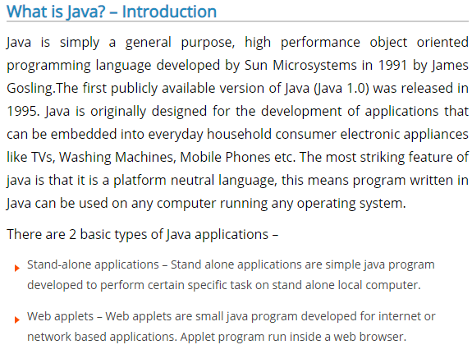

Slide 4
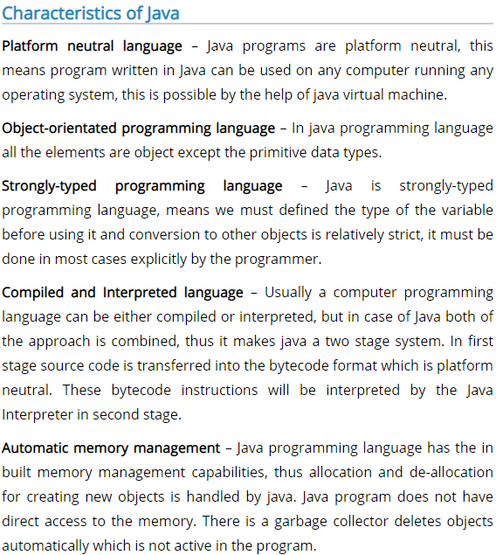

Slide 5
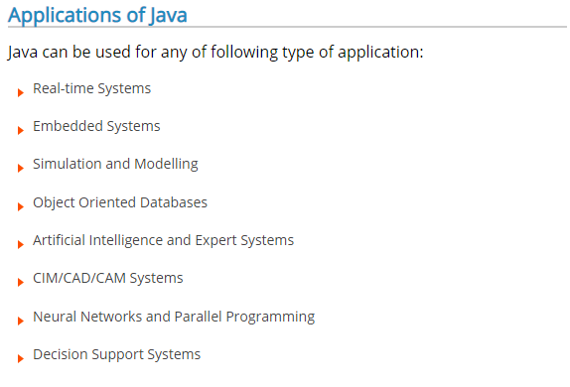

Slide 6
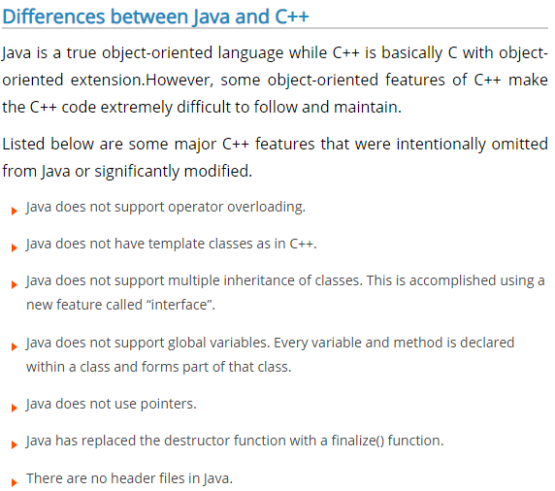

Slide 7
Java development environment
A Java program always consists of one or more classes.
A Java source file name must have the extension .java.
You typically put the program code for each class in a separate file, and you must give each file the same name as that of the class that is defined within it.

Slide 8
Program Modules in in java
Three kinds of modules exits in java- methods, classes and packages.
Java Programs are written with predefined methods and classes available in the Java Application Programming Interfaces (also referred to as the Java API or Java class library).
Related classes are grouped into packages so that they can be imported into programs and reused.
The Java API classes are part of the JDK.

Slide 9
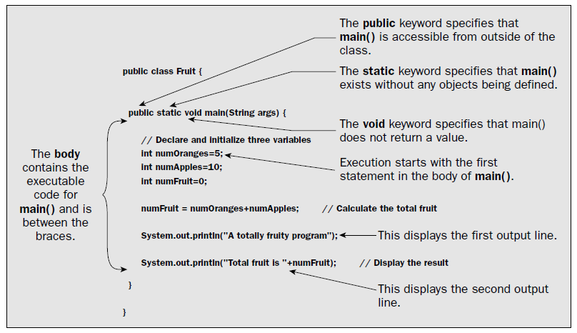
Basic structure of java Program

Slide 10
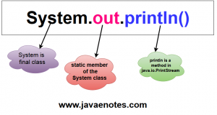
System.out.println is a Java statement that prints the argument passed, into the System.out which is generally stdout.
System is a Class
out is an object
println() is a method
System is a class in the java.lang package . The out is a static member of the System class, and is an instance of java.io.PrintStream . The println is a method of java.io.PrintStream. This method is overloaded to print message to output destination, which is typically a console or file. the System class belongs to java.lang package

Slide 11
Introduction to JDK
Javac The name of Java compile is Javac
The Java Language Compiler compiles programs written in the Java Programming language.
Translates Java source code into Bytecodes.
Produces or creates .class containing bytecodes
Java language Complier compiles java programs into platform independent bytecode.
.class file contains bytecodes or Containing compiled version of the program
javac MyProgram.java

Slide 12
Introduction to JDK
A Java compiler converts the Java source code that you write into a binary program consisting of bytecodes.
Bytecodes are the Platform independent instructions for the Java Virtual Machine. When you execute a Java program, a program called the Java interpreter inspects and translates the bytecodes then executes the actions that the bytecodes specify within the Java Virtual Machine.

Slide 13
What is Java Bytecode ?
Bytecodes: is the result of compiling source code written in java language. This bytecode can be run in any platform which has a Java installation in it.
We you compile a java program, the java complier (javac) creates a .class file, that contains bytecodes.
Upon compile, the Java source code is converted into the .class bytecode.
Bytecodes are the Platform independent instructions or portable instructions.

Slide 14
The Java bytecode is not completely compiled, but rather just an intermediate code sitting in the middle because it still has to be interpreted and executed by the JVM installed on the specific platform such as Windows, Mac or Linux.
https://en.wikipedia.org/wiki/Java_bytecode

Slide 15
Compilation and Execution of a Java Program
In Java, programs are not compiled into executable files; they are compiled into bytecode, which the JVM (Java Virtual Machine) then executes. Java source code is compiled into bytecode when we use the javac compiler. The bytecode gets saved on the disk with the file extension .class. When the program is to be run, the bytecode is converted, using the just-in-time (JIT) compiler. The result is machine code which is then fed to the memory and is executed.

Slide 16
Compilation
First, the source ‘.java’ file is passed through the compiler, which then encodes the source code into a machine independent encoding, known as Bytecode.
The content of each class contained in the source file is stored in a separate ‘.class’ file. While converting the source code into the bytecode, the compiler follows the following steps:
Execution
The class files generated by the compiler are independent of the machine or the OS, which allows them to be run on any system. To run, the main class file (the class that contains the method main) is passed to the JVM, and then goes through three main stages before the final machine code is executed. These stages are:

Slide 17
Class Loader
The main class is loaded into the memory by passing its ‘.class’ file to the JVM,
All the other classes referenced in the program are loaded through the class loader.
Bytecode Verifier
After the bytecode of a class is loaded by the class loader, it has to be inspected by the bytecode verifier, whose job is to check that the instructions don’t perform damaging actions. The following are some of the checks carried out:
Variables are initialized before they are used.
Method calls match the types of object references.
Rules for accessing private data and methods are not violated.
Local variable accesses fall within the runtime stack.
The run time stack does not overflow.
If any of the above checks fails, the verifier doesn’t allow the class to be loaded.

Slide 18
Introduction to JDK
Java Virtual Machine (JVM): Is the engine that executes java bytecodes
The JVM is part of the JDK. Java bytecode runs on the virtual machine
JVM is a software converts the .class file containing bytecodes into specific platform such windows, linux, solaris etc.
execution environment for Java byte-code
Java command is used to launch the JVM.

Slide 19
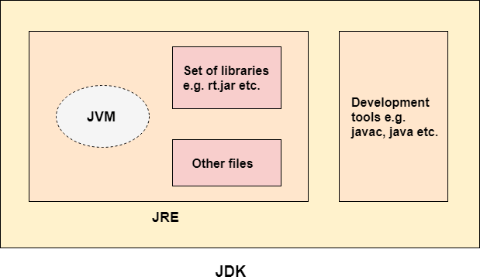
JVM – Java Virtual machine(JVM) is a very important part of both JDK and JRE because it is contained or inbuilt in both. Whatever Java program you run using JRE or JDK goes into JVM and JVM is responsible for executing the java program line by line hence it is also known as interpreter.

Slide 20
Introduction to JDK
Java Core API Or Java Class libraries
A library in Java is a collection of classes.
Collection of predefiened classes
Collections of classes organized in packages
The classes are grouped together into related sets that are called packages
java.lang (Object, Integer, String ….)
java.util (Vector, Hashtable, Date….)
java.awt (Window, Menu, Button….)
java.net (Socket, URL, DatagramPacket….)
https://docs.oracle.com/javase/7/docs/api/

Slide 21
Introduction to JDK
JRE stands for “Java Runtime Environment”.
JRE is part of the Java Development Kit (JDK): it consists of the Java Virtual Machine (JVM), core classes, and supporting files.
JRE consists of the following components:
Deployment technologies, including deployment, Java Web Start and Java Plug-in.
User interface toolkits, including Abstract Window Toolkit (AWT), Swing, Java 2D, Accessibility, Image I/O, Print Service, Sound, drag and drop (DnD) and input methods.
Integration libraries, including Interface Definition Language (IDL), Java Database
Connectivity (JDBC), Java Naming and Directory Interface (JNDI), Remote Method
Invocation (RMI), Remote Method Invocation Over Internet Inter-Orb Protocol (RMI-IIOP) and scripting.

Slide 22
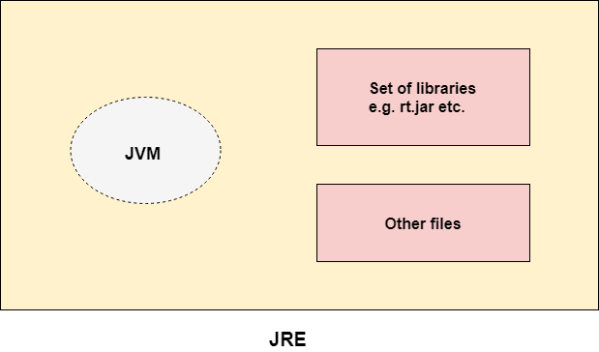
Introduction to JDK
it consists of the Java Virtual Machine (JVM), core classes, and supporting files.
JRE consists of the following components:

Slide 23
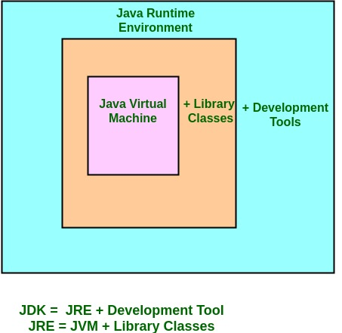
JRE stands for “Java Runtime Environment”.

Slide 24

The Java Development Kit (JDK) is a software development environment used for developing Java applications and applets. It includes the Java Runtime Environment (JRE), an interpreter/loader (Java), a compiler (javac), an archiver (jar), a documentation generator (Javadoc) and other tools needed in Java development.
When you run the Java program, Java compiler first compiles your Java code to bytecode. Then, the JVM translates bytecode into native machine code (set of instructions that a computer's CPU executes directly).
Java is a platform-independent language. It's because when you write Java code, it's ultimately written for JVM but not your physical machine (computer). Since, JVM ​executes the Java bytecode which is platform independent, Java is platform-independent.

Slide 25
Java development environment
Normally java programs go through the following phases
Phase 1. Edit : Program is created in an editor and stored on disk in a file ending with . . . . java extension.
Phase 2. Compile : The compiler translates the java source code into bytecodes and stores them on disk in a file ending with . Class extension
Phase 3. Load : Loader reads .class file containing bytecodes from disk and puts those bytecodes in memory.
Phase 4. Verify : Bytecode verifier confirms that all bytecodes are valid .
Phase 5. Execute : To execute a program , JVM reads bytecodes and translates them into a language the computer understands

Slide 26
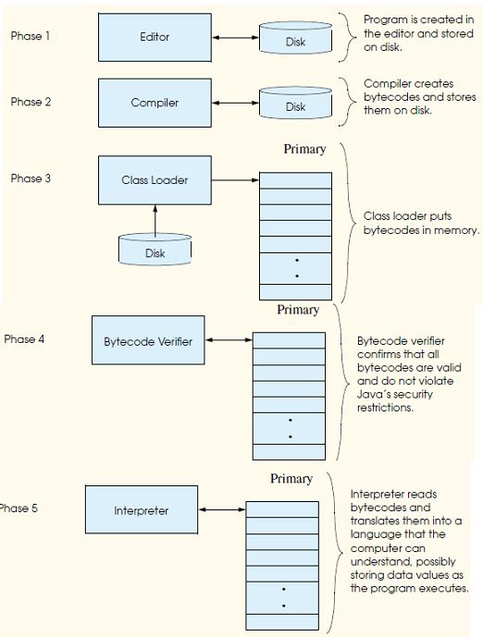

Slide 27
JDK Components listed below:
JRE: Java Runtime Environment
java: It’s simply a loader that works for all the java applications. Also, this particular tool interprets the class file generated by javac. The single java launcher is used for the purpose of development and deployment. Gone are the days, when JRE was used as the deployment launcher. Nowadays, JRE doesn’t exist with the Sun JDK and totally replaced by this new java loader.
javac: It’s a compiler. And, basically, it converts source code into Java bytecode
appletviewer: Through this component, without taking the help of a web browser, we can run the Java applets and even debug them.
apt: This is used as an annotation-processing tool
extcheck: For identifying the conflicts, this next check is used
idlj: An IDL-to-Java compiler, used to generate Java bindings from the provided Java IDL file
jabswitch: It is a Java Access Bridge
javadoc: It is a documentation generator, which produces documentation from source code comments, automatically
jar: It is an archiver. Along with related class libraries packages into one JAR file. Also, it manages those files
javafxpackager: It is a tool to attain packages and sign JavaFX applications
jarsigner: It’s a verification and jar signing tool
javah: It’s a stub generator and ‘C’ header that is used for writing built-in methods
javap: It’s a class file disassembler
javaws: It’s a Java Web Start launcher for JNLP applications
JConsole: It’s a Console used for Java Monitoring and Management
jdb: It’s a debugger
jhat: It’s a Java Heap Analysis Tool (experimental)
jinfo: It particularly used to get the configuration information from a running Java process
jmap: It’s an Oracle jmap which is also a Memory Map. This gives the result of the memory map for Java. On the other hand, it is useful in printing heap memory or shared object memory maps details of a particular core dump or process.
jmc: It’s known as a Java Mission Control
jps: it’s a JVM Process, Status Tool. It is capable of listing the instrumented HotSpot JVMs on the target system
jrunscript: It’s a Java command-line script shell
jstack: A tool prints Java stack traces of Java threads
jstat: Java Virtual Machine statistic monitoring tool
keytool: A tool for manipulating the Keystore
pack200: JAR compression tool
Policytool: Utility that determines the Java runtime. That means it is a policy creation and management tool.
VisualVM: It’s a visual tool. It is integrated with numerous command-line JDK tools.
wsimport: It produces portable JAX-WS artifacts with an aim to invoke a web service
xjc: It’s the part of the Java API boosting the XML Binding (JAXB) API. After accepting the XML schema, it generates Java classes

Slide 28
Escape Sequences
Escape Sequence Description
\n Newline. Position the screen cursor to the beginning of the next line.
\t Horizontal tab. Move the screen cursor to the next tab stop.
\r Carriage return. Position the screen cursor to the beginning of the current line; do not advance to the next line. Any characters output after the carriage return overwrite the characters previously output on that line.
\\ Backslash. Used to print a backslash character.
\’ Single quote.
\" Double quote. Used to print a double-quote character. For example,
System.out.println( "\"in quotes\"" ); displays
"in quotes"

Slide 29
Basic components of JDK

Slide 30
Data Types
Primitive data types
Java defines eight primitive data types.
byte
short
int
long
char
float
double
boolean

Slide 31
Integer data Types
Variable: A variable is a space in the computer’s memory set a side for a certain kind of data and gives it a name for easy reference.
Integers : There are four types of variables that you can use to store integer data.
The value can be –ve or +ve.
Data Type | Description
Byte | Variables of this type can have values from -128 to +127 and occupy 1 byte (8 bits) in memory
short | Variables of this type can have values from -32768 to 32767 and occupy 2 bytes (16 bits) in memory
int | Variables of this type can have values from-2147483648 to 2147483647 and occupy 4 bytes (32 bits) in memory
long | Variables of this type can have values from -9223372036854775808 to 9223372036854775807 and occupy 8 bytes (64 bits) in memory

Slide 32
Byte & Short
byte : The smallest integer type is byte. This is a signed 8-bit type that has a range from –128 to 127.
Declaration & Assignment
byte variables are declared by use of the byte keyword.
For example, the following declares two byte variables called var1 and var2:
byte var1, var2;
Assignment Statement
byte var1=20;
short : short is a signed 16-bit type. It has a range from –32,768 to 32,767.
It is probably the least-used Java type. Here are some examples of short variable declarations:
short s;
short t;

Slide 33
Int & long
The most commonly used integer type is int. It is a signed 32-bit type that has a range from –2,147,483,648 to 2,147,483,647.
In addition to other uses, variables of type int are commonly employed to control loops and to index arrays. Although you might think that using a byte or short would be more efficient than using an int in situations in which the larger range of an int is not needed.
Long : is a signed 64-bit type and is useful for those occasions where an int type is not large enough to hold the desired value. The range of a long is quite large.
This makes it useful when big, whole numbers are needed.
long milliseconds;
long population;

Slide 34
Integer Data Types Example Program
public class EggBasket {
public static void main(String[] args){
int numberOfBaskets, eggsPerBasket, totalEggs;
numberOfBaskets= 10;
eggsPerBasket= 6;
totalEggs= numberOfBaskets* eggsPerBasket;
System.out.println(eggsPerBasket+ " eggs per basket and");
System.out.println(numberOfBaskets+ " baskets, then");
System.out.println("the total number of eggs is " + totalEggs);
}
}

Slide 35
Floating Point Data Types
Float
Double
Data Type | Description
float | Variables of this type can have values from -3.4E38 to +3.4E38 and occupy 4 bytes in memory.
double | Variables of this type can have values from -1.7E308 to +1.7E308 and occupy 8 bytes in memory

Slide 36
Floating-point Data Types Example Program
// Compute the area of a circle.
class Area {
public static void main(String args[]) {
double pi, r, a;
r = 10.8; // radius of circle
pi = 3.1416; // pi, approximately
a = pi * r * r; // compute area
System.out.println("Area of circle is " + a);
}
}

Slide 37
Characters
in Java char is a 16-bit type. The range of a char is 0 to 65,536.
Internally characters are stored as numbers.
CharacterExample Program
// Demonstrate
class CharDemo{
public static void main(String args[]) {
char ch1, ch2;
ch1 = 65; // code for A
ch2 = 'Y';
System.out.print("ch1 and ch2: ");
System.out.println(ch1 + " " + ch2);
}
}

Slide 38
Booleans
Java has a primitive type, called boolean, for logical values.
It can have only one of two possible values, true or false.
This is the type returned by all relational operators, as in the case of a < b.
Booleans Example Program
public static void main(String args[]){
boolean b=true, c=false;
System.out.println("b = "+b);
System.out.println("c = "+c);
System.out.println("b is equal to c: "+ (b==c) );
System.out.println("b is NOT equal to c: “ + (b!=c) );
}
}

Slide 39
ASCII and Unicode
American Standard Code for Information Interchange (ASCII) is a character-encoding scheme and it was the first character encoding standard. It is a code for representing English characters as numbers, with each letter assigned a number from 0 to 127. Most modern character-encoding schemes are based on ASCII, though they support many additional characters
ASCII defines 128 characters, which map to the numbers 0–127.
ASCII uses 7 bits to represent a character. For example, the number 65 means “Latin capital 'A‘
By using 7 bits, we can have a maximum of 2^7 (= 128) distinct combinations*. Which means that we can represent 128 characters maximum.
Wait, 7 bits? But why not 1 byte (8 bits)?
The last bit (8th) is used for avoiding errors as parity bit

Slide 40
ASCII and Unicode
Unicode is a superset of ASCII, and is a character-encoding scheme. Basically, they are standards on how to represent difference characters in binary.
The Unicode standard was initially designed using 16 bits to encode characters because the primary machines were 16-bit PCs.
Unicode is designed to uniquely encode characters used in written languages throughout the world.
The numbers 0–128 have the same meaning in ASCII as they have in Unicode.

Slide 41
ASCII and Unicode
Problem
The encodings for languages with large character sets have variable length. Some common characters are encoded as single bytes, other require two or more byte.
Solution
To solve these problems, a new language standard was developed i.e. Unicode System.
In unicode, character holds 2 byte, so java also uses 2 byte for characters

Slide 42
ASCII and Unicode
The major advantage of Unicode is that at its maximum it can accommodate a huge number of characters. Because of this, Unicode currently contains most written languages and still has room for even more. This includes typical left-to-right scripts like English and even right-to-left scripts like Arabic. Chinese, Japanese, and the many other variants are also represented within Unicode

Slide 43
ASCII and Unicode
Summary:
1.ASCII uses an 8-bit encoding while Unicode uses a variable bit encoding.
2.Unicode represents most written languages in the world while ASCII does not.
3.ASCII has its equivalent within Unicode.

Slide 44
ASCII and Unicode
Unicode: defines two mapping methods, the UTF (Unicode Transformation Format) encodings, and the UCS (Universal Character Set) encodings. Unicode-based encodings implement the Unicode standard and include UTF-8, UTF-16 and UTF-32/UCS-4. UTF-8 - uses 1 byte to represent characters in the ASCII set, two bytes for characters in several more alphabetic blocks, and three bytes for the rest of the BMP. Supplementary characters use 4 bytes. UTF-16 - uses 2 bytes for any character in the BMP, and 4 bytes for supplementary characters.

Slide 45
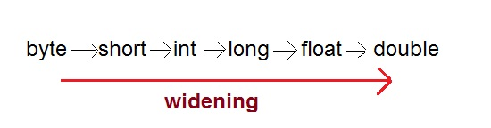
Type Conversion and Casting Java’s Automatic Conversions
Type Casting Assigning a value of one type to a variable of another type is known as Type Casting.
Example
int x = 10;
byte y = (byte) x;
In Java, type casting is classified into two types,
Widening Casting(Implicit) Conversion: it takes place when two types are compatible and the destination type is larger than the source type.
e.g. byte value assigned to int type.

Slide 46
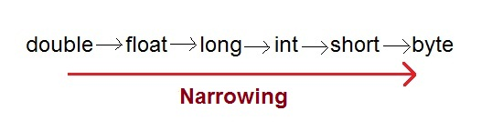
Type Conversion and Casting
Narrowing Casting(Explicitly done)
Narrowing conversion takes place when a value of larger data type is assigned to the variable of smaller data type.
E.g. An int value to a byte variable.

Slide 47
Type Conversion and Casting
class Test {
public static void main(String[] args) {
int i = 100;
long l = i; //no explicit type casting required
float f = l; //no explicit type casting required
System.out.println("Int value "+i);
System.out.println("Long value "+l);
System.out.println("Float value "+f);
}
}

Slide 48
Narrowing or Explicit type conversion
public class Test {
public static void main(String[] args) {
double d = 100.04;
long l = (long) d; //explicit type casting required
int i = (int)l; //explicit type casting required
System.out.println("Double value "+d);
System.out.println("Long value "+l);
System.out.println("Int value "+i);
}
}

Slide 49
J2SE vs J2ME vs J2EE
Java is basically a general purpose, high level programming language, which is widely used for development of application softwares.
It’s used in a wide variety of platforms such as mobile phones, embedded systems, web pages, servers and much more. Due to its cross platform compatibility, it makes it ideal for working across platforms.
The most important characteristic of Java is that it was designed from the outset to be machine independent.
You can run Java programs unchanged on any machine and operating system combination that supports Java
Java features
Simple, Object-oriented and familiar
Robust and Secure
Architecture-neutral and portable
High performance
Interpreted and dynamic

Slide 50
J2SE(Java Platform, Standard Edition)
Also known as Core Java, this is the most basic and standard version of Java. It’s the purest form of Java, a basic foundation for all other editions.
It consists of a wide variety of general purpose API’s (like java.lang, java.util) as well as many special purpose APIs
J2SE is mainly used to create applications for Desktop environment.
It consist all the basics of Java the language, variables, primitive data types, Arrays, Streams, Strings Java Database Connectivity(JDBC) and much more.
This is the standard, from which all other editions came out, according to the needs of the time.
The famous JVM of Java, the heart of Java development, was also given by this edition only

Slide 51
J2SE(Java Platform, Standard Edition)
The Java Development Kit has been referred to at various times as the JDK—the Java Development Kit—and as the SDK—the Software Development Kit.
The usage with release 5.0 is JDK but with release 1.4 it was SDK, so if you see SDK this generally means the same as JDK.
we’ll use JDK to refer to any Java Development Kit in the course.

Slide 52
J2ME(Java Platform, Micro Edition)
This version of Java is mainly concentrated for the applications running on embedded systems, mobiles and small devices.(which was a constraint before it’s development)
Constraints included limited processing power, battery limitation, small display etc.
J2ME uses many libraries and API’s of J2SE, as well as, many of it’s own.
The basic aim of this edition was to work on mobiles, wireless devices, Old Nokia phones, which used Symbian OS, used this technology.
Most of the apps, developed for the phones(prior to smartphones era), were built on J2ME platform only(the .jar apps on Nokia app store).

Slide 53
J2EE(Java Platform, Enterprise Edition)
The Enterprise version of Java has a much larger usage of Java, like development of web services, networking, server side scripting and other various web based applications.
J2EE is a community driven edition, i.e. there is a lot of continuous contributions from industry experts, Java developers and other open source organizations.
J2EE uses many components of J2SE, as well as, has many new features of it’s own like Servlets, JavaBeans, Java Message Services, adding a whole new functionalities to the language.
J2EE uses HTML, CSS, JavaScript etc., so as to create web pages and web services. It’s also one of the most widely accepted web development standard.

Slide 54
Apart from these three versions, there was another Java version, released Java Card.
This edition was targeted, to run applets smoothly and securely on smart cards and similar technology. Portability and security was its main features.
JavaFX is another such edition of Java technology, which is now merged with J2SE 8.It is mainly used, to create rich GUI (Graphical User Interface) in Java apps.
It replaces Swings (in J2SE), with itself as the standard GUI library.
It is supported by both Desktop environment as well as web browsers.
PersonalJava was another edition, which was not deployed much, as its function was fulfilled by further versions of J2ME. Made to support World Wide Web (and Java applets) and consumer electronics.
PersonalJava was also used for embedded systems and mobile. But, it was discontinued in its earlier stages.

Slide 55
Learning Java
To be able to program effectively in Java, you also need to understand the libraries (Java APIs) that go with the language, and these are very extensive.
2. Java’s Syntax

Slide 56
Java Programs
There are two basic kinds of programs you can write in Java.
Programs that are to be embedded in a web page are called Java applets, and
Normal standalone programs are called Java applications.
You can further subdivide Java applications into console applications, which output to your computer screen (to the command line on a PC under Windows, for example), and
Windowed applications, which can create and manage multiple windows. The latter use the typical GUI mechanisms of window-based programs—menus, toolbars, dialogs, and so on

Slide 57
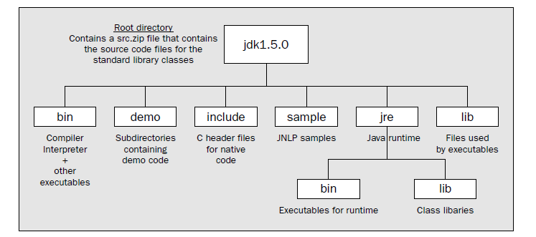

Slide 58
JOPtionPane Class of javax.swing
The messageType argument can be assigned one of these static finals:
JOptionPane.ERROR_MESSAGE
JOptionPane.INFORMATION_MESSAGE
JOptionPane.WARNING_MESSAGE
JOptionPane.QUESTION_MESSAGE
JOptionPane.PLAIN_MESSAGE (no icon will be used)
For example, the following code displays four different JOptionPane dialogs.
JOptionPane.showMessageDialog (null, "Message", "Title", JOptionPane.INFORMATION_MESSAGE);
JOptionPane.showMessageDialog (null, "Message", "Title", JOptionPane.WARNING_MESSAGE); JOptionPane.showMessageDialog (null, "Message", "Title", JOptionPane.ERROR_MESSAGE);
Online Java™ Platform, Standard Edition 7 API Specification
http://www.oracle.com/technetwork/java/api-141528.html
https://docs.oracle.com/javase/7/docs/api/

Slide 59
Tasks
Write a program in which declare some variables with valid identifiers and conventions rule, to hold your name, your total marks in previous semester, percentage, your grade, your status of pass or fail (by a Boolean variable) etc, assign them explicitly and print them. Try to declare variables of all (8) data types and assign the appropriate values.

Slide 60
Tasks
Write a program to declare and initialize a double variable with some value such as 50.25. Then retrieve the integral part and store it in the variable of type long, and the fractional part and store it in a variable of of type double. Display actual number, integral part Fractional part.

