Slide 1
LAB#12
Objective: To become familiar with Files and Streams.
Stream Definition: A stream is a sequence of bytes or data. Or a stream refers to a flow of data.
In Java a stream is composed of bytes. It's called a stream because it is like a stream of water that continues to flow.
In java, 3 streams are created automatically. All these streams are attached with the console.
1) System.out: standard output stream
2) System.in: standard input stream
3) System.err: standard error stream

Slide 2
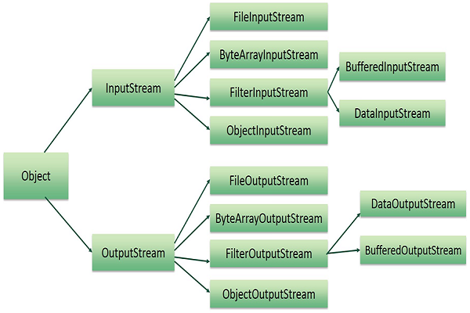
Hierarchy of classes to deal with Input and Output streams.

Slide 3
The code to print output and error message to the console.
System.out.println("simple message");
System.err.println("error message");
The code to get input from console.
int i=System.in.read();//returns ASCII code of 1st character
System.out.println((char)i);//will print the character .
We can perform file handling in java by Java I/O API.
The java.io package contains all the classes required for input and output operations.

Slide 4
There are two kinds of Streams
InputStream : java application uses InputStream to read data from a source. it may be a file,
an array, peripheral device or socket.
2) OutPutStream − Java application uses an outputStream to write data to a destination. it may be a file,
an array, peripheral device or socket.
InputStream vs OutputStream

Slide 5
byte Stream
byte Streams
Java byte streams are used to perform input and output of 8-bit bytes.
Streams that input and output bytes to files are known as byte based streams, storing data in its binary format
there are many classes related to byte streams but the most frequently used classes are, FileInputStream and FileOutputStream.

Slide 6
Character streams
Character streams are used to perform input and output for 16-bit unicode.
Streams that input and output characters to files are known as character based streams, storing data as a sequence of characters.
Though there are many classes related to character streams but the most frequently used classes are,
FileReader and FileWriter.
Though internally FileReader uses FileInputStream and
FileWriter uses FileOutputStream but here the major difference is that FileReader reads two bytes at a time and
FileWriter writes two bytes at a time.

Slide 7
OutputStream class is an abstract class. It is the superclass of all classes representing an output stream of bytes. An output stream accepts output bytes.

Slide 8
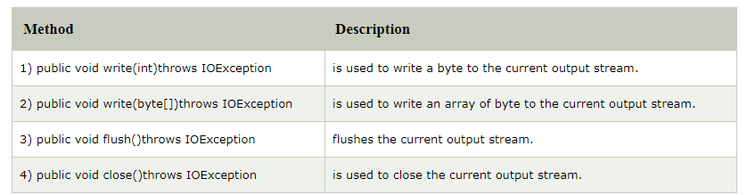
OutputStream class
OutputStream class is an abstract class. It is the super class of all classes representing
an output stream of bytes. An output stream accepts output bytes and sends them to
some sink.
Useful methods of OutputStream

Slide 9
Java FileOutputStream is an output stream used for writing data to a file.
FileOutputStream is used to create a file and write data into it. The stream would create a file, if it doesn't already exist, before opening it for output.
If you have to write primitive values into a file, use FileOutputStream class.
You can write byte-oriented as well as character-oriented data through
FileOutputStream class. But, for character-oriented data, it is preferred to use FileWriter than FileOutStream.
Following constructor takes a file name as a string to create an input stream object to write the file −
FileOutputStream aFile = new FileOutputStream("C:/java/hello.txt");
Once you have OutputStream object in hand, then there is a list of helper methods, which can be used to write to stream or to do other operations on the stream.

Slide 10
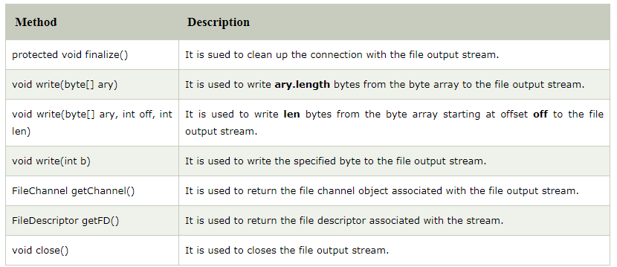
Useful methods of FileOutputStream

Slide 11
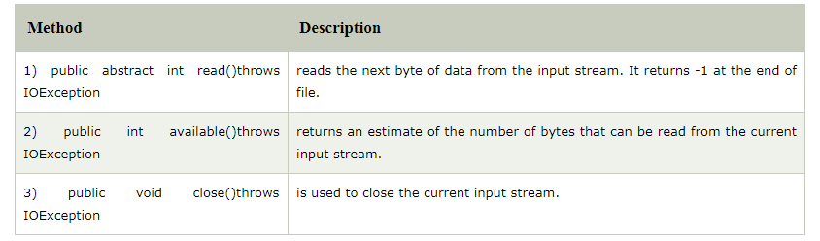
InputStream class
InputStream class is an abstract class.
It is the super class of all classes representing an input stream of bytes.
Useful methods of InputStream

Slide 12
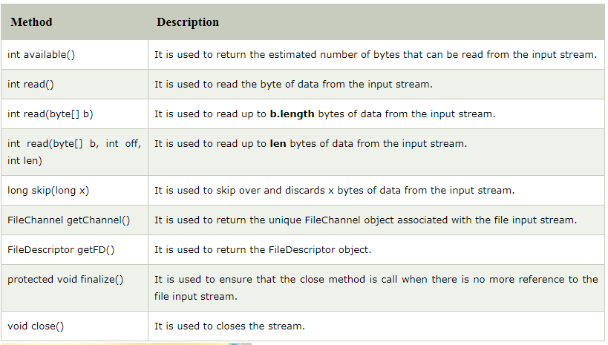
Java FileInputStream Class
Java FileInputStream class obtains input bytes from a file. It is used for reading
byte-oriented data (streams of raw bytes) such as image data, audio, video etc. You can also read character-stream data. But, for reading streams of characters, it is recommended to use FileReader class.
Useful methods of FileIutputStream

Slide 13
Java BufferedOutputStream Class
Java BufferedOutputStream class is used for buffering an output stream.
It internally uses buffer to store data. It adds more efficiency than to write
data directly into a stream. So, it makes the performance fast.
For adding the buffer in an OutputStream, use the BufferedOutputStream class.
In this example, we are writing the textual information in the BufferedOutputStream object which is connected to the FileOutputStream object. The flush() flushes the data of one stream and send it into another. It is required if you have connected the one stream with another.
FileOutputStream fout=new FileOutputStream("D:/testout.txt");
BufferedOutputStream bout=new BufferedOutputStream(fout);
String s="Welcome to javaTpoint.";
byte b[]=s.getBytes();
bout.write(b);
bout.flush();
bout.close();
fout.close();
System.out.println("success");

Slide 14
Java BufferedInputStream Class
Java BufferedInputStream class is used to read information from stream.
It internally uses buffer mechanism to make the performance fast.

Slide 15
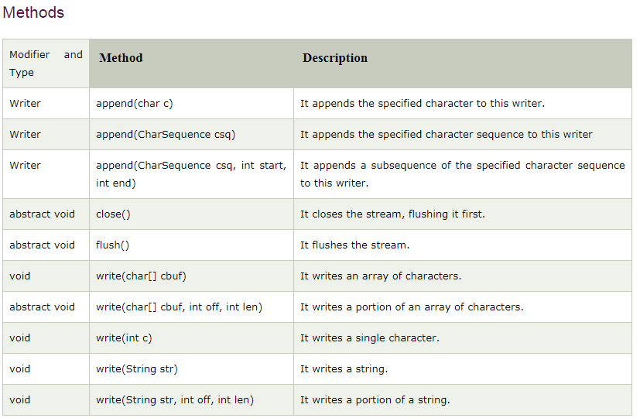
Java Writer :It is an abstract class for writing to character streams.
The methods that a subclass must implement are write(char[], int, int), flush(), and close().
Most subclasses will override some of the methods defined here to provide higher efficiency,
functionality or both.

Slide 16
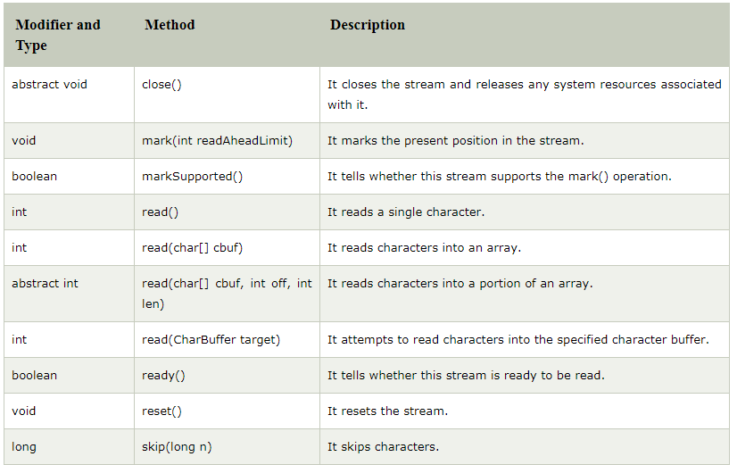
Java Reader: is an abstract class for reading character streams.
The only methods that a subclass must implement are read(char[], int, int) and close().

Slide 17
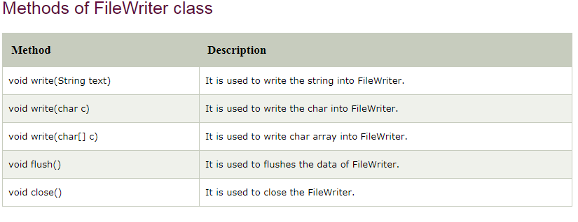
Java FileWriter Class
Java FileWriter class is used to write character-oriented data to a file.
It is character-oriented class which is used for file handling in java.
Unlike FileOutputStream class, you don't need to convert string into byte array because it provides method to write string directly.

Slide 18
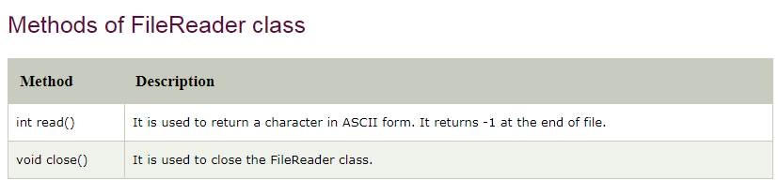
Java FileReader Class class is used to read data from the file.
It returns data in byte format like FileInputStream class.
It is character-oriented class which is used for file handling in java.

Slide 19
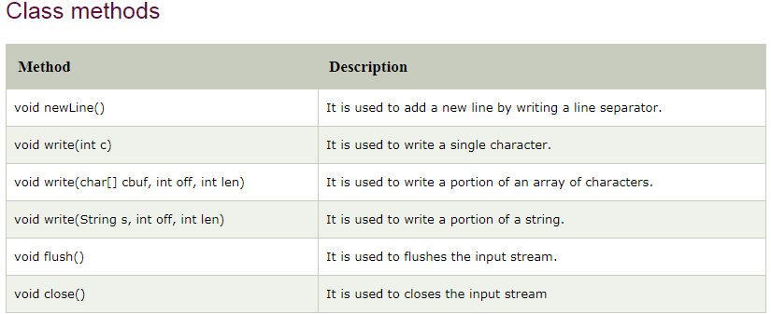
Java BufferedWriter Class
Java BufferedWriter class is used to provide buffering for Writer instances.
It makes the performance fast. It inherits Writer class.
The buffering characters are used for providing the efficient writing of single arrays, characters, and strings.

Slide 20
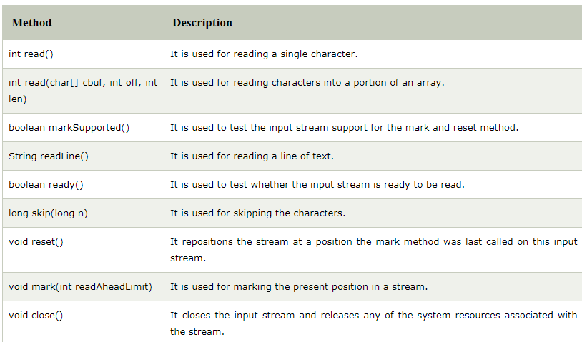
Java BufferedReader Class
Java BufferedReader class is used to read the text from a character-based
input stream. It can be used to read data line by line by readLine() method.
It makes the performance fast. It inherits Reader class.

Slide 21
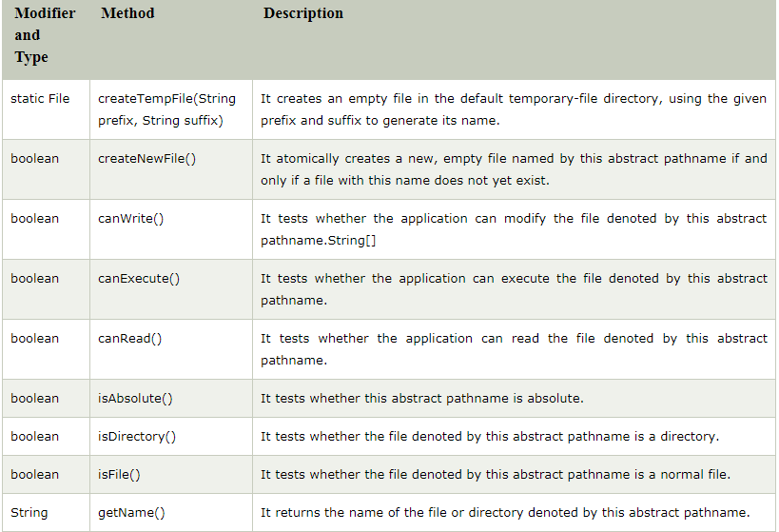
Java File Class
The File class have several methods for working with directories and files such
as creating new directories or files, deleting and renaming directories or files,
listing the contents of a directory etc.

Slide 22
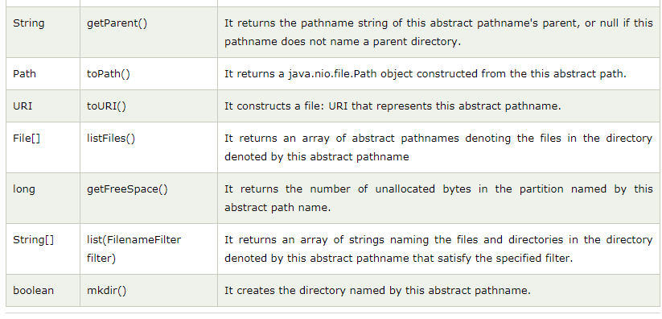
Java File Class
The File class have several methods for working with directories and files such
as creating new directories or files, deleting and renaming directories or files,
listing the contents of a directory etc.

Slide 23
ByteArrayOutputStream
Java ByteArrayOutputStream Class
Java ByteArrayOutputStream class is used to write common data into multiple files. In this stream, the data is written into a byte array which can be written to multiple streams later.
The ByteArrayOutputStream holds a copy of data and forwards it to multiple streams.
The buffer of ByteArrayOutputStream automatically grows according to data.

Slide 24
ByteArrayInputStream
Java ByteArrayInputStream Class
The ByteArrayInputStream is composed of two words: ByteArray and InputStream. As the name suggests, it can be used to read byte array as input stream.
Java ByteArrayInputStream class contains an internal buffer which is used to read byte array as stream. In this stream, the data is read from a byte array.
The buffer of ByteArrayInputStream automatically grows according to data.

Slide 25
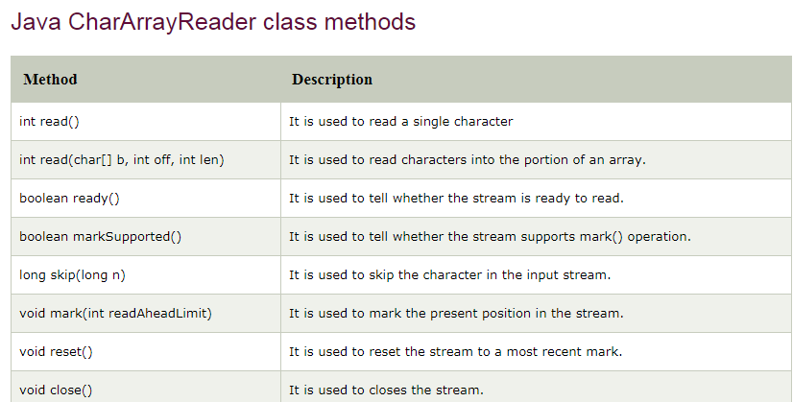
Java CharArrayReader Class
The CharArrayReader is composed of two words: CharArray and Reader. The CharArrayReader class is used to read character array as a reader (stream). It inherits Reader class.

Slide 26
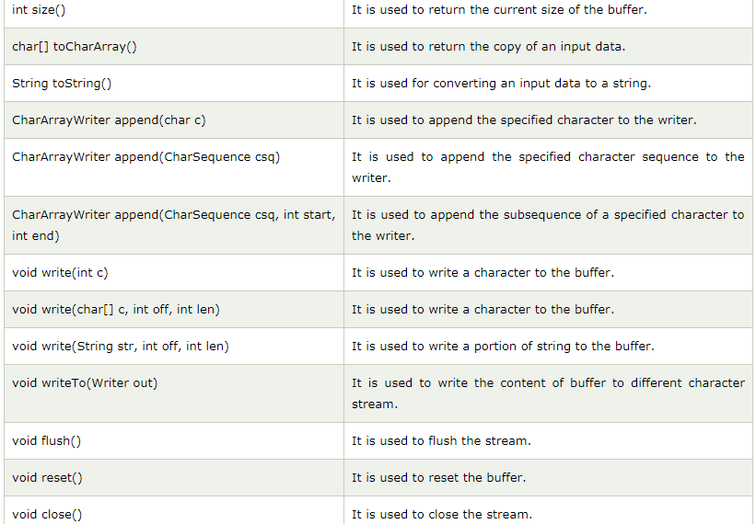
Java CharArrayWriter Class
The CharArrayWriter class can be used to write common data to multiple files.
This class inherits Writer class. Its buffer automatically grows when
data is written
in this stream.
Calling the
close() method
on this object
has no effect.

Slide 27
Java PrintStream Class
The PrintStream class provides methods to write data to another stream. The PrintStream class automatically flushes the data so there is no need to call flush() method. Moreover, its methods don't throw IOException.
PrintWriter Class
Java PrintWriter class is the implementation of Writer class. It is used to print the formatted representation of objects to the text-output stream.

Slide 28
Java Console class
The Java Console class is be used to get input from console. It provides methods to read texts and passwords.
If you read password using Console class, it will not be displayed to the user.
The java.io.Console class is attached with system console internally.
Let's see a simple example to read text from console.
String text=System.console().readLine();
System.out.println("Text is: "+text);
String readLine() It is used to read a single line of text from the console.
char[] readPassword() It is used to read password that is not being displayed on the console.
Console printf(String format, Object... args) It is used to write a string to the console output stream.

Slide 29
Java SequenceInputStream Class
Java SequenceInputStream class is used to read data from multiple streams. It reads data sequentially (one by one).

Slide 30
Java.io.ObjectStreamClass in Java
This class is serialization’s descriptor for classes. It contains the name and serialVersionUID of the class. The ObjectStreamClass for a specific class loaded in this Java VM can be found/created using the lookup method. It extends class Object and implement serialisable.

Slide 31
Filing
Task: 1. Write a program based on filing. Perform Read and Write operations like, first the user writes in the file and then reads it (use read/write methods in one program).

