Slide 1
Object Oriented Programming In JAVA
(Practical#02)

Slide 2
OPERATORS IN JAVA
Object : To become familiar with Operators in JAVA
An operator, in Java, is a special symbol for performing specific operations/ calculations on operands.
OR Operators Are the symbols that perform operations / calculations on operands.
Expression : any arrangement of variables, constants and operators that specifies a computation.
Example : sum =num1+num2;
Three categories of operators :
Binary Operators : act or operate on two operands.
Unary Operators act or operate on one operand
Ternary Operators act or operate on three operands

Slide 3
Program Modules in in java
Three kinds of modules exits in java- methods, classes and packages.
Java Programs are written with predefined methods and classes available in the Java Application Programming Interfaces (also referred to as the Java API or Java class library).
Related classes are grouped into packages so that they can be imported into programs and reused.
The Java API classes are part of the JDK.

Slide 4
Java Applications
Every Java application contains a class that defines a method called main(). The name of this class is the name that you use as the argument to the Java interpreter when you run the application.
You can call the class whatever you want, but the method which is executed first in an application is always called main().
The program consists of a definition for a class I have called urFirstProgram. The class definition contains only one method, the method main(). The first line of the definition for the method main() is
always of the form:
public static void main(String[] args)

Slide 5
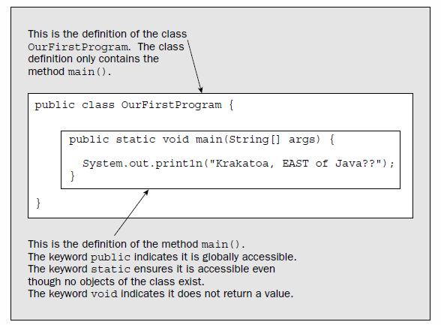
Java Applications

Slide 6
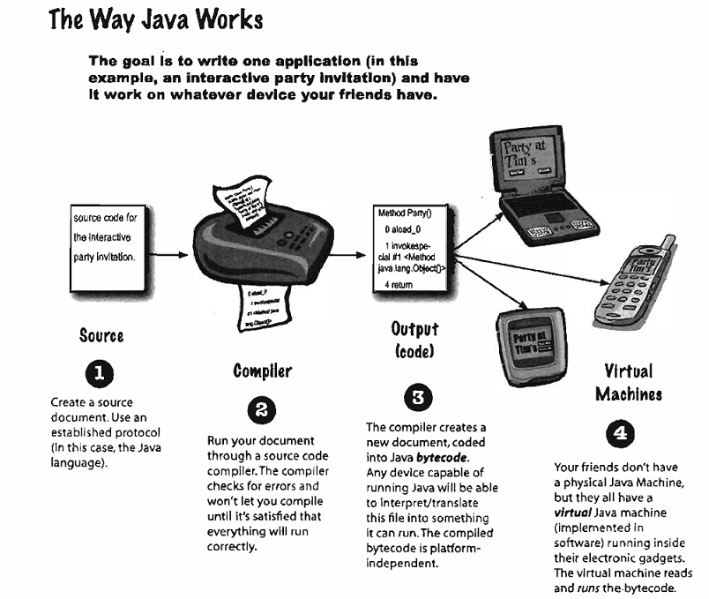

Slide 7
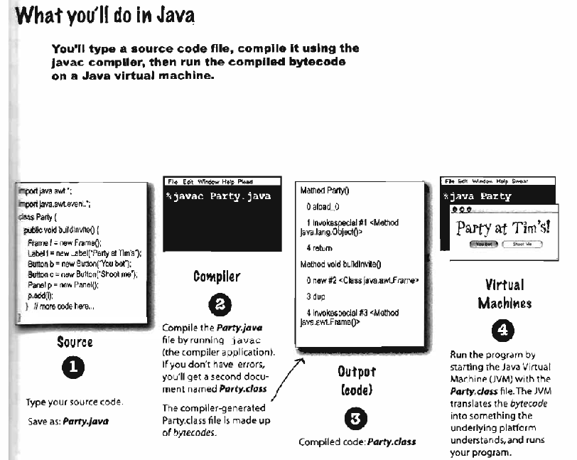

Slide 8
Java Programs
There are two basic kinds of programs you can write in Java.
Programs that are to be embedded in a web page are called Java applets, and
Normal standalone programs are called Java applications.
You can further subdivide Java applications into console applications, which output to your computer screen (to the command line on a PC under Windows, for example), and
Windowed applications, which can create and manage multiple windows. The latter use the typical GUI mechanisms of window-based programs—menus, toolbars, dialogs, and so on

Slide 9
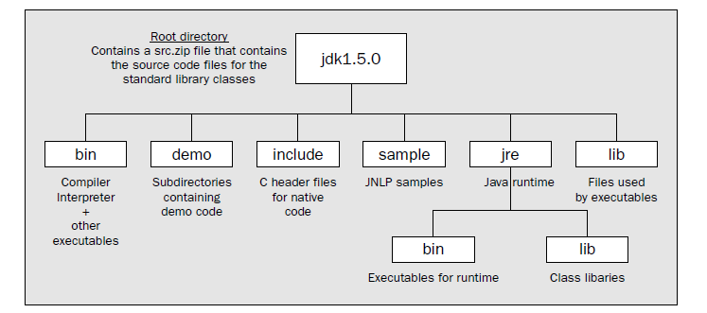

Slide 10
Java.lang package contains the classes that are fundamental to the design of the Java programming language.
Java.lang (object.Integer, String……)
https://www.tutorialspoint.com/java/lang/index.htm
Java.util package contains the collections framework, legacy collection classes, event model, date and time facilities, internationalization, and miscellaneous utility classes.

Slide 11
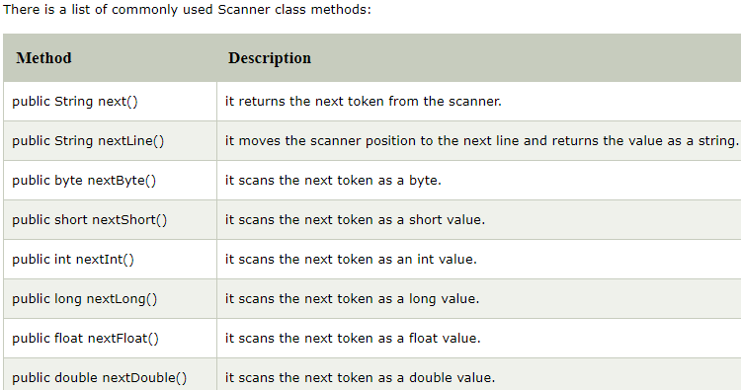
Java Scanner class ( Java Scanner gets input from console)
There are various ways to read input from the keyboard, the java.util.Scanner class is one of them.
The Java Scanner class breaks the input into tokens using a delimiter that is whitespace bydefault. It provides many methods to read and parse various primitive values. https://www.tutorialspoint.com/java/util/index.htm

Slide 12
OPERATORS IN JAVA
Arithmetic Operators
Operators | Result
+ | Addition
__ | Subtraction
* | Multiplication
/ | Division
% | Modulus

Slide 13
Arithmetic Operator Example
class ArthemticOperator {
public static void main(String args[]) {
int a = 4, b = 2, c;
c = a + b;
System.out.println(“Addition: ”+c);
c = a – b;
System.out.println(“Subtraction: ”+c);
c = a * b;
System.out.println(“Multiplication: ”+c);
c = a / b;
System.out.println(“Division: ”+c);
c = a % b;
System.out.println(“Modulus: ”+c);
} }

Slide 14
Compound Assignment Operators
Java provides several assignment operators for abbreviating assignment expressions.
For example, you can abbreviate the statement
c = c + 3;
with the addition assignment operator, +=, as
c += 3;

Slide 15
Compound Assignment Operators
Operator | Example Expression | Result
+= | var1+=var2 | var1 is assigned the value that is the sum of var1 and var2
_= | var1-=var2 | var1 is assigned the value that is the value of var2 subtracted from the value of var1
*= | var1*=var2
/=
%=

Slide 16
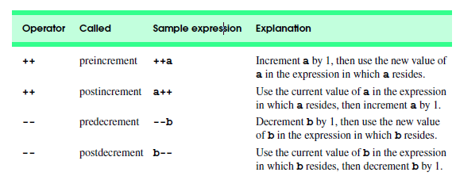
Increment & Decrement Operators
Increment & Decrement Operators : Java provides two unary operators for adding 1 to or subtracting 1 from the value of a numeric variable.

Slide 17
Increment & Decrement Operators
Operator | Example Expression | Result
++ | var1=++var2 | var1 is assigned the value of var2+1.
++ | var1=var2++ | var1 is assigned the value of var2. var2 is incremented by 1.
-- | var1= --var2
-- | var1=var2--

Slide 18
Preincrementing and postincrementing Example
public class Increment {
// main method begins execution of Java application
public static void main( String args[] ) {
int c;
c = 5;
System.out.println( c ); // print 5
System.out.println( c++ );
System.out.println( c );
System.out.println();
c = 5;
System.out.println( c );
System.out.println( ++c );
System.out.println( c );
} // end method main
} // end class Increment

Slide 19
Preincrementing and postincrementing Example
public class Increment {
// main method begins execution of Java application
public static void main( String args[] ) {
int c;
c = 5;
System.out.println( c ); // print 5
System.out.println( c++ ); // print 5 then postincrement
System.out.println( c ); // print 6
System.out.println(); // skip a line
c = 5;
System.out.println( c ); // print 5
System.out.println( ++c ); // preincrement then print 6
System.out.println( c ); // print 6
} // end method main
} // end class Increment

Slide 20
Relational Operators
Java has six relational operators that compare two numbers and return a Boolean value.
The outcome of these operations is a Boolean value.
Operator Meaning
== Equal to
> Greater than
>= Greater than or equal to
< Less than
<= Less than or equal to
!= not equal to

Slide 21
Relational Operators
Operator | Example Expression | Result
== | var1=var2==var3; | var1 is assigned the value true if var2 is equal to var3, or false otherwise.
!= | var1= var2 !=var3; | var1 is assigned the value true if var2 is not equal to var3, or false otherwise.
< | Var1= var2 < var3;
<= | Var1=var2<=var3;
> | Var1=var2 > var3;
>= | Var1=var2>=var3;

Slide 22
Relational Operators Example
public class Test {
public static void main(String args[]) {
int a = 10; int b = 20;
System.out.println("a == b = " + (a == b) );
System.out.println("a != b = " + (a != b) );
System.out.println("a > b = " + (a > b) );
System.out.println("a < b = " + (a < b) );
System.out.println("b >= a = " + (b >= a) );
System.out.println("b <= a = " + (b <= a) );
}
}
output

Slide 23
Java Operator Precedence
Operator precedence determines the order in which the operators in an expression are evaluated.
Example: Operator Precedence
class Precedence {
public static void main(String[] args) {
int a = 10, b = 5, c = 1, result;
result = a- ++c - ++b;
System.out.println(result); } }
When you run the program, the output will be:
2
The operator precedence of prefix ++ is higher than that of - subtraction operator. Hence,
result = a-++c-++b;
is equivalent to
result = a-(++c)-(++b);

Slide 24
Exercises.
What is the result of the following code fragment?
int x = 5; int y = 10; int z = ++x * y--;
2. What is the result of the following code fragment? Explain.
Answer: 1 + 2 = 12 and 1 + 2 = 3, respectively. If either (or both) of the operands of the + operator is a string, the other is automatically cast to a string. String concatenation and addition have the same precedence. Since they are left-associative, the operators are evaluated left-to-right. The parentheses in the second statement ensures that the second + operator performs addition instead of string concatenation.
System.out.println("1 + 2 = " + 1 + 2); System.out.println("1 + 2 = " + (1 + 2));
3. What does the following code fragment print?
Answer: 3abc and abc12, respectively. The + operator is left associative, whether it is string concatenation or addition.
System.out.println(1 + 2 + "abc"); System.out.println("abc" + 1 + 2);

Slide 25
Operators | Precedence
Post increment and decrement | ++ , --
Prefix increment and decrement | ++, --
multiplicative | *, /, %
additive | +, -
shift | << >> >>>
relational | < > <= >=
equality | == !=
bitwise AND | &
bitwise exclusive OR | ^
bitwise inclusive OR | |
logical AND | &&
logical OR | ||
ternary | ? :
assignment | = += -= *= /= %= &= ^= |= <<= >>= >>>=

Slide 26
Associativity of Operators in Java
If an expression has two operators with similar precedence, the expression is evaluated according to its associativity (either left to right, or right to left). Let's take and example
a = b = c;
Here, the value of c is assigned to variable b. Then the value of b is assigned of variable a. Why? It's because the associativity of = operator is from right to left.

Slide 27
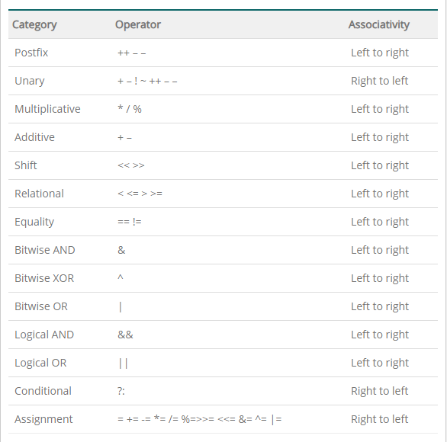
The table below shows the associativity of Java operators along with their associativity.

Slide 28
Number System
For representing values, coding information, counting , comparing amounts, performing calculations, making measurements, and transmitting data.
Decimal Number System having (base 10)
This uses 10 different symbols 0,1,2,3,4,5,6,7,8,9.
The decimal number system is also called the base 10 system.
Binary Number System having (base 2)
Binary number are used extensively in digital electronics and computers.
Octal (base 8) and Hexadecimal (base 16)Number Systems

Slide 29
Decimal-to-Binary Conversion (?)₁₀ = (?)₂
Examples of Decimal numbers: 2, 4, 20 etc.
(10)₁₀ = (?)₂
(8)₁₀ = (?)₂

Slide 30
Binary-to-Decimal Conversion (?)₂ = (?)₁₀
Examples of Binary numbers:
(Most Significant Bit ) (Left Significant Bit)
MSB LSB
00000000, 00001010 etc.
(1010)₂ = (?)₁₀
(11111)₂ = (?)₁₀

Slide 31
2’s Complement Representation
Negative numbers are represented by 2’s complement representation.
(-10)₁₀ = (?)₂
Binary representation of number 10
₁₀₌ ₁₀₁₀
_{0101 1’s complement}
1 2’s complement 0110 = 6 decimal

Slide 32
The Bitwise Operators
There are also the bitwise operators in Java which are used to perform bitwise operations on bit patterns or binary numerals that involve the manipulation of individual bits.
Bitwise operators can be applied to the integer types, long, int, short, char, and byte.
Bitwise operator works on bits and performs bit-by-bit operation.
Example if a = 60 and b = 13; now in binary format they will be as follows −
a = 0011 1100
b = 0000 1101

Slide 33
Operator | Description
& (bitwise and) | Binary AND Operator
| (bitwise or) | Binary OR Operator
^ (bitwise XOR) | Binary XOR Operator
~ (bitwise compliment) | Binary Ones Complement Operator is unary and has the effect of 'flipping' bits.
<< (left shift) >>> | Binary Left Shift Operator. The left operands value is moved left by the number of bits specified by the right operand. Shift right fill zero
>> (right shift) | Binary Right Shift Operator. The left operands value is moved right
& = | Binary AND assignment Operator
|= | Binary OR assignment Operator
^= | Binary XOR assignment Operator
<<= | Binary Left Shift assignment Operator.
>> = | Binary Right Shift assignment Operator.

Slide 34
The Bitwise Operators
The Bitwise AND

Slide 36
The Bitwise Operators
The Bitwise OR
The Bitwise XOR

Slide 37
The Bitwise Operators
The Bitwise Complement The unary bitwise complement operator "~" inverts a bit pattern; it can be applied to any of the integral types, making every "0" a "1" and every "1" a "0". For example, a byte contains 8 bits; applying this operator to a value whose bit pattern is "00000000" would change its pattern to "11111111".
Acts on its operand by inverting each of its bits, such that each bit i.e. 0 will be changed to 1 and vice versa.
Example Number 42 in binary is 00101010
After Bitwise NOT operation the value is 11010101
Example Number 10 in binary is 00001010
After Bitwise NOT operation the value is 11110101

Slide 38
The Bitwise Operators
Left shift Operator: shifts a bit pattern to the left.
The left operands value is moved left by the number of bits specified by the right operand.
value << num
Example
13<<2 = 52
13 in binary is 00000000000000000000000000001101
shift left 2 positions and fill right bits with 0,s
you obtain : 00000000000000000000000000110100

Slide 39
The Bitwise Operators
class ShiftLeftBit {
public static void main(String args[]) {
System.out.println(" << operator");
// shift all the bits to the left by 2
Int y = 13<<2;
System.out.println("13<<2 = "+y);
}
}

Slide 40
The Bitwise Operators
Signed Right Shift : The left operands value is moved right by the number of bits specified by the right operand. signed right shift operator ">>" shifts a bit pattern to the right. The bit pattern is given by the left-hand operand, and the number of positions to shift by the right-hand operand
value >> num
Explanation of 20>>2 = 5
20 in binary is: 00000000000000000000000000010100
shift all bits 2 positions to right 00000000000000000000000000000101

Slide 41
The Bitwise Operators
The UnSigned Right Shift : Right shift fill zero >>> shift a zero to the left most position.
10 >>>2 will give 15 which is 0000 1111
int a = -1;
a = a >>> 24;
11111111 11111111 11111111 11111111 –1 in binary as an int
>>>24 00000000 00000000 00000000 11111111 255 in binary as an int

Slide 43
The Boolean Logical Operators
Java provides logical operators to enable programmers to form more complex conditions by combining simple conditions. The logical operators are
&& (logical AND),
& (boolean logical AND),
|| (logical OR),
| (boolean logical inclusive OR),
^ (boolean logical exclusive OR) and one side true and one side false
! (logical NOT, also called logical negation).

Slide 44
The Boolean Logical Operators
// Demonstrate the booleanlogical operators.
class BoolLogic{
public static void main(String args[]) {
Boolean a = true;
Boolean b = false;
Boolean c = a | b;
Boolean d = a & b;
Boolean e = a ^ b;
Boolean f = (!a & b) | (a & !b);
Boolean g = !a;
//continued on next slide
//continued
System.out.println(" a = " + a);
System.out.println(" b = " + b);
System.out.println(" a|b= " + c);
System.out.println(" a&b= " + d);
System.out.println(" a^b= " + e);
System.out.println("!a&b|a&!b = " + f);
System.out.println(" !a = " + g);
}
}

Slide 45
Tasks for Lab # 2
Task # 1: Write a java program to demonstrate the concept of java runtime arguments. Input your name and roll number and print it on the console.
Task # 2: Write java program to demonstrate the working of the following operators:
Relational operators
Logical Boolean operators
Task #3 : Write java program that Declares 5 floating numbers and print their total sum and average.
Task #4 : Write java code that define radius for a circle and print the circumference, diameter and area for the circle.
Task #5 : Write java program to demonstrate the working of the Bitwise operators.

