Slide 1
Object Oriented Programming in JAVA
(Practical#03)

Slide 2
Objective: To become familiar with Control Structures Working with conditional
structures (Selection Statements)
Control flow or flow of control is the order in which instructions or statements are executed.
The execution of the program is linear.
In java, Statements inside your code are generally executed sequentially from top to bottom, in order that they appear.
You may require to execute or skip certain set of instructions based on condition, jump to another statements, or execute a set of statements repeatedly.
Control Structures are used to alter/change the flow of program.
In Java, control flow statements are used to alter, redirect, or to control the flow of program execution based on the application login.

Slide 3
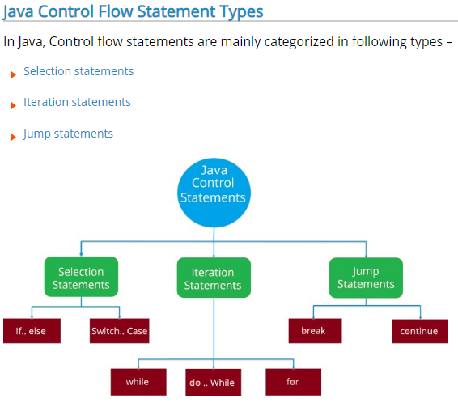

Slide 4
Program Modules in in java
Three kinds of modules exits in java- methods, classes and packages.
Java Programs are written with predefined methods and classes available in the Java Application Programming Interfaces (also referred to as the Java API or Java class library).
Related classes are grouped into packages so that they can be imported into programs and reused.
The Java API classes are part of the JDK.

Slide 5
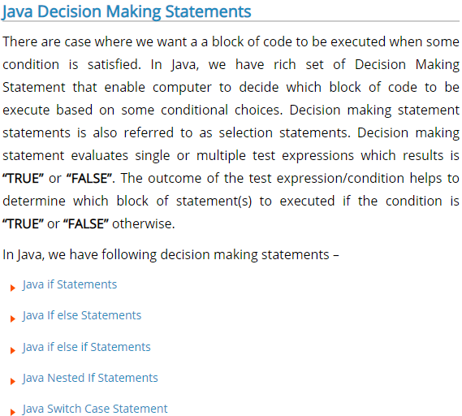
Selection Statements
Execute code based on a condition(s).

Slide 6
Selection Statements
If statement: Performs an action if a condition is true or skips the action if the condition is false.
If Statement allows a block of code to be executed when a specified condition is true.
Syntax:
if( condition / Test expression )
statement; // Single - statement if body
if ( condition / Test expression ) {
statement;
statement; // Multiple Statement if body
statement;
}

Slide 7
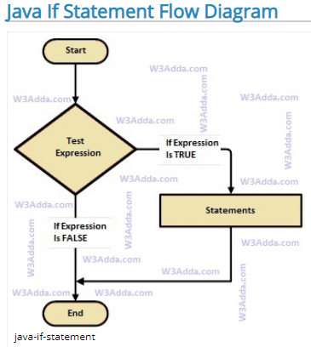
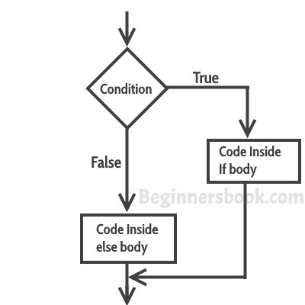

Slide 8
If statement Example
Class IfPositiveNumber {
public static void main(String args[]) {
Int num= 10;
if( num > 0)
{
System.out.println(“It’s a positive number”);
}
}
}

Slide 9
Selection Statements
If ...else statement : Performs an action if the condition is true and performs a different action if the condition is false.
when we want to execute a block of code when of condition is true and another block of code when if condition is false, in such a case we use if…else statement.
Syntax:
if( condition / Test expression)
Statement; // Single - statement if body
else
Statement; // Single - statement else body
if ( condition / Test expression ) {
Statement;
statement; } // Multiple Statement if body
else {
Statement;
statement;
} // Multiple Statement else body

Slide 10
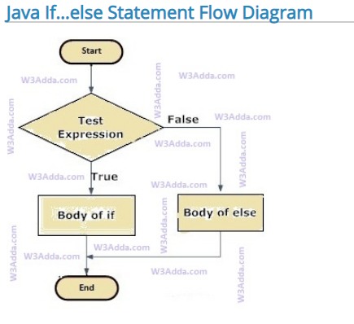

Slide 11
Example
Class IfElsePositiveNumber {
public static void main(String args[]) {
Int num= -10;
if(num > 0) {
System.out.println(“It’s a positive number”);
}
else {
System.out.println(“It’s a negative number”);
}
}
}

Slide 12
Conditional Operator (Ternary)
Ternary Operator: acts or performs operation on three operands
A decision making operator is called Conditional operator.
It consist of two symbols, (? :) which operate on three operands.
The operator returns one of two values depending on the result of an expression.
It's effects are similar to the if-else statement

Slide 13
Conditional Operator (Ternary)
The basic syntax :
(condition) ? true : false
Which is basically the same as:
if ( condition)
if_true;
else if_false;

Slide 14
Conditional Operator (Ternary)
Example:
void main() {
int maxval, val1,val2;
if(val1 > val2)
{ maxval=val1; }
else
{ maxval=val2; }
Example:
void main() {
int maxval, val1,val2;
maxval= (val1 > val2) ? val1 : val2;
Test expression Expression1 Expression2

Slide 15
Selection Statements
Nested if : if statement within an other if statement
When there is an if statement inside another if statement then it is known as nested if else.
A nested if is an if statement that is the target of another if or else.
if(condition1) {
if(condition2) {
}
if(condition3) {
}
}

Slide 16
Example
class NestedIf {
public static void main(String args[]){
Int num= 15;
if(num> 10) {
if(num<20) {
System.out.println(“number is between 10 to 20”);
System.out.println(“end of inner if”);
}
System.out.println(“end of outer if”);
}
System.out.println(“end of program”);
}
}

Slide 17
Selection Statements
If . . .else if statement / ladder : When can add multiple condition checks by using if else-if else statement
if(condition)
statement;
else if(condition)
statement;
else if(condition)
statement;
.
.
else
statement;

Slide 18
If . . .else if statement / ladder : When can add multiple condition checks by using if else-if else
if-else-if statement is used when we need to check multiple conditions.
The nested if...else statement allows you to check for multiple test expressions and execute different codes for more than two conditions.
The most important point to note here is that in if-else-if, as soon as the condition is met, the corresponding set of statements get executed, rest gets ignored.

Slide 19
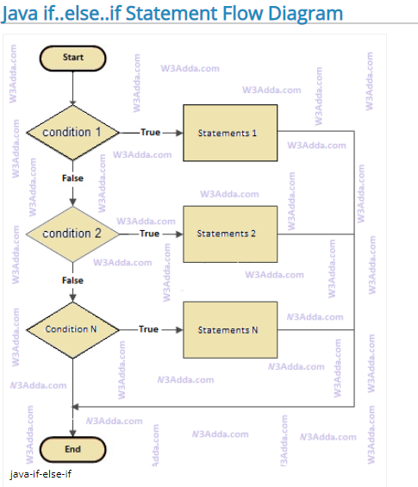
Syntax
if(condition)
statement;
else if(condition)
statement;
else if(condition)
statement;
.
.
else
statement;

Slide 20
Example
class IfElseLadder {
public static void main(String args[]){
String designation = “boss”;
if(designation == “boss”) {
System.out.println(“hello boss!”); }
else if(designation == “manager”) {
System.out.println(“hi sir!”); }
else if(designation == “office boy”) {
System.out.println(“bring me cup of water chump!”); }
else {
System.out.println(“Good By ”);
}
}
}

Slide 21
Switch statement:
is a multiple selection statement, performs one of different actions.
A switch statement allows a variable to be tested for equality against a list of values. Each value is called a case, and the variable being switched on is checked for each case.
Switching: Transfers control to one of the several statements, depending on the value of a condition.

Slide 22
Switch statement:
Switch case statement is used when we have multiple conditions and we need to perform different action based on the condition.
When the variable being switched on is equal to a case, the statements following that case will execute until a break statement is reached.
A break statement ends the switch case.
The optional default case is for when the variable does not equal any of the cases.

Slide 23
Switch statement:
is a multiple selection statement, performs one of different actions
Default keyword
If none of the constants matches the value of the expression, then the default statement is executed.
The default statement is optional
Syntax:
switch (expression) {
case value1:
// statement sequence
break;
case value2:
// statement sequence
break;
. . .
case valueN:
// statement sequence
Break;
default:
// default statement sequence
}

Slide 24
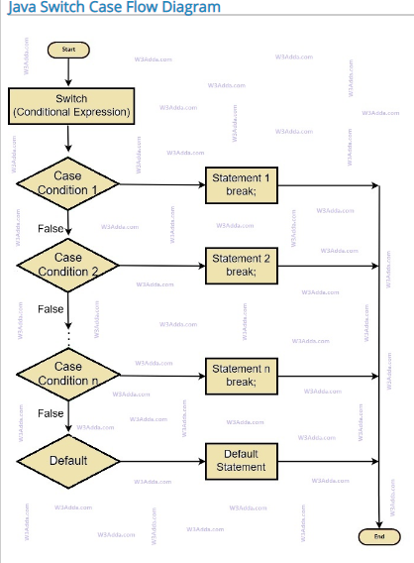

Slide 25
int main () {
char grade = 'D';
switch(grade) {
case 'A' :
cout << "Excellent!" << endl; //prints
break; //and exits the switch
case 'B' :
cout << "Well done" << endl;
break;
case 'D' :
cout << "You passed" << endl;
break;
default :
cout << "Invalid grade" << endl;
}
cout << "Your grade is " << grade << endl;
return 0;
}

Slide 26
Switch statement Example:
Class SwitchTest{
public static void main(String args[]){
Int temperature = 10;
switch(temperature){
case 0:
System.out.println(“its freezing”);
break;
case 30:
System.out.println(“it’s a sunny day”);
break;
default:
System.out.println(“invalid temperature”);
break;
}
}
}

Slide 27
Switch v/s if….else
In an if….else construction you can use a series of expressions that involve unrelated variables.
However in switch statement all the decisions depend on the value of the same variable.

Slide 28
Switch statement Example:
void main(){
char character= ‘i’;
switch(character){
case ‘a’:
cout<<“it’s vowel”;
break;
case ‘e’:
cout<<“it’s vowel”;
break;
…
…
default:
cout<<“it’s consonent”;
}
}

