Slide 1
Object Oriented Programming in JAVA
(Practical#04)

Slide 2
Objective: To become familiar with Control Structures (Iteration statements/ Loops)
The execution of the program is linear.
Control Structures are used to alter/change the flow of program.
Controls which statement(s) should be executed next.
Control Structures
Selection / Iterative/ Conditional/ Branching Loops (Jump Statements)

Slide 3

Loops Definition : cause a section of your code to repeated a certain number of times, the repetition continues while a condition remains true, when the condition becomes false the loop terminates and the control transferred to the statements following the loop.
For Loop
Enhanced For Loop
While Loop
Do-while Loop
Jump Statements break and continue Statements

Slide 4
Program Modules in in java
Three kinds of modules exits in java- methods, classes and packages.
Java Programs are written with predefined methods and classes available in the Java Application Programming Interfaces (also referred to as the Java API or Java class library).
Related classes are grouped into packages so that they can be imported into programs and reused.
The Java API classes are part of the JDK.

Slide 5
(Iteration statements) Loops
for Loop : Executes a section of your program a fixed number of times.
The for loop is used when you know before entering the loop, how many times the loop body will execute.
Syntax
for (initialization; test expression/condition; increment)
{
// body of for loop
}
The loop first starts, the initialization portion of the loop is executed and sets the value of the loop control variable.
The condition is evaluated and this must be a Boolean expression.
Increment expression is an expression that increments or decrements the loop control variable.

Slide 6
for Loop : Syntax
In case of Multiple Statements, enclose them into pair of braces to form a code block.

Slide 7
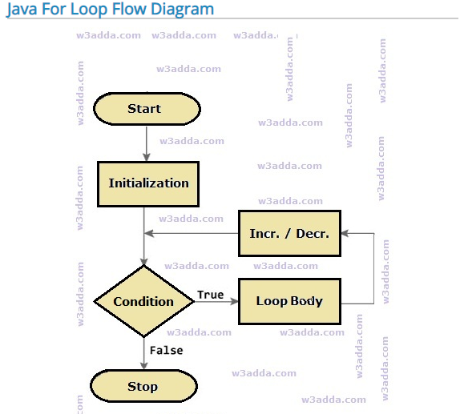

Slide 8
Iteration Statements
class ForDemo{
public static void main(String args[]) {
Int n;
for(n=1; n<=10; n++)
System.out.println(“Loop Cyc le: " + n);
}
}

Slide 9
Iteration Statements

Slide 10
loop variations
for(int z = 100; z>=1; z--);
//loops from 100 to 1 with step of -1.
•for(int i = 5; i<=100; i+=5);
//loop from 5 to 100 with step of +5.

Slide 11
Nested for Loop
Nested: one for loop inside the other for loop.
One for loop can be nested inside the other one.
For each single step of the outer loop, inner for loop will complete its all iterations.
Nested for loops have a lot of applications, they are mostly used to access elements in multi dimensional arrays.

Slide 12
Iteration Statements
While : A while statement repeats an action again and again as long as a controlling Boolean expression is true, when condition becomes false, control passes to the next line of code immediately following the loop.
Used when we don’t know the exact number of repetitions to be performed in our program.
Syntax
while(test expression)
{
// body of loop
}

Slide 13
Iteration Statements
While : Syntax
When condition becomes false, control passes to the next line of code immediately following the loop.
Used when we don’t know the exact number of repetitions to be performed in our program.
It uses “while” (without quotes) as a c++ keyword for looping.
Syntax
while(test expression)
{
// body of loop
}

Slide 14
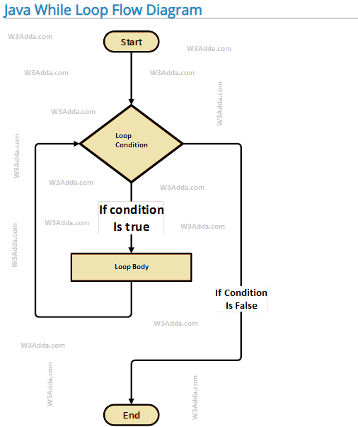

Slide 15
While counter-controlled repetition
Class WhileDemo{
public staicvoid main(String args[]){
Int count =0;
while(count < 50 ){
System.out.println(count);
count++;
}
System.out.println(“End of loop”);
}
}

Slide 16
While Sentinel-controlled repetition
Class WhileDemo{
public staicvoid main(String args[]){
Int count =10;
while(count > 0 ){
System.out.print(count+”, ”);
count--;
}
System.out.println(“End of loop”);
}
}

Slide 17
Nested while loop
Allow the flow of execution to jump to a different part of the program.
Break: terminates the existing structure.
continue : causes a loop to stop its current iteration and begin the next one.
goto: causes the logic to jump to a different place in the

Slide 18
Iteration Statements
do . . . While
the body of a do-while loop is always executed at least once.
Syntax
do {
First_Statement
Second_Statement
. . .
Last_Statement
}
while(Boolean_Expression);

Slide 19
do-while loop
Allow the flow of execution to jump to a different part of the program.
Break: terminates the existing structure.
continue : causes a loop to stop its current iteration and begin the next one.
goto: causes the logic to jump to a different place in the

Slide 20
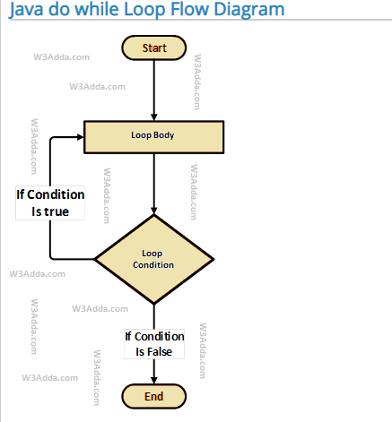

Slide 21
Iteration Statements
Class DoWhileDemo {
public staicvoid main(String args[]){
Int count =0;
Do {
System.out.print(count);
count++;
}
while(count<=10);
System.out.println(“End of loop”);
}
}

Slide 22
Nested do-while loop
Allow the flow of execution to jump to a different part of the program.
Break: terminates the existing structure.
continue : causes a loop to stop its current iteration and begin the next one.
goto: causes the logic to jump to a different place in the

Slide 23
(Jump Statements)
Allow the flow of execution to jump to a different part of the program.
Break: terminates the existing structure.
continue : causes a loop to stop its current iteration and begin the next one.
goto: causes the logic to jump to a different place in the program.
return: causes a function to jump back to the function that called it.

Slide 24
break statement
break statement terminates the existing structure
break statement is used to terminate the for loop or to take exit from the for loop.
class Forbreak{
public static void main(String args[]) {
for(int i=1; i<=100; i++) {
if ( i==20 )
Break;
System.out.println(“: " + i);
}
}

Slide 25
Continue statement
Continue statement causes the current loop cycle to terminate, the execution continues with the next loop cycle
class ForContinue{
public static void main(String args[]) {
for(int i=1; i<=10; i++) {
if ( i%2 !=0 )
Continue;
System.out.println(“: " + i);
}
}

Slide 26
Java Enhanced For Loop
In Java, there is another form of for loop (in addition to standard for loop) to work with arrays and collection, the enhanced for loop.
If you are working with arrays and collections, you can use alternative syntax of for loop (enhanced form of for loop) to iterate through items of arrays/collections. It is also referred as for-each loop because the loop iterates through each element of array/collection

Slide 27
Enhanced for loop is useful when scanning the array instead of using for loop. Syntax of enhanced for loop is:
for (data_type variable: array_name)
Example
class EnhancedForLoop { public static void main(String[] args) {
int primes[] = { 2, 3, 5, 7, 11, 13, 17, 19, 23, 29};
for (int t: primes) {
System.out.println(t); }
}
}

Slide 28
Java enhanced for loop strings
class EnhancedForLoop {
public static void main(String[] args) {
String languages[] = { "C", "C++", "Java", "Python", "Ruby"};
for (String sample: languages) { System.out.println(sample);
}
}
}

Slide 29
Command line argument in Java
The command line argument is the argument passed to a program at the time when you run it.
To access the command-line argument inside a java program is quite easy, they are stored as string
in String array passed to the args parameter of main() method.
public static void main (String args[]) { }
The java command-line argument is an argument i.e. passed at the time of running the java program.
The arguments passed from the console can be received in the java program and it can be used as an input.

Slide 30
Command line argument example In this example, we are receiving only one argument and printing it. To run this java program, you must pass at least one argument from the command prompt. class CommandLineExample{ public static void main(String args[]){ System.out.println("Your first argument is: "+args[0]); } } compile by > javac CommandLineExample.java run by > java CommandLineExample Ahmed Output: Your first argument is: Ahmed

