Slide 1
Object Oriented Programming in JAVA
(Practical#7)

Slide 2
OOP (Inheritance)
Objective: OOP Inheritance, to become familiar with the concept of constructor chaining, Keywords final and super and static block.
What is Inheritance ?
Definition: Inheritance: Is a feature OOP which is a form of software reuse.
A mechanism where in a new class is derived from an existing class. OR
Is the process of creating new classes called subclasses from existing classes or superclasses
The subclass will inherit and extend the features (i.e. members) of its superclass and in addition can have its own.
Inheritance promotes code-reusability.

Slide 3
Important terminology:
Super Class: The class whose features are inherited is known as super class(or a base class or a parent class).
Sub Class: The class that inherits the other class is known as sub class(or a derived class, extended class, or child class). The subclass can add its own fields and methods in addition to the superclass fields and methods.
Reusability: Inheritance supports the concept of “reusability”, i.e. when we want to create a new class and there is already a class that includes some of the code that we want, we can derive our new class from the existing class. By doing this, we are reusing the fields and methods of the existing class.

Slide 4
How to use inheritance in Java
The keyword used for inheritance is extends.
extends is the keyword used to inherit the properties of a class. Following is the syntax of extends keyword.
class Super {
..... .....
………
}
class Sub extends Super {
..... .....
}

Slide 5
Person super Class
Person
# Name : Sring
+Person() +setName(newName:String) +getName():String
Inheritance Example 2
Student
-RollNo : String #Dept/Technology: String
+setRollno(rollno:String) +setDept(dept:String) +displayData()
Employee
#Empno : String #Designation/jobTitle : String #Salary: double
+setDesignation(dept:String) +setSalary()

Slide 6
Product Super Class
Product class
#Name : Sring #Price: float #Description: String
+setPrice()
Inheritance Example 1
Inheritance symbol
Is-a kind of relationship
Sub classes
Medicine class
-MgtDate : Date -ExpDate : Date
+setmfDate() +setExpDate()
Book class
#authorName : Sring #Edition : Sring
+setauthor(authorName:String)

Slide 7
Some more examples
1.Students
2. Bank account
3.Product
3. Employees
4. Vehicle
Note: A super class’s private members are not inherited by its sub class.
Constructors are not inherited.

Slide 8
The idea behind inheritance in java is that you can create new classes that are built upon existing classes. When you inherit from an existing class, you can reuse methods and fields of parent class.
Moreover, you can add new methods and fields in your current class also.
In Java the class hierarchy begins with class object in package (java.lang) which every class directly or indirectly extends or inherits from.
Why use inheritance in java
For Method Overriding (so runtime polymorphism can be achieved).
For Code Reusability.

Slide 9
“IS-A” relationship or IS-A kind of relationship
Inheritance represents the ”IS-A relationship”, also known as parent-child relationship. In an Is- a relationship, an object of sub class can also be treated as an object of superclass
If a class “A” is derived from a class “B”. We can say that ‘B’ is kind of A.
This is because B has all the characteristics of ‘A’, and in addition some of its own.
For this reason inheritance is often called an
“IS-A” relationship or A kind of relationship

Slide 10
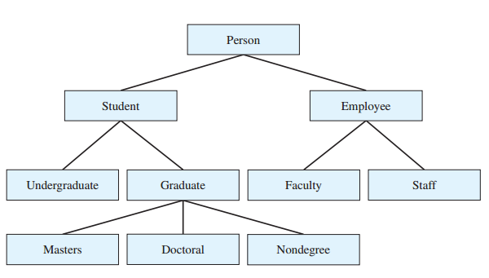
An example of class hierarchy:
Inheritance relationship form tree-like hierarchical structure.
A super class exists in hierarchical relationship with its subclasses.

Slide 11
Inheritance, Generalization and Specialization
Generalization / Specialization represents the is a relationship set.
Generalization is the process of organizing or combining common attributes and operations (i.e. characteristics) from two or more classes into a single generalized class.
A sub class may have more specialized attributes and operations.
For example : Product class defines common characteristics for a book and others sub classes.

Slide 12
Constructors in the sub classes / Constructor call sequence
When a program creates a subclass object, the subclass constructor immediately calls its superclass constructor.
Instantiating a subclass object begins a chain of constructor calls, in which the subclass constructor, before performing its own task, invokes its direct super class’s constructor.
The original subclass constructor’s body finishes executing last.

Slide 13
Using Super
Super is a keyword used in java to refer the super class or base class.
Whenever a subclass needs to refer to its immediate superclass, it can do so by use of the keyword super.
It is used inside a sub-class method definition to call a method defined in the super class.
Private methods of the super-class cannot be called. Only public and protected methods can be called by the super keyword.
super has two general forms:
The first calls the superclass’ constructor.
The second is used to access a member of the superclass.

Slide 14
Types of inheritance in java
On the basis of class, there can be three types of inheritance in java:
single, multilevel and hierarchical.
In java programming, multiple and hybrid inheritance is supported through interface only.

Slide 15
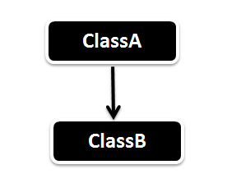
Single Inheritance is the simple inheritance of all,
When a class extends another class (Only one class) then we call it as Single inheritance.
The diagram represents the single inheritance in java where Class B extends only one class Class A.
Here Class B will be the Sub class and Class A will be one and only Super class

Slide 16
public class ClassA
{
public void dispA()
{
System.out.println("disp() method of ClassA");
}
}
public class ClassB extends ClassA
{
public void dispB()
{
System.out.println("disp() method of ClassB");
}
public static void main(String args[])
{
//Assigning ClassB object to ClassB reference
ClassB b = new ClassB();
//call dispA() method of ClassA
b.dispA();
//call dispB() method of ClassB
b.dispB();
}
}

Slide 17
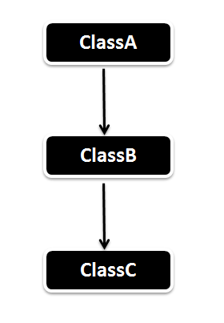
In Multilevel Inheritance a derived class will be inheriting a parent class and as well as the derived class act as the parent class to other class.
As seen in the diagram. ClassB inherits the property of ClassA and again ClassB act as a parent for ClassC. In Short ClassA parent for ClassB and ClassB parent for ClassC.

Slide 18
public static void main(String args[]) {
//Assigning ClassC object to ClassC reference
ClassC c = new ClassC();
//call dispA() method of ClassA
c.dispA();
//call dispB() method of ClassB
c.dispB();
//call dispC() method of ClassC
c.dispC(); }}
public class ClassA {
public void dispA() {
System.out.println("disp() method of ClassA"); }}
public class ClassB extends ClassA {
public void dispB() {
System.out.println("disp() method of ClassB"); }}
public class ClassC extends ClassB{
public void dispC() { System.out.println("disp() method of ClassC"); }

Slide 19
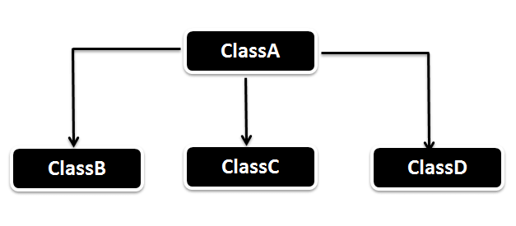
In Hierarchical inheritance one parent class will be inherited by many sub classes.
As per the below example ClassA will be inherited by ClassB, ClassC and ClassD.
ClassA will be acting as a parent class for ClassB, ClassC and ClassD.

Slide 20
public class HierarchicalInheritanceTest {
public static void main(String args[]) {
//Assigning ClassB object to ClassB reference
ClassB b = new ClassB();
//call dispB() method of ClassB
b.dispB();
//call dispA() method of ClassA
b.dispA();
//Assigning ClassC object to ClassC reference
ClassC c = new ClassC();
//call dispC() method of ClassC c.dispC();
//call dispA() method of ClassA c.dispA();
//Assigning ClassD object to ClassD reference
ClassD d = new ClassD();
//call dispD() method of ClassD
d.dispD();
//call dispA() method of ClassA d.dispA(); }}
public class ClassA {
public void dispA() {
System.out.println("disp() method of ClassA"); }}
public class ClassB extends ClassA {
public void dispB() {
System.out.println("disp() method of ClassB"); }}
public class ClassC extends ClassA{
public void dispC() {
System.out.println("disp() method of ClassC"); }}
public class ClassD extends ClassA{
public void dispD() {
System.out.println("disp() method of ClassD");
}}

Slide 21
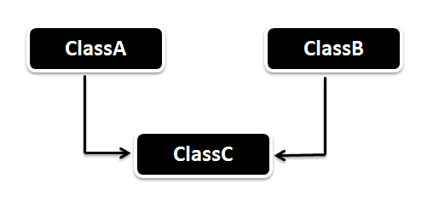
Multiple Inheritance (Through Interfaces) : In Multiple inheritance ,one class can have more than one superclass and inherit features from all parent classes.
OR
Multiple Inheritance is nothing but one class extending more than one class.
Note that Java does not support multiple inheritance with classes. In java, we can achieve multiple inheritance only through Interfaces. In image below, Class C is derived from interface A and B.

Slide 22
Important facts about inheritance in Java
Default superclass: Except Object class, which has no superclass, every class has one and only one direct superclass (single inheritance). In the absence of any other explicit superclass, every class is implicitly a subclass of Object class.
Superclass can only be one: A superclass can have any number of subclasses. But a subclass can have only one superclass. This is because Java does not support multiple inheritance with classes. Although with interfaces, multiple inheritance is supported by java.
Inheriting Constructors: A subclass inherits all the members (fields, methods, and nested classes) from its superclass. Constructors are not members, so they are not inherited by subclasses, but the constructor of the superclass can be invoked from the subclass.
Private member inheritance: A subclass does not inherit the private members of its parent class. However, if the superclass has public or protected methods(like getters and setters) for accessing its private fields, these can also be used by the subclass.

Slide 23
Q) Why multiple inheritance is not supported in java?
To reduce the complexity and simplify the language, multiple inheritance is not supported in java.
Consider a scenario where A, B and C are three classes. The C class inherits A and B classes. If A and B classes have same method and you call it from child class object, there will be ambiguity to call method of A or B class.
The problem occurs when there exist methods with same signature in both the super classes and subclass. On calling the method, the compiler cannot determine which class method to be called and even on calling which class method gets the priority.

Slide 24
Example
class A{
void msg(){System.out.println("Hello");}
}
class B{
void msg(){System.out.println("Welcome");}
}
class C extends A,B{//suppose if it were
Public Static void main(String args[]){
C obj=new C();
obj.msg();//Now which msg() method would be invoked? } }

Slide 25
Static Block : Java supports a special block, called static block (also called static clause) which can be used for static initializations of a class. This code inside static block is executed only once: the first time you make an object of that class or the first time you access a static member of that class (even if you never make an object of that class). For example, check output of following Java program.
A static initialization block is a block defined using the keyword static and is executed once when the class is loaded. A static initialization block can initialize only static data members of the class.

Slide 26
Static blocks are nothing but a normal block of code, enclosed in braces { }, preceded with static keyword.
These static blocks will be called when JVM loads the class into memory.
Incase a class has multiple static blocks across the class, then JVM combines all these blocks as a single block of code and executes it.

Slide 27
// filename: Main.java class Test { static int i; int j; // start of static block static { i = 10; System.out.println("static block called "); } // end of static block } class Main { public static void main(String args[]) { // Although we don't have an object of Test, static block is // called because i is being accessed in following statement. System.out.println(Test.i); } }
Output: static block called 10

Slide 28
Also, static blocks are executed before constructors. For example,
check output of following Java program.
// filename: Main.java class Test { static int i; int j; static { i = 10; System.out.println("static block called "); } Test(){ System.out.println("Constructor called"); } } class Main { public static void main(String args[]) { // Although we have two objects, static block is executed only once. Test t1 = new Test(); Test t2 = new Test(); } }
Output: static block called Constructor called Constructor called

Slide 29
What is Package in Java?
A Package is a collection of related classes. It helps organize your classes into a folder structure and make it easy to locate and use them. More importantly, it helps improve re-usability.
A Package can be defined as a grouping of related types (classes, interfaces, enumerations and annotations ) providing access protection and namespace management.
Each package in Java has its unique name and organizes its classes and interfaces into a separate namespace, or name group.
Packages are used in Java in order to prevent naming conflicts, to control access, to make searching/locating and usage of classes, interfaces, enumerations and annotations easier, etc.
Some of the existing packages in Java are −
java.lang − bundles the fundamental classes
java.io − classes for input , output functions are bundled in this package

Slide 30
A package as the name suggests is a pack(group) of classes, interfaces and other packages. In java we use packages to organize our classes and interfaces.
We have two types of packages in Java: built-in packages and the packages we can create (also known as user defined package).
Syntax:-
Step 1. package mypackage;

Slide 31
To put a class into a package
Create a class
Defining a method which prints a line.
Defining the main method
Creating an object of class
Calling method
Step 2) In next step, save this file as packagedemo.java
Step 3) Now we have to create a package, use the command
javac –d . demo.java
This command forces the compiler to create a package.
The "." operator represents the current working directory.
Step 4) When you execute the code, it creates a package . When you open the java package inside you will see the .class file.
Step 5) Compile the same file using the following code
javac –d .. demo.java
Here ".." indicates the parent directory. In our case file will be saved in parent directory which is C Drive

Slide 32
Java Runtime class is used to interact with java runtime environment.
The java.lang.Runtime class allows the application to interface with the environment in which the application is running.
Every Java application has a single instance of class Runtime that allows the application to interface with the environment in which the application is running. The current runtime can be obtained from the getRuntime method.
An application cannot create its own instance of this class
Java Runtime class provides methods to execute a process, invoke GC, get total and free memory etc. There is only one instance of java.lang.Runtime class is available for one java application.
The Runtime.getRuntime() method returns the singleton instance of Runtime class.

Slide 33
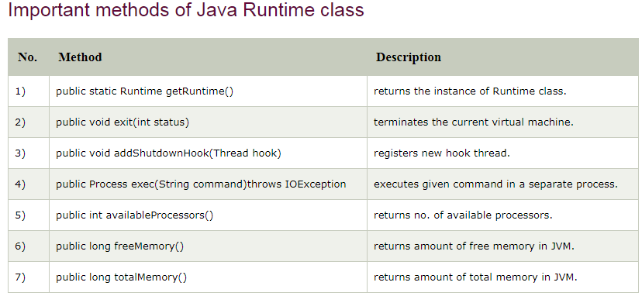

Slide 34
Tasks for Lab # 7
Task # 1
Task # 2
Demonstrate the use of the following:
Keyword super

