Slide 1
Object Oriented Programming in JAVA
(Practical#08)

Slide 2
Math Class
The Math class contains methods for performing basic numeric operations such as elementary exponential, logarithm, square root and trigonometric functions. The Math class Provides a collection of methods that enables you to perform common mathematical calculations. includes the fields
public static final double PI
The class includes the overloaded function
int abs(int), long abs(long), float abs(float), double abs(double)
The Math class also contains all the standard mathematical functions such as
sin(), cos(), tan(), acos(), asin(), atan(), exp(), log(), sqrt()
The data type passed to these functions is double and the return data type is also double. Furthermore, we have the functions
pow(), ceil(), floor(), max(), min()
The class also includes a method to generate random number (data type double) in the interval [0, 1]) public static double random()

Slide 3
Objective: OOP (Polymorphism), To become familiar with Abstract classes and Concrete Classes, Interfaces and Interface Implementation.
Polymorphism is a feature of Object-Oriented Programming.
Is derived from two Greek words Poly + Morphs
The word “Poly” means Many and “Morphs” means Forms.
Polymorphism means one thing with several distinct forms.

Slide 4
polymorphism is the ability of an entity to take more than one shape when required and act according to the situation in need.
Example : Arithmetic Addition Operator +

Slide 5
Polymorphism means the same code or Operation or object behave differently .
The word ‘polymorphism’ literally means ‘a state of having many shapes’ or ‘the capacity to take on different forms’.
When applied to object oriented programming languages like Java, it describes a language’s ability to process objects of various types and classes through a single, uniform interface.

Slide 6
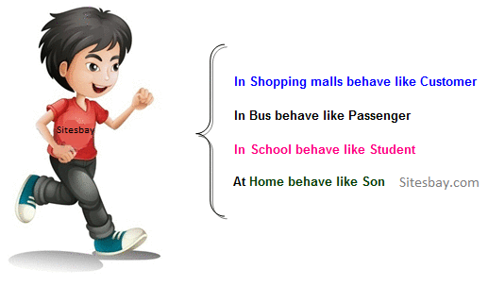
Real life example of polymorphism
Suppose if you are in class room that time you behave like a student,
when you are in market at that time you behave like a customer,
when you at your home at that time you behave like a son or daughter,
Here one person present in different-different behaviors.

Slide 7
How to achieve Polymorphism in java:
In java language, Polymorphism has two types:
Compile time Polymorphism (Static binding) (Method Overloading)
Run-time Polymorphism (Dynamic binding) (Method Overriding)
Method overloading is an example of static polymorphism, while
Method overriding is an example of dynamic polymorphism.
An important example of polymorphism is how a parent class refers to a child class object.

Slide 8
Parts/component of a Method:
Method declaration:
Method Definition:
Method Call
Method Signature:
Method Declaration and Method Signature
void display(parameter list); display(parameter list);

Slide 9
Compile time Polymorphism (Static Polymorphism)
In Java, static polymorphism is achieved through method overloading.
Method overloading is one of the ways that Java supports polymorphism.
Method overloading means there are several methods present in a class having the same name but different types/order/number of parameters.
Defining two or more methods with the same name in a class is called method overloading.
The compiler is able to distinguish between the methods because of their method signatures.
At compile time, Java knows which method to invoke by checking the method signatures. So, this is called compile time polymorphism or static binding.
The name of a method together with the types and sequence of the parameters form the signature of the method.

Slide 10
public static void main(String args[]) {
System.out.println("Compile Time Ploymprphism Demo");
MethodOverlpoadingDemo obj=new MethodOverlpoadingDemo();
obj.test(); // method 1 called
obj.test(100); // method 2 called
obj.test(2,2); // method 3 called } }
public class MethodOverlpoadingDemo {
public void test() {
System.out.println("No parameters");
}
void test(int a) {
System.out.println("a: " + a);
}
void test(int a, int b) {
System.out.println("a and b: " + a + " " + b);
}
The compiler looks at the method signature and decides which method to invoke for a particular method call at compile time. This called static binding because, which method to be invoked is decided at the time of compilation

Slide 11
Run-time Polymorphism (dynamic binding) (Method Overriding)\
Overriding means a derived class is implementing a method of its super class. The call to overridden method is resolved at runtime, thus called runtime polymorphism
Runtime polymorphism or Dynamic Method Dispatch is a process in which a call to an overridden method is resolved at runtime rather than compile-time.
In this process, an overridden method is called through the reference variable of a superclass. The determination of the method to be called is based on the object being referred to by the reference variable

Slide 12
Rules for method overriding:
In java, a method can only be written in Subclass, not in same class.
The argument list should be exactly the same as that of the overridden method.
The return type should be the same or a subtype of the return type declared in the original overridden method in the super class.
The access level cannot be more restrictive than the overridden method’s access level. For example: if the super class method is declared public then the overriding method in the sub class cannot be either private or protected.

Slide 13
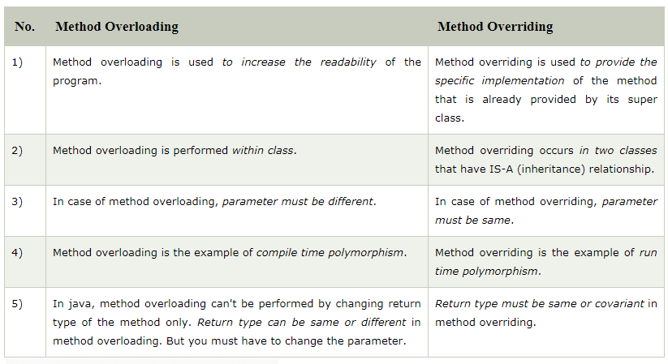
Difference b/w Overloading and Overriding

Slide 14
class Singer {
void sings() {
System.out.println(“Sings a songs..."); } }
class Ahmed extends Singer {
@Override
void sings() {
System.out.println(" Ahmed sings a songs...");
} public static void main(String arg[]) {
Singer ahmed=new Ahmed(); //upcasting ahmed.sings();
Singer singer=new Singer();
singer.sings();
} }
class Person {
void walk() {
System.out.println("Can Run...."); } }
class Employee extends Person {
void walk() {
System.out.println("Running Fast...");
} public static void main(String arg[]) {
Person p=new Employee(); //upcasting p.walk(); } }
O/P Running fast
Upcasting : When reference variable of Parent class refers to the object of Child class, it is known as upcasting.

Slide 15
So, when a call to sings() is made, Java waits until runtime to determine which object is actually being pointed to by the reference.
In this case, the object is of the class Ahmed. So, the sings() method of Ahmed class will be called.
In the second call to sings(), the object is of the class Singer.
So, the sings() method of Singer will be called.
As the method to call is determined at runtime,
this is called dynamic binding or late binding.

Slide 16
Abstract Methods, Abstract Classes and Concrete Classes
Classes used only as super classes in the inheritance hierarchy are called
“abstract” classes
OR classes used only for deriving other classes (sub classes).
The purpose of an abstract class is to provide appropriate
super class from which other classes can inherit and thus
share a common design

Slide 17
Abstract Methods, Abstract Classes and Concrete Classes
A class that is declared using “abstract” keyword is known as abstract class.
It can have abstract methods (methods without body) as well as concrete methods
(regular methods with body).
A normal class(non-abstract class) cannot have abstract methods.
An abstract method is a method that is declared without an implementation
(without braces, and followed by a semicolon),
Example abstract void moveTo(double X, double Y);
Abstract classes cannot be instantiated, which means you are not allowed to
create an object of it. but they can be sub classed.

Slide 18
Abstract Methods, Abstract Classes and Concrete Classes
If a class includes abstract methods, then the class itself must be declared abstract, as in:
public abstract class GraphicObject {
// declare fields
// declare nonabstract methods
abstract void draw();
}
Subclass of an abstract class must either implement all of the abstract methods in the superclass,
or be itself declared abstract.
When an abstract class is subclassed, the subclass usually provides implementations for all of
the abstract methods in its parent class. However, if it does not, then the subclass must also be
declared abstract.

Slide 19
Concrete Classes
Is derived class that implements all the missing
functionality (means provides implementation
for all abstract class’s methods is called a
concrete class.

Slide 20
abstract class MyClass{
public void disp()
{ System.out.println("Concrete method of parent class"); }
abstract public void disp2(); }
class Demo extends MyClass{
/* Must Override this method while extending * MyClas */
public void disp()
{ System.out.println("overriding abstract method"); }
public static void main(String args[]){
Demo obj = new Demo();
obj.disp2();
} }
Output:
overriding abstract method

Slide 21
What is an interface in Java?
An Interface is a collection of implicitly public methods and properties that are grouped together to encapsulate specific functionality.
Using interface, you can specify what a class must do, but not how it does it. (Data Abstraction)
Interface looks like a class but it is not a class. An interface can have methods and variables just like the class but the methods declared in interface are by default abstract, (no implementation, no body). Also, the variables declared in an interface are public, static & final by default.
Since methods in interfaces do not have body, they have to be implemented by the class before you can access them. The class that implements interface must implement all the methods of that interface.

Slide 22
What is an interface in Java?
In general an Interface defines the ways in which things such as people and systems can interact.
An interface declaration begins with the keyword interface and contains only constants and abstract methods.
Interface tea {
void (milk, water, sugar,teadust);
void (milk, water, sugar);
void (milk, water);
void (milk,sugar,teadust);

Slide 23
Interface and inheritance Example
interface Inf1{
public void method1(); }
interface Inf2 extends Inf1 {
public void method2(); }
public class Demo implements Inf2{
/* Even though this class is only implementing the * interface Inf2,
it has to implement all the methods * of Inf1 as well because the interface Inf2 extends Inf1 */
public void method1(){
System.out.println("method1"); }
public void method2(){
System.out.println("method2"); }
public static void main(String args[]){
Inf2 obj = new Demo();
obj.method2(); } }

Slide 24
IS-A relationship in OOP (Inheritance)
Has-A relationship (Association)
IS-A (Inheritance) :
In Object oriented programming, IS-A relationship denotes “one object is type of another”. IS-A relation denotes Inheritance methodology.
Has-A (Association) :
In Object orientation design, We can say “class one is in Has-A relationship with class B if class A holds reference of Class B”.
By this reference of class B, A can access all properties of class B which are allowed.

Slide 25
class HardDisk {
public void writeData(String data)
{ System.out.println("Data is being written : " + data);
} }
class UseDell {
// segate is referece of HardDisk class in UseDell class. // So, UseDell Has-A HardDisk
HardDisk segate = new HardDisk();
public void save (String data) {
segate.writeData(data);
} }

Slide 26
Tasks for Lab # 8
Task # 1
Task # 2
Demonstrate the use of the following:
Abstract class and abstract methods and concrete class
Method overloading and method overriding
Interface implementation

