Slide 1
Object Oriented Programming in JAVA
(Practical#09)

Slide 2
Objective: Introduction to GUI in Java :
GUI Graphical User Interface presents a user-friendly environment and mechanism for interacting with an application.
A GUI gives an application a distinctive “look” and “feel”.
These GUIs are built from GUI components.
There are three sets of Java APIs for graphics programming:
AWT Abstract Windows Tool kit in package java.awt
Swing in package javax.swing and JavaFX.
AWT, Swing JavaFX are used for building graphical user interfaces (GUIs) in java.

Slide 3
AWT API was introduced in JDK 1.0. Most of the AWT components have become obsolete and should be replaced by newer Swing components.
Swing API, a much more comprehensive set of graphics libraries that enhances the AWT, was introduced as part of Java Foundation Classes (JFC) after the release of JDK 1.1. JFC consists of Swing, Java2D, Accessibility, Internationalization, and Pluggable Look-and-Feel Support APIs. JFC has been integrated into core Java since JDK 1.2.
The latest JavaFX, which was integrated into JDK 8, is meant to replace Swing.

Slide 4
Programming GUI with AWT
start with the AWT before moving into Swing to give you a complete picture of Java Graphics.
AWT Packages
AWT is huge! It consists of 12 packages of 370 classes (Swing is even bigger, with 18 packages of 737 classes as of JDK 8). Fortunately, only 2 packages - java.awt and java.awt.event - are commonly-used.
The java.awt package contains the core AWT graphics classes:
GUI Component classes, such as Button, TextField, and Label.
GUI Container classes, such as Frame and Panel.
Layout managers, such as FlowLayout, BorderLayout and GridLayout.
Custom graphics classes, such as Graphics, Color and Font.

Slide 5
Programming GUI with AWT
start with the AWT before moving into Swing to give you a complete picture of Java Graphics.
AWT Packages
The java.awt.event package supports event handling:
Event classes, such as
ActionEvent, MouseEvent, KeyEvent and WindowEvent,
Event Listener Interfaces, such as
ActionListener, MouseListener, MouseMotionListener, KeyListener and WindowListener,
Event Listener Adapter classes, such as MouseAdapter, KeyAdapter, and WindowAdapter.

Slide 6
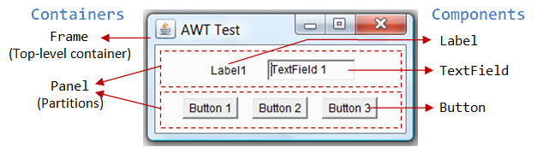
Two Types of GUI elements (Containers and Components)

Slide 7
There are two types of GUI elements:
Component: Components are elementary GUI entities, such as Button, Label, and TextField.
Container: Containers, such as Frame and Panel, are used to hold components in a specific Layout (such as FlowLayout or GridLayout). A container can also hold sub-containers.
In the above figure, there are three containers: a Frame and two Panels. A Frame is the top-level container of an AWT program. A Frame has a title bar (containing an icon, a title, and the minimize/maximize/close buttons), an optional menu bar and the content display area. A Panel is a rectangular area used to group related GUI components in a certain layout.
In the above figure, the top-level Frame contains two Panels. There are five components: a Label (providing description), a TextField (for users to enter text), and three Buttons (for user to trigger certain programmed actions).
In a GUI program, a component must be kept in a container. You need to identify a container to hold the components. Every container has a method called add(Component c). A container (say c) can invoke c.add(aComponent) to add aComponent into itself.
For example,
Panel pnl = new Panel(); // Panel is a container Button btn = new Button("Press"); // Button is a component pnl.add(btn); // The Panel container adds a Button component
GUI components are also called controls (e.g., Microsoft ActiveX Control), widgets (e.g., Eclipse's Standard Widget Toolkit, Google Web Toolkit), which allow users to interact with (or control) the application.

Slide 8
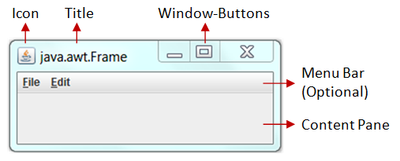
AWT Container Classes (Frame, Dialog and Applet)
Each GUI program has a top-level container. The commonly-used top-level containers in AWT are Frame, Dialog and Applet:
A Frame provides the "main window" for your GUI application. It has a title bar (containing an icon, a title, the minimize, maximize/restore-down and close buttons), an optional menu bar, and the content display area. To write a GUI program, we typically start with a subclass extending from java.awt.Frame to inherit the main window as follows:

Slide 9
import java.awt.Frame; // Using Frame class in package java.awt // A GUI program is written as a subclass of Frame - the top-level container // This subclass inherits all properties from Frame, e.g., title, icon, buttons, content-pane
public class MyGUIProgram extends Frame { // private variables ...... // Constructor to setup the GUI components
public MyGUIProgram() { ...... } // methods ...... ...... // The entry main() method
public static void main(String[] args) { // Invoke the constructor (to setup the GUI) by allocating an instance
new MyGUIProgram(); } }

Slide 10
An AWT Dialog is a "pop-up window" used for interacting with the users. A Dialog has a title-bar (containing an icon, a title and a close button) and a content display area, as illustrated.
An AWT Applet (in package java.applet) is the top-level container for an applet, which is a Java program running inside a browser.
Secondary Containers: Panel and ScrollPane
Secondary containers are placed inside a top-level container or another secondary container. AWT provides these secondary containers:
Panel: a rectangular box used to layout a set of related GUI components in pattern such as grid or flow.
ScrollPane: provides automatic horizontal and/or vertical scrolling for a single child component.
others.

Slide 11
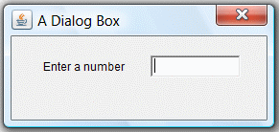
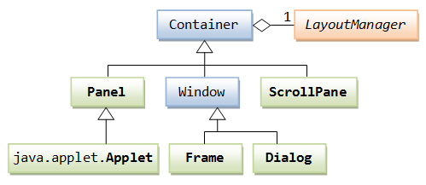
Hierarchy of the AWT Container Classes
The hierarchy of the AWT Container classes is as follows:
As illustrated, a Container has a LayoutManager to layout the components in a certain pattern.

Slide 12
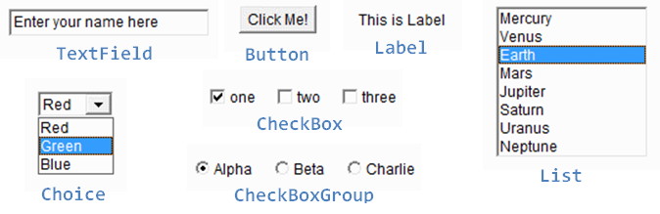
AWT provides many ready-made and reusable GUI components in package java.awt. The frequently-use are: Button, TextField, Label, Checkbox, CheckboxGroup (radio buttons), List, and Choice, as illustrated below.
AWT Component classes

Slide 13
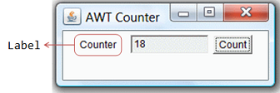
AWT GUI Component: java.awt.Label
A java.awt.Label provides a descriptive text string.
Take note that System.out.println() prints to the system console, NOT to the graphics screen. You could use a Label to label another component (such as text field) to provide a text description. Check the JDK API specification for java.awt.Label.
Constructors
public Label(String strLabel, int alignment); // Construct a Label with the given text String, of the text alignment public Label(String strLabel); // Construct a Label with the given text String public Label(); // Construct an initially empty Label
The Label class has three constructors:
The first constructor constructs a Label object with the given text string in the given alignment. Note that three static constants Label.LEFT, Label.RIGHT, and Label.CENTER are defined in the class for you to specify the alignment (rather than asking you to memorize arbitrary integer values).
The second constructor constructs a Label object with the given text string in default of left-aligned.
The third constructor constructs a Label object with an initially empty string. You could set the label text via the setText() method later.

Slide 14
Constants (final static fields)
public static final LEFT; // Label.LEFT
public static final RIGHT; // Label.RIGHT
public static final CENTER; // Label.CENTER
These three constants are defined for specifying the alignment of the Label's text, as used in the above constructor.
Public Methods
// Examples public String getText(); public void setText(String strLabel); public int getAlignment(); public void setAlignment(int alignment); // Label.LEFT, Label.RIGHT, Label.CENTER
The getText() and setText() methods can be used to read and modify the Label's text. Similarly, the getAlignment() and setAlignment() methods can be used to retrieve and modify the alignment of the text.

Slide 15
Constructing a Component and Adding the Component into a Container
Example
Label lblInput; // Declare an Label instance called lblInput
lblInput = new Label("Enter ID"); // Construct by invoking a constructor via the new operator
add(lblInput); // this.add(lblInput) - "this" is typically a subclass of Frame
lblInput.setText("Enter password"); // Modify the Label's text string
lblInput.getText(); // Retrieve the Label's text string
An Anonymous Instance
You can create a Label without specifying an identifier, called anonymous instance. In the case, the Java compiler will assign an anonymous identifier for the allocated object. You will not be able to reference an anonymous instance in your program after it is created. This is usually alright for a Label instance as there is often no need to reference a Label after it is constructed.
Example
// Allocate an anonymous Label instance. // "this" container adds the instance. // You CANNOT reference an anonymous instance to carry out further operations. add(new Label("Enter Name: ", Label.RIGHT)); // Same as
Label xxx = new Label("Enter Name: ", Label.RIGHT)); // xxx assigned by compiler
add(xxx);

Slide 16
AWT GUI Component: java.awt.Button
A java.awt.Button is a GUI component that triggers a certain programmed action upon clicking.
Event : Clicking a button fires a so-called ActionEvent and triggers a certain programmed action.
Example
Button btnColor = new Button("Red"); // Declare and allocate a Button instance called btnColor add(btnColor); // "this" Container adds the Button ... btnColor.setLabel("Green"); // Change the button's label
btnColor.getLabel(); // Read the button's label
... add(Button("Blue")); // Create an anonymous Button. It CANNOT be referenced later

Slide 17
Overview of Swing Components
java Swing is a part of Java Foundation Classes (JFC) that is used to create GUI OR window-based applications.
The javax.swing package provides classes for java swing API such as JButton, JTextField, JTextArea, JRadioButton, JCheckbox, JMenu, JColorChooser etc.
Unlike AWT, Java Swing provides platform-independent and lightweight components.
JFC-Java’ libraries for cross platform GUI development.
The Java Foundation Classes (JFC) are a set of GUI components which simplify the development of desktop applications. other parts of JFC are java2D and Abstract window toolkit (AWT).

Slide 18
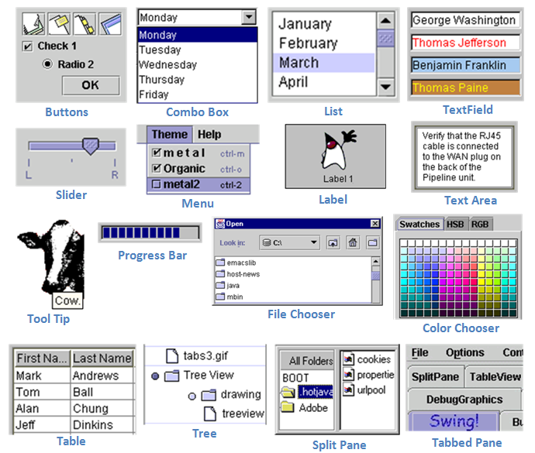
Swing's Features
Swing is huge (consists of 18 packages of 737 classes as in JDK 1.8) . Compared with AWT, Swing provides a huge and comprehensive collection of reusable GUI components, as shown in the Figure below

Slide 19
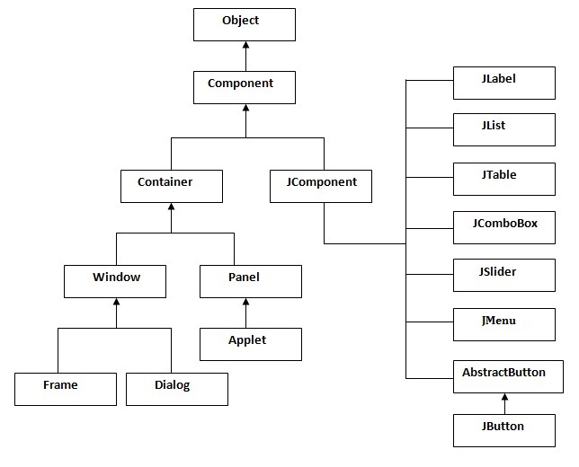
Swing hierarchy

Slide 20
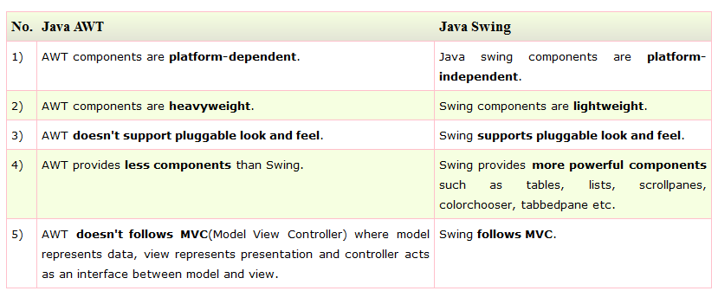
Difference between AWT and Swing

Slide 21
The main features of Swing are:
Swing is written in pure Java (except a few classes) and therefore is 100% portable.
Swing components are lightweight. The AWT components are heavyweight (in terms of system resource utilization).
AWT components rely heavily on the underlying windowing subsystem of the native operating system.
For example, an AWT button ties to an actual button in the underlying native windowing subsystem, and relies on the native windowing subsystem for their rendering and processing.
Swing components (JComponents) are written in Java. They are generally not "weight-down" by complex GUI considerations imposed by the underlying windowing subsystem.
Swing components support pluggable look-and-feel. You can choose between Java look-and-feel and the look-and-feel of the underlying OS (e.g., Windows, UNIX or Mac). If the later is chosen, a Swing button runs on the Windows looks like a Windows' button and feels like a Window's button. Similarly, a Swing button runs on the UNIX looks like a UNIX's button and feels like a UNIX's button.

Slide 22
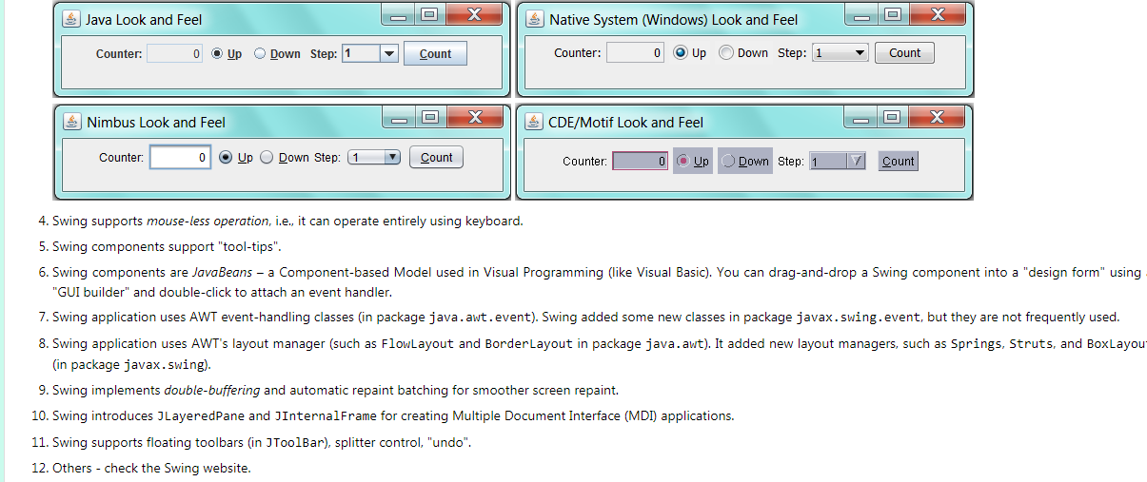

Slide 23
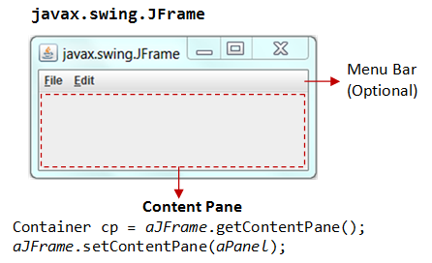
Swing's Top-Level and Secondary Containers
Just like AWT application, a Swing application requires a top-level container. There are three top-level containers in Swing:
JFrame: used for the application's main window (with an icon, a title, minimize/maximize/close buttons, an optional menu-bar, and a content-pane), as illustrated.
JDialog: used for secondary pop-up window (with a title, a close button, and a content-pane).
JApplet: used for the applet's display-area (content-pane) inside a browser’s window.
Similarly to AWT, there are secondary containers (such as JPanel) which can be used to group and layout relevant components.

Slide 24
The Content-Pane of Swing's Top-Level Container
However, unlike AWT, the JComponents shall not be added onto the top-level container (e.g., JFrame, JApplet) directly because they are lightweight components. The JComponents must be added onto the so-called content-pane of the top-level container. Content-pane is in fact a java.awt.Container that can be used to group and layout components.
You could:
get the content-pane via getContentPane() from a top-level container, and add components onto it. For example,
public class SwingDemo extends JFrame {
// Constructor public SwingDemo() { // Get the content-pane of this JFrame, which is a java.awt.Container // All operations, such as setLayout() and add() operate on the content-pane
Container cp = getContentPane();
cp.setLayout(new FlowLayout());
cp.add(new JLabel("Hello, world!"));
cp.add(new JButton("Button")); ...... } ....... }

Slide 25
2. set the content-pane to a JPanel (the main panel created in your application which holds all your GUI components) via JFrame's setContentPane().
public class SwingDemo extends JFrame {
// Constructor
public SwingDemo() {
// The "main" JPanel holds all the GUI components
JPanel mainPanel = new JPanel(new FlowLayout());
mainPanel.add(new JLabel("Hello, world!"));
mainPanel.add(new JButton("Button")); // Set the content-pane of this JFrame to the main JPanel
setContentPane(mainPanel);
...... } ....... }
Notes: If a component is added directly into a JFrame, it is added into the content-pane of JFrame instead, i.e.,
// Suppose that "this" is a JFrame
add(new JLabel("add to JFrame directly"));
// is executed as
getContentPane().add(new JLabel("add to JFrame directly"));

Slide 26
Writing Swing Applications
In summary, to write a Swing application, you have:
Use the Swing components with prefix "J" in package javax.swing, e.g., JFrame, JButton, JTextField, JLabel, etc.
A top-level container (typically JFrame) is needed. The JComponents should not be added directly onto the top-level container. They shall be added onto the content-pane of the top-level container. You can retrieve a reference to the content-pane by invoking method getContentPane() from the top-level container.
Swing applications uses AWT event-handling classes, e.g., ActionEvent/ActionListener, MouseEvent/MouseListener, etc.
Run the constructor in the Event Dispatcher Thread (instead of Main thread) for thread safety

Slide 27
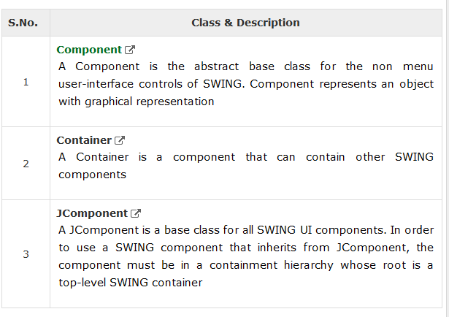
Introduction to Swing

Slide 28
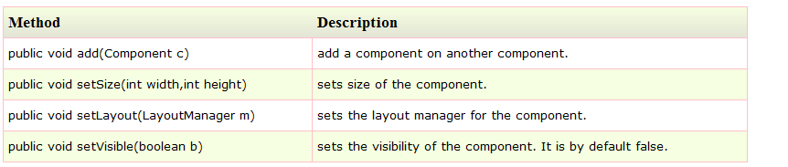
Commonly used Methods of Component class

Slide 29
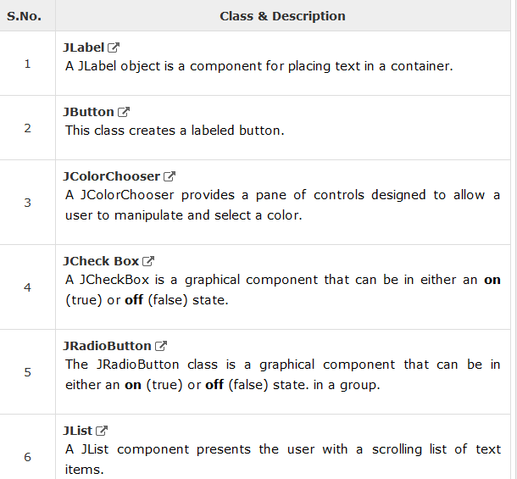
SWING UI Elements

Slide 30
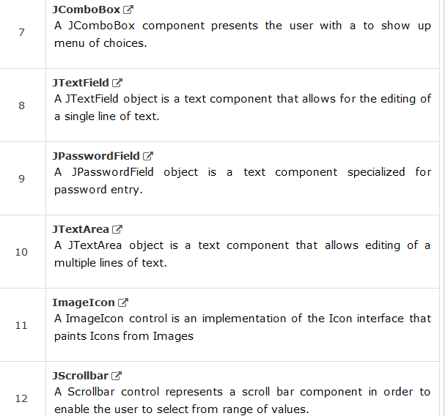
SWING UI Elements

Slide 31
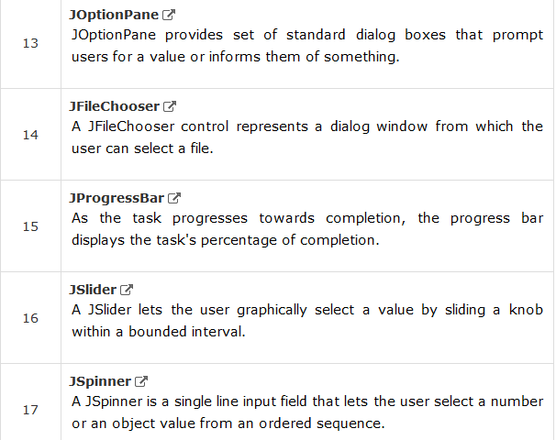
SWING UI Elements

Slide 32
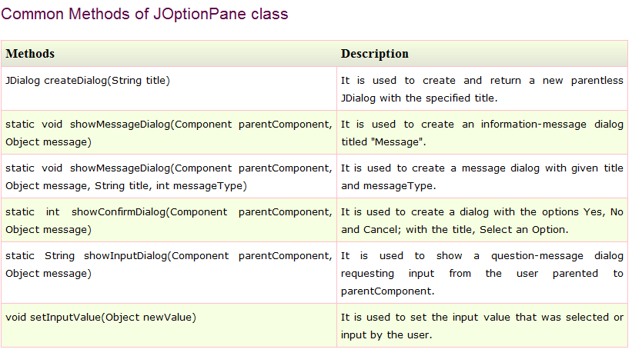
Java JOptionPane The JOptionPane class is used to provide standard dialog boxes such as message dialog box, confirm dialog box and input dialog box. These dialog boxes are used to display information or get input from the user.
T

Slide 33
Introduction to GUI
What are these Components ?
These components are sometimes called controls.
A GUI component is an object with which the user interacts via mouse, the keyboard etc. or an other form of input
Every user interface considers the following three main aspects −
UI Elements − These are the core visual elements the user eventually sees and interacts with.
Layouts − They define how UI elements should be organized on the screen and provide a final look and feel to the GUI (Graphical User Interface).
Behavior − These are the events which occur when the user interacts with UI elements.

Slide 34
JFrame – A frame is an instance of JFrame. Frame is a window that can have title, border, menu, buttons, text fields and several other components.
A Swing application must have a frame to have the components added to it.
Class Jframe is used to create a Frame.
Example
import javax.swing.Jframe;
JFrame frame=new JFrame(“Frame Example”);
OR
class MyClass extends Frame {
...setTitle("My Frame");

Slide 35
Introduction to Swing Components
JFrame – Methods
JFrame frame=new JFrame();
frame.setTitle("My Frame");
frame.setVisible(true);
frame.setSize(400, 300); frame.setResizable(false);
frame.setLocationRelativeTo(null);
frame.setLayout(null);
frame.setDefaultCloseOperation(JFrame.EXIT_ON_CLOSE);
frame.add(object);

Slide 36
Commonly used Methods of Component class

Slide 37
JLabel
A JLabel object is a component for placing text in a container. It is used to display a single line of read only text.
Displays uneditable text or icons
JLabel class declaration
javax.swing.JLabel;
JLabel lbl=new JLabel(“any text”);

Slide 38
Commonly used Methods:
void setText(String text) It defines the single line of text this component will display
String getText() It returns the text string that a label displays.
setBounds(x,y,w,h); specify the position and size.
lbl.setForeground(Color.red);
lbl.setToolTipText("User info");

Slide 39
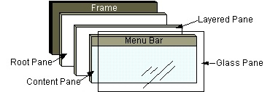
getcontentpane in java
container such as (JFrame) has several layers. You can think of a layer as a transparent film that overlays the container. In Java Swing, the layer that is used to hold objects is called the content pane. Objects are added to the content pane layer of the container.
The getContentPane() method retrieves the content pane layer so that you can add an object to it. The content pane is an object created by the Java run time environment. You do not have to know the name of the content pane to use it. When you use getContentPane(), the content pane object then is substituted there so that you can apply a method to it.

Slide 40
Every Swing top level container (and JFrame) has what's called a JRootPane.
This is responsible for actually managing the overall layout of the window.
The root pane has a number of layers, one of which is the content pane. When you add something to a frame, it is automatically added to the content pane for you, before this, you had to call getContentPane().add(...) yourself.
JLabel emptyLabel = new JLabel("");
frame.getContentPane().add(emptyLabel)

Slide 41
JTextField
A JTextField object is a text component that allows the editing of a single line text. It allows the editing of a single line of text.
Enables Users to enter data from keyboard. Can also be used to display editable or uneditable text.
JTextField class declaration
javax.swing.JTextField;
JTextField txtfield=new JTextField() ; // Creates a new TextField

Slide 42
Commonly used Methods:
String getText() It returns the text string that a textfield displays.
void setText(String text)
setBounds(x,y,w,h);
setEditable(boolean); it is used to enable or disable the txtfield.
void addActionListener(ActionListener l) It is used to add the specified action listener to receive action events from this textfield.
void setFont(Font f) It is used to set the font.

Slide 43
JPasswordField
A JPasswordField object is a text component specialized for password entry. It allows the editing of a single line of text.
JPasswordField class declaration
javax.swing.JPasswordFieldField;
JPasswordFieldField txtpassfield=new JPasswordFieldField () ;
// Creates a new PasswordField

Slide 44
JButton
The JButton class is used to create a labeled button. The application result in some action when the button is pushed.
JButton class declaration
javax.swing.JButton;
JButton btn=new JButton(“Submit”) ; // Creates a new JButton

Slide 45
JButton
Commonly used Methods:
void setText(String s) It is used to set specified text on button
String getText() It is used to return the text of the button.
void setEnabled(boolean b) It is used to enable or disable the button.
void addActionListener(ActionListener a) It is used to add the action listener to this object.

Slide 46
JCheckBox
The JCheckBox class is used to create a checkbox. . It is used to choose one or more options from multiple options.
It is used to turn an option on (true) or off (false). Clicking on a CheckBox changes its state from "on" to "off" or from "off" to "on “.
JCheckBox class declaration
JCheckBox() chkbtn=new JCheckBox (“Java”) ;
// Creates a new CheckBox

Slide 47
JCheckBox
Commonly used Constructors:
JCheckBox() Creates an initially unselected check box button with no text.
JChechBox(String s) Creates an initially unselected check box with text.
JCheckBox(String text, boolean selected) Creates a check box with text and specifies whether or not it is initially selected.
Example
JCheckBox() chkbtn=new JCheckBox (“Java”,true) ;

Slide 48
JRadioButton & ButtonGroup
The JRadioButton class is used to create a radio button. It is used to choose one option from multiple options.
JRadioButton class declaration
JRadioButton radiobtn=new JRadioButton(“Male”) ;
// Creates a new JRadioButton

Slide 49
JComboBox
The object of JComboBox class is used to show popup menu of choices. Choice selected by user is shown on the top of a menu.
Provides a drop-down list of items from which the user can make a selection by clicking an item.
JComboBox class declaration
JComboBox cmbbtn=new JComboBox () ; // Creates a new JComboBox

Slide 50
JComboBox
void addItem(Object anObject) It is used to add an item to the item list.
void removeItem(Object anObject) It is used to delete an item to the item list.
void removeAllItems() It is used to remove all the items from the list.
void setEditable(boolean b) It is used to determine whether the JComboBox is editable.
void addActionListener(ActionListener a) It is used to add the ActionListener.

Slide 51
JPanel – A panel is an instance of JPanel. Provides and area in which components can be placed and organized.
A frame can have more than one panels and each panel can have several components. You can also call them parts of Frame. Panels are useful for grouping components and placing them to appropriate locations in a frame.

Slide 52
JList is part of Java Swing package . The object of JList class represents a list of text items. The list of text items can be set up so that the user can choose either one item or multiple items. It inherits JComponent class.
JList is a component that displays a set of Objects and allows the user to select one or more items . JList inherits JComponent class. JList is a easy way to display an array of Vectors .
Constructor for JList are :
JList(): creates an empty blank list
JList(E [ ] ) : creates new list with the elements of the array.
JList(ListModel d): creates a new list with the specified List Model

Slide 53
METHOD | EXPLANANTION
getSelectedIndex() | returns the index of selected item of the list
getSelectedValue() | returns the selected value of the element of the list
setSelectedIndex(int i) | sets the selected index of the list to i
setSelectionBackground(Color c) | sets the background Color of the list
setSelectionForeground(Color c) | Changes the foreground color of the list
setListData(E [ ] l) | Changes the elements of the list to the elements of l .
setVisibleRowCount(int v) | Changes the visibleRowCount property
setSelectedValue(Object a, boolean s) | selects the specified object from the list.
setSelectedIndices(int[] i) | changes the selection to be the set of indices specified by the given array.
setListData(Vector l) | constructs a read-only ListModel from a Vector specified.
setLayoutOrientation(int l) | defines the orientation of the list
setFixedCellWidth(int w) | Changes the cell width of list to the value passed as parameter.
setFixedCellHeight(int h) | Changes the cell height of the list to the value passed as parameter.

Slide 54
sSelectedIndex(int i) | returns true if the specified index is selected, else false.
indexToLocation(int i) | returns the origin of the specified item in the list’s coordinate system.
getToolTipText(MouseEvent e) | returns the tooltip text to be used for the given event.
getSelectedValuesList() | returns a list of all the selected items.
getSelectedIndices() | returns an array of all of the selected indices, in increasing order
getMinSelectionIndex() | returns the smallest selected cell index, or -1 if the selection is empty.
getMaxSelectionIndex() | returns the largest selected cell index, or -1 if the selection is empty.
getListSelectionListeners() | returns the listeners of list
getLastVisibleIndex() | returns the largest list index that is currently visible.
getDragEnabled() | returns whether or not automatic drag handling is enable
addListSelectionListener(ListSelectionListener l) | adds a listSelectionlistener to the list

Slide 55
JMenuBar, JMenu and JMenuItem
The JMenuBar class is used to display menubar on the window or frame. It may have several menus.
The object of JMenu class is a pull down menu component which is displayed from the menu bar.
The object of JMenuItem class adds a simple labeled menu item.

Slide 56
JMenuBar, JMenu and JMenuItem JMenuBar mb=new JMenuBar(); // Creates MenuBar
JMenu menu=new JMenu("Menu"); // Creates Menu
JMenuItem i1, i2, i3; // Declares MenuItems
i1=new JMenuItem("Item 1");
i2=new JMenuItem("Item 2");
i3=new JMenuItem("Item 3");
submenu=new JMenu("Sub Menu");
menu.add(i1); menu.add(i2);
submenu.add(i3);
menu.add(submenu);
mb.add(menu);
f.setJMenuBar(mb);
f.setSize(400,400);
f.setLayout(null);
f.setVisible(true);

Slide 57
A JWindow is a container that can be displayed anywhere on the user’s desktop. It does not have the title bar, window-management buttons, or other trimmings associated with a JFrame, but it is still a “first-class citizen” of the user’s desktop, and can exist anywhere on it.
The JWindow component contains a JRootPane as its only child. The contentPane should be the parent of any children of the JWindow. As a convenience add and its variants, remove and setLayout have been overridden to forward to the contentPane as necessary.

