Slide 1
Predictive Analytics for Social good
Predicting Project Success at DonorsChoose.org

Slide 2
What is DonorsChoose.org ?
A nonprofit organization that allows individuals to donate directly to public school classroom projects
Enables teachers to request materials and resources for their classrooms

Slide 3
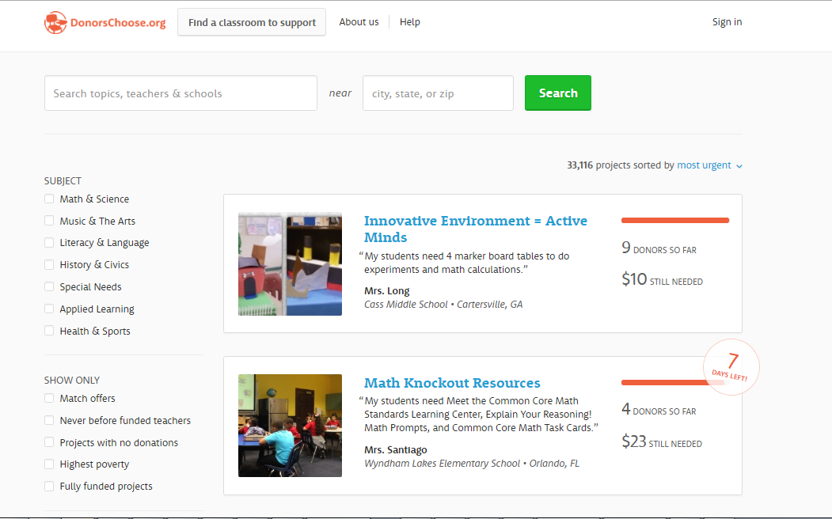

Slide 4
The Problem
WHAT IF - we were able to predict if a Project would be successfully funded or not ?
By identifying early, DonorsChoose.org could -
Improve funding outcomes, better the user experience
Make suggestions to projects that might not succeed
Order the resources from vendors well in advance cutting down the wait time for teachers and students

Slide 5
Dataset
Projects
IDs, School Location, School Type(charter,magnet,nlns,kipp etc)
Project Categories – primary/secondary subject,resource type, poverty level
Project pricing – Total price, Student reach
Project Donations – Total donation amount, number of donors
Project Status – Funding status(completed, expired, live), date created/expired
Donations
IDS - DonationId, ProjectId, AccountId
Donor Info – Donor location, Is_Teacher
Donation amount and type , Payment_type – credit card, gift card, check etc
Project Resources
All materials/resources requested by teacher
Project written essays
Full text of teacher written requests for their projects

Slide 6
Data Wrangling
Raw data from csv
Removed whitespaces from the columns while reading from csv
Handled mismatch between row values and columns they belong
Additional unnecessary columns created due to bad values in data
Other Data wrangling
Exclude projects that have 0 as total expenses as it was just bad data
Extracted year and month from project date posted and used them as features
Merged projects data and donations data to get meaningful insights
Found out teachers donating to their own projects by matching the donor account id with the teacher account it

Slide 7
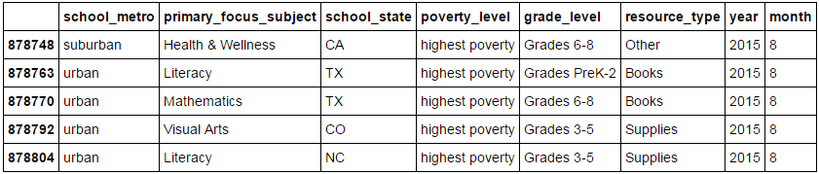
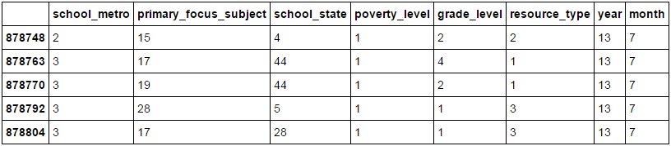
Data Preprocessing
One Hot Encoding
Why? – For feeding categorical data to many scikit-learn estimators
Decision tree classifier needs One Hot Encoding to input categorical features
Original data
After One-Hot Encoding

Slide 8
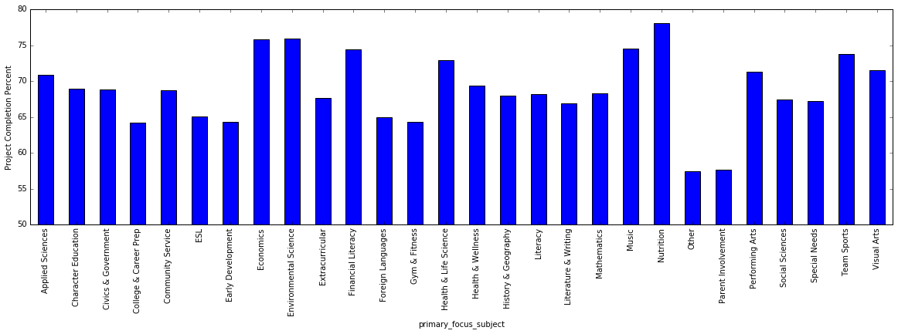
Exploratory Data Analysis
Subject Category vs Project Completion percent
(project completion percent = number of projects completed under a category/ total number of projects under a category)

Slide 9
Exploratory Data Analysis
Observations
‘Other’ scored the lowest (57.39 % projects completed)-
‘Other’ comes under ‘Applied Learning’ category. So for a teacher, it is better to have a project assigned to some category rather than having it in ‘Other’
‘Parent Involvement’ projects also scored very low compared to other categories(57.68% projects completed)
Suggestion to DonorsChoose.org
DonorsChoose.org could have a small tip while registering a project saying – Chances of getting a project noticed are high if you have an assigned category.

Slide 10
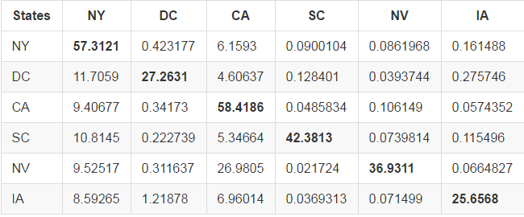
Exploratory Data Analysis
Correlation between project’s state and donor’s state
Table - State wise Projects vs Donations

Slide 11
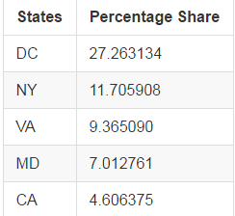
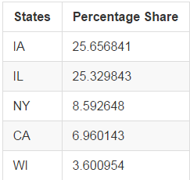
Exploratory Data Analysis
Top 5 donations for a project in District of Columbia
Top 5 donations for a project in Iowa
Definite correlation between state of a donor and state of a project
Suggestion to DonorsChoose.org-
If DonorsChoose.org decide to build a recommendation system that recommend projects to donors based on their interests, the state in which the donor resides could play an important feature, as Donors generally prefer a project in their own state or a neighboring state.

Slide 12
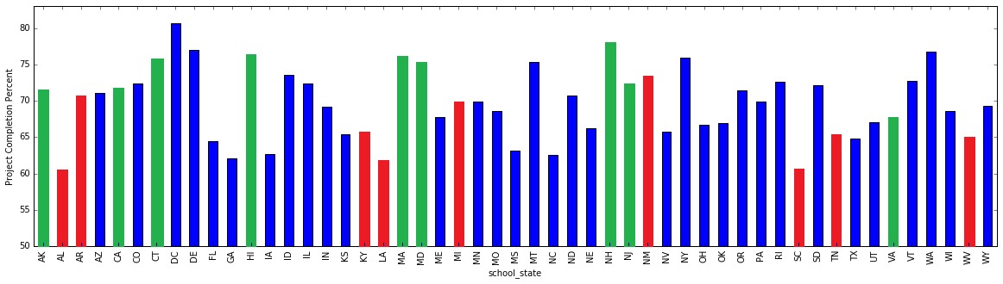
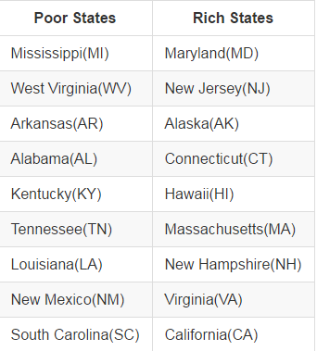
Exploratory Data Analysis
Correlation between average median household income of a state and project success rate in a state
Rich states are marked in green and Poor states are marked in red
U.S. Census Bureau’s 2014 American Community Survey (ACS)

Slide 13
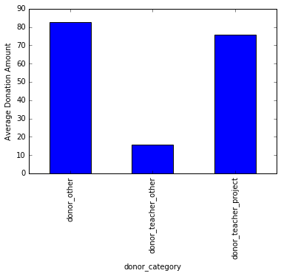
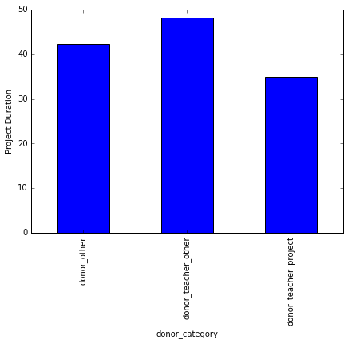
Exploratory Data Analysis
Plot between donor category and project duration and donation amount
donor_teacher_project – Teachers donating to their own projects
donor_teacher_other – Teachers donation to other projects
donor_other – Donors other than teachers

Slide 14
Exploratory Data Analysis
Plot between donor category and project duration and donation amount
Observations –
A person who is not a teacher is likely to be more generous than a teacher.
There are a lot of teachers who donate a significant amount to their own projects.
Teachers contribute very less to projects that they don't own.
There is a possibility of a teacher donating a significant amount to his/her project to meet the funding requirement and hence the duration of the project is much less compared to other projects

Slide 15
Model
Chose Decision tree mainly because of the dependencies that exist among different input features
For better results, used an ensemble approach of Random Forest Model
Used GridSearchCV by scikit-learn to make an exhaustive search over input parameters
Scoring function used was f2score
5 fold cross validation used
60% training and 40% testing

Slide 16
Results
Best estimator results has
20 number of trees in the forest,
5 number of features considered when looking for best split,
10 minimum number of samples in newly created leaves,
2 minimum number of samples required to split an internal node
Precision – 0.77
Recall – 0.90
F-Score – 0.83
Confusion Matrix
 | Predicted(p) | Predicted(n)
Actual(p) | 212642 | 24600
Actual(n) | 64262 | 36929

Slide 17
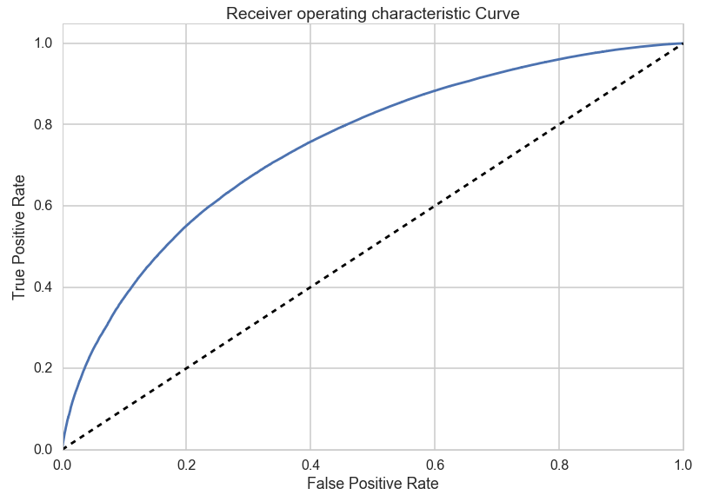
Results
ROC curve
Area under Curve(AUC) – 0.755

Slide 18
Future Enhancements
Text processing and Sentiment analysis on teacher’s essay data that has teacher’s requests as well as responses to donors.
This could add important features in determining a successful project
A Recommendation engine that can recommend projects to individual donors based on his/her interests
Would help projects reach funding goal and entire process would be more efficient pulling in more projects and donors in future

Slide 19
Recommendations
My current model could be used to determine well in advance, if a project would be fully funded or not and hence prepare in advance by ordering resources, improve funding outcomes and better the user experience
Based on the exploratory data analysis done, the client could have a small note in project registration page saying – “Chances of getting a project notices are high if you have an assigned category”
If the client decides to build a recommendation engine, the state in which the donor resides could be used as a important feature as Donors generally prefer a project in their own state or a neighboring state

