Slide 1
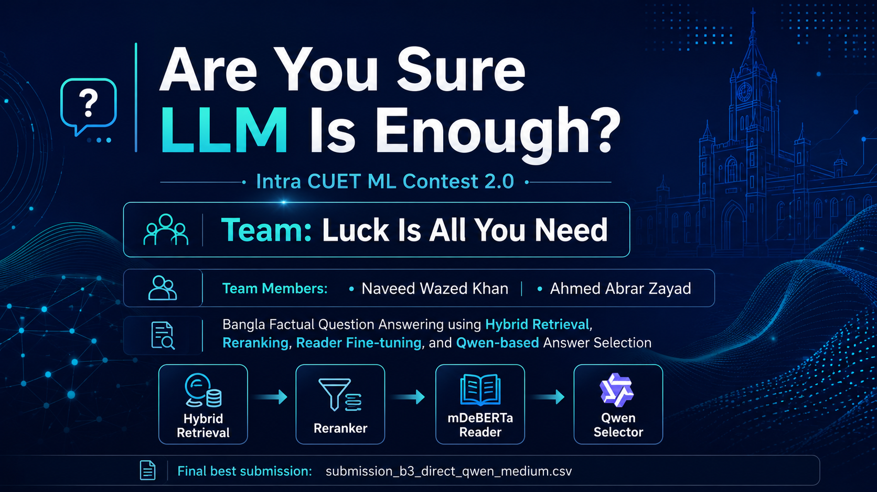

Slide 2
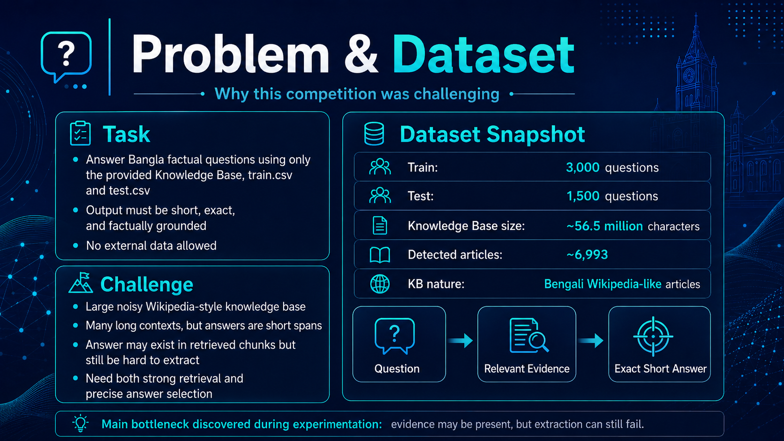

Slide 3
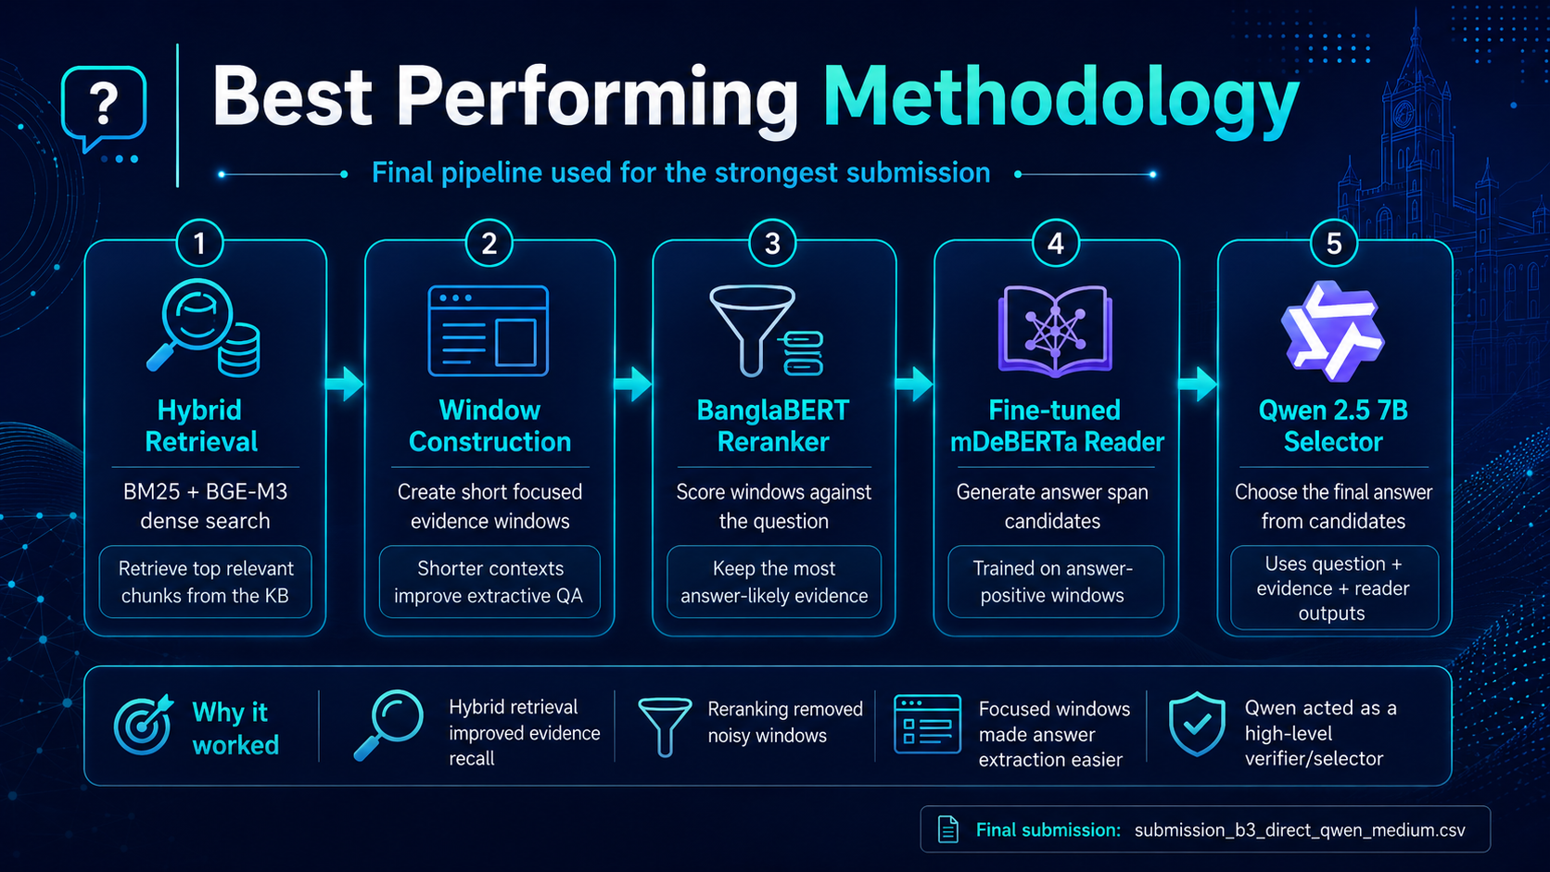

Slide 4
5
Step 1 — Hybrid Retrieval Setup
Sprint-1: building the evidence foundation
🔎 Dense Retrieval
🧾 Sparse Retrieval
⚙ Hybrid Merge
Used BGE-M3 embeddings to encode KB chunks and questions.
BM25 captured keyword overlap and rare entity names.
Combined BM25 and BGE-M3 rankings into a stronger candidate pool.
Stored dense vectors in a FAISS index for fast top-k search.
Worked well for dates, names, places, and exact fact questions.
Retrieved broad top evidence before reranking.
Dense search captured semantic similarity even when exact words differed.
Balanced dense retrieval by preventing semantic drift.
This stage set the upper bound for the entire QA system.
Question
BM25 + BGE-M3
Top KB Chunks
Evidence Candidates

Slide 5
6
Step 2 — Focused Evidence Windows
Why full chunks were not enough for extractive QA
⚠ Problem with raw chunks
🪟 Window generation strategy
Retrieved chunks were often long and noisy, with navigation/table text mixed in.
Created multiple window types: keyphrase, title, answer-centered, sentence, and overlap windows.
The answer span was short, but the reader had to scan too much context.
Each window kept a compact piece of evidence around likely answer regions.
Long context increased confusion: nearby facts could look like plausible answers.
Generated positive training examples only when the gold answer appeared in a window.
Therefore, retrieval alone was not enough; we needed answer-focused windows.
Reader training became closer to the final inference setting.
Key idea: convert a noisy document-retrieval task into a precise evidence-window ranking and span-extraction task.

Slide 6
7
Step 3 — BanglaBERT Hard-Negative Reranker
Learning which window actually supports the answer
1
2
3
4
Top-100 Windows
Positive Window
Hard Negatives
Reranker
From hybrid retrieval
Contains gold answer
High-rank but answer absent
BanglaBERT
🎯 Training signal
📈 Why it helped
Positive examples: windows that contain answer spans.
Reranking improved the ordering of evidence before the reader.
Hard negatives: visually relevant windows that do not contain the answer.
The mDeBERTa reader saw stronger contexts at top ranks.
This forced the model to distinguish real evidence from noisy related text.
It reduced the number of plausible but unsupported answer candidates.
Practical effect: the reader’s job became easier because the top evidence windows were more answer-likely.

Slide 7
8
Step 4 — Fine-tuned mDeBERTa Reader
Extracting exact answer spans from reranked evidence
📚 Training setup
🔬 Inference setup
🧩 Reader candidate pool
Trained on answer-positive evidence windows generated in Sprint A.
For each test question, the reader scanned top reranked windows.
Duplicate or similar spans were grouped by normalized text.
Used extractive QA style: predict start and end token of answer span.
Generated many candidate spans instead of only one answer.
Answer candidates received voting and confidence features.
Focused on short Bangla factual answers: names, dates, places, numbers.
Stored reader score, evidence rank, reranker score, and window source.
This pool enabled B3 voting and Qwen selection later.
mDeBERTa turned reranked evidence into candidate answers; final performance depended on selecting the correct candidate.

Slide 8
9
Step 5 — B3 Direct + Qwen Selector
From many spans to one final answer
1
2
3
4
Reader Candidates
B3 Voting
Qwen 2.5 Selector
Final Answer
Answer spans
Score + vote
Judge candidates
Exact short span
🧠 B3 Direct ensemble
✨ Qwen selector
Aggregated answer candidates from multiple windows.
Qwen did not freely generate answers; it selected from existing candidates.
Used reader confidence, reranker score, rank, answer vote count, and answer type.
Prompt included question, top evidence, B3 direct answer, and candidate spans.
Produced a strong direct submission before any LLM selection.
Invalid Qwen outputs were rejected, keeping the pipeline safe and extractive.
B3 Direct scored Public 0.61634 and Private 0.63588.
Final Qwen Medium scored Public 0.61950 and Private 0.64512.
Main insight: the LLM was most useful as a verifier/selector, not as a standalone generator.

Slide 9
10
Previous Attempts & Lessons Learned
Each sprint exposed a new bottleneck
Sprint 2 Baseline
Early Sprint 3
Sprint 3 Recovery
Hybrid retrieval + basic answer generation
Reasoning-chunk reader fine-tune attempt
Positive KB chunks + answer selection
Public 0.52723 Private 0.51452
Lesson: retrieval alone was insufficient.
Discarded
Lesson: reasoning text was not the right training context.
Public 0.57626 Private 0.58104
Lesson: answer-containing windows improved extraction.
Sprint 3 Improved
Improved-2
Final Direction
Fast short-window gated reader
Fresh mDeBERTa on focused windows
Reranker + reader + Qwen selector
Public 0.58676 Private 0.57976
Lesson: shorter contexts helped but confidence gating was limited.
Public 0.59474 Private 0.58468
Lesson: better reader helped, but evidence ranking still mattered.
Public 0.61950 Private 0.64512
Lesson: the full multi-stage pipeline gave the best result.
We kept the diagnostic learnings, but the final method focuses on the strongest fallback-free pipeline.

Slide 10
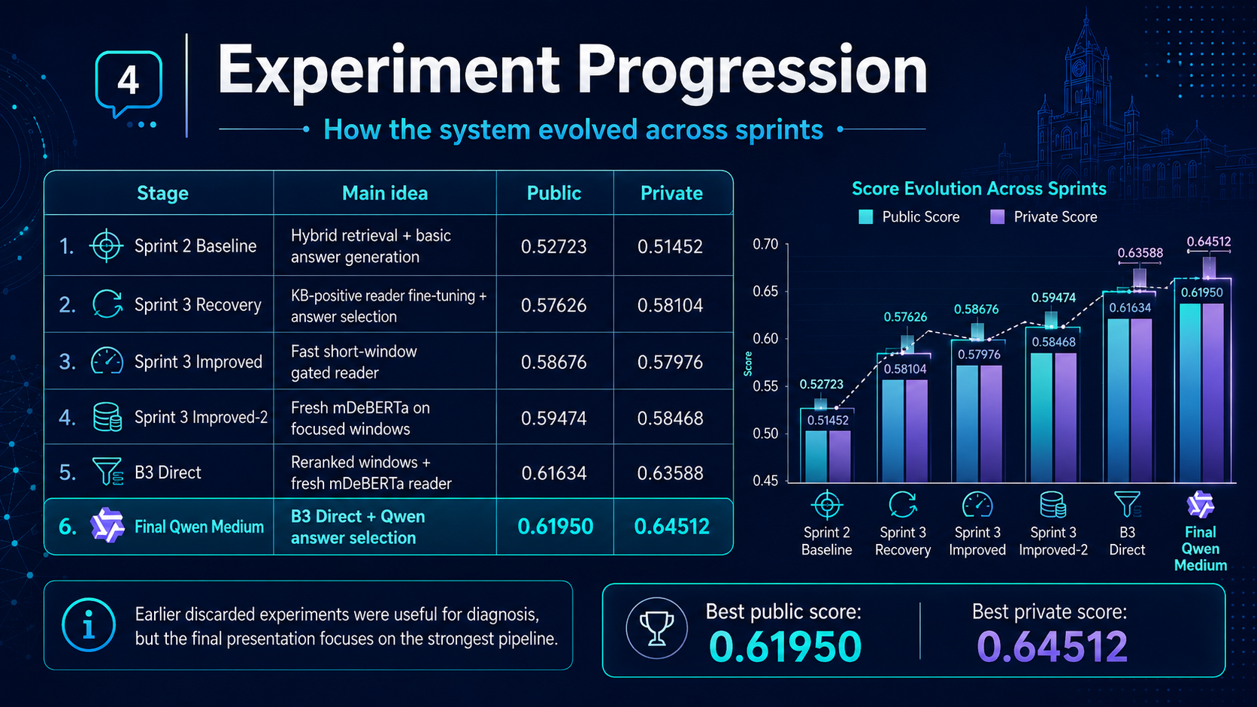

Slide 11
