Slide 1
Expense Approval Workflow
Durable Functions vs. Logic Apps + Service Bus
Your Name Here
Student Number | CST8917 — Serverless Applications
Spring/Summer 2026

Slide 2
Introduction
The expense approval pipeline both versions implement
Input
Employee name/email, amount, category, description, manager email
Flow at a glance
Request received
Validation
Reject requests missing fields or using an invalid category
↓
Validate fields & category
Auto-Approve
Expenses under $100 need no manager
↓
< $100 ? → auto-approve
Manager Approval
Expenses ≥ $100 wait for a manager decision
↓
≥ $100 → wait for manager
Timeout
No response in time → auto-approve and flag as escalated
↓
Timeout → escalate & approve
Notification
Employee always receives the final outcome by email
↓
Notify employee
CST8917 — Expense Approval Workflow Comparison
2

Slide 3
Version A — Durable Functions
Code-first orchestration, Python v2 programming model
HTTP Client Fn
POST /expenses
Orchestrator
expense_orchestrator
Activity: Validate
→
→
↓
Activity: Notify
Human Interaction Pattern
context.task_any([
wait_for_external_event("ManagerDecision"),
create_timer(deadline)
])
Key design decisions
Single orchestrator drives the whole pipeline — validate, branch on $100 threshold, race approval vs. timer, notify
Manager decision endpoint (POST /expenses/{id}/decision) raises the ManagerDecision external event
Durable timer + task_any() gives escalation "for free" — no extra polling logic needed
Timeout kept short (1 min) for local testing; production value + rationale documented in README
CST8917 — Expense Approval Workflow Comparison
3

Slide 4
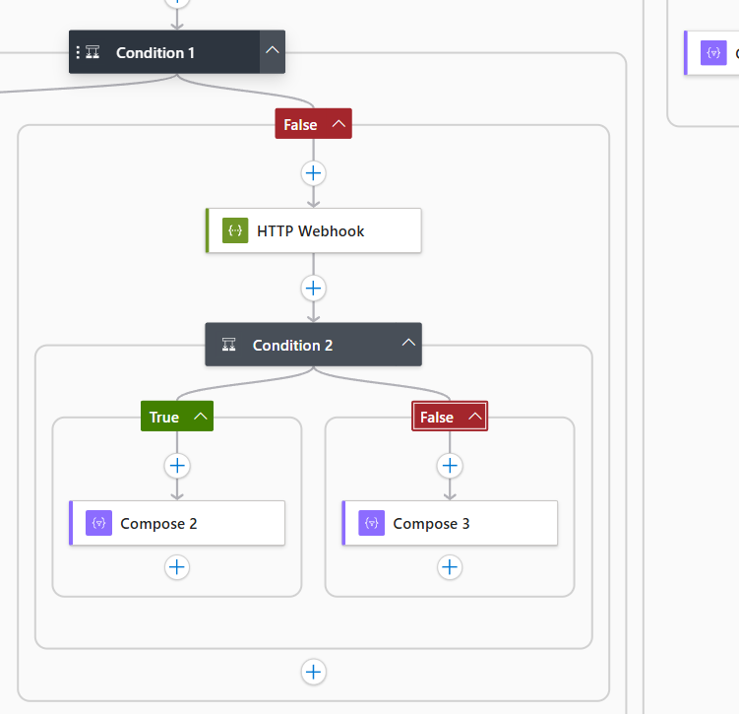
Version B — Logic Apps + Service Bus
Visual / declarative orchestration
Queue:
expense-requests
Logic App
Fn: validate
Manager approval design
HTTP Webhook action pauses the run and hands out a callback URL. A relay endpoint emails the manager approve/reject links; clicking one POSTs the decision back to the callback URL.
Timeout branch fires natively off the webhook action's TimedOut status — no separate polling loop.
→
→
↓
↓
< $100: auto-approve
≥ $100: HTTP Webhook
↓
↓
Manager approves/rejects
or times out → escalated
↓
Topic: expense-outcomes
↓
Sub: approved
Sub: rejected
Sub: escalated
CST8917 — Expense Approval Workflow Comparison
5

Slide 5
Comparison
Six dimensions, judged from direct build experience
Dimension
Durable Functions
Logic Apps + Service Bus
Development Experience
Fast; specific tracebacks led straight to root causes
Designer was reliable; hand-authored JSON repeatedly wasn't
Testability
Fully local via Azurite — no Azure needed to test
No local emulator; only isolated Functions testable offline
Error Handling
Full Python stack traces pinpoint the exact line
ARM errors were accurate but often pointed at symptoms
Human Interaction
Native task_any() pattern — worked first try
No native support; required a custom-built relay Function
Observability
statusQueryGetUri gives instant structured JSON
Rich run history by design, not reachable in this build
Cost (100/day → 10k/day)
~$0-2/mo → ~$5-10/mo (within free grant)
~$11/mo → ~$100/mo (linear per-action billing)
CST8917 — Expense Approval Workflow Comparison
7

Slide 6
Recommendation
For this workflow, in production, today: Durable Functions
Choose Durable Functions when…
Choose Logic Apps when…
• Local, offline testability matters — verified all 6 scenarios without touching Azure
• The workflow needs a real wait-for-human-or-timeout pattern
• Cost predictability at scale matters (stayed ~10x cheaper at 10k/day in our estimate)
• Non-developers need to read or adjust the logic visually
• The workflow leans heavily on pre-built SaaS connectors
• The team stays inside the designer
CST8917 — Expense Approval Workflow Comparison
8

Slide 7
Lessons Learned
What surprised me
• The “visual/declarative” platform was harder to get right by hand than the “code-first” one.
• Durable Functions' human-interaction primitive worked correctly on the first real test.
What I would do differently
• Start Version B earlier and use the Logic App designer from the beginning, since implementing it manually was much more difficult than expected.
CST8917 — Expense Approval Workflow Comparison
9

Slide 8
Thank You

