Slide 1
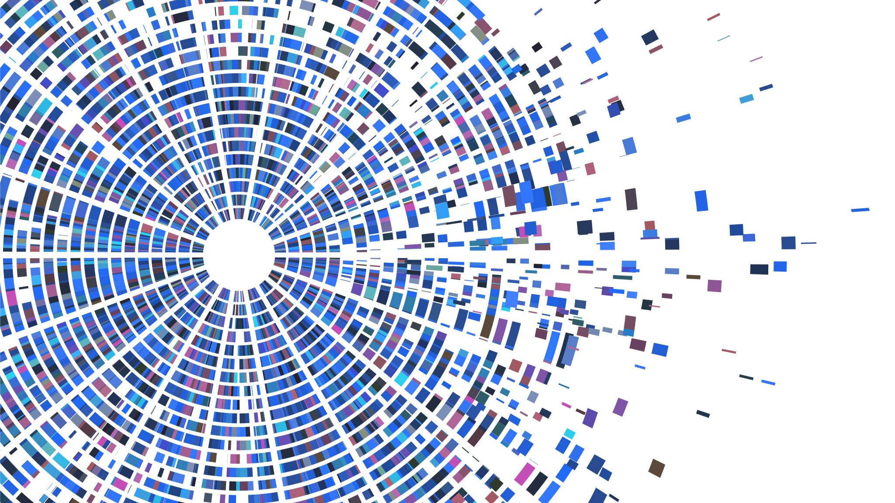

IT 203 MINI-PROJECT PRESENTATION
Alimurtaza Merchant 191IT205
Abhinav Bharali 191IT201
Naveen Shenoy 191IT134
Pratham Nayak 191IT241

Slide 2

Problem Statement
Doctor-Patient Combined Matching Problem & Its Solving Algorithms (DPCMP)
Overview: A mathematical model of the DPCMP is constructed, and improved ant colony optimization algorithms are designed. Finally, certain examples verify the effectiveness and good performances of the proposed methods.

Slide 3

Assumptions
Disease is relatively stable (not an emergency)
Disease is not cross-infectious
Knowledge sharing between doctors and patients greatly affect the treatment of diseases

Slide 4
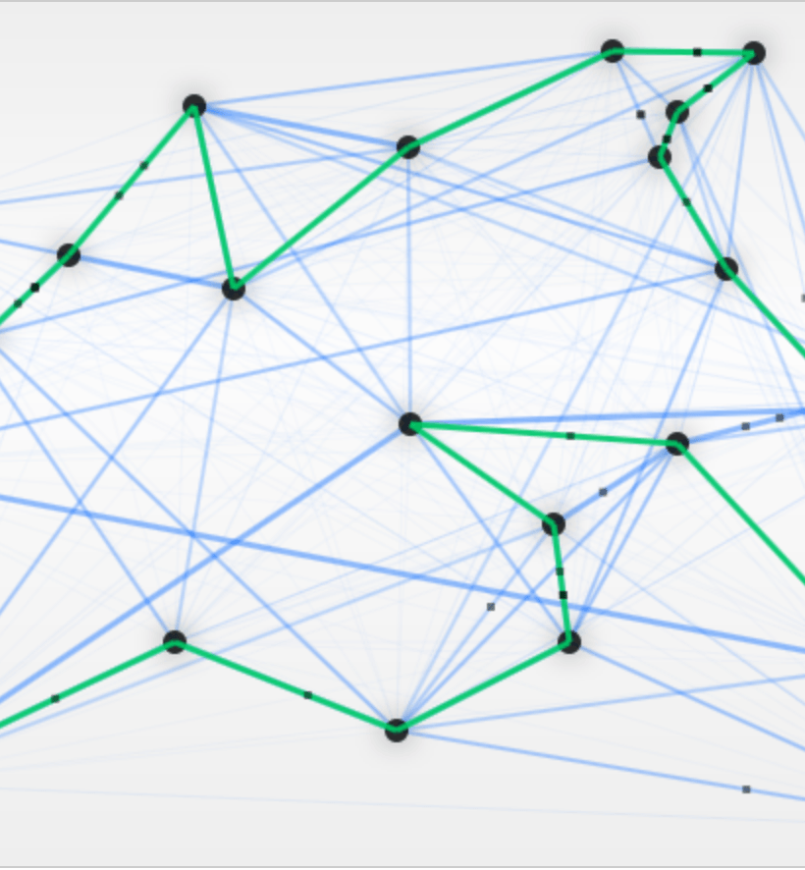
Ant Colony Optimization Algorithm
The ant colony optimization algorithm (ACO) is a probabilistic technique for solving computational problems which can be reduced to finding good paths through graphs.
The pheromone-based communication of biological ants is often the predominant paradigm used.
Combinations of Artificial Ants and Local Search algorithms have become a method of choice for numerous optimization tasks

Slide 5

Work Done
Undirected Graph Construction:
Constructed an undirected Graph represented by adjacency matrix where edge represents two patient groups can be grouped together.

Slide 6

Work Done (Contd.)
Route construction:
The four processes during the route construction are:
Choose the next group based on a probability function of two attraction measures.
Keep a history of the groups visited during the current route.
Update the set of allowed groups selected in the next step.
Update the trail intensities of the edges visited. Then, local search procedures are applied to enhance the solution quality.

Slide 7


Work Done(Contd.)
Local Search: The aim of the LS operation is to improve the solution by performing small changes that lead to a neighbouring solution of better quality. After m ants create routes, the LS procedure is started. For the implementation of the local search operation in the paper, we have used the Random-restructure.
Random-restructure: In this method, the solution sequence is divided into two parts at a randomly selected element. The first part of the sequence does not change, and the second part of the sequence is regenerated.

Slide 8
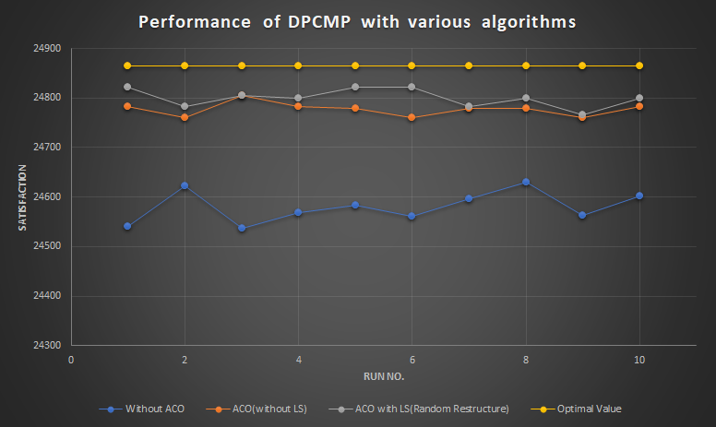
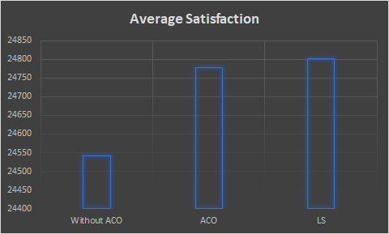
Results & Analysis
Performance of the random algorithm with ACO is quite poor
The ACO algorithm predicts values which are quite close to the actual or optimal value
The ACO with LS algorithm is a slight improvement upon the normal ACO algorithm

Slide 9
THANK YOU

