Slide 1


Slide 2
by Naveen Kumar
REVENUE OPERATIONS ANALYSIS IN POWER BI

Slide 3
Data Over View & analysis over view
Revenue analysis Prepare by as per the data inputs these details given below
(MONTH YEAR, PLAN NAME, Customer ID, Region, Product , Net Revenue, Gross Revenue )
Based on data insights, we analyze selling behavior across different regions, examine discounting practices, and identify high-selling products and plans. Additionally, we evaluate current selling behaviors and develop improvement strategies using Power BI for our analyses.
Variety of product - FMCG, Fresh Product, Health care, technology and Personal Care in my under standing about the analysis.

Slide 4

Content
Data Highlights
Analysis Overview
Region based View
Revenue Trends
Impact factors
Summary

Slide 5
Highlights of the Data
Product & Region
Business Type & Revenue

Slide 6
Highlights of the Data
The top 3 product types are P1, P6, and P4.
PD1 generates 43% of the net revenue.
A total of 1,247 customers purchase more than one product.
The highest revenue region is NA.
The average purchase value per customer is 306 Rs region wise.
India has the highest overall average percentage of discounts.
Product & Region

Slide 7
Highlights of the Data
Large business type has high sales revenue but low quantity sold (Qty: 4884 / Revenue: 4411k).
Small Business plan has the highest quantity of products sold but generates low sales revenue.
Every three months, the revenue for one particular business plan increases, except for the Small Business plan.
All business types significantly impact the gross revenue.
Business Type & Revenue

Slide 8
Analysis Overview
Large business plans generate more revenue
Small business plans sell more products in terms of quantity.
Discounts on products do not significantly impact sales.
PD1 and PD6 together contribute 83% of the revenue (PD1 accounts for 43%, and PD6 accounts for 40%).
Sales from large business plans are significantly higher compared to the other two business plans.
Based on the data, the gross value for December 2021 is Rs. 1,022,890. It is expected that December 2022 sales will be higher.
The company employs geographical pricing strategies and dynamic pricing.

Slide 9
Geo Graphical Pricing Strategies and Dynamic pricing is Working or Not?
Not all regions, business types, and products were included.
Seasonal pricing positively impacted revenue, leading to increased sales.
The strategy was effective primarily in major cities.
We need to focus more on our pricing strategy.

Slide 10
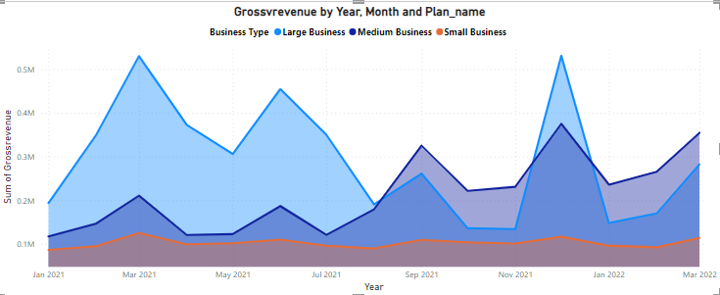
Gross revenue By Months and Business
Every three months, there is an increase in sales.
Small businesses have overall monthly revenue without significant improvement.

Slide 11


Region based View
Discount percentages do not have a significant impact on regional-level sales.
Based on analysis, price has a major impact on regional-level sales
In most region, Product Knowledge has not reached the desired level
India has the highest average percentage at 19.7% compared to other regions, but this does not impact sales.
The region with the highest average purchase value is North America (NA), where one person spends an average of 308 RS.
There are more than 10,000 customer sales in the region of North America (NA).

Slide 12

Revenue Trend
1. Revenue increases every three months for at least one business type.
2. Overall revenue is significantly impacted by products PD1 and PD6, which together account for more than 80% of total revenue.
3. Specifically, the large business plan has a substantial impact on gross revenue, contributing more than 4 million in revenue.

Slide 13
Impact Factors
Product Regional Pricing
Product Discount
Product Knowledge
Focusing business plan

Slide 14
Summary
Pricing has the most significant impact on overall revenue across all data
Regional pricing variations have minimal impact on the market; therefore, there should be greater emphasis on region-specific pricing strategies.
The small business plan attracts a high volume of customers, but monthly revenue shows no improvement.
Product discounts are ineffective across all regions; their impact is limited to the small business plan only.

Slide 15
My suggestion
Focus on Pricing : Emphasize strategic pricing adjustments to optimize revenue.
Product Promotion: Increase efforts in promoting products to enhance visibility and customer engagement.
Digital Marketing Initiatives: Increase investment in digital marketing campaigns to reach a wider audience and generate more leads
Focus on Discounts: Implement targeted discount strategies to stimulate sales and attract price-sensitive customers.
Geographical Marketing: Tailor marketing campaigns to specific geographical segments to maximize market penetration and effectiveness.
Partnership Development: Forge strategic partnerships that can amplify our reach and offer mutual benefits.

Slide 16
Thank you

