Slide 1


Slide 2
by Naveen Kumar
REVENUE OPERATIONS ANALYSIS IN POWER BI

Slide 3
Data Over View & analysis over view
Revenue analysis Prepare by as per the data inputs these details given below
(MONTH YEAR, PLAN NAME, Customer ID, Region, Product , Net Revenue, Gross Revenue )
Based on the data insights, we analyze the selling behavior across different regions, examine discounting practices, and identify high-selling products and plans. We also evaluate current selling behavior and develop strategies for improvement, utilizing Power BI for these analyses.
Variety of product - FMCG, Fresh Product, Health care, technology and Personal Care in my under standing about the analysis.

Slide 4

Content
Data Highlights
Analysis Overview
Region based View
Revenue Trade
Impact factors
Summary

Slide 5
Highlights of the Data
Product & Region
Business Type & Revenue

Slide 6
Highlights of the Data
Top 3 Product type P1, P6, P4
Majorly 43% of Net revenue generate by PD1
Major of product Qty sold in Small Business plan but sale revenue is low
Total 1247 Customers purchase more then 1 product
Over all Highest revenue region is NA
Over all Highest Average percentage of Discount region is India
Product & Region

Slide 7
Highlights of the Data
Sales revenue wise Large business type is high but Qty wise is very low.(QTY-4884 / Revenue- 4411k )
Every 3 month once one particular Business plan revenue was increase expect Small business plan type
One customer Avg purchase Value is 350.Rs
All Business type majorly impact in the Gross Revenue
Business Type & Revenue

Slide 8
Analysis Overview
Large business plan provide more revenue
Product Qty wise Small business plan selling more Qty
Product Discount % is not big impact in product Selling
Gross and Net Revenue Wise PD1 &PD6 involve 83% of the Revenue (PD1-43% / PD2-40%)
Large business plan Sales is very high compare to other two business plan.
As per the data 2021 Dec Gross value is 1022890.Rs. So we can easy to predict 2022 Dec Sale level is more high
They implementing Geo Graphical Pricing Strategies and Dynamic pricing

Slide 9
Geo Graphical Pricing Strategies and Dynamic pricing is Working or Not?
Yes but not all the Regions, business Type and product
Seasonal Pricing Reflect on Revenue. It was increase the sales
It was working in major cities only
So we need to more Focus on Pricing Strategy

Slide 10
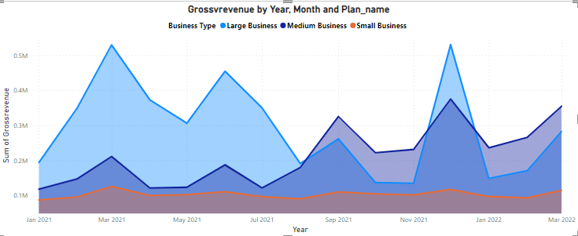
Gross revenue By Months and Business
Every 3 month once sale was Raise
Small business type Revenue is over all month no improvement

Slide 11


Region based View
Discount percentage not big impact in Regional Level
Based on analysis price is major impact on regional level sales
Most of the region Product Knowledge not reached
India Given Highest Avg Percentage Compare to other Region 19.7% but that is not impact is sales
High Average Purchase value Region is “NA”. One person Averagely Spending 308.RS
More then 10K Customer Sales Based on Region “NA”

Slide 12

Revenue Trade
Every 3month Revenue was increase in any one the Business type
In the over all revenue Product PD1 and PD6 Most impact Product, Because More then 80% of revenue involve in Revenue
Particularly Large business plan impact in Gross Revenue, More the 4M

Slide 13
Impact Factors
Product Regional Pricing
Product Discount
Product Knowledge
Focusing business plan

Slide 14
Summary
Based on over all data Pricing is more affecting the over all revenue
Regional level pricing not working
Small business plan type is high volume customer count but here but every month no more sales value improvement
They need to more focus on region wise pricing
Product Discount not working all region in it impact in only Small Business plan

Slide 15
My suggestion
Based on over all analysis here I mention the suggestion for improve the revenue
Focus on Pricing
Focusing on product Promotion
Focus on Discount
Focus on Geographical Marketing (Particular segment )

