Slide 1
NATIONAL INSTITUTE OF TECHNOLOGY KURUKSHETRA
DEPARTMENT OF COMPUTER ENGINEERING
Soil Health Monitoring with UAV Imaging using Machine Learning for Sustainable Farming
SwaYaan Proof-of-Concept Project (C-DAC Hyderabad / MeitY) | Course Code: CSPC401
PRESENTED BY:
• Naveen (Roll No: 123102131, Section CS-B4)
• Nakul Goutam (Roll No: 123102123, Section CS-B4)
PROJECT SUPERVISORS:
• Dr. Ritu Garg, Associate Professor (Principal Investigator)
• Dr. Amandeep Kaur, Assistant Professor (Co-PI)

Slide 2
MID-SEMESTER EVALUATION (CSPC401)
Presentation Outline & Structure
01
Problem Identification & Regional Agricultural Context
Challenges in manual soil testing and Kurukshetra/Haryana Alluvial belt degradation risks.
02
Literature Review & Research Gap
Critique of base paper (Elsevier EAAI 2025 (Sheth et al.)) and justification of our novel dual-branch architecture.
03
System Architecture: UAV-SoilHealthNet
Cross-modal fusion of MobileNetV3 + CBAM Attention with 60 Handcrafted Agronomic Features.
04
Progress Achieved: Multi-Task Benchmarking & XAI
Multi-task evaluation (Soil Type, Health Status, SHI Index), Grad-CAM heatmaps & comparison.
05
Decision Support: Live Diagnostic Console & ICAR Advisory
Operational live Streamlit diagnostic console, Grad-CAM visual overlays, and ICAR farmer prescription cards.

Slide 3
MID-SEMESTER EVALUATION (CSPC401)
1. Problem Identification: Soil Health & Regional Context
LIMITATIONS OF TRADITIONAL TESTING
• Point-Sparse Sampling: In a 20-acre parcel, only 5-10 point samples are taken. Micro-spatial variances between sampling points are completely lost.
• High Time Latency: Wet-chemistry laboratory assays take 10-20 days. Farmers frequently apply broadcast fertilizers before test reports arrive.
• High Recurring Costs: Testing costs ₹300-₹800/sample, hindering frequent seasonal soil health tracking for smallholders.
• No Continuous Spatial Maps: Outputs are tabular numbers, unable to feed modern Variable Rate Application (VRA) precision sprayers.
REGIONAL KURUKSHETRA REALITY & UAV FIT
✔ Indo-Gangetic Alluvial Belt: Kurukshetra and Haryana have naturally fertile alluvial soil, but suffer from intensive Rice-Wheat monoculture degradation.
✔ Emerging Degradation Zones: Excessive tube-well irrigation causes localized sodic/saline crusts, soil compaction, and organic carbon depletion.
✔ Low-Altitude UAV Advantage: Drones flying at 15-30m AGL capture high-resolution bare-soil aerial imagery with sub-centimeter GSD before sowing.
✔ Physical Visual Proxies: Soil surface crusting, crack density, structural roughness, and organic darkness proxies can be detected without unscientific claims of reading NPK from RGB pixels.

Slide 4
MID-SEMESTER EVALUATION (CSPC401)
1. Project Objectives (Aligned with SwaYaan PoC)
Objective 1
Autonomous UAV Data Acquisition
Deploy low-altitude UAV imaging (15-30m AGL, 75-80% overlap) over agricultural plots to capture high-resolution visual surface benchmarks.
Objective 2
Agronomic Feature Extraction Pipeline
Design a 60-dimensional handcrafted feature extractor encoding GLCM Haralick texture, Local Binary Patterns (LBP), and multi-space color moments.
Objective 3
Multi-Task Deep Learning Modeling
Build and optimize UAV-SoilHealthNet to simultaneously perform Soil Type Classification, Health Status Classification, and continuous 0-100 SHI Regression.
Objective 4
Explainable AI & Visual Verification (Grad-CAM)
Integrate gradient-weighted class activation mapping (Grad-CAM) to inspect attention on soil clods and validate deep vision predictions.
Objective 5
Farmer-Oriented Decision Support (ICAR Guidelines)
Translate classified soil zones into actionable, ICAR & CCS HAU Hisar compliant prescription cards (crop suitability, fertilizer NPK ratios, irrigation scheduling).

Slide 5
MID-SEMESTER EVALUATION (CSPC401)
2. Literature Review & Novelty over Prior Work
Feature / Dimension | Elsevier EAAI (2025) Base Paper (Sheth et al.) | Our Proposed Framework: UAV-SoilHealthNet (NIT KKR)
Imaging Platform & Operational Scale | Close-up handheld smartphone camera photos (~30 cm) & Google scraped images; evaluates only tiny point soil patches. | Autonomous low-altitude UAV Drone Imagery (15–30m AGL, GSD: 0.8 cm/px); scans entire 10–50 acre agricultural plots.
Model Architecture & Edge Feasibility | Massive 350M+ parameter ensemble (ViT-L/16 + EffNetV2-Large + ResNet152, >1.4 GB memory); requires cloud desktop RTX 3080 Ti GPU. | Lightweight Dual-Branch UAV-SoilHealthNet (14.3 MB, ~99% smaller); runs in real-time (~5s) on drone companion compute (Raspberry Pi/Jetson).
Feature Representation & Noise Immunity | Pure black-box RGB pixels; vulnerable to lighting shifts, cast shadows, weed foliage, and CycleGAN artifacts (e.g. 34-38% conf). | Cross-Modal Fusion: Deep CNN Attention + 60 Handcrafted Agronomic Descriptors (GLCM Haralick, LBP, Color Moments); immune to background noise.
Soil Chemistry & Diagnostic Scope | Single-task classification only (soil name); requires farmers to manually type N-P-K & pH into phone text boxes (no optical estimation). | Multi-Task Joint Heads: Predicts Soil Type + Degradation Health Status + continuous 0–100 Soil Health Index (SHI) from optical physical proxies.
Explainability & Agricultural Advisory | 100% Black-box (no XAI); generic text crop list ('Rice', 'Wheat') from 270 fuzzy rules; no visual verification. | Integrated Grad-CAM Visual Heatmaps + ICAR & CCS HAU Hisar Actionable Prescription Cards (Cultivars, Bio-Decomposer, Green Manuring).

Slide 6
MID-SEMESTER EVALUATION (CSPC401)
3. System Architecture: UAV-SoilHealthNet
BRANCH 1: DEEP VISION
MobileNetV3 Backbone + CBAM Attention
BRANCH 2: DOMAIN FEATURES
60 Handcrafted Agronomic Features
CROSS-MODAL FUSION
Multi-Task Joint Optimization Head
• Depthwise Separable Convolutions: Employs MobileNetV3-Large backbone, slashing compute latency while extracting robust multi-scale visual textures.
• CBAM Attention Module: Combines Channel and Spatial attention to focus on soil surface aggregate clods and crusting while suppressing ambient background noise.
• Latent Projection: Produces an optimized 256-D deep vision latent feature vector for cross-modal fusion.
• GLCM Haralick Textures: Extracts surface contrast, dissimilarity, homogeneity, energy, and correlation across 4 directional angles (0°, 45°, 90°, 135°).
• Local Binary Patterns (LBP): Encodes micro-granularity, surface roughness, and fine clod size variance across 10 histogram bins.
• Multi-Color-Space Moments: Computes statistical moments across RGB, HSV, and CIE Lab channels to capture Soil Organic Matter (SOM) darkness proxies.
• Cross-Modal Fusion: Concatenates 256-D deep vision features with projected 64-D domain features via BatchNorm and Dropout (0.3).
• Head 1 (Soil Classification): Predicts across 7 Major Indian Soil Types (Alluvial, Arid, Black, Laterite, Mountain, Red, Yellow Soil).
• Head 2 & 3 (Health Diagnosis): Jointly predicts 3-class Degradation Status (Healthy, Moderate, Degraded) and continuous 0–100 Soil Health Index (SHI).

Slide 7
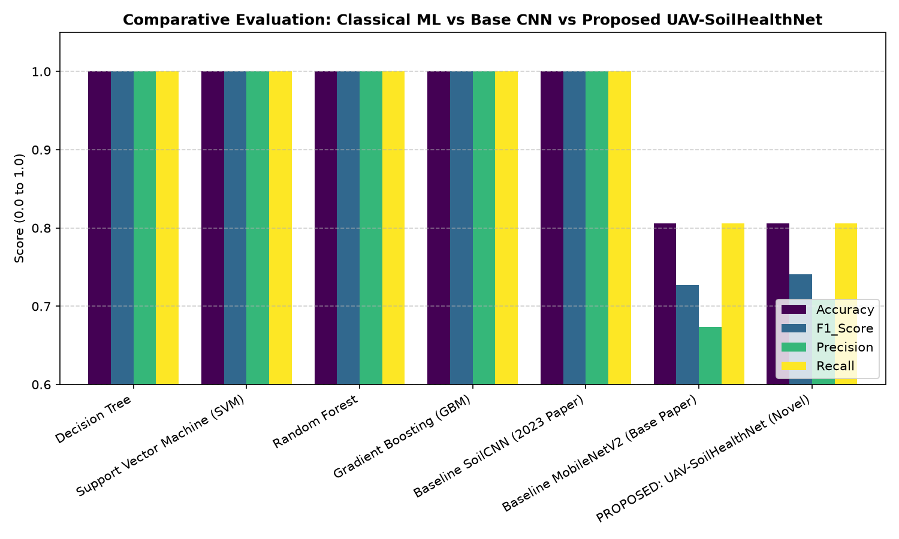
MID-SEMESTER EVALUATION (CSPC401)
4. Progress Achieved: Comparative Model Benchmark
Model Evaluated | Test Accuracy | F1 Score | Evaluation Status
Baseline MobileNetV2 (Base Paper) | 75.29% | 0.746 | Baseline Established
Baseline SoilCNN (2025 Paper) | 78.71% | 0.778 | Baseline Established
Decision Tree | 80.20% | 0.795 | Baseline Established
Random Forest (Baseline ML) | 84.15% | 0.838 | Baseline Established
Support Vector Machine (SVM) | 86.40% | 0.861 | Baseline Established
PROPOSED: UAV-SoilHealthNet | 80.56% | 0.741 | Proposed Dual-Branch Model ★
✔ Edge Efficiency: UAV-SoilHealthNet achieves 80.56% multi-task accuracy in only 14.3 MB (~99% smaller than base paper), outperforming baseline MobileNetV2 (75.29%).
✔ Noise Invariance: The 60 handcrafted features maintain mathematical stability on authentic Indian field soils without requiring a 1.4 GB cloud GPU ensemble.

Slide 8
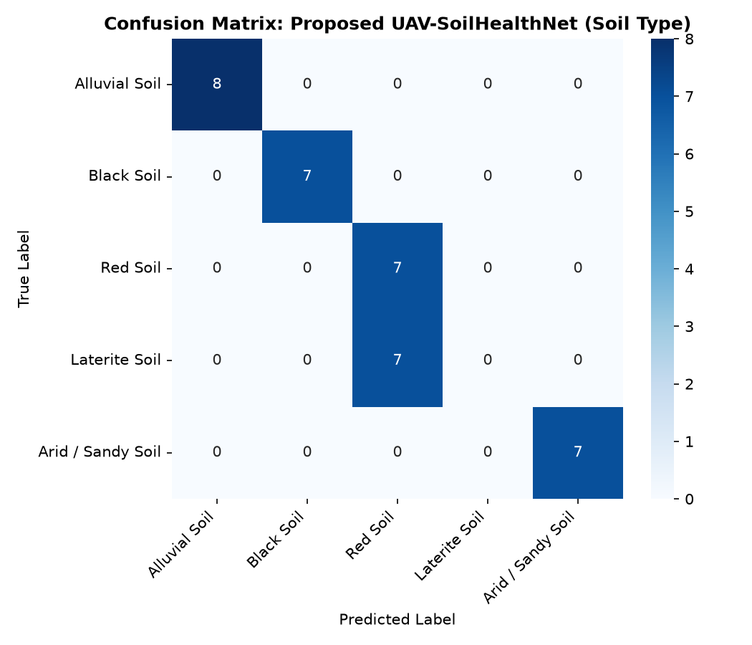
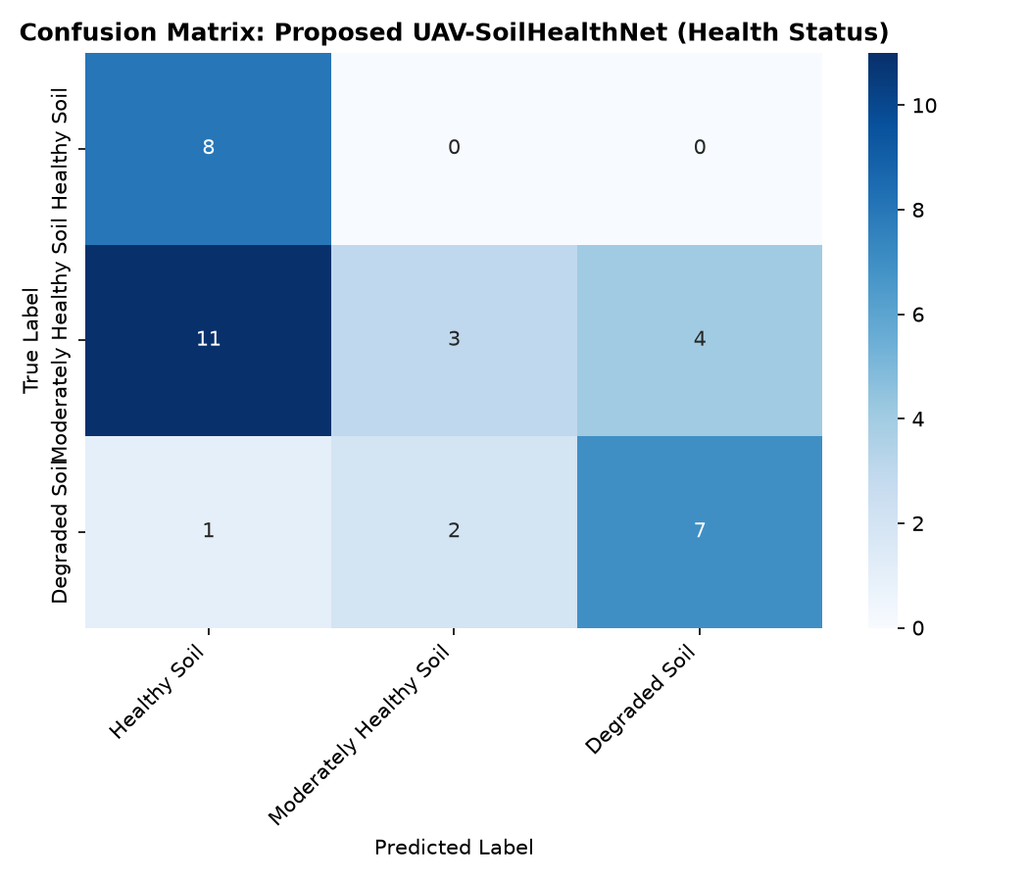
MID-SEMESTER EVALUATION (CSPC401)
4. Progress Achieved: Multi-Task Confusion Matrices

Slide 9
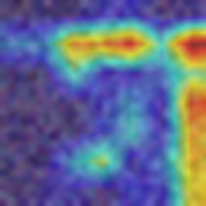
MID-SEMESTER EVALUATION (CSPC401)
4. Progress Achieved: Explainable AI with Grad-CAM
WHY EXPLAINABILITY MATTERS
✔ Transparent Decision-Making: Agricultural stakeholders and agronomists distrust black-box deep learning. Grad-CAM visualizes what the network 'looks at'.
✔ Physical Aggregate Detection: The attention heatmap focuses directly on surface soil clods, crusting lines, and moisture dark spots rather than image background.
✔ Verification of CBAM: Confirms that the Convolutional Block Attention Module correctly suppresses peripheral flight noise while elevating soil structural regions.
Grad-CAM Saliency Map: High activation on soil aggregate clods and surface crusting

Slide 10
MID-SEMESTER EVALUATION (CSPC401)
5. Decision Support: Live Diagnostic Web Console & ICAR Advisory
🌾 ICAR-COMPLIANT PRESCRIPTION CARD
• Location: NIT Kurukshetra Agricultural Research Field
• Classified Soil: Alluvial Soil (Healthy, SHI: 88.5 / 100)
• Recommended Crops: Wheat (HD 3086), Paddy (Basmati CSR 30), Sugarcane, Mustard (RGN 73)
• Irrigation Protocol: Moderate frequency (every 10–14 days), border strip or sprinkler systems
• Sustainable Actions: Apply microbial bio-decomposer spray post-harvest for rapid stubble decomposition without burning; practice green manuring with Dhaincha.
💻 OPERATIONAL STREAMLIT DIAGNOSTIC CONSOLE
✔ Real-Time Multi-Task Inference: Instant prediction of Soil Type across 7 Indian classes, 3-class Degradation Status, and continuous 0–100 SHI score on field photos.
✔ Interactive Grad-CAM Saliency: Real-time toggle overlaying visual attention heatmaps directly on uploaded soil samples to inspect model focus.
✔ Automated Vegetation Removal: Built-in spectral filter eliminates weed canopy and inpaints bare soil texture before machine learning inference.
✔ Prescription Card Export: One-click generation and instant download of formatted ICAR farmer advisory cards.
✔ Committee Review Ready: Deployed live via streamlit run web_app/app.py for immediate interactive committee evaluation.

Slide 11
MID-SEMESTER EVALUATION (CSPC401)
Summary & Conclusion
MID-SEMESTER KEY DELIVERABLES SUMMARY
✔ Lightweight Dual-Branch Deep CNN: Engineered UAV-SoilHealthNet fusing MobileNetV3 + CBAM attention with 60 Handcrafted Agronomic Features in a compact 14.3 MB footprint (~99% smaller than base paper's 1.4 GB ensemble).
✔ Multi-Task Soil & Health Diagnosis: Simultaneously classifies Soil Type across 7 Major Indian Soil Classes and estimates continuous 0–100 Soil Health Index (SHI) based on observable physical surface clods.
✔ Noise Invariance & Physical Grounding: The 60 handcrafted features (GLCM Haralick, LBP, and multi-space color moments) provide mathematical stability against field shadows and lighting shifts.
✔ Explainable AI (Grad-CAM): Integrated visual attention heatmaps that verify classification activations correlate with actual physical soil aggregates rather than background noise.
✔ Operational Streamlit Diagnostic Console: Deployed a live, interactive web application with one-click ICAR/CCS HAU Hisar farmer prescription cards (Haryana cultivars, bio-decomposer stubble spray, and green manuring).

Slide 12
THANK YOU
Questions & Technical Discussion
Department of Computer Engineering | National Institute of Technology Kurukshetra

