Slide 1





SMART INDIA HACKATHON 2026
TITLE PAGE
Problem Statement ID – SIH26056
Problem Statement Title – Development of a Real-time Airfare Price Index for India through Automated Web Scraping of Airline and Online Travel Aggregator Portals for Augmentation of the Consumer Price Index (CPI)
Theme – Travel & Tourism
PS Category – Software
Team ID – __________
Team Name (Registered on portal) – AeroDex
Ministry of Statistics and Programme Implementation (MoSPI) · Data Informatics & Innovation Division
AeroDex
60 routes · 420 strata
183 automated tests passing
A reproducible, daily Domestic Airfare Price Index (DAPI) for India, built to national-statistics standards.
Bit-identical re-runs (SHA-256)
Refuses to publish synthetic data
Notes:
Open with the one-line claim: AeroDex is a daily airfare index that a third party can recompute from its published inputs. Then name the PS (SIH26056, MoSPI) and move on — the next slide is where the idea starts.

Slide 2







AeroDex
AeroDex — A Daily Airfare Price Index for India
Proposed Solution
AeroDex prices a fixed panel of 60 domestic routes at 7 booking horizons, three times a day, and publishes a daily, DGCA-weighted airfare index that anyone can recompute from its published inputs — giving the CPI a sub-monthly, route-level signal it does not have today.
THE MEASUREMENT GAP
HOW IT WORKS
CPI today
AeroDex
1 Observe
2 Clean
3 Index
4 Publish
Cadence
Monthly
Daily · 3 IST slots
Look-ahead
One spec
7 horizons, 1–60 days
60 routes × 7 horizons
3 fixed IST slots a day
All-in fare, as a traveller sees it
Normalise, dedup, tag attributes
Index the all-inclusive fare, as paid
Bounds checks, quarantine
Matched-model Jevons per stratum
Lowe aggregation, DGCA weights
Missing data imputed, capped at 5%
Dashboard and open API
Coverage, imputation, hashes on every point
aerodex verify re-derives it
Coverage
Sampled
60 routes · 23 airports
Disclosure
Index level
+ coverage, imputation, hash
INNOVATION AND UNIQUENESS
Reproducible by construction
Refuses to overstate
Horizon-controlled
Statistical-office method
A pure function: the same archived panel and config always give the same SHA-256. CI re-checks it every night.
Blocks synthetic-only runs and any run over 5% imputed weight. Coverage failures are published, never hidden.
Fixed advance-purchase windows separate a real fare rise from late booking, as the IMF TA to MoSPI advised.
Jevons + Lowe, the family MoSPI’s CPI 2024 uses, on DGCA 2025 traffic weights for all 60 routes.
Proof · aerodex verify → REPRODUCIBLE
Proof · PUBLICATION REFUSED, exit code 3
Proof · 7 horizons in config/panel.yaml
Proof · 60 of 60 DGCA route weights
@SIH Idea submission- Template
2
Notes:
Problem to solution in one sentence, then the four steps. The innovation row is the pitch: reproducibility, honesty about coverage, horizon control, and statistical-office method. Everything in the bottom row is verifiable in the repo: `aerodex verify`, the publisher refusal, and config/methodology.yaml.

Slide 3
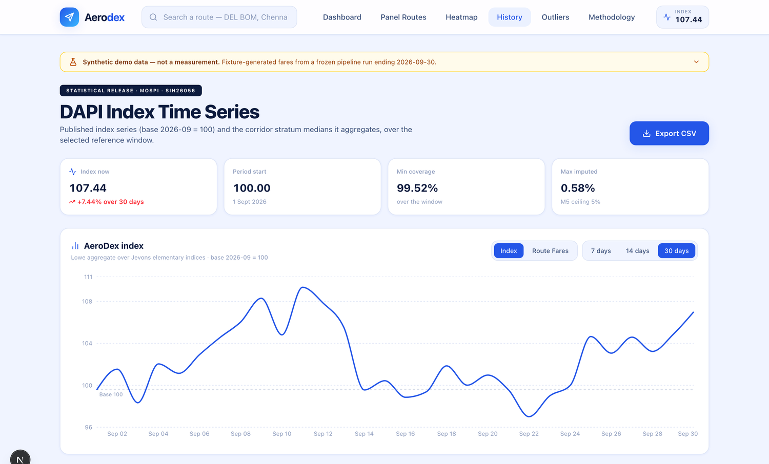
AeroDex
TECHNICAL APPROACH
End-to-end pipeline · status as of 24 Sep 2026
DATA SOURCES · 3-TIER LADDER
1
2
3
4
5
6
7
T1
Institutional feed
PLANNED
Schedule
Acquire
Normalise
Validate
Store
Index
Publish
MoSPI / DGCA route
T2
Licensed fare API
NEXT
systemd timers, 3 IST slots ±15 min
ladder + robots.txt and rate-limit guard
dedup, attribute tags, all-in fare
plausibility bounds, quarantine
append-only quotes, DB triggers
pure function, Jevons then Lowe
refusal gate, JSON artifacts
HasData / SerpApi · Duffel
T3
Fixture, demo only
BUILT
Never publishable
BUILT
FIXTURE
BUILT
BUILT
BUILT
BUILT
BUILT
PostgreSQL + TimescaleDB ▸ static JSON artifacts ▸ FastAPI (11 endpoints) ▸ Next.js dashboard (9 screens)
TECHNOLOGIES TO BE USED
INDEX METHODOLOGY
WORKING PROTOTYPE
Language, data
Python 3.12 · pandas · NumPy · Pydantic
1
Stratify route × horizon → 420 strata
BUILT
FIXTURE DATA · LABELLED ON EVERY PAGE
Storage
PostgreSQL 16 · TimescaleDB · append-only triggers
2
Matched-model Jevons per stratum
BUILT
3
Lowe aggregation, DGCA 2025 weights
BUILT
Collection
httpx · own RFC 9309 robots parser · systemd timers
4
Group-mean imputation, capped at 5%
BUILT
Serving
FastAPI · Next.js 16 · React 19 · TypeScript · Recharts
5
Chained daily series, 2026-09 = 100
BUILT
Assurance
pytest (183) · ruff · mypy · GitHub Actions, nightly hash check
6
Hedonic quality adjustment (log-fare)
NEXT
7
Seasonal adjustment (STL / X-13)
PLANNED
$ aerodex verify
weighted c3523b87…ba27 OK
REPRODUCIBLE
Hosting
Vercel (API live) · Cloudflare R2 + Oracle A1 as the ₹0 target
Every point ships: value · coverage · imputed share · n quotes · config hash · panel hash
@SIH Idea submission- Template
3
Notes:
Walk the pipeline left to right. Be upfront about the one amber box: Acquire runs on a fixture today because no lawful free source exists; the publisher therefore refuses to release fixture-derived numbers, which is what the terminal snippet and the dashboard banner show. Hedonic and seasonal adjustment are configured but not yet implemented — say so before a judge asks.

Slide 4





AeroDex
FEASIBILITY AND VIABILITY
PS SIH26056 deliverables — where we stand
Challenges and risks → how we overcome them
Cleaned fare database with metadata
No lawful free fare feed
BUILT
Postgres / Timescale schema, append-only quote archive, normalise, validate, quarantine.
OTA terms bar automation; Amadeus self-service closed 17 Jul 2026. Licensed fare-search API for the MVP; MoSPI / DGCA route pursued in parallel.
Index-construction module
BUILT
Matched-model Jevons to Lowe on DGCA 2025 weights; imputation gate; 11 golden tests.
A source blocks or changes
Interactive daily-index dashboard
Drop it and publish the coverage ratio. Imputation is capped at 5% or the run is refused.
BUILT
9 screens over an 11-endpoint API; every page labels fixture data.
Documentation and testing
API quota and cost
BUILT
183 tests passing; API, data-dictionary, operations and methodology docs.
1,260 stratum-slots a day (~1,155 after overlap suppression), sized to a ~$99/month plan.
Multi-source collection engine (Python)
Fare attributes missing
PARTIAL
Adapter framework, robots and rate-limit guard, 3-tier ladder done; live adapter is next.
Hedonic set cut to the fields the source returns; matched-model comparison stays in force.
Fare split: base, taxes, fees
PARTIAL
Dashboard shows a labelled estimate from statutory rates; the index uses the all-inclusive fare.
Fixture read as a measurement
30-day back-test against DGCA data
data_source tag on every API response, banner on every page, refusal in the publisher.
PARTIAL
Harness runs on the fixture panel; a valid back-test needs 30 days of real quotes.
PS lists 5 airlines and 6 OTAs. The fixture models all 5 airlines; OTA pages are not scraped, because their terms bar automated access.
VIABILITY
Cost — A 30-day demo run ≈ $25; the full 60-route panel ≈ $99/month (provider pages, 25 Aug 2026).
Handover — A ₹0-recurring configuration on free tiers is kept for a ministry handover.
Roadmap — Now: pipeline + dashboard. Next: licensed adapter, 30 real days. Later: hedonic, seasonal, institutional feed.
@SIH Idea submission- Template
4
Notes:
This slide answers "what is real and what is not". Green is built and tested; amber is honestly partial. The strongest sentence is the last risk row: we built the guardrail that stops a fixture number being mistaken for a measurement. Costs are provider list prices read on 25 Aug 2026 (docs/research/S3_PRICING_AND_COST_MODEL.md).

Slide 5





AeroDex
IMPACT AND BENEFITS
Potential impact on the target audience
Benefits of the solution
MoSPI
Social
Economic
A daily, route-level series beneath the monthly CPI airfare item, with coverage and imputation disclosed for every point.
Trust through a disclosed method and open code
Better-informed travel decisions
A price people feel, measured in public
30-day demo ≈ $25; full panel ≈ $99/month
₹0-recurring handover configuration
Earlier read on transport prices for policy
DGCA
Tariff spot checks become a continuous, horizon-controlled series: which routes move, how early, and why.
Travellers and researchers
Technological
Environmental
Open dashboard, API and method: what a festival window costs, how far ahead to book, LCC against full-service.
Open API and a reproducible pipeline pattern
Pure-function index, golden tests, hash verify
Same engine extends to other high-frequency prices
Digital collection replaces field visits for this item
Sized for one small VM: 2 OCPU, 12 GB
A modest benefit, stated plainly
The wider statistical system
Append-only archive, hashed config, pure function and golden tests are reusable for any high-frequency price.
INDEPENDENTLY CORROBORATED BY MoSPI’s OWN RECORD
CPI 2024 FAQ, Q20–21 — Jevons for elementary indices, Young / modified Laspeyres above — the same family AeroDex uses.
IMF TA, Recommendation 11 — Wider advance-purchase timings (14 and 21 days) and the airline as a price-determining characteristic.
Expert Group, Rec. 11(a) — DGCA already holds min / max tariff data for all routes — a documented institutional route to data.
SDG 17.18 · timely, reliable data
SDG 9 · innovation, infrastructure
Digital India
Atmanirbhar Bharat · open source
@SIH Idea submission- Template
5
Notes:
Lead with MoSPI and DGCA, then the wider reuse argument. The corroboration row is deliberate: the two most consequential methodological choices (Jevons at the elementary level, Lowe-family aggregation above it) match what MoSPI’s own CPI 2024 FAQ says, and the multi-horizon panel operationalises the IMF technical-assistance recommendation. All three are primary-source claims in docs/research/s3/CLAIM_EVIDENCE_REGISTER.md.

Slide 6
AeroDex
RESEARCH AND REFERENCES
How others build an airfare index — and where AeroDex sits
References
Who
How fares are obtained
Cadence
Lesson for AeroDex
[1] MoSPI, FAQs on CPI 2024 series (Q20–21, Q27) — mospi.gov.in
[2] MoSPI, Expert Group Report on CPI updation (IMF TA Rec. 11; Rec. 11(a)) — mospi.gov.in
[3] ILO / IMF / OECD / UNECE / World Bank, Consumer Price Index Manual: Concepts and Methods
[4] Eurostat, Practical guidelines on web scraping for the HICP (2020)
[5] US BLS, CPI airline fares — bls.gov; DOT O&D Survey, 14 CFR Part 241
[6] UK ONS and ABS, web scraping in consumer price statistics
[7] DGCA city-pair traffic — Vonter/india-aviation-traffic (ODbL)
[8] Collection of Statistics Act, 2008 — mospi.gov.in
[9] RFC 9309, Robots Exclusion Protocol — rfc-editor.org
[10] MoSPI, CPI: changes in the revised series (base 2012 = 100) — cpi.mospi.gov.in
[11] Code, tests and decision log — github.com/Naveen-Boddepalli/aerodex
China
CAAC · TravelSky
A state reservation system sees every domestic fare; the regulator sets fare bands.
Monthly ticket-price index
Owns the rails: India needs a data mandate.
United States
BLS · DOT
A mandatory ticket sample (14 CFR 241) selects routes; BLS prices them from a fare database.
Monthly CPI
Sample routes from real tickets; fixed advance-purchase specs.
UK · Australia
Netherlands
The statistics office runs its own web-scraping unit on a fixed route panel.
Monthly, priced N days ahead
Fixed panel and fixed windows: AeroDex’s design.
India today
CPI 2024 collects airfare from online platforms; airlines refused DGCA’s passenger-level data request (Mar 2026).
Monthly
The gap PS SIH26056 targets.
Typical scraper prototype
Direct OTA scraping against site terms; breaks when the page layout changes.
Ad hoc
Not reproducible or defensible as an official statistic.
AeroDex
Licensed fare API now, institutional feed as the target; fixed 60 × 7 panel.
Daily, 3 IST slots
A reproducible bridge to a mandate-based feed.
OUR RESEARCH RECORD (docs/research/ in the repository)
6
research passes
40+
sources reviewed
20 × 29
providers × axes
3
verdicts revised, all kept
@SIH Idea submission- Template
6
Notes:
This is the "why has nobody done this" slide. The pattern abroad is that every country that measures airfares well owns a data tap (state reservation system, mandatory ticket filing, or an in-house scraping unit). India has none of the three yet, which is why AeroDex is framed as a reproducible bridge. Full case study: docs/research/INTERNATIONAL_AIRFARE_INDEX_PRACTICE.md.

