Slide 1

PROJECT - P924
BANK LOAN & TRANSACTION ANALYTICS PROJECT
Presented By
NAVEEN N

Slide 2


Problem Statement
Banks face challenges in tracking loan performance and understanding customer spending patterns.
This project aims to analyze loan data and credit/debit transactions to uncover key insights and improve financial decision-making.
DATASET USED
Bank Loan Details
Bank Debit & Credit Details

Slide 3

KPIs and Insights
KPIs from Loan Data
KPIs from Debit & Credit Data
Total Loans 65.5K
Total Funded 751M
Total Collection 808M
Default Loan Rate 1.56%
Top Age Group 18–25 years
Average Loan Amount per Customer: ₹11,465
Total Amount 255M
Top Bank by Transactions
Axis Bank
Top Expense
Utility Bill Payment (₹26M)
Highest Drop in MOM %
96% drop in December

Slide 4
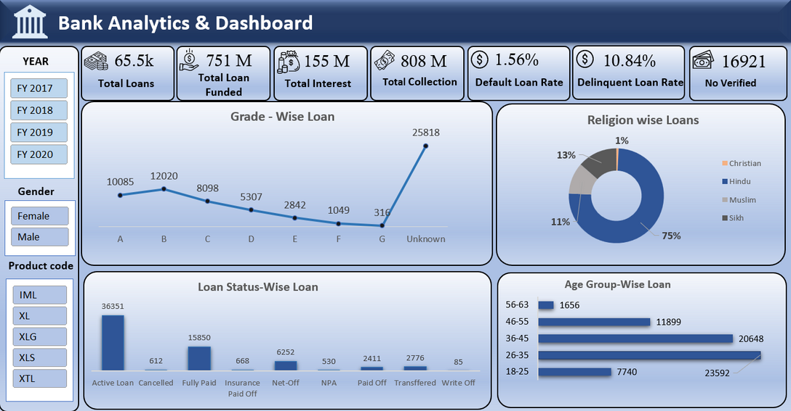
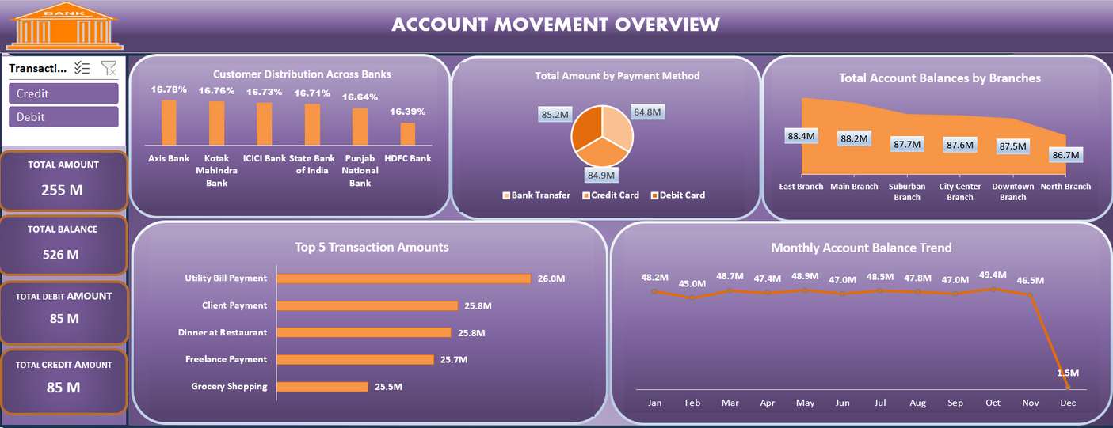
Excel Dashboard
Bank Loan Details
Bank Debit & Credit Details

Slide 5
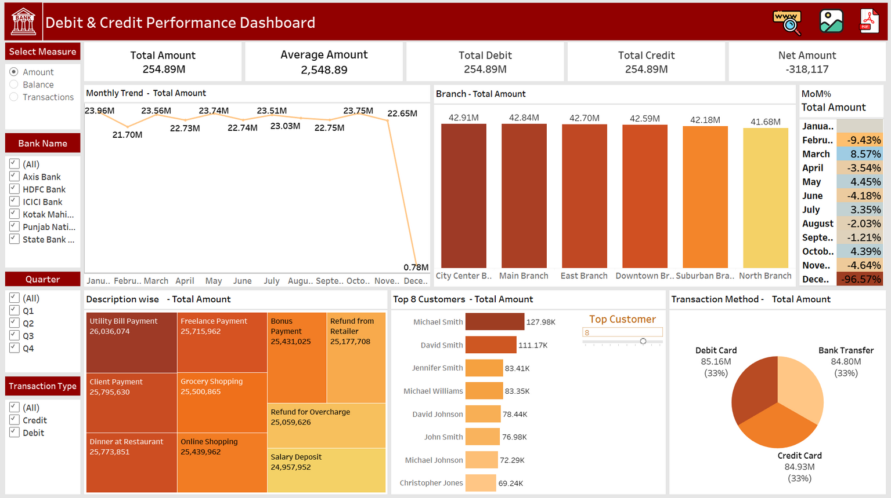
Tableau Dashboard
Bank Debit & Credit Details

Slide 6
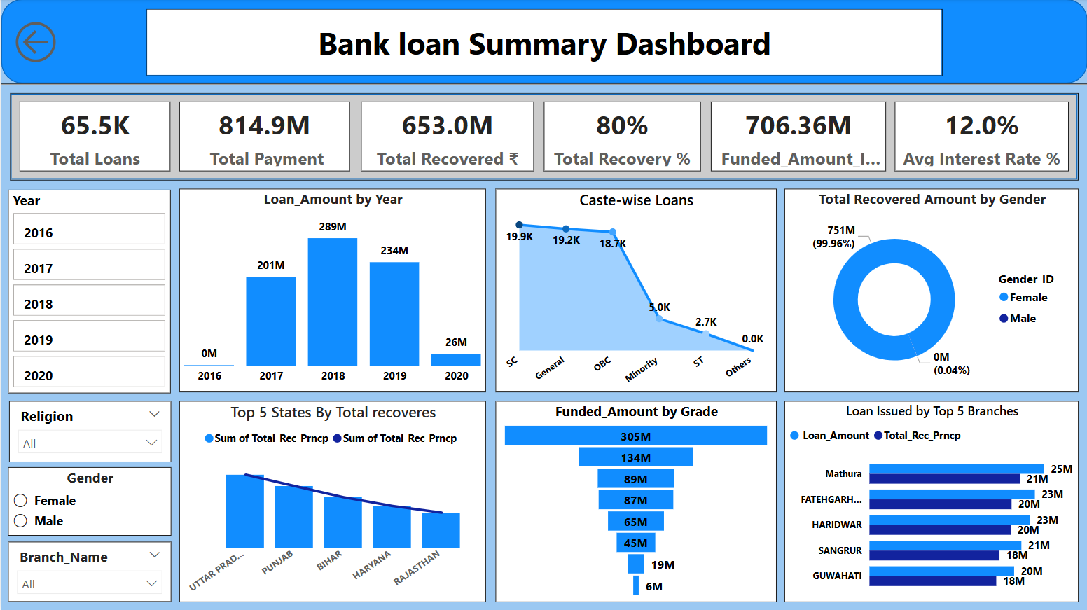
Power BI Dashboard
Bank Loan Details

Slide 7
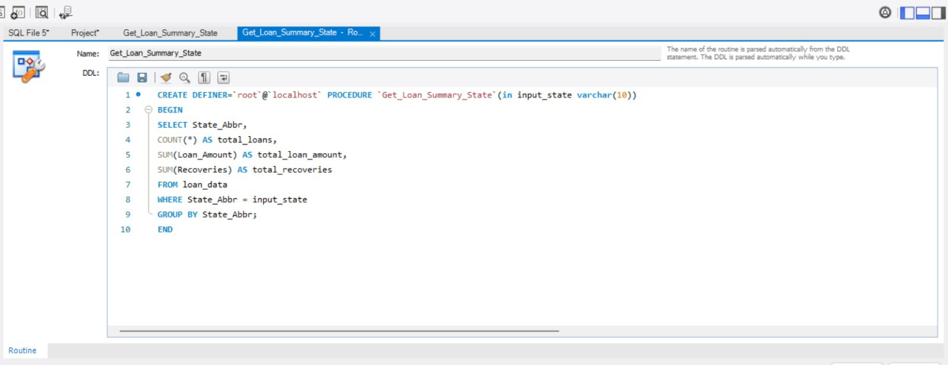
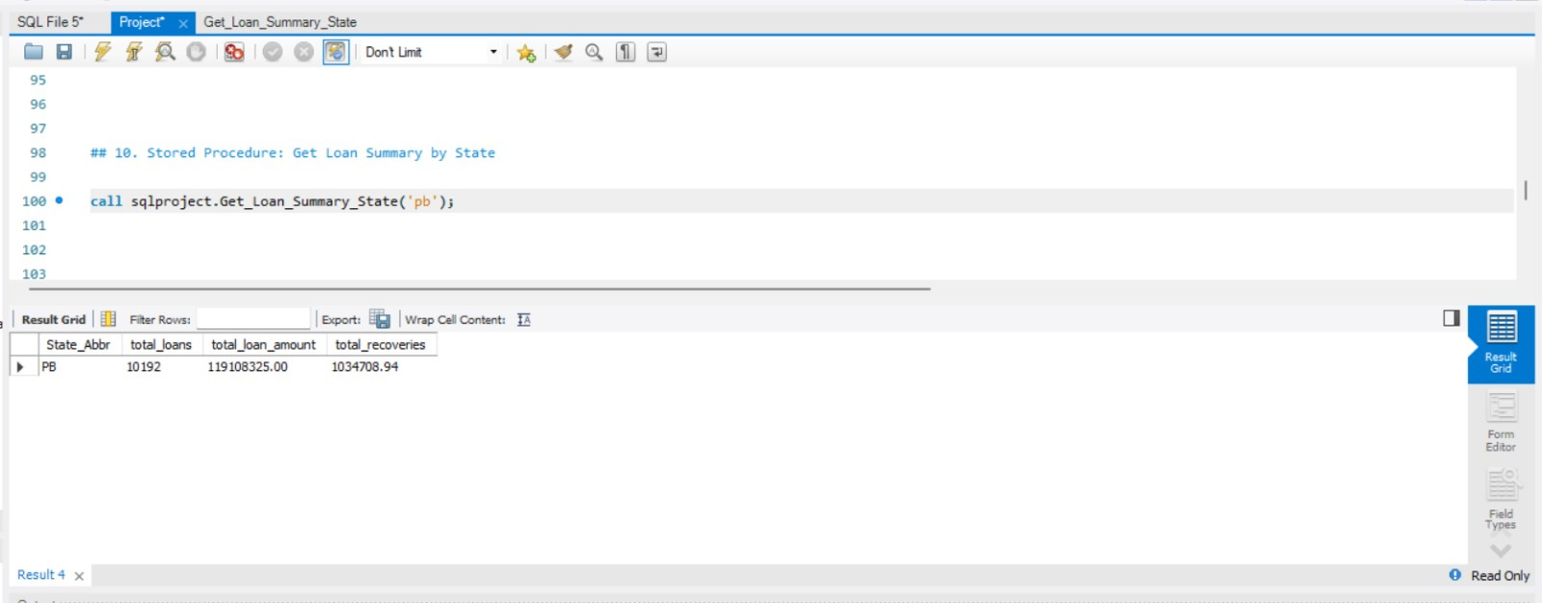
SQL Queries and Output
Bank Loan Details
Queries
Output

Slide 8
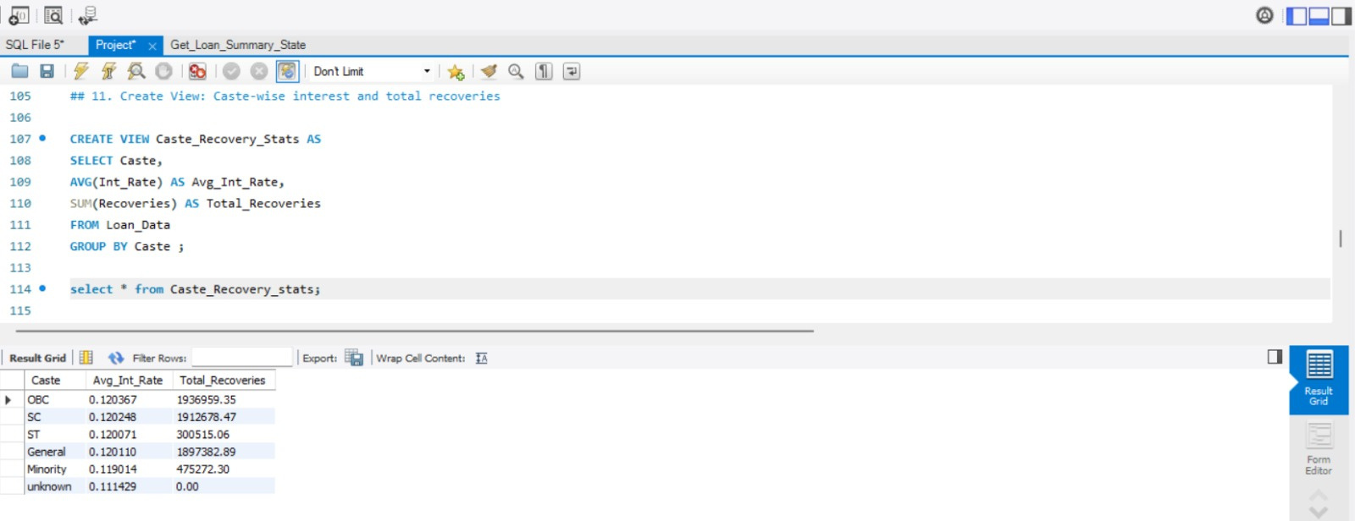
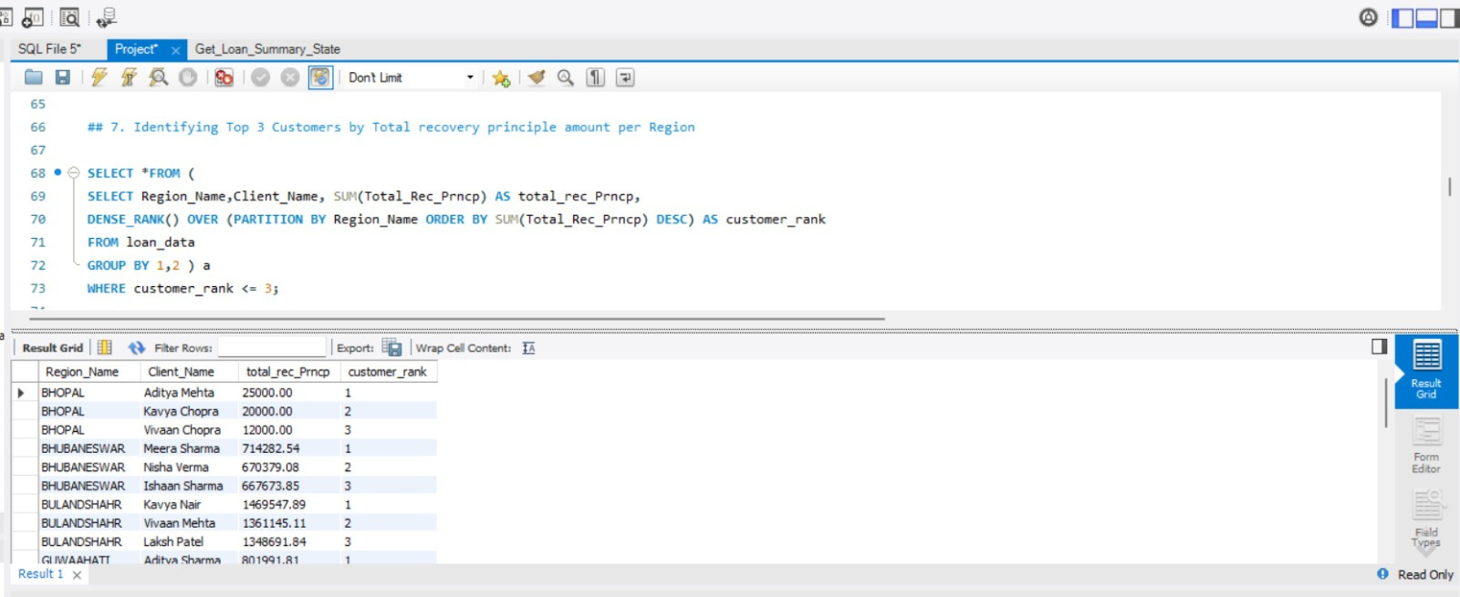
SQL Queries and Output
Bank Loan Details
Queries
Output

Slide 9
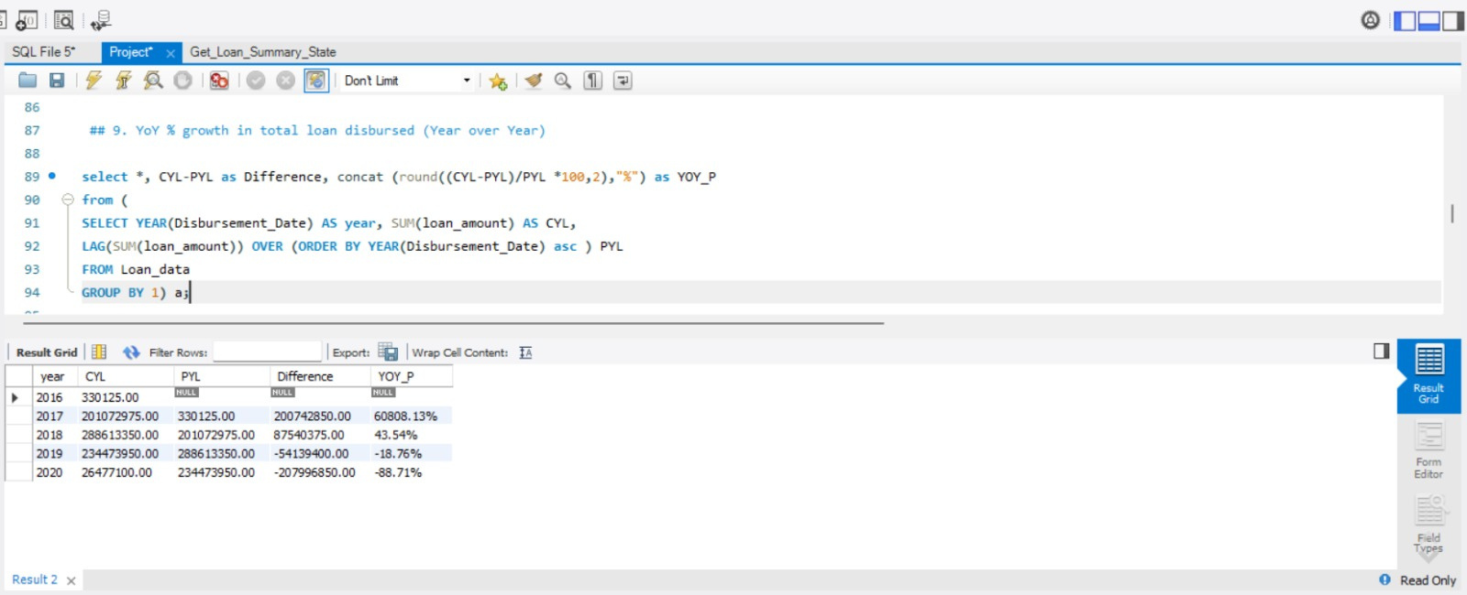
SQL Queries and Output
Bank Loan Details
Queries
Output

Slide 10
Project Summary
Conclusion
Analyzed 65K+ loan records and ₹255M+ worth of transactions
Built interactive dashboards using Excel, Power BI, and Tableau
Performed SQL-based advanced data aggregation & analysis
Identified trends in loan defaults, customer transactions, and regional loan behavior
Key Learnings
Learned to clean, analyze, and visualize multi-source datasets
Gained hands-on experience with BI tools and SQL queries
Understood how to derive actionable insights like default risk, spending habits, and branch-level performance
Improved team collaboration, presentation, and storytelling skills

Slide 11
Thank you
very much!

