Slide 1




GraphQL Will Do To REST What JSON Did To XML
Frontcon Riga 05/04/2019

Slide 2

Who is this for?
@gethackteam

Slide 3

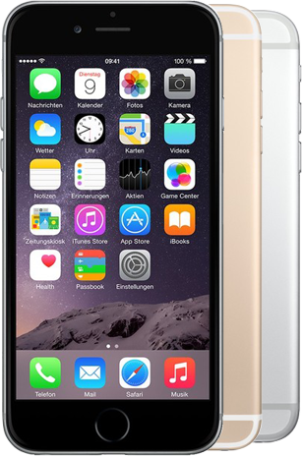

Who is this for?
BACKEND
@gethackteam

Slide 4
What is wrong with REST?
@gethackteam

Slide 5
REST has multtiple endpointts that return fixed datta sttructtures
@gethackteam

Slide 6
Let’s build an UI that fetches data from a REST API
@gethackteam

Slide 7
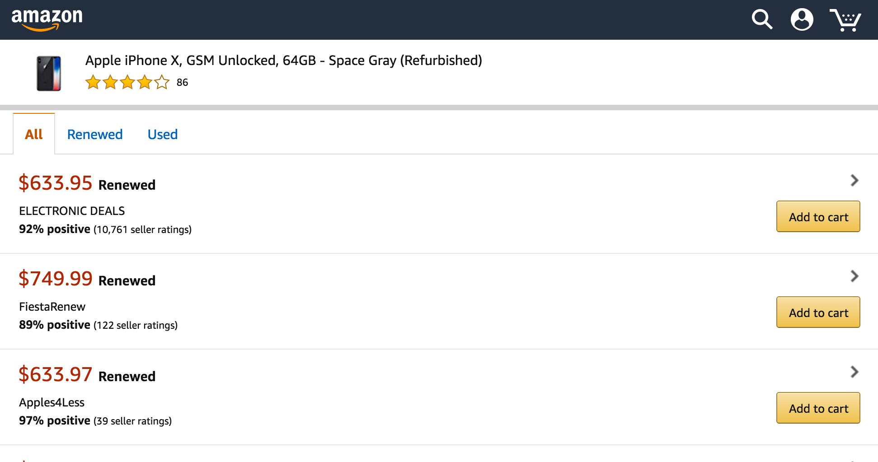
What is wrong with REST?
Multtiple Endpointts
@gethackteam

Slide 8
What is wrong with REST?
Multtiple Endpointts
@gethackteam

Slide 9
What is wrong with REST?
Multtiple Endpointts
@gethackteam

Slide 10
What is wrong with REST?
Multtiple Endpointts
@gethackteam

Slide 11
What is wrong with REST?
Multtiple Endpointts
@gethackteam

Slide 12
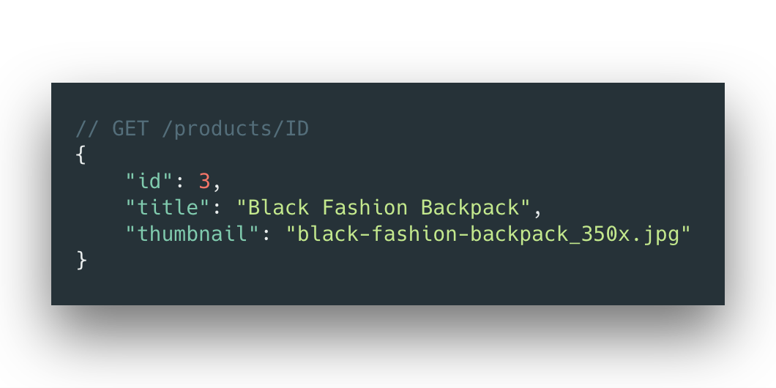
What is wrong with REST?
Multtiple Endpointts
1
@gethackteam

Slide 13
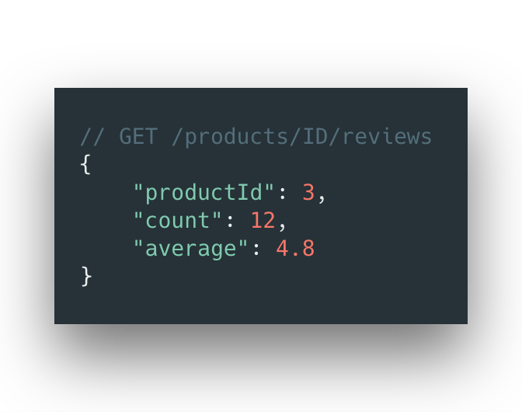
What is wrong with REST?
Multtiple Endpointts
1
2
@gethackteam

Slide 14
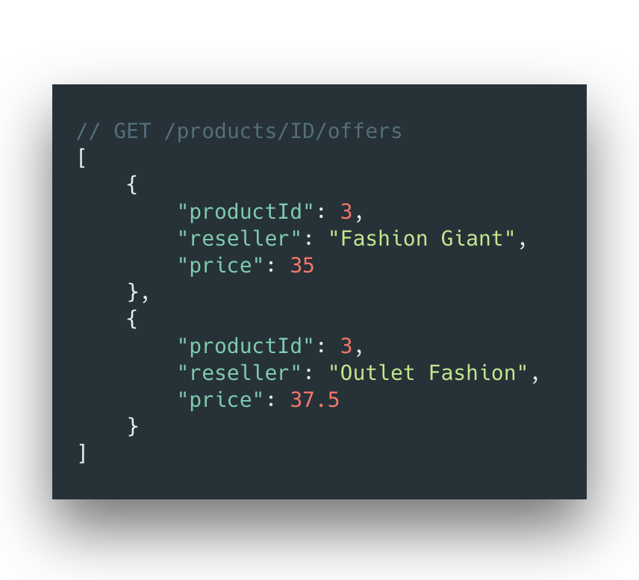
What is wrong with REST?
Multtiple Endpointts
1
2
3
@gethackteam

Slide 15
Why not create one endpointt
with all information?
@gethackteam

Slide 16
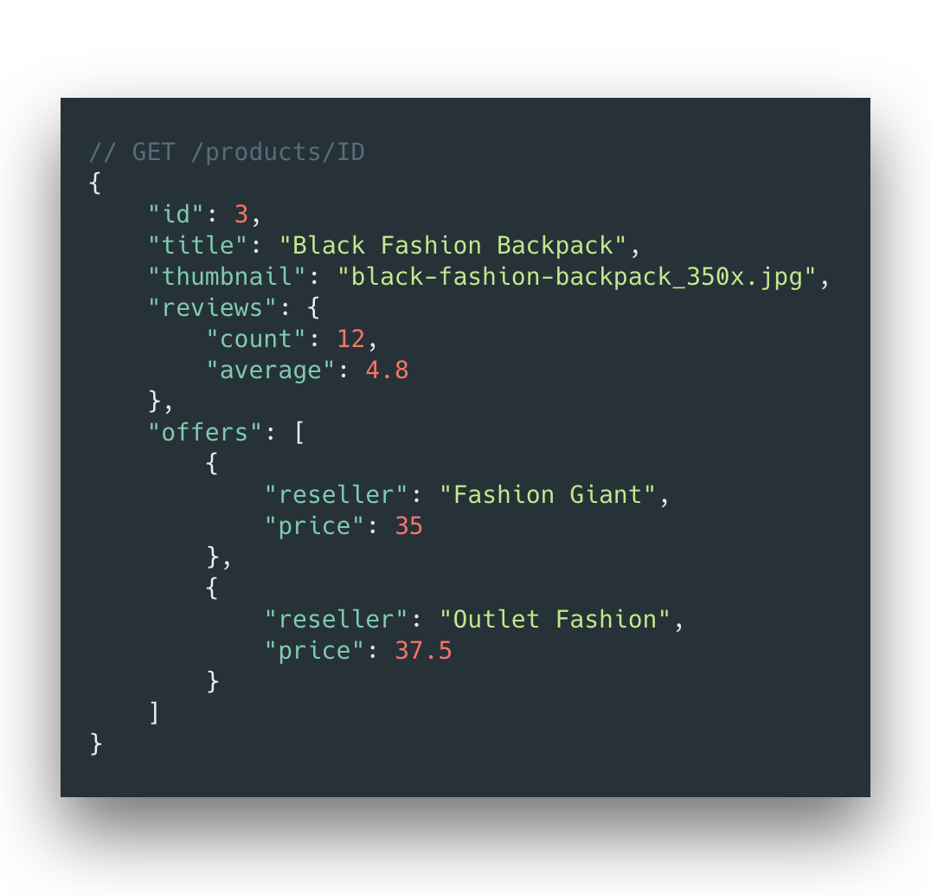
What is wrong with REST?
Multtiple Endpointts
@gethackteam

Slide 17
What is wrong with REST?
Multtiple Endpointts
@gethackteam

Slide 18
What is wrong with REST?
Multtiple Endpointts
@gethackteam

Slide 19
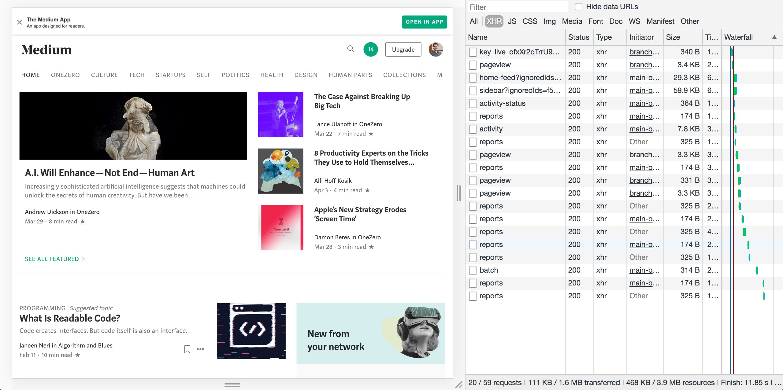
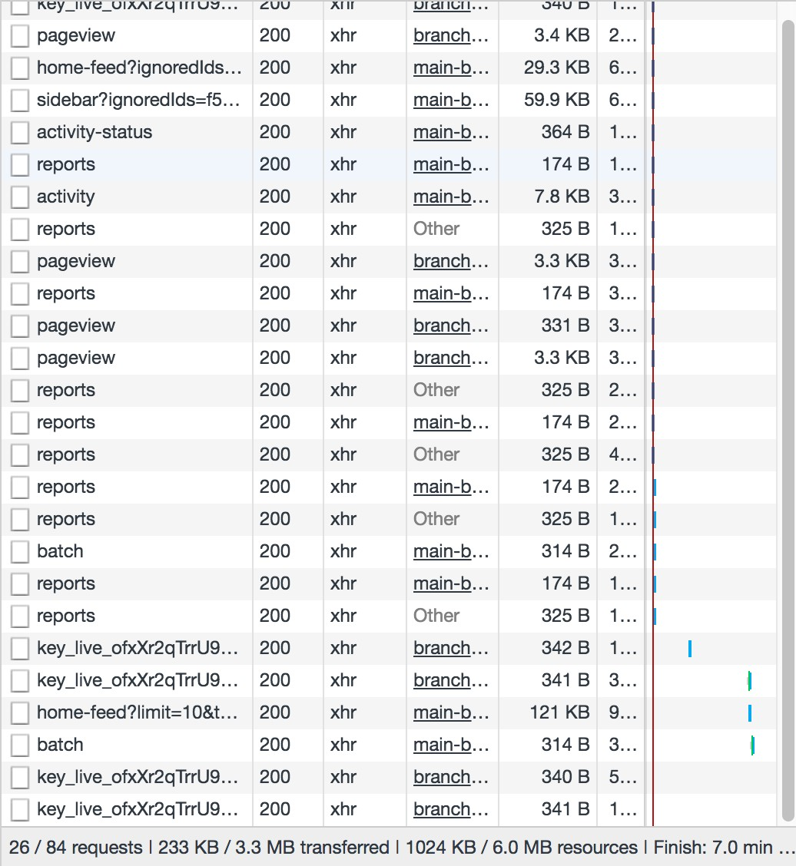


Slide 24
One problem: we’ve used a
nestted layoutt design

Slide 25
What is wrong with REST?
Under/Over-fettching

Slide 26
What is wrong with REST?
Under/Over-fettching

Slide 27
Why not specify parametters
you want to receive?

Slide 28
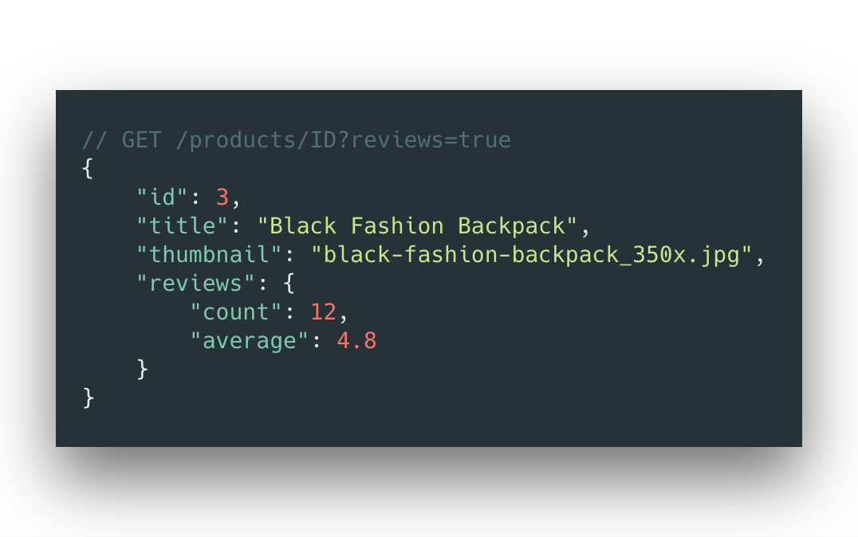
What is wrong with REST?
Under/Over-fettching

Slide 29
What is wrong with REST?
Under/Over-fettching

Slide 30
But what if we do want to show offers but only tthe lattestt one?

Slide 31
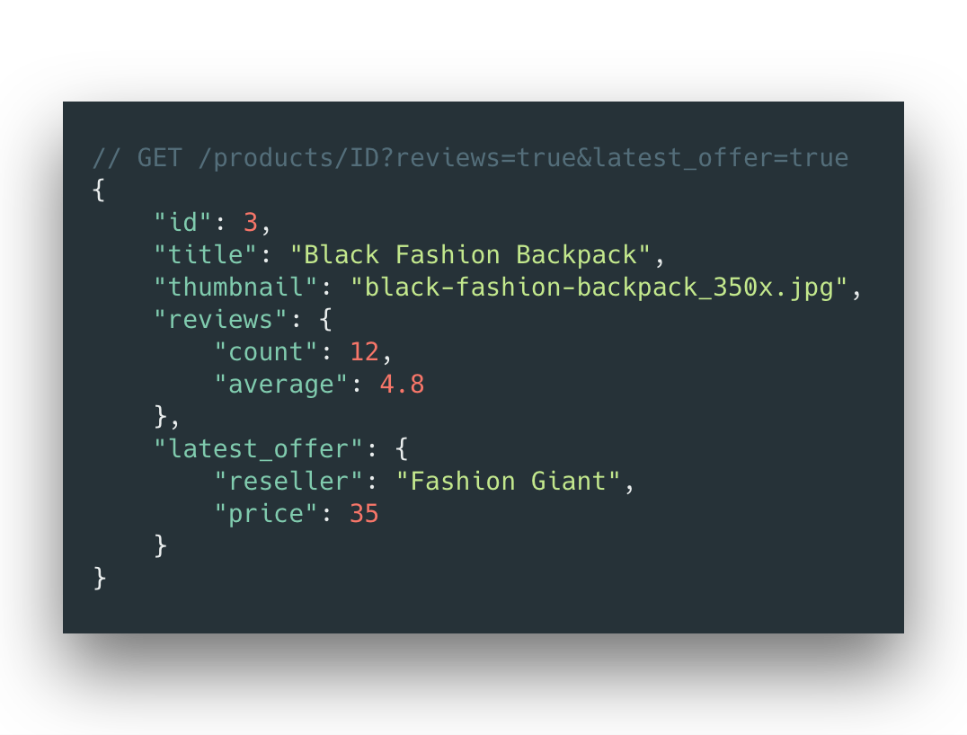
What is wrong with REST?
Under/Over-fettching

Slide 32
What is wrong with REST?
Under/Over-fettching

Slide 33
What is wrong with REST?
Under/Over-fettching

Slide 34
How can we display all the offers again?

Slide 35
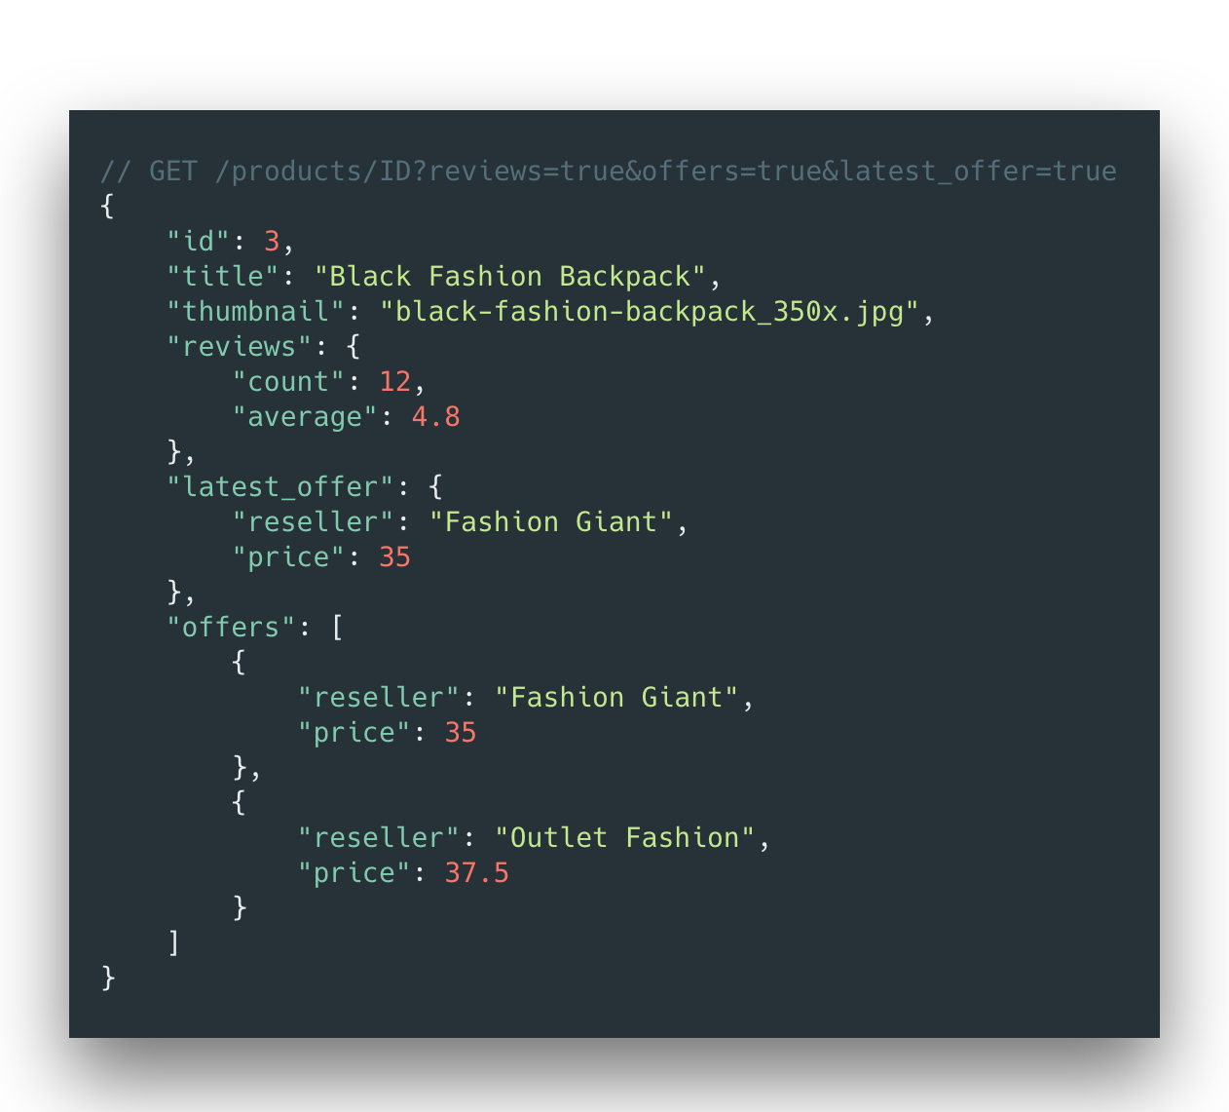
What is wrong with REST?
Under/Over-fettching

Slide 36
What is wrong with REST?
Under/Over-fettching
SHOW

Slide 37
What is wrong with REST?
Under/Over-fettching
SHOW

Slide 38
What is wrong with REST?
Under/Over-fettching
1
SHOW
2

Slide 39
But how does this affect the first version of the application?

Slide 40
What is wrong with REST?
Versioning
SHOW MORE
V1
V2

Slide 41
Versioning
What is wrong with REST?
Diﬀerent endpoints
SHOW MORE
V1
V2

Slide 42
Versioning
What is wrong with REST?
Diﬀerent endpoints
Diﬀerent parameters
SHOW MORE
V1
V2

Slide 43
Versioning
What is wrong with REST?
Diﬀerent endpoints
Diﬀerent parameters Diﬀerent datastructures
SHOW MORE
V1
V2

Slide 44
Wait a minute..
Did we documentt all this?

Slide 45
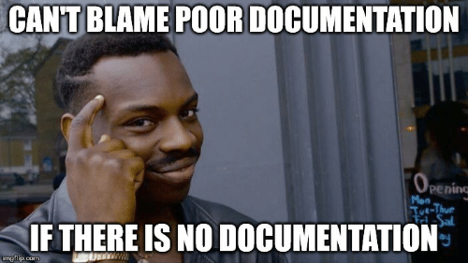

Slide 46
Don’t forget the HAL
guidelines btw

Slide 47
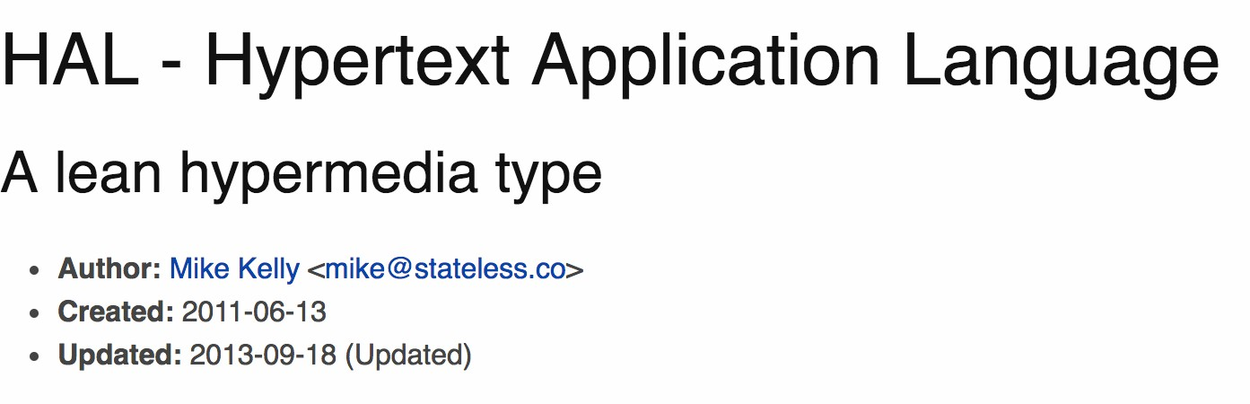
What is wrong with REST?
HAL
@gethackteam

Slide 48
What is wrong with REST?
HAL
@gethackteam

Slide 49
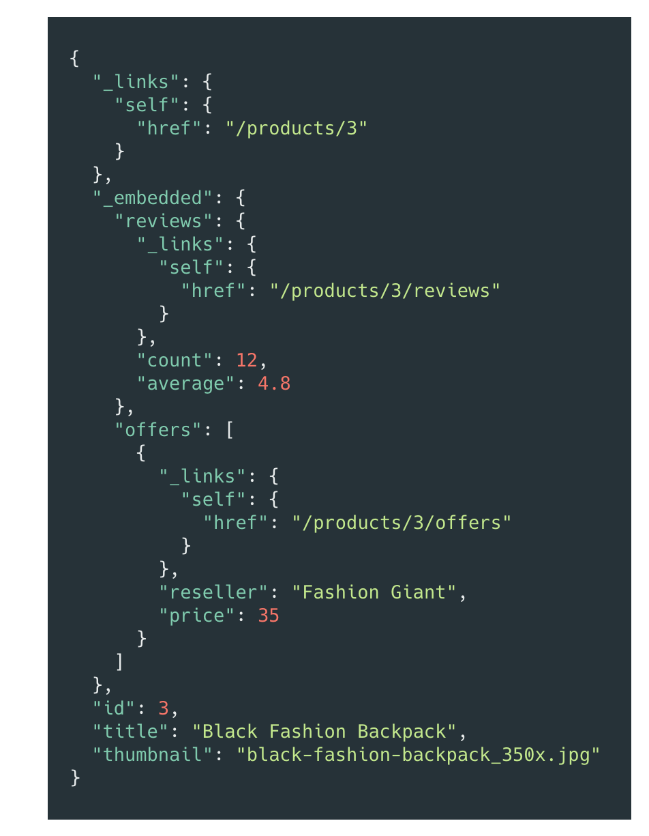
What is wrong with REST?
HAL
@gethackteam

Slide 50
What is wrong with REST?
HAL
@gethackteam

Slide 51
What is wrong with REST?
HAL
@gethackteam

Slide 52

How does GraphQL solve tthese problems?
@gethackteam

Slide 53
Multiple Endpoints
How does GraphQL solve tthese problems?
@gethackteam

Slide 54
Multiple Endpoints
How does GraphQL solve tthese problems?
Over-fetching
@gethackteam

Slide 55
Under-fetching (N+1)
Multiple Endpoints
How does GraphQL solve tthese problems?
Over-fetching
@gethackteam

Slide 56
Under-fetching (N+1)
Multiple Endpoints
How does GraphQL solve tthese problems?
Over-fetching
Versioning / Documentation
@gethackteam

Slide 57
GraphQL has a single endpointt that returns ftexible datta sttructtures
@gethackteam

Slide 58
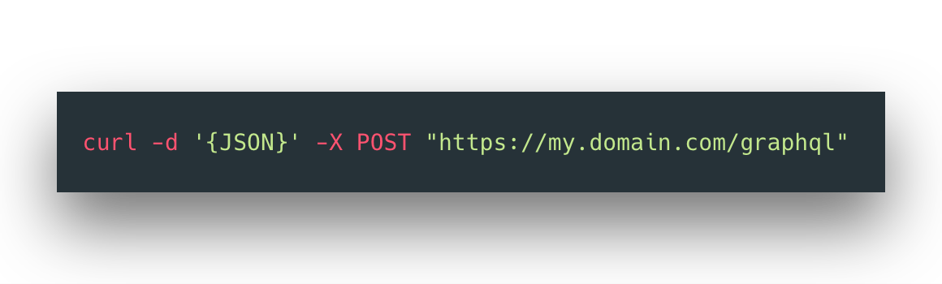
How does GraphQL Solve This
Multtiple Endpointts
@gethackteam

Slide 59
How does GraphQL Solve This
Multtiple Endpointts
@gethackteam

Slide 60
How does GraphQL Solve This
Multtiple Endpointts
Query
GET
@gethackteam

Slide 61
How does GraphQL Solve This
Multtiple Endpointts
Query
Mutation
GET
POST
PUT
PATCH
DELETE
@gethackteam

Slide 62
How does GraphQL Solve This
Multtiple Endpointts
Query
Mutation
GET
POST
PUT
PATCH
DELETE
@gethackteam

Slide 63
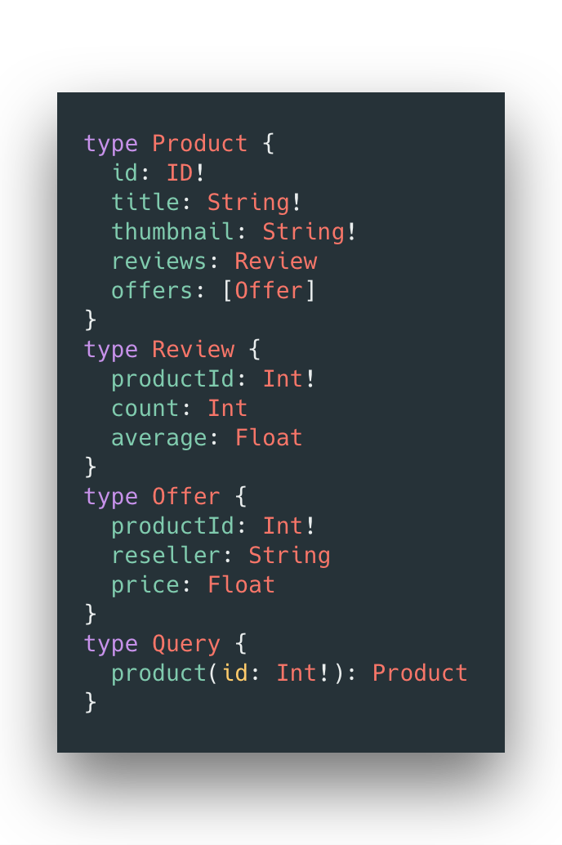
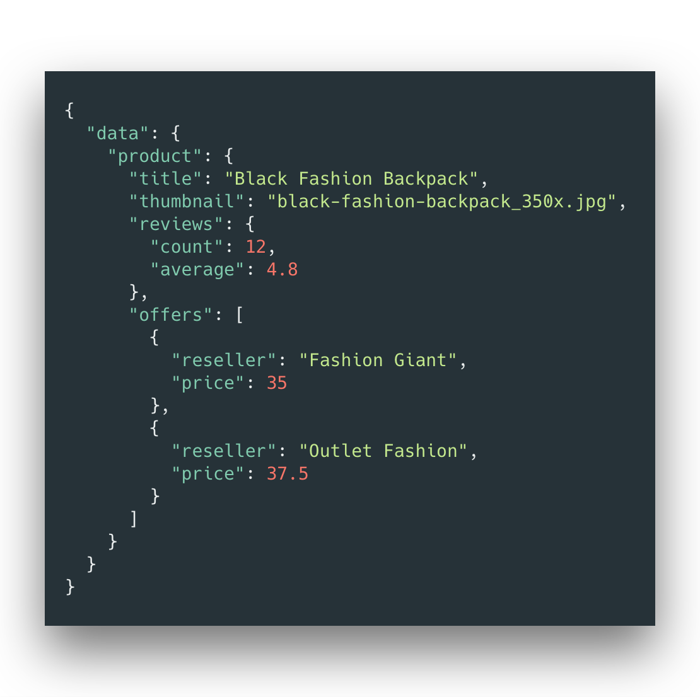
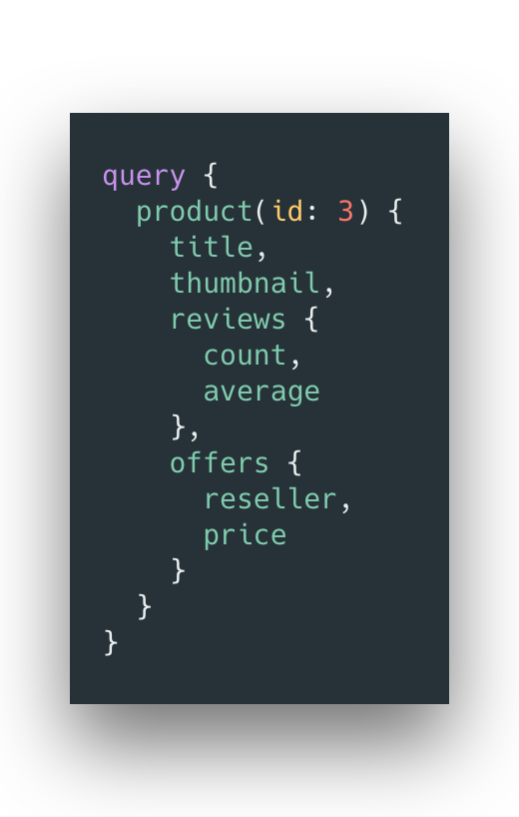
How does GraphQL Solve This
Single endpointt

Slide 64


How does GraphQL Solve This
Single endpointt

Slide 65
Single endpointt
How does GraphQL Solve This
Describe the data structure

Slide 66
Single endpointt
How does GraphQL Solve This
Describe the data structure
Set the possible queries

Slide 67

How does GraphQL Solve This
Single endpointt

Slide 68
Single endpointt
How does GraphQL Solve This
Specify which data to return

Slide 69
Single endpointt
How does GraphQL Solve This
Specify which data to return
Set dynamic parameters

Slide 70
How does GraphQL Solve This
Single endpointt

Slide 71
Single endpointt
How does GraphQL Solve This
Predictable return result

Slide 72
Sounds great! How can I implement this?

Slide 73
Implementation
BACKEND

Slide 74
Implementation
BACKEND

Slide 75
Frontend
@gethackteam

Slide 76
Frontend
@gethackteam

Slide 77
Frontend
Query
GET
@gethackteam

Slide 78
Frontend
Query
Mutation
GET
POST
PUT
PATCH
DELETE
@gethackteam

Slide 79
Whatt else has GraphQL tto offer?
@gethackteam

Slide 80
Modern Tooling
Whatt else has GraphQL tto offer?
@gethackteam

Slide 81
Developer Community
Modern Tooling
Whatt else has GraphQL tto offer?
@gethackteam

Slide 82
Developer Community
Modern Tooling
Whatt else has GraphQL tto offer?
Platform agnostic
@gethackteam

Slide 83
Developer Community
Modern Tooling
Whatt else has GraphQL tto offer?
Industry Adoption
Platform agnostic
@gethackteam

Slide 84
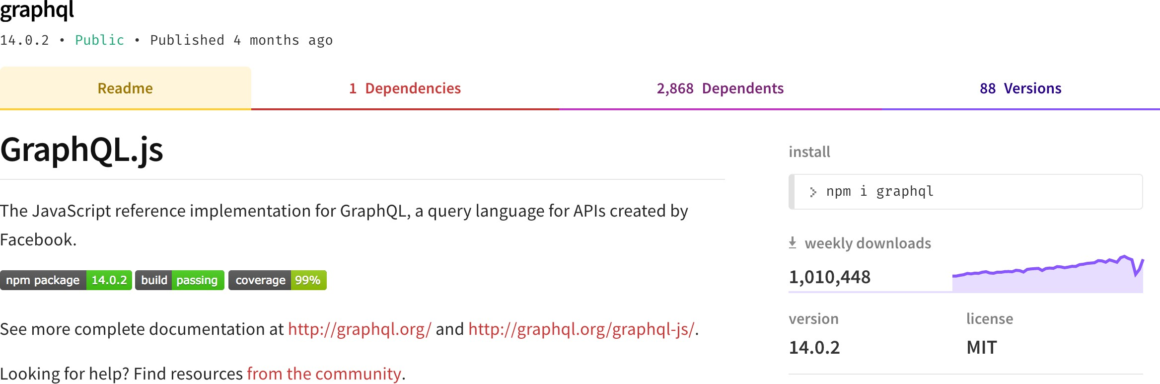
What else has GraphQL to offer?
Developer Communitty

Slide 85
What else has GraphQL to offer?
Developer Communitty

Slide 86
What else has GraphQL to offer?
Developer Communitty

Slide 87

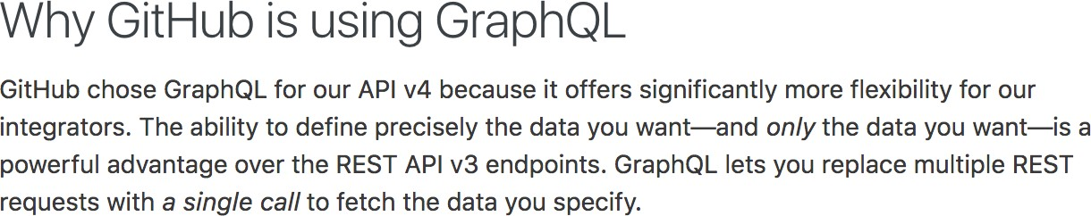
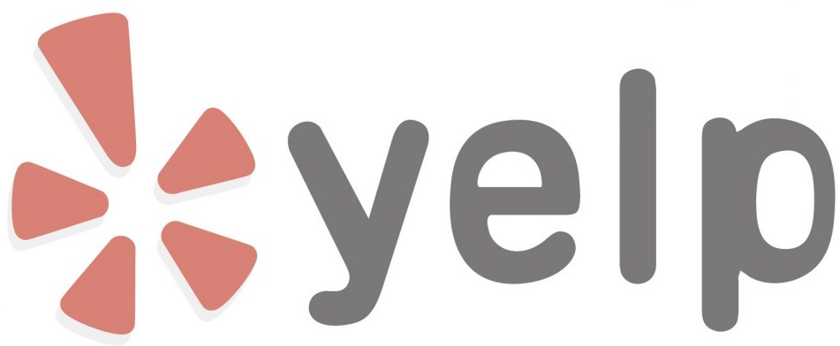


What else has GraphQL to offer?
Industtry Adopttion

Slide 88
To summarise..

Slide 89
REST has multtiple endpointts that return fixed datta sttructtures

Slide 90
REST has multtiple endpointts that return fixed datta sttructtures
GraphQL has a single endpointt that returns ftexible datta sttructtures

Slide 91
GraphQL can be built on ttop of your existting datta and code

