Slide 1



-BY ARAVINDS.B.R (14ITR007) KISHORE.N(14ITR041) MANISHA.B(14ITR046) PROJECT GUIDE: Dr.P.SURESH
DETECTION OF FRAUDULENT FINANCIAL STATEMENTS USING THE HYBRID DATA MINING APPROACH

Slide 2
OBJECTIVE
To detect the fraudulent financial statements using an effective and accurate fraudulent financial statement detection model.

Slide 3
LITERATURE REVIEW
S NO | TITLE | AUTHOR | FINDINGS
1 | Method to determine fraud | Lenard and Alam | The analysis of ratios is chosen as one of the methods to determine fraud is found.
2 | Detecting evolutionary financial statement fraud | Wei Zhou | The effectiveness of the techniques such as regression, decision tree, neural networks and Bayesian networks are examined.
3 | Machine Learning classifier | Wang et al., | For the machine learning classifier, a variety of lexical, syntactic and knowledge-based features are used and it shows how much these features contribute to the performance of the classifier are found.

Slide 4
PROBLEM DEFINITION
Intentional or reckless conduct based on false information or omissions that results in significantly misleading financial reports
The cost of the prevention of fraudulent financial statements is estimated to be in the billions each year

Slide 5
MODULE DESCRIPTION
Random forest (RF) :
Uses fully grown decision trees and it has low bias and high variance.
Reduces error by reducing bias.
It is a collection of trees, all slightly different from each other.
Gradient Boosting Algorithm (GBM) :
It has high bias and low variance.
Uses decision trees as base learners.
Builds one tree at a time, where each new tree helps to correct errors made by previously trained tree

Slide 6
Generalized linear model (GLM) :
A ordinary linear regression that allows for response variables
Have error distribution models other than a normal distribution
Artificial Neural Network (ANN) :
The signal at a connection between artificial neurons is a real number
The output of each artificial neuron is calculated by a non-linear function of the sum of its inputs.
Artificial neurons and connections typically have a weight that adjusts as learning proceeds

Slide 7
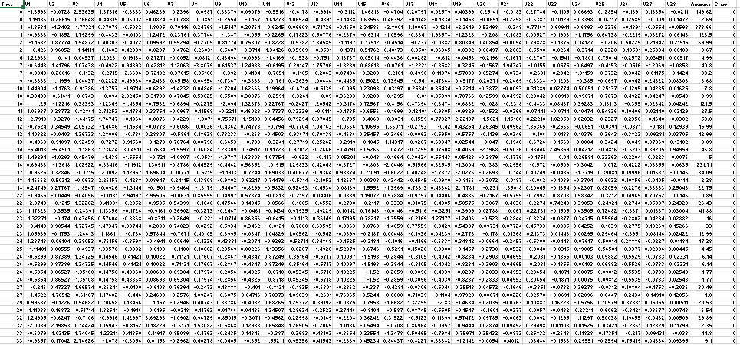
DATASET

Slide 8
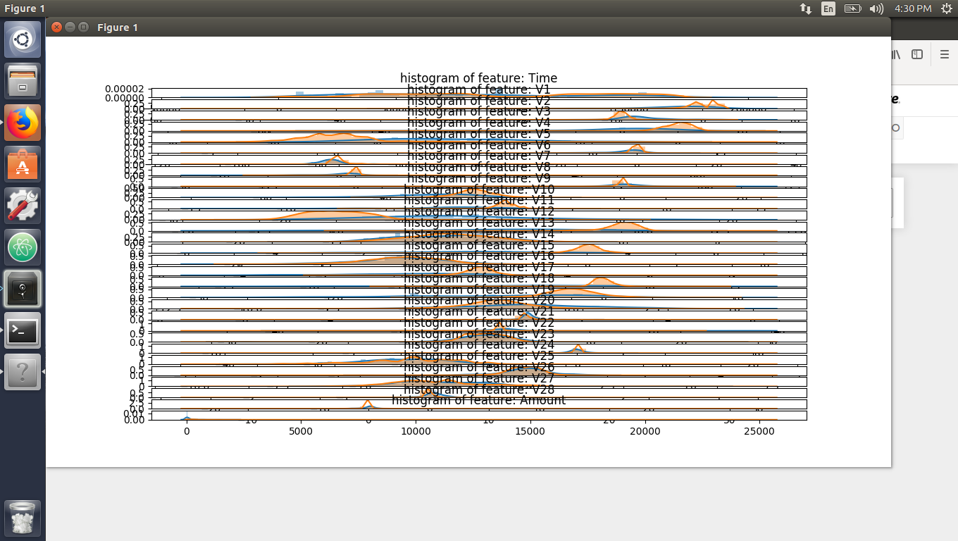
VARIABLE SELECTION
RESULTS

Slide 9
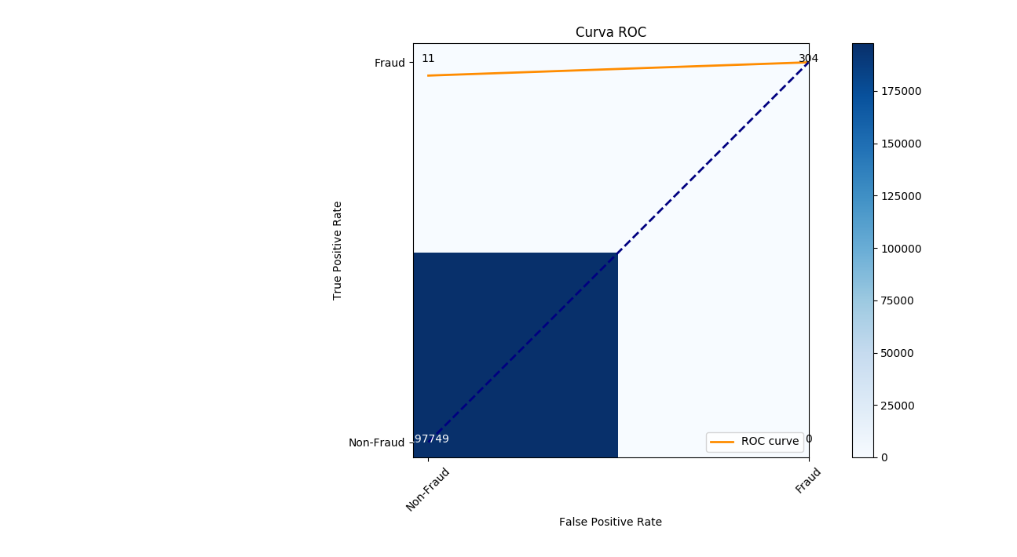
TRAIN DATA RESULT

Slide 10
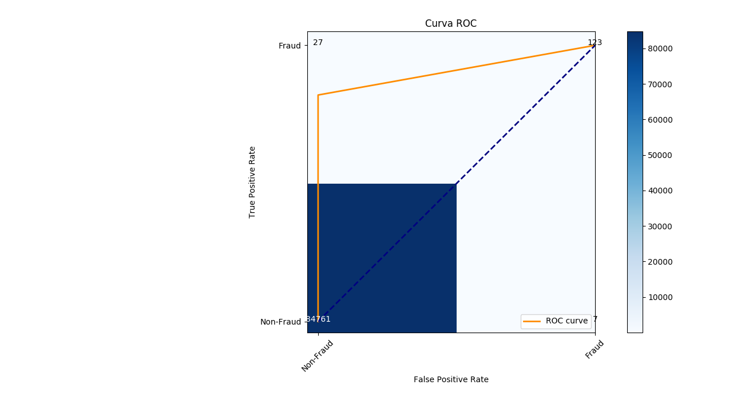
TEST DATA RESULT

Slide 11
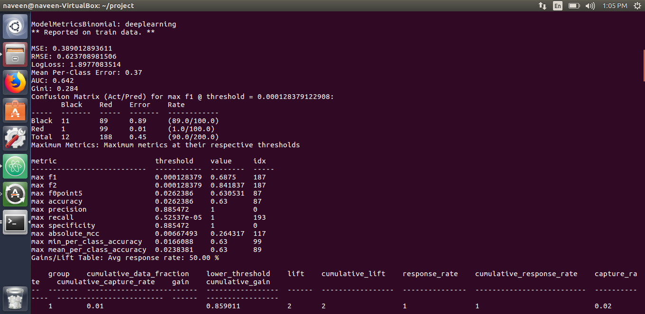
ANN Result

Slide 12
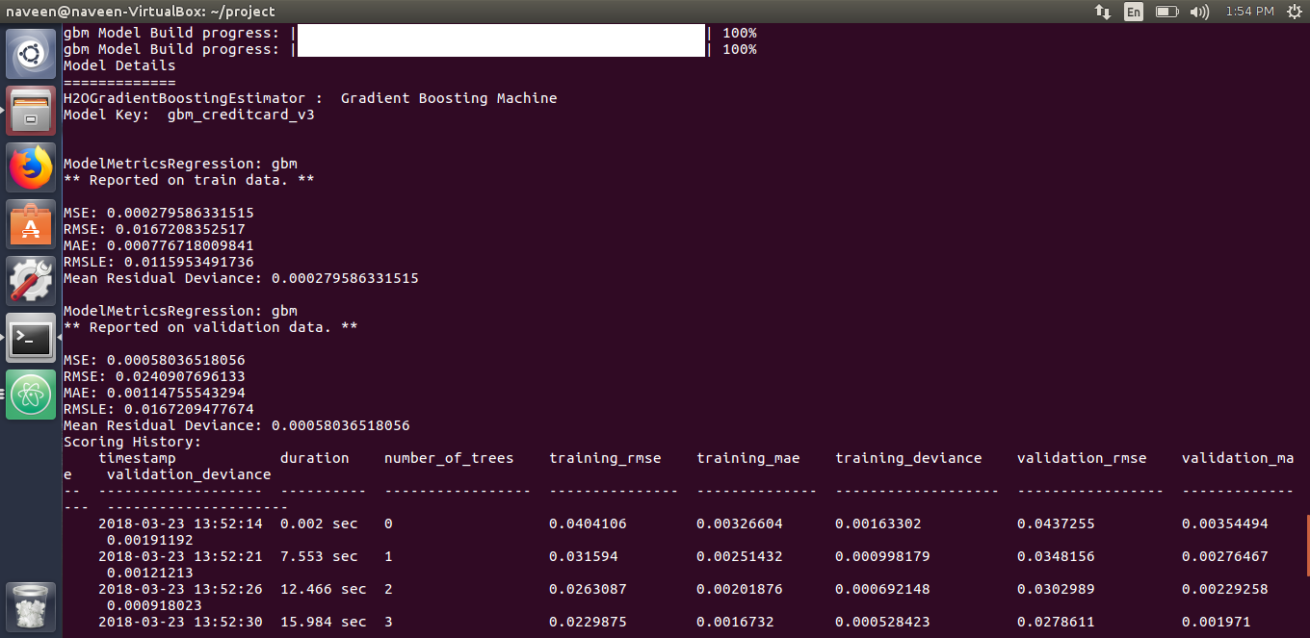
GBM Result

Slide 13
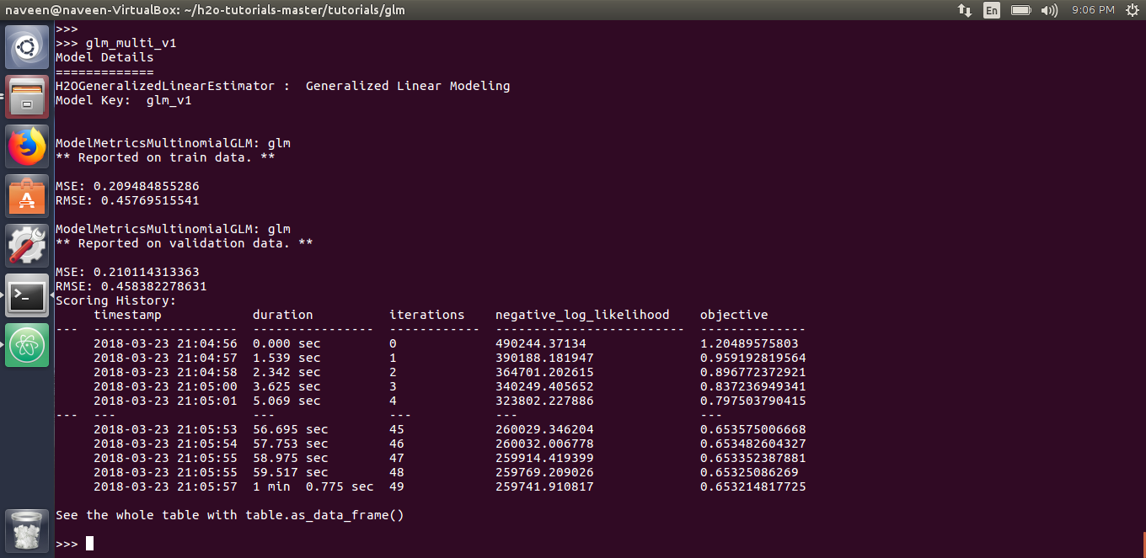
GLM Result

Slide 14
CONCLUSION
Artificial Neural Network is used to detect the fraudulent financial statements and it has higher accuracy.
It detects the fraud prior to its occurrence and prevents the loss incurred.

Slide 15
FUTURE SCOPE
Artificial intelligence concept can be used to detect the fraudulent financial statements of any organization using which prevents the financial loss incurred by the organization and improves the accuracy.
New methods with higher accuracy can also be used to detect the fraud.

Slide 16
REFERENCES
1. Chen S (2016), ‘Detection of fraudulent financial statements using the hybrid data mining approach’, SpringerPlus, Vol.5, No.1, pp. 89.
2. Kamarudin K A et al., (2012), ‘Aggressive financial reporting and corporate fraud’, Procedia-Social and Behavioral Sciences,Vol.65, pp.638-643.
3. Ravisankar P et al., (2011), ’Detection of financial statement fraud and feature selection using data mining techniques’, Decision Support Systems, Vol.50,No.2, pp. 491-500.
4. Yeh C C et al., (2010), ‘A hybrid approach of DEA, rough set and support vector machines for business failure prediction’, Expert Systems with Applications, Vol.37,No.2, pp.1535- 1541.

Slide 17
THANK YOU!

