Slide 1





Architecture Desgin
Provided Excel Files
Storing the extracted
data using python code
in MySQL
Developed Python
Code with IMDBpy library

Slide 2

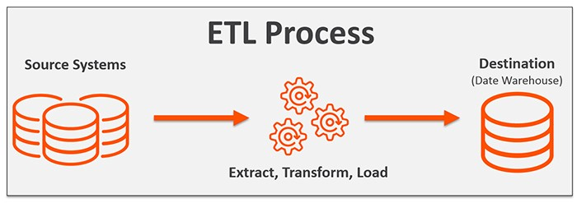
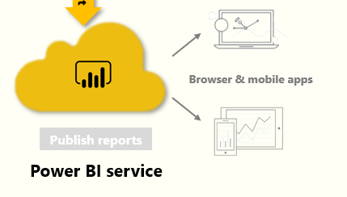


q
Connecting Data source to PowerBI
ETL
Data source
Report building
Data modeling
Publishing report

