Slide 1
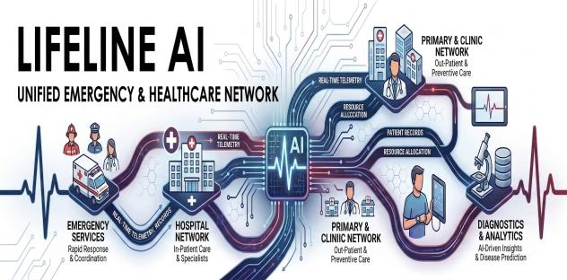
Lifeline AI Unified Emergency & Healthcare Network

Slide 2
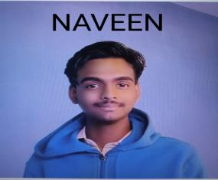


Name : Shaan Bellary skills : python, Django, java, Data structure. Gen ai education : BCA ACHIEVEMENTS : Winner – national level IT - Fest (Context fusion).
Name: Gourav P Niranjan
Skills:JavaSpring Boot REST API Development , data science
Education: BCA
Achievements: Winner - Ciphers Oracle (Spectrum) 2025.
NAME : NAVEEN GALENNAVER
SKILLS : MERN STACK WITH PYTHON , FLUTTER , DATA SCIENCE
EDUCATION : BCA
PORTFOLIO : https://codinginkannada.vercel.app/

Slide 3
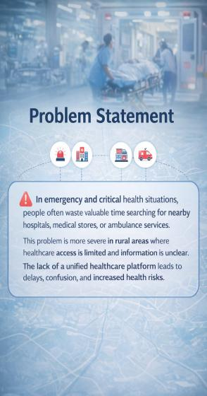
Problem Statement: In emergency and critical health situations, people often waste valuable time searching for nearby hospitals, medical stores and Medison's, or ambulance services. This problem is more severe in rural areas where healthcare access is limited and information is unclear. The lack of a unified healthcare platform leads to delays, confusion, and increased health risks in rural areas same people don’t have smart phone this problem in rural so this software solve this mention user problem and solution page
Solution – Lifeline AI
Lifeline AI is a unified healthcare platform that helps users quickly find nearby hospitals, medical stores, doctors, and emergency services based on their location. The platform integrates AI-powered health guidance, emergency response support, and real-time navigation in one simple interface.
Users can enter their health problem and receive AI-based guidance, nearby doctor suggestions, and pharmacy availability. In emergency situations, the system can suggest calling 108, connect to nearby ambulances, and provide the fastest route to hospitals.
For rural users who do not have smartphones, Lifeline AI provides a helpline number with an AI voice assistant that guides users through simple voice options and connects them to medical help.
The system also includes a chatbot for health questions, monitoring features for stress and health risks, and smart alerts to guide users during emergencies, creating an accessible healthcare support system for both urban and rural communities.

Slide 4
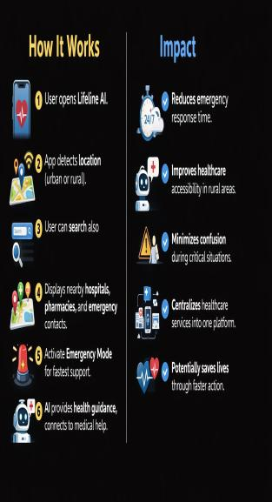
How It Works
User opens Lifeline AI (web or app).
The system detects the user’s location (urban or rural).
User can search for hospitals, doctors, pharmacies, or ambulance services.
The platform shows nearby hospitals, medical stores, doctors, and emergency contacts.
User can order medicines or check pharmacy availability.
In emergencies, user can activate Emergency Mode for the fastest route and quick ambulance connection.
The AI assistant gives basic health guidance and answers health questions.
If the user has no smartphone (rural users), they can call a helpline number and an AI voice assistant guides them (Press 1 for doctor, Press 2 for ambulance, Press 3 for pharmacy).
The system can also monitor user stress, sleep, and health trends and warn about possible risks early.

Slide 5
Impact
Reduces emergency response time.
Improves healthcare access in both rural and urban areas.
Helps users quickly find doctors, pharmacies, and ambulance services.
Supports people without smartphones through a voice helpline system.
Minimizes confusion during critical medical situations.
Provides AI-based health guidance and early health risk alerts.
Centralizes healthcare services into one easy-to-use platform.
Can grow into a startup platform for emergency healthcare services.
Helps users order medicines and get medical help faster.
Potentially saves lives by reducing delays in emergencies.

Slide 6
Project Details (Simple Points)
Problem
In emergency situations, people may need medical help at any time (day or midnight).
Sometimes doctors or pharmacies are not available nearby, especially at night.
Rural areas often have limited medical facilities and many people do not have smartphones to access digital healthcare services.
People waste valuable time searching for hospitals, doctors, pharmacies, or ambulance services during emergencies.
Ambulance drivers sometimes struggle to find the fastest route because of traffic, damaged roads, or poor navigation guidance.
In cities, users also face difficulty finding nearby pharmacies with available medicines quickly.
Many people realize health problems like stress, fatigue, or burnout too late because there is no early monitoring system.
Due to lack of a unified platform, patients cannot quickly connect with doctors, pharmacies, and ambulance services when needed.

Slide 7
User Persona Mindset:
1. Rural Resident
Lives in a village or remote area.
Does not know nearby hospitals or doctors.
Needs quick medical help during emergencies.
Needs simple guidance and health awareness.
2. Urban User
Lives in a city with many hospitals.
Needs a fast way to find the nearest available doctor or pharmacy.
Wants quick healthcare information and support.
3. Emergency Patient
Facing a critical health situation.
Needs an ambulance and hospital immediately.
Requires the fastest route and emergency assistance.
4. Family Member / Caregiver
Helping a patient during an emergency.
Needs quick information about hospitals, doctors, and medical stores.
Wants fast decisions to get medical help.
5. Travelers / Visitors
In a new city and unfamiliar with healthcare facilities.
Need to quickly locate nearby hospitals or emergency services.
6. Busy Users / Workers
Often ignore stress or health issues due to busy schedules.
Realize burnout or health problems too late.
Need AI alerts and health guidance before problems become serious.

Slide 8
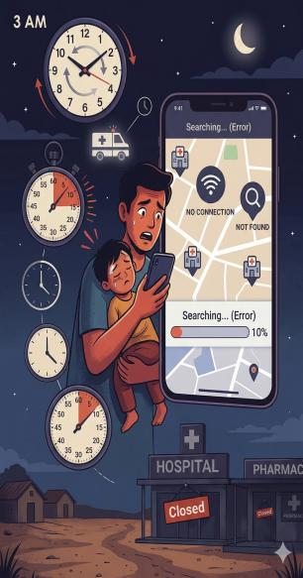
U1 – User Problem
People often face medical emergencies late at night when doctors are not easily available.
In rural areas, finding a nearby hospital or medical help becomes very difficult.
During emergencies, users waste valuable time searching for hospitals, doctors, or ambulance services.
Most apps only show hospital locations and do not provide instant emergency support or quick connections to medical services.

Slide 9
U1 – Solution
Users can enter their health problem in the web app.
The system provides quick guidance and connects the user to nearby available doctors or medical stores.
Users can also ask health-related questions using an AI assistant (similar to Gemini Live).
The AI provides clear answers and basic health guidance.
The solution is shown in the user’s preferred language.
If the user cannot read, the AI can automatically read the guidance aloud and explain what the user should do next.
in simple
AI feature
Doctor connection
Rural accessibility
Voice assistance

Slide 10
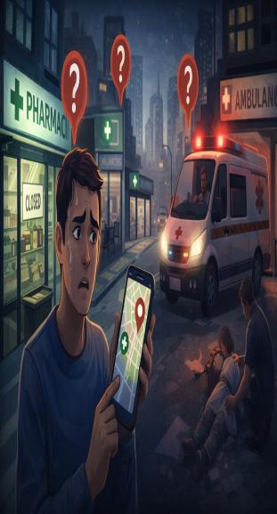
U2 – User Problem (City Emergency)
In cities, during emergencies people struggle to quickly find nearby medical stores.
Users need medicines urgently but do not know which pharmacy is open.
It takes time to search different shops and check medicine availability.
During emergencies, users also struggle to find available ambulances nearby.
There is no single platform to quickly locate medicines and ambulance services.

Slide 11
U2 – Solution
The web app tracks the user’s location to show or search nearby medical stores.
Users can search medicines and see which pharmacy has them available. And user if need medicines they can order
The system works similar to Zomato-style search but for medicines.
Users can also find nearby available ambulances in real time.
The platform connects users directly to ambulance owners so they can contact or book quickly.
This most demanded idea in real world so this become startup idea also

Slide 12
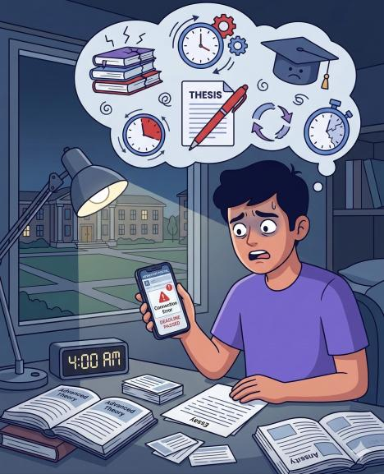
User 3– Problem (Aarav)
Name: Aarav
Age: 21
Problem: Exam stress and poor sleep
Issues
Studies late at night
Sleeps less
Feels tired before exams
Goal
Avoid burnout
Stay consistent
Improve performance

Slide 13
Our solution:
Solution – Early Health Risk Prediction
What Are We Building? A software that predicts health risks early.
Who Is It For? Students and professionals who are under stress.
What Problem Does It Solve? People often realize burnout and fatigue too late.

Slide 14
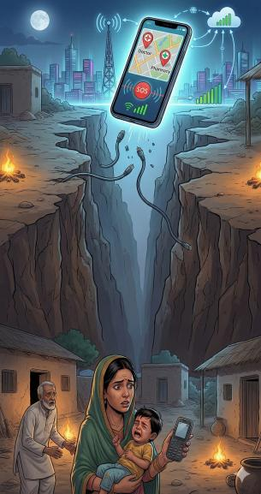
U4 – User Problem (Rural Users Without Smartphones)
Many rural users do not have smartphones or internet access.
They cannot use web apps or mobile apps to find doctors or medicines.
During emergencies, they do not know where to get medical help.
They cannot access AI guidance or online healthcare services.
This creates a gap between digital healthcare systems and rural communities.

Slide 15
U4 – Solution
Provide a special helpline phone number for the service.
Users can call the number using any basic phone.
An AI voice agent answers the call and guides the user.
The system asks simple questions like “Press 1 for doctor, Press 2 for ambulance, Press 3 for medical store.”
Based on the selection, the AI connects the user to nearby doctors, medical stores, or ambulance services.
This also become future startup idea

Slide 16
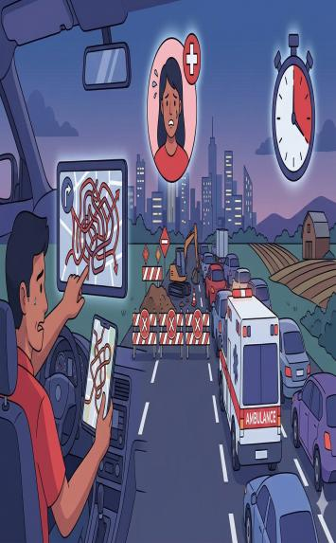
U5 – User Problem (Ambulance Navigation)
In emergency situations, ambulance drivers sometimes do not know the best route to the hospital.
Some roads may be damaged, blocked, or have heavy traffic.
This problem happens in both cities and rural areas.
Drivers can get confused and lose valuable time during critical emergencies.
Delays in reaching the hospital can put the patient’s life at risk.

Slide 17
U5 – Solution
The system provides smart navigation for ambulances, similar to Google Maps.
It suggests the fastest and safest route to the hospital.
The system detects damaged roads or blocked routes and avoids them.
It provides voice guidance to help the ambulance driver follow the correct path.
The app can also show images or alerts of damaged roads to warn drivers in advance.
Future Startup Feature
Users and drivers can report damaged roads by uploading photos.
The system updates the map and warns other ambulance drivers.
AI analyzes road conditions and suggests safer emergency routes.
This can become a smart emergency navigation platform for ambulances and emergency vehicles.

Slide 18

Thank you
This ppt is make future startup production and improve the health domain sides

