Slide 1
Chi-Square Distribution & Goodness of Fit
Statistical Analysis for Evaluating Conformity to Expected Distributions
VisionText AI
1

Slide 2

Real Problem
Results deviate from expectations
Difference raises questions
Need to assess difference
Statistical method is crucial
Interpret results accurately
2
Notes:
Emphasize deviations between expected and actual results.

Slide 3

Example: Dice Roll
Roll a dice 60 times.
Compare expected and observed frequencies.
Determine if the dice is fair or biased.
Expected (if fair):
10, 10, 10, 10, 10, 10
Observed (actual):
8, 12, 9, 11, 10, 10
3
Notes:
Explain expected vs observed frequencies using the dice roll example.

Slide 4

Key Idea
Compare expected and observed
Similar values are normal
Big differences indicate a problem
4
Notes:
This key idea is the Chi-Square test foundation.

Slide 5
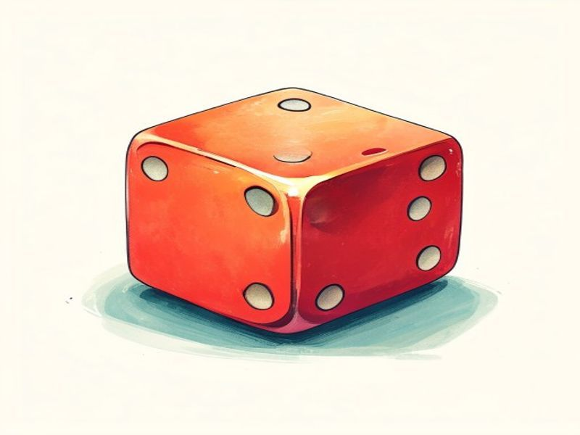
Meaning of Fair
Fairness means equal chance.
Each outcome has same probability.
Fairness is key in statistics.
Fairness matters in real life.
Games, elections need fairness.
5
Notes:
Fairness is about equal chance. It's crucial in statistics and real-life applications.

Slide 6
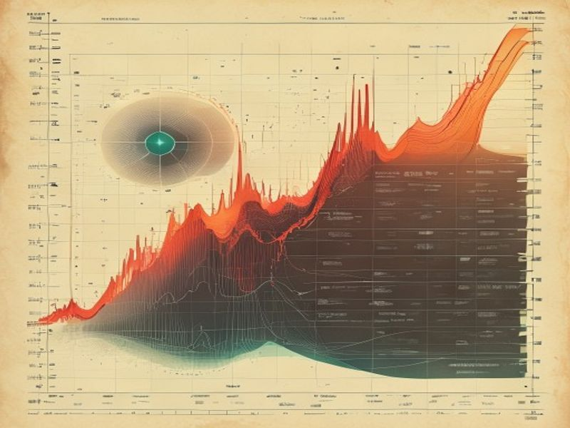
What is Chi-Square Test?
Compares observed and expected data.
Measures frequency differences.
Finds associations between variables.
Determines if differences are real.
Non-parametric test.
6
Notes:
Explain the Chi-Square test compares observed and expected data to determine significant differences.

Slide 7
Chi-Square Formula
χ² = Σ (O - E)²
Chi-Square
7
Notes:
Emphasize Chi-Square formula importance.

Slide 8
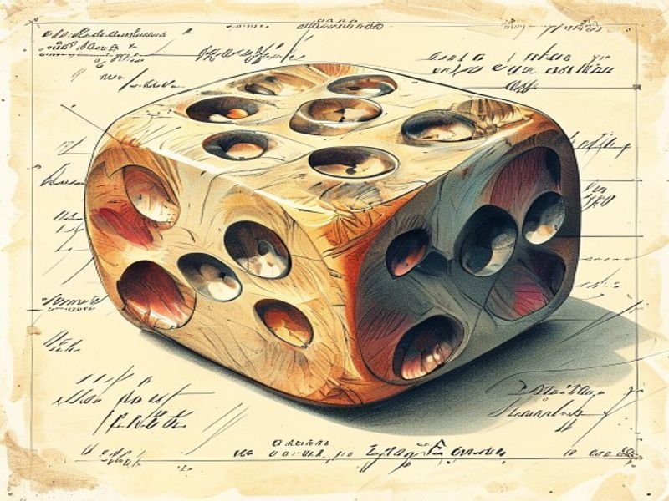
Apply Formula
Observed frequencies: 8, 12, 9, 11, 10, 10
Expected frequencies: 10, 10, 10, 10, 10, 10
Calculate differences and squared differences for each category
Apply Chi-Square formula: χ² = Σ (O - E)² / E
8
Notes:
For this slide, explain how the Chi-Square formula is applied to the dice roll example, highlighting the step-by-step calculation of the χ² value. Emphasize the importance of understanding the differences between observed and expected frequencies.

Slide 9

What is Hypothesis?
Hypothesis: a statement to test.
Null: no effect or difference.
Alternative: an effect or difference.
Hypotheses guide testing.
Test result: accept or reject.
9
Notes:
Explain that a hypothesis is a statement tested using stats. Null and alternative hypotheses help interpret test results.

Slide 10
Degrees of Freedom
df = n - 1
1 to 10
Degrees of Freedom Formula
Degrees of Freedom Range
10
Notes:
Degrees of freedom is key in Chi-Square tests.

Slide 11
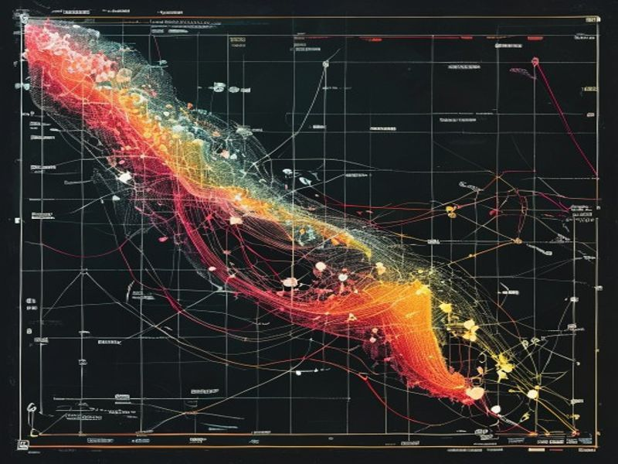
Decision Rule for Chi-Square Test
Compare χ² to critical value.
χ² > critical: reject fair dice.
χ² < critical: keep fair dice.
Critical value depends on freedom and level.
Common levels: 0.01, 0.05.
11
Notes:
The decision rule helps interpret Chi-Square test results. Choose a suitable level.

Slide 12
Final Decision
Compare χ² to table value.
χ² < table: dice is fair.
χ² > table: dice is not fair.
Calculated χ² is 1.0.
Result shows if differences are chance or bias.
12
Notes:
Explain the decision rule. Compare χ² to table value to see if dice is fair.

Slide 13
Interpreting Chi-Square Test Results
Small Chi-Square: close to expected
Large Chi-Square: significant difference
Result shows chance or real effect
p-value determines significance
Low p-value: reject null hypothesis
13
Notes:
Explain Chi-Square test result importance. Emphasize p-value.

Slide 14
What is Goodness of Fit?
Goodness of fit: how well data fits.
Checks for difference between observed and expected.
Chi-Square test is used.
Good fit: data is consistent.
Poor fit: data has big differences.
14
Notes:
Goodness of fit checks data.

Slide 15
Chi-Square Test
Step 1
Define hypothesis
Step 2
Calculate expected
Step 3
Collect data
Step 4
Apply Chi-Square
Step 5
Find critical value
15
Notes:
Explain Chi-Square test steps. Each step leads to the next. Understand the flow to interpret results.

Slide 16

Chi-Square Test
Games of chance
Survey data
Business trends
Machine learning
Medical research
16
Notes:
Chi-Square test is used in many areas.

Slide 17
Chi-Square Statistic Calculator
17
Notes:
This tool calculates Chi-Square. It compares observed and expected values. The results help make informed decisions.

Slide 18
Conclusion
Chi-Square: goodness of fit
Measures observed vs expected
Used in many fields
Essential for data analysis
Identifies distribution fit
18
Notes:
Chi-Square: vital in statistics

Slide 19
“
Thank You
19

