Slide 1

Final Project Review-3
MARKET BASKET ANALYSIS RECOMMENDATION
BATCH NUMBER: 05
Presented by:
24B11AI109 - G. Vardhan Sai - AIML
24B11AI360 - R Naveen - AIML
24B11AI088
24B11AI091
- D Tilak
- D Pardhu
- AIML
- AIML
Under esteemed guidance of:
Mr. D .Priyanth
B.Tech, Assistant Professor (AIML)

Slide 2
Outline
Problem formulation
Problem Definition
Literature review
Research Gaps 5.Objectives
6.Methodology 7.Technological requirements
8.Expected outcome
9.Conclusion 10.References.

Slide 3
Problem Formulation
Market Basket Analysis (MBA) is a data mining technique used to identify
relationships among items purchased together in a transactional database. The problem is formulated by analyzing a set of transactions to discover frequent
itemsets that occur above a specified minimum support threshold. From these itemsets, association rules of the form 𝑋 ⇒ 𝑌are generated, where 𝑋and 𝑌are disjoint subsets of items. The strength of these rules is evaluated using measures such as support, confidence, and lift.

Slide 4
Problem Definition
Market Basket Analysis is the problem of finding relationships among items in a transactional database where items are purchased together.
It involves identifying frequent itemsets that occur above a specified minimum
support threshold.
From these itemsets, association rules of the form 𝑋 ⇒ 𝑌are generated, where
𝑋and 𝑌are disjoint sets of items.
The strength of these rules is evaluated using measures like support, confidence, and lift, with minimum thresholds applied.
The objective is to discover useful patterns that help in decision-making such as product placement, cross-selling, and recommendations.

Slide 5
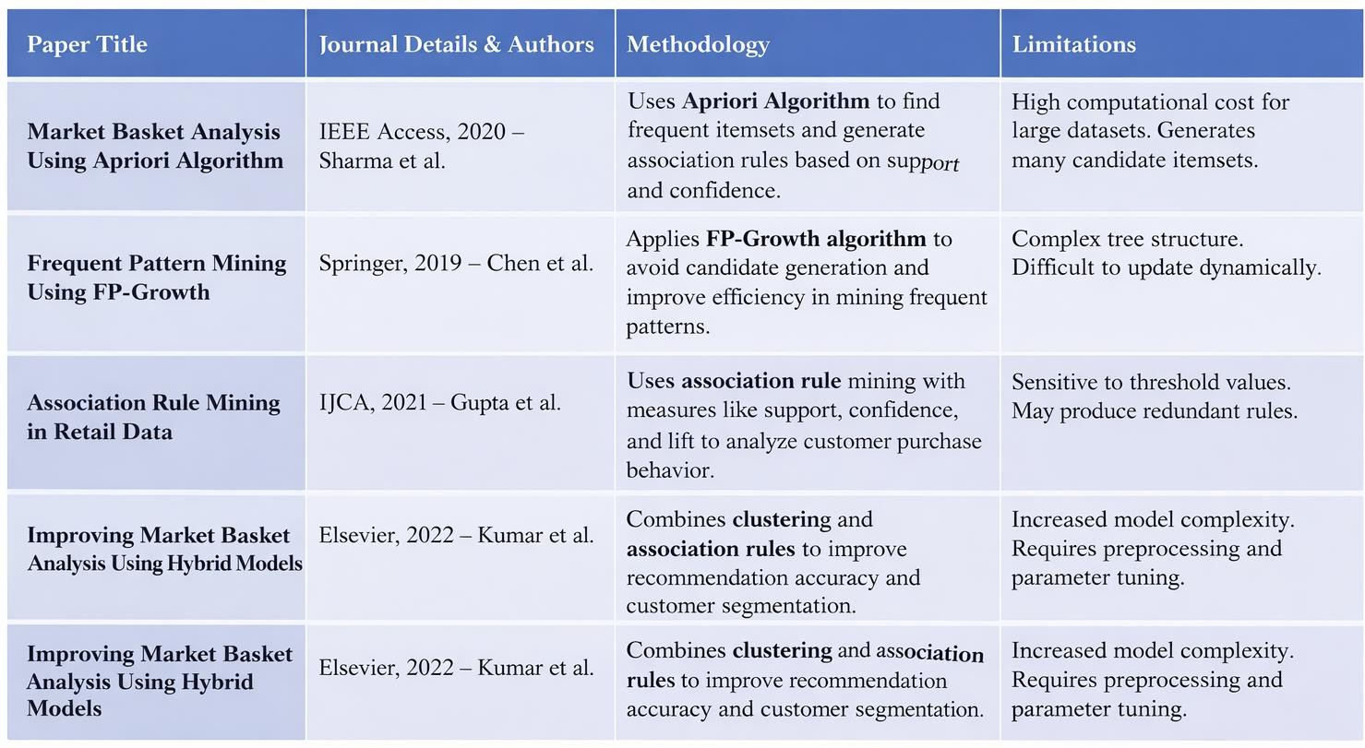
Literature Review

Slide 6
Research Gap
Traditional algorithms like Apriori and FP-Growth struggle with scalability when
handling large and real-time datasets.
Most studies focus only on item frequency and ignore temporal patterns (e.g., seasonal or time-based buying behavior).
Existing models do not effectively incorporate customer personalization or user-
specific preferences.
Handling of dynamic and streaming data (online transactions) is still limited in many approaches.
Many approaches generate too many rules, leading to redundancy and difficulty in
interpretation.
Limited integration of MBA with advanced techniques like deep learning and recommendation systems.
Privacy concerns and secure handling of customer data are not adequately addressed
in many models.

Slide 7
Objectives
To identify frequent itemsets that commonly occur together in transactional data.
To generate association rules that reveal relationships between products (e.g.,
𝑋 ⇒ 𝑌).
To analyze customer purchasing behavior and buying patterns.
To improve product placement and store layout for increased sales.
To support cross-selling and up-selling strategies in retail and e-commerce.
To enhance recommendation systems by suggesting relevant products to customers.
To optimize inventory management by understanding product demand relationships.

Slide 8
Challenges and Risks
Scalability Issues: Handling large-scale transactional data can be computationally expensive, especially with algorithms like Apriori.
Data Quality Problems: Missing, noisy, or inconsistent data can reduce the
accuracy of discovered patterns.
Rule Explosion: Generates a large number of association rules, making it difficult to identify truly useful insights.
Dynamic Data Handling: Difficulty in processing real-time or continuously
changing transaction data.
Interpretability: Some patterns may be statistically strong but not practically meaningful for business decisions.
Privacy Concerns: Use of customer purchase data may raise ethical and data security issues.
Imbalanced Data: Rare but important item combinations may be overlooked due to
low support values. .

Slide 9
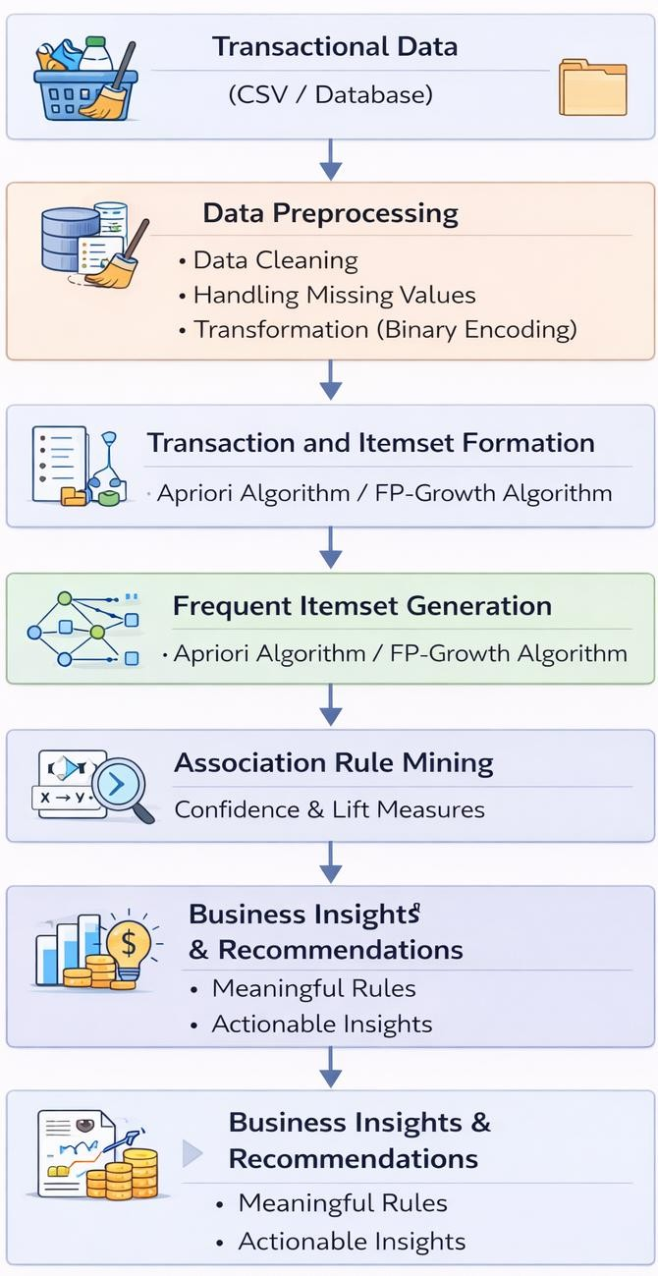
Methodology
Transactional data is collected from retail or e-commerce datasets (CSV/database).
Data preprocessing is performed including data cleaning, handling missing values, and transformation (binary enco ding of items).
The dataset is organized into transactions and itemsets for analysis.
Frequent itemsets are generated using algorithms like Apriori or
FP-Growth based on minimum support.
Association rules are derived using confidence and lift measures.
The model is evaluated, and meaningful rules are selected for
business insights and recommendations.

Slide 10
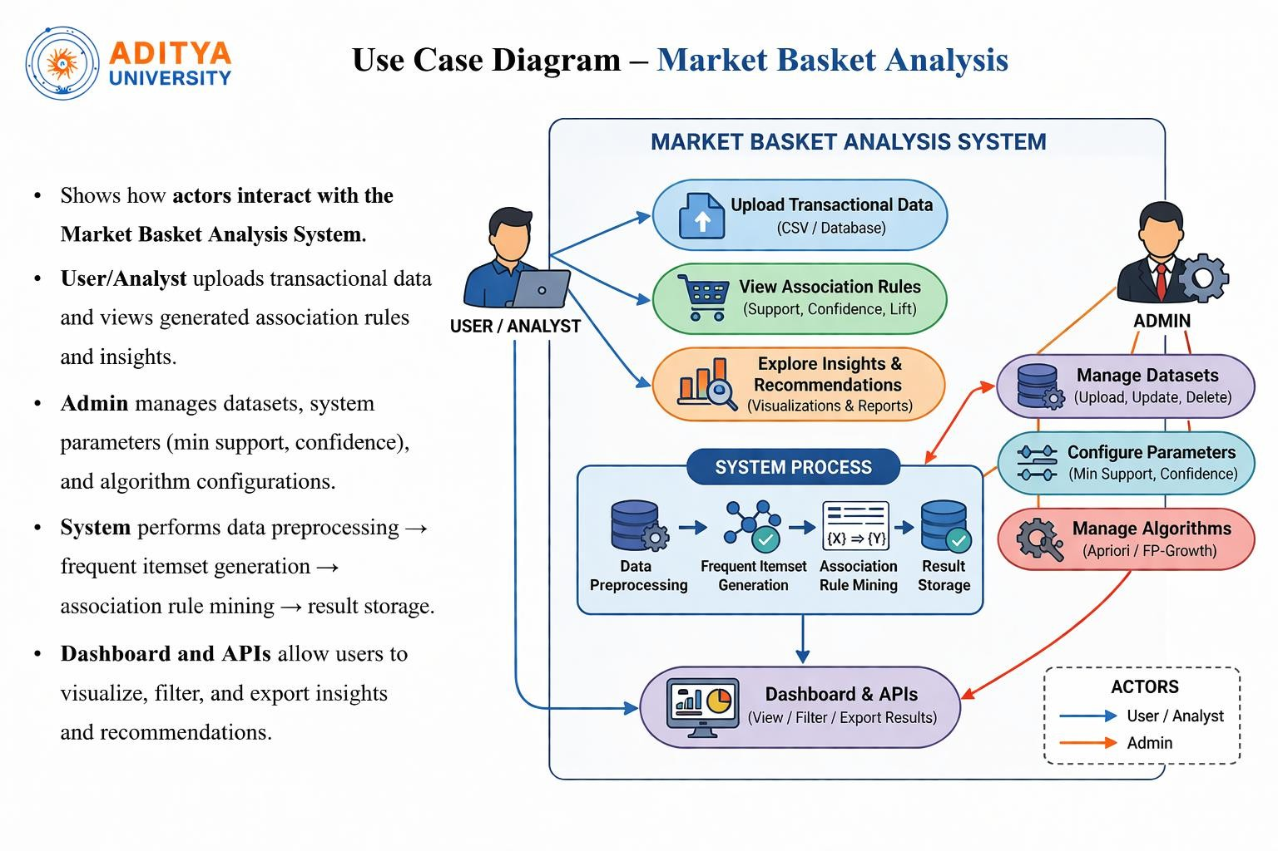
4. Association Rule Generation
Once frequent itemsets are identified, association rules are generated.
An association rule is represented as:
A → BThis means if a customer buys A, they are likely to buy B. Rules are evaluated using three main metrics:
SupportIndicates how frequently items appear together.
Confidence
Confidence(A → B) = Support(A ∪ B) / Support(A)It measures how often B is purchased when A is purchased.
Lift
Lift(A → B) = Confidence(A → B) / Support(B)Lift > 1 indicates strong positive association
between items.
Only rules that satisfy minimum confidence and lift thresholds are selected.

Slide 11
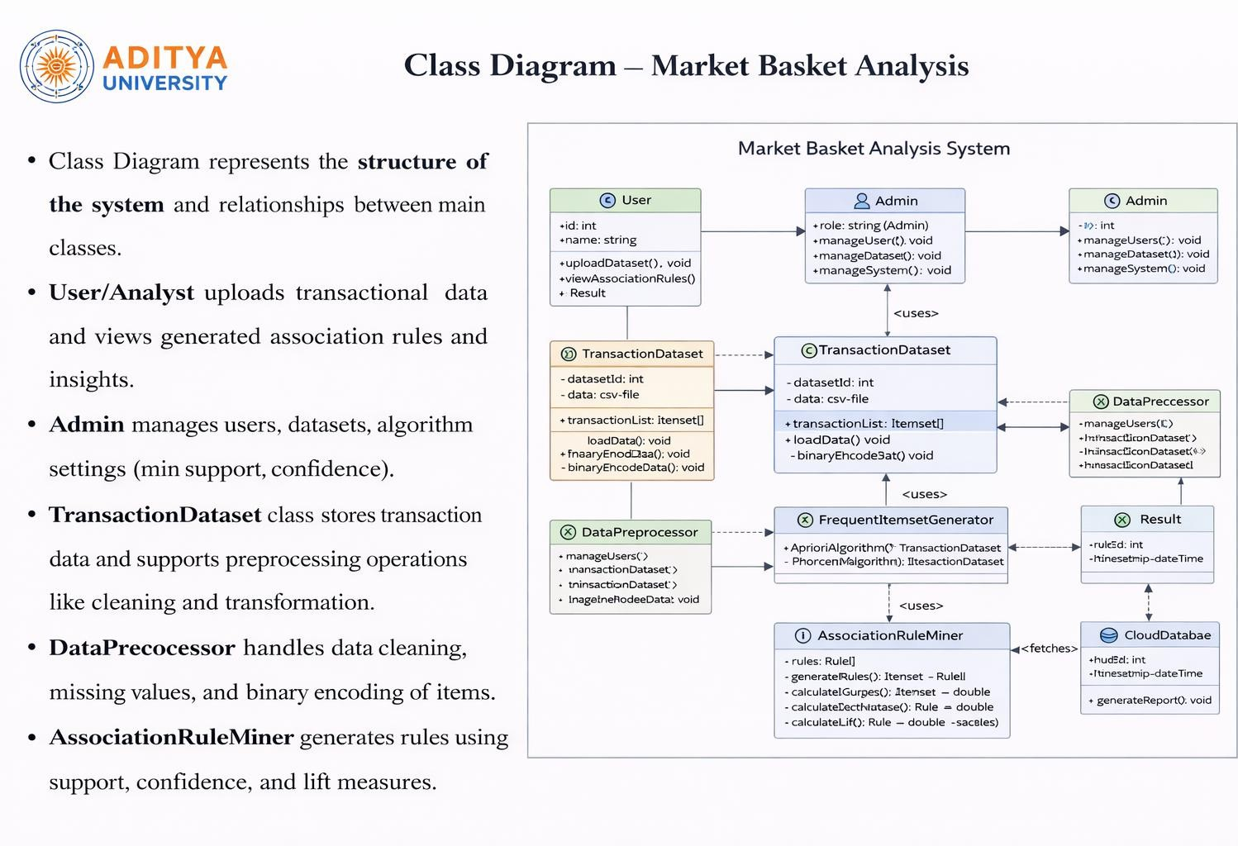

Slide 12
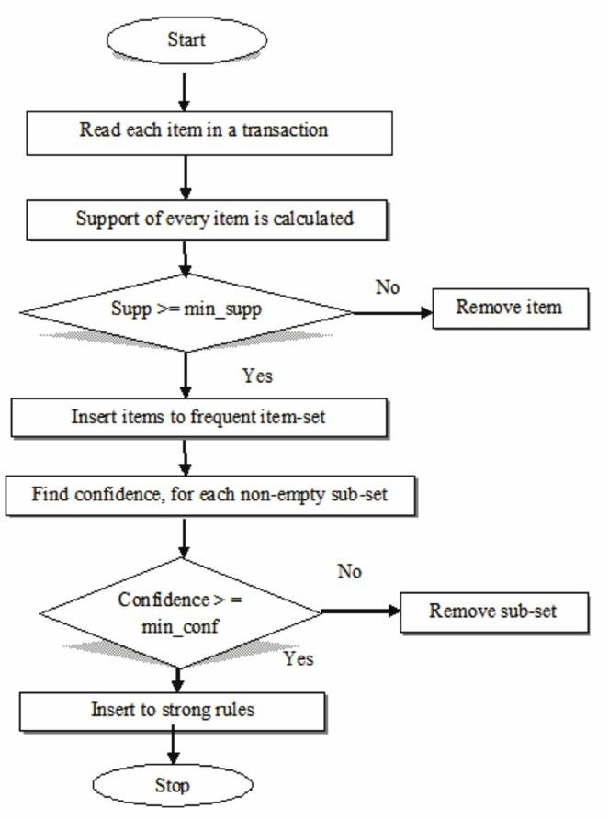
Object Diagram
Snapshot of objects at runtime during one
transaction analysis session.
Contains customers, transactions, items, frequent itemsets, and association rules.
Demonstrates how purchased items are
grouped and processed to find patterns.
Shows relationships between transactions, itemsets, rules, and database storage.
Helps visualize how recommendations are generated based on buying behavior.

Slide 13
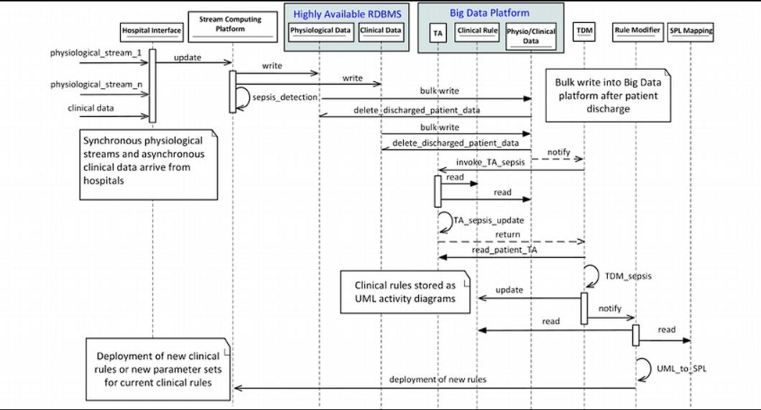
Sequence Diagram
Step-by-step data flow of market basket analysis processing.
User uploads transaction data → preprocessing → frequent itemset generation → association rule mining → database update.
System identifies item relationships (e.g., Bread → Butter) using support and confidence.
Results (frequent itemsets & rules) are sent to the dashboard for insights.
Ends with report generation and product recommendation output.

Slide 14
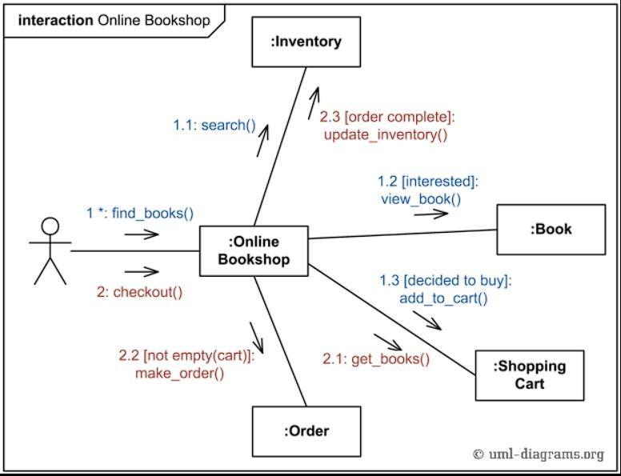
Collaboration Diagram
Focuses on communication between system components in the market basket analysis workflow.
Shows message flow using numbered interactions (dataset upload → preprocessing → itemset generation → rule mining → report → storage).
Backend connects with preprocessing module, Apriori algorithm engine, and database system.
User/Retailer interface receives frequent itemsets, association rules, and recommendation reports for analysis.

Slide 15
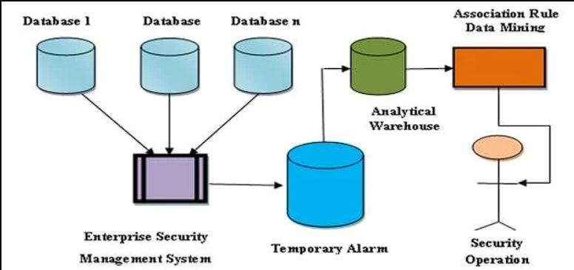
State Machine Diagram
Represents the lifecycle of market basket analysis
processing.
Flow: Data Uploaded → Preprocessing → Frequent Itemset Generation → Rule Mining → Result Generated/Failed.
Processing is repeated for each transaction dataset or batch input.
Ends when association rules are successfully
generated or if an error occurs.

Slide 16
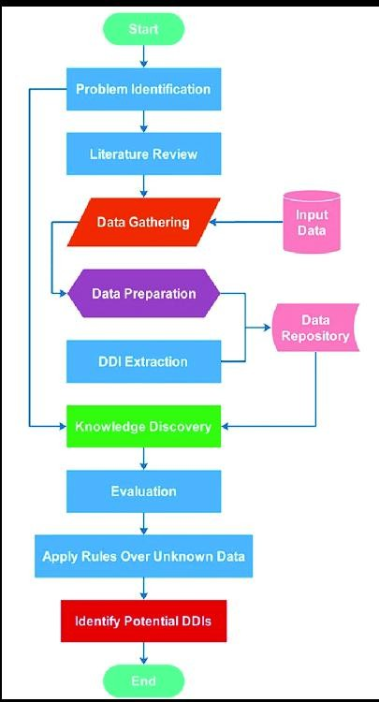
Activity Diagram
End-to-end workflow of market basket analysis process.
Transaction data input → preprocessing → frequent itemset mining → association rule generation.
Stores results → dashboard update → product
recommendation insights.
Allows exporting reports (PDF/CSV) for business decisions.

Slide 17
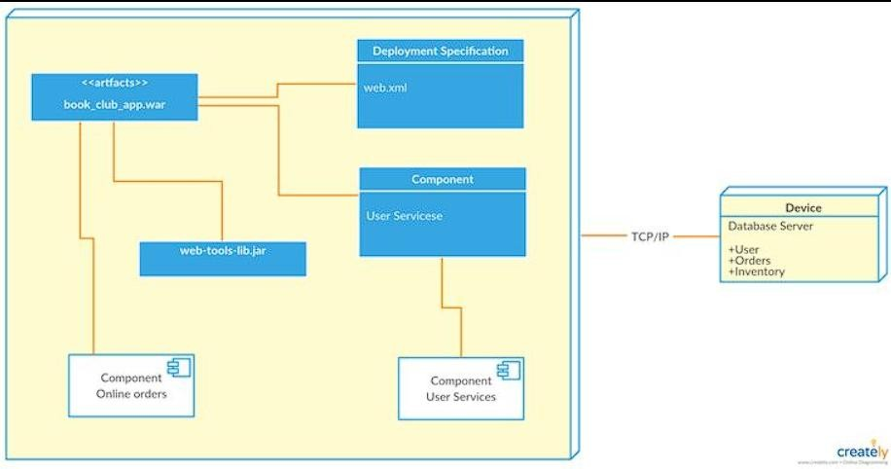
Deployment Diagram
Shows how the market basket analysis system is deployed across different machines.
Client UI sends transaction data to backend
server via the internet.
Backend coordinates preprocessing, Apriori algorithm, and rule generation services.
Database and cloud storage manage transaction data, itemsets, and generated rules.

Slide 18
Technology Requirements
Software Requirements:
Google Collab
Python (3.x version)
Jupyter Notebook / VS Code / PyCharm
Libraries:
Pandas (for data handling) NumPy (for numerical operations)
Matplotlib/Seaborn (for visualization)
mlxtend (for Apriori and association rules)
Operating System:
Windows / Linux / macOS

Slide 19
Hardware Requirements
Processor: Intel i3 or above
RAM: Minimum 4GB (8GB recommended)
Storage: 500GB HDD or SSD
System: Windows/Linux/Mac
Since this is a data mining project, no high-end hardware is required for moderate datasets.

Slide 20
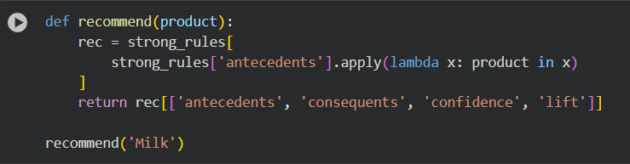
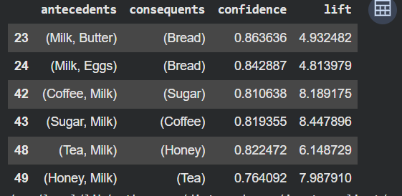
Final Results
Fig: Displaying Recommended Products

Slide 21
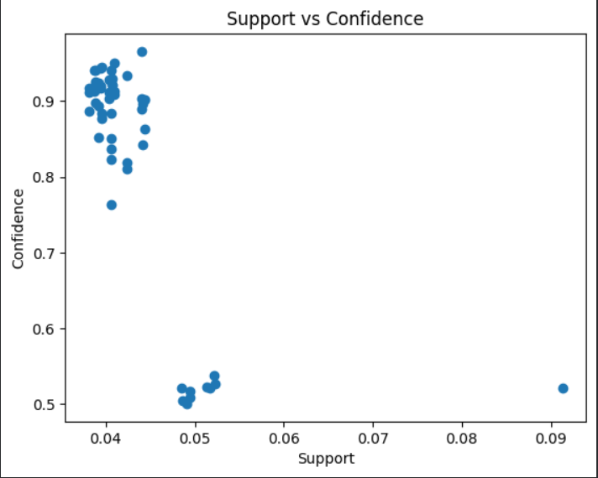
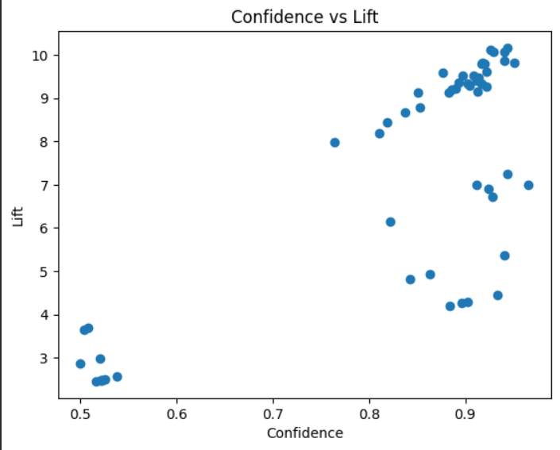
Final Results
Support vs Confidence
Confidence vs Lift

Slide 22
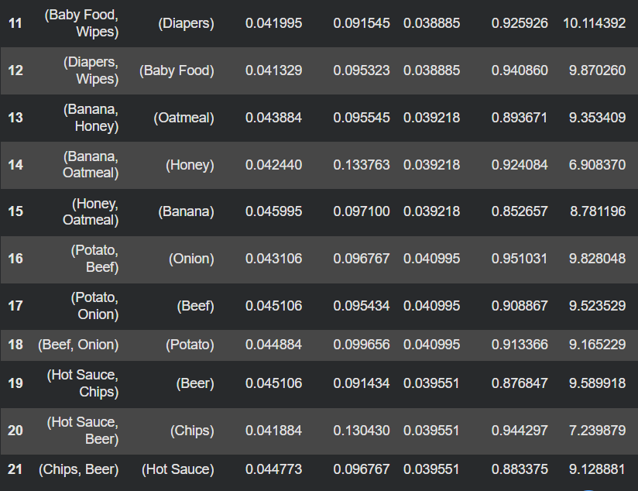
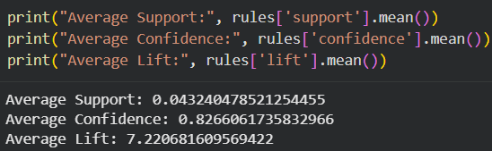
Final Results
Fig: Average of support ,lift ,confidence
Fig: Results based on lift and confidence

Slide 23
Conclusion
The system successfully identifies frequent itemsets and association rules using data mining techniques like Apriori.
Efficient preprocessing and rule generation improve accuracy, helping retailers understand customer buying patterns.
Enables better product placement, cross-selling, and recommendation strategies in real-time
retail environments.
Future Enhancements
Integration with real-time transaction systems for live recommendation updates.
Development of a mobile/web dashboard for interactive visualization of buying patterns
Use of advanced algorithms like FP-Growth for faster processing of large datasets.

Slide 24
THANK YOU

