Slide 1
Healthcare Appointment and Management System

Slide 2
Introduction
A Web Application for Managing Appointments, Departments, and Doctors

Slide 3
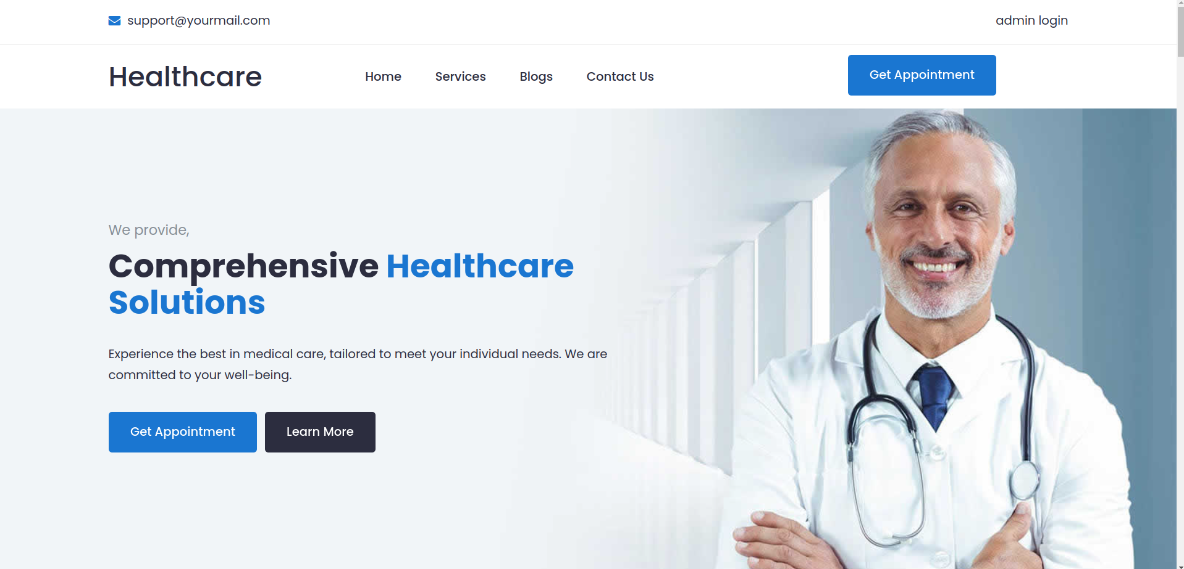

Slide 4
Benfits
Improved appointment scheduling efficiencyEarth is the planet where we live on
Enhanced patient experience
Reduced errors
Increased productivity

Slide 5
Features
Doctor
Appointment
Appoitment booking
Avialable Doctors List
Department
Admin login
Department list
Login for admin

Slide 6
Technical Requirements
Front-end
Back-end
UI
API’s
Angular
MySQL
Bootstrap,Html,Css,Js
Restful

Slide 7
Team
Naveen Ch
Kaiwalya G
Sai B
Front-end
Back-end
API’s

Slide 8
Conclusion
. Efficient Appointment Management: The system streamlines appointment scheduling, cancellation, and management, reducing errors and improving patient experience.
Centralized Healthcare Information: The system provides a centralized platform for managing department, doctor, and patient information, enhancing productivity and decision-making.

Slide 9

Thanks

