Slide 1
LIGHTMETRICS / 3D EXPLORATION
01
Interactive 3D
for websites
A practical guide for designers, motion designers, 3D artists and developers
TOOLS, WORKFLOWS AND WEBSITE INTEGRATION
Notes:
A shared vocabulary and a practical production guide. Read the core slides first. The final examples are optional developer detail. Research checked on 9 October 2026. Recommendations reflect the needs of a branded product website, not a universal ranking.
Sources:

Slide 2
LIGHTMETRICS / 3D EXPLORATION
02
The questions this guide answers
The experience comes first. The tools follow.
01 Understand
What makes a website genuinely interactive in 3D?
02 Compare
Where do Blender, Three.js and WebGL fit?
03 Produce
How do assets, motion and code reach a live site?
04 Choose
Which approach fits your team and your project?
Notes:
Suggested audience route: everyone reads slides 1–10. Designers focus on 11–18 and 21–25. Artists and motion designers focus on 6–8 and 19–23. Developers also use the code appendix. No prior graphics programming knowledge is assumed.
Sources:

Slide 3
LIGHTMETRICS / 3D EXPLORATION
03
What interactive 3D adds
The visitor changes the view or the scene while the browser draws it.
Product viewer
Rotate, zoom and inspect a camera from multiple angles.
Configurator
Change a material, finish or accessory and see the result.
Guided story
Reveal a feature through controlled camera movement.
Simulation / game
Explore a space and respond to objects or rules.
Notes:
These are experience categories, not automatic features of every library. A 360-degree photo sequence only reveals captured views. A geometric 3D scene can show intermediate viewpoints if the model contains those surfaces.
Sources:
https://threejs.org/manual/pages/creating-a-scene.html
https://modelviewer.dev/

Slide 4
LIGHTMETRICS / 3D EXPLORATION
04
The five layers of a 3D website
Each layer solves a different part of the problem.
Layer | Examples | Responsibility
Create the asset | Blender | Shape, materials and animation
Deliver the asset | glTF / GLB | Portable scene and model data
Run the experience | Three.js / viewer / engine | Loading, camera and interaction
Draw on the device | WebGL / WebGPU | Browser access to the GPU
Present the page | HTML / CSS / Webflow / React | Text, navigation and accessible controls
Notes:
Read this table from top to bottom. Blender is an authoring application. Three.js is a JavaScript library. WebGL is a browser graphics API. They can work together in a single project. React is optional. A browser engine still needs an HTML page and asset hosting.
Sources:
https://docs.blender.org/manual/en/5.1/addons/import_export/scene_gltf2.html
https://www.khronos.org/gltf/
https://threejs.org/manual/pages/creating-a-scene.html
https://developer.mozilla.org/en-US/docs/Web/API/WebGL_API

Slide 5
LIGHTMETRICS / 3D EXPLORATION
05
A small 3D vocabulary
Six terms explain most conversations between design and development.
Mesh
The object’s shape, usually made from triangles.
Material
Rules for how a surface reflects or transmits light.
Texture
An image that adds color or surface information.
Camera
The viewpoint and lens used to see the scene.
Scene
The collection of objects, cameras and lights.
Render
Calculate the final image visible on the screen.
Notes:
A mesh combines geometry with a material. A normal map can suggest fine surface relief without adding geometry, but does not repair the silhouette. A shader is a program used in rendering to calculate positions or colors. The GPU is the device processor specialized for parallel graphics work.
Sources:
https://threejs.org/manual/pages/creating-a-scene.html
https://developer.mozilla.org/en-US/docs/Web/API/WebGL_API

Slide 6
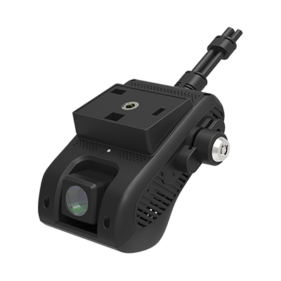
LIGHTMETRICS / 3D EXPLORATION
06
Blender creates the source asset
Best fit: detailed modeling, material preparation and authored animation.
How it works
An artist edits geometry, UVs, materials and keyframes in a desktop scene.
Website handoff
Export a web-ready GLB, then load it with a viewer or engine.
What to watch
Check export compatibility. Complex materials and simulations may need baking.
Camera reference used in this project
Notes:
UVs describe where a texture sits on the model. Baking converts a complex result into simpler textures or sampled animation. Keep an editable source file as well as the exported asset. The browser does not load a .blend scene directly through a standard GLB loader. Recommendation: use Blender to refine the product’s geometry before adjusting web lighting.
Sources:
https://docs.blender.org/manual/en/5.1/addons/import_export/scene_gltf2.html

Slide 7
LIGHTMETRICS / 3D EXPLORATION
07
GLB is the handoff file
A practical delivery format for models on the web.
Format | Purpose | Website workflow
.blend | Editable Blender project | Keep for future art changes
.gltf | Scene description with referenced resources | Useful for inspecting separate assets
.glb | Binary glTF container | Often packages a model into one file
.fbx / .obj | Interchange formats | Usually convert before web delivery
Notes:
glTF is an open runtime asset delivery specification. GLB is its binary container. A GLB can include geometry and textures, but check whether an export references external resources. glTF supports selected material and animation features, not every feature of a digital content creation tool. A file extension alone does not guarantee low size or fast rendering.
Sources:
https://www.khronos.org/gltf/

Slide 8
LIGHTMETRICS / 3D EXPLORATION
08
The asset preparation workflow
A clean export makes the website easier to build and maintain.
01 Match
Check silhouette, dimensions and visible product details against references.
02 Prepare
Use clear part names, sensible pivots and consistent scale.
03 Simplify
Remove hidden geometry and use textures for very fine details.
04 Export
Export GLB and reopen it in the target web viewer.
05 Approve
Review front, side and rear views under the final lighting.
Notes:
This is a recommended production workflow. An artist should preserve features needed for interaction, such as a separately selectable lens or removable cover. Compression can reduce transfer size but has decoding cost and may require loader support. Keep the original uncompressed source. Recheck material appearance after conversion.
Sources:
https://docs.blender.org/manual/en/5.1/addons/import_export/scene_gltf2.html
https://threejs.org/docs/pages/GLTFLoader.html
https://www.khronos.org/gltf/

Slide 9
LIGHTMETRICS / 3D EXPLORATION
09
WebGL draws through the GPU
Best fit: graphics foundations and specialized low-level rendering.
Input
JavaScript sends geometry, textures and rendering instructions.
Processing
Shaders transform vertices and calculate pixel appearance.
Output
The GPU produces an image in an HTML canvas.
Tradeoff
Direct WebGL gives control, with substantial setup and graphics code.
Notes:
WebGL is a browser API, not a modeling application or a ready-made viewer. Libraries usually handle its buffers, shader programs and drawing calls. Learn direct WebGL when you need graphics-engine expertise or a specialized renderer. For a conventional product viewer, a higher-level library is normally easier to maintain. WebGL availability depends on browser and hardware support.
Sources:
https://developer.mozilla.org/en-US/docs/Web/API/WebGL_API

Slide 10
LIGHTMETRICS / 3D EXPLORATION
10
Three.js builds the live scene
Best fit: a custom product viewer or a distinctive interactive website.
Scene + camera
Place the object and choose the initial product view.
Materials + lighting
Define how the model looks in the browser.
Controls + events
Connect drag, zoom, buttons and object selection.
Renderer
Draw the scene after changes or during animation.
Notes:
Three.js exposes reusable scene, camera, mesh, material and renderer objects. A developer combines them into the desired experience. Loading and control helpers reduce setup, but accessibility, error states and page behavior remain project work. Libraries do not automatically recreate a product accurately from its photograph.
Sources:
https://threejs.org/manual/pages/creating-a-scene.html
https://threejs.org/docs/pages/GLTFLoader.html
https://threejs.org/docs/pages/OrbitControls.html

Slide 11
LIGHTMETRICS / 3D EXPLORATION
11
The main options at a glance
Choose by the experience and the team that will maintain it.
Option | Strong starting point | Engineering effort
model-viewer | Product display and optional AR | Low to moderate
Spline | Visual web scenes and motion | Low to moderate
Three.js | Custom viewer and interaction | Moderate to high
React Three Fiber | 3D inside a React application | React + Three.js skills
Babylon.js / PlayCanvas | Richer applications and game-like scenes | Moderate to high
Direct WebGL / WebGPU | Specialized rendering systems | High
Notes:
Effort is a qualitative recommendation, not a measured benchmark. Asset complexity and interaction requirements can dominate the work. A simple embed still needs optimized content, mobile testing and a fallback. Blender complements all these choices as an asset authoring tool.
Sources:
https://modelviewer.dev/
https://docs.spline.design/exporting-your-scene/web/exporting-as-spline-viewer
https://r3f.docs.pmnd.rs/getting-started/introduction
https://www.babylonjs.com/
https://developer.playcanvas.com/user-manual/editor/
https://developer.mozilla.org/en-US/docs/Web/API/WebGPU_API

Slide 12
LIGHTMETRICS / 3D EXPLORATION
12
model-viewer: a focused product embed
Best fit: one product with camera controls, hotspots or an AR entry point.
How it works
A web component loads a model and supplies viewer behavior.
How to publish
Load the component script, add a <model-viewer> element and set its src.
Choose it when
The requirements fit a standard product presentation.
Check first
Custom interactions and AR support vary by feature and device.
Notes:
A web component is a reusable HTML element with built-in behavior. model-viewer accepts glTF/GLB. It can expose product annotations and animation controls. AR may use WebXR, Scene Viewer or Quick Look depending on configuration and device. Verify the exact product flow on the target phones rather than assuming every AR mode works everywhere.
Sources:
https://modelviewer.dev/
https://modelviewer.dev/docs/

Slide 13
LIGHTMETRICS / 3D EXPLORATION
13
Spline: visual scene design
Best fit: designers exploring interactive brand graphics and page motion.
Create
Arrange objects and build interactions in a visual editor.
Publish
Export a Spline Viewer embed or another supported web export.
Connect
Use configured pointer or scroll events to relate the scene to the page.
Evaluate
Check export rights, hosting requirements and current plan limits.
Notes:
Spline Viewer is an HTML web component. A public-URL iframe isolates interactions within its frame, while the viewer can support page-level events. This makes Spline useful for design-led exploration. For exact product modeling, evaluate the required modeling workflow and source assets. Pricing and branding restrictions change, so this deck deliberately avoids fixed subscription claims.
Sources:
https://docs.spline.design/exporting-your-scene/web/exporting-as-spline-viewer

Slide 14
LIGHTMETRICS / 3D EXPLORATION
14
React Three Fiber: Three.js in React
Best fit: a React site where 3D responds to application state.
How it works
React components describe a Three.js scene.
Typical use
A configurator links selected options to model materials or parts.
Developer advantage
Reusable scene components fit an existing React codebase.
Learning requirement
The team still needs Three.js and 3D fundamentals.
Notes:
React Three Fiber is a React renderer for Three.js. It changes how scenes are authored and composed. It does not create the source model and does not make scene optimization unnecessary. Match compatible React, Fiber and Three.js versions. Prefer plain Three.js if introducing React would add complexity to a small existing non-React viewer.
Sources:
https://r3f.docs.pmnd.rs/getting-started/introduction

Slide 15
LIGHTMETRICS / 3D EXPLORATION
15
Babylon.js and PlayCanvas
Best fit: applications that need more than a product turntable.
Tool | How it works | When to explore it
Babylon.js | An engine with tools for rendering and application features. | Consider for complex interactive scenes, XR or game-like behavior.
PlayCanvas | A web engine with a browser-based scene editor. | Consider when artists and developers need a shared visual workflow.
Notes:
Both can also build product viewers. Their appeal grows when the project needs richer scene management, animation or game-style capabilities. PlayCanvas offers editor workflows and publishing options. Babylon.js provides a broad engine and debugging tools. Prototype the hardest requirement in each shortlisted engine before committing. The best choice depends on team expertise and required features.
Sources:
https://www.babylonjs.com/
https://developer.playcanvas.com/user-manual/editor/

Slide 16
LIGHTMETRICS / 3D EXPLORATION
16
WebGPU: a newer graphics foundation
Best fit: advanced rendering or compute workloads with tested device support.
What it adds
A modern browser API for GPU rendering and general-purpose GPU compute.
How teams use it
Through a supporting engine, or through a custom graphics pipeline.
Three.js route
WebGPURenderer can use a WebGPU backend with a WebGL 2 fallback.
Decision rule
Verify features and performance on real target devices before switching.
Notes:
WebGPU requires a secure context and availability varies across browsers, operating systems and devices. Faster performance is not automatic. The Three.js renderer documentation notes differences in features and workload performance relative to WebGLRenderer. Existing custom shader code may need adaptation. Use a static fallback if the chosen rendering path cannot initialize.
Sources:
https://developer.mozilla.org/en-US/docs/Web/API/WebGPU_API
https://threejs.org/manual/pages/webgpurenderer

Slide 17
LIGHTMETRICS / 3D EXPLORATION
17
Other useful approaches
The desired visitor action determines whether real-time 3D is necessary.
Approach | Useful for | Limitation
Video / rendered animation | A fixed story with a carefully controlled look | Visitors cannot choose arbitrary angles
360° image sequence | Spin through photographed or rendered views | Limited to captured viewpoints
CSS 3D transforms | Tilt or rotate page elements | No general mesh-based product rendering
WebXR | Immersive AR or VR on supported devices | Extra compatibility and interaction testing
Notes:
Recommendations: a video can be appropriate for a purely cinematic sequence. A photo spin can preserve photographed appearance when suitable source views exist. CSS perspective is useful for interface elements. WebXR is an API for immersive experiences rather than an asset authoring tool. For WebXR, check HTTPS, permissions and device capabilities.
Sources:
https://developer.mozilla.org/en-US/docs/Web/API/WebXR_Device_API/Permissions_and_security
https://developer.mozilla.org/en-US/docs/Web/API/WebGL_API

Slide 18
LIGHTMETRICS / 3D EXPLORATION
18
Choosing by project
These are recommended starting points, not universal winners.
Project | Starting point | Reason
Simple product viewer | model-viewer | Small integration surface
Custom product viewer | Three.js | Direct control over the experience
React configurator | React Three Fiber | Scene behavior follows app state
Interactive hero | Spline | Visual iteration and web embeds
Room or simulation | Babylon.js / PlayCanvas | Broader application workflows
Cinematic sequence | Rendered video | Predictable art direction
Notes:
This is a synthesis of the documented capabilities and typical production needs. It is not a benchmark or feature ranking. Validate asset requirements, accessibility, maintenance, hosting and target-device performance before final selection.
Sources:
https://modelviewer.dev/
https://threejs.org/manual/pages/creating-a-scene.html
https://r3f.docs.pmnd.rs/getting-started/introduction
https://docs.spline.design/exporting-your-scene/web/exporting-as-spline-viewer
https://www.babylonjs.com/
https://developer.playcanvas.com/user-manual/editor/

Slide 19
LIGHTMETRICS / 3D EXPLORATION
19
Motion design for live interaction
The visitor can interrupt, reverse or repeat the motion.
Authored animation
Create named clips such as OpenCover or RevealLens.
Procedural motion
Use code for hover responses, camera moves or product rotation.
Scroll behavior
Map scroll progress to a camera or animation state when useful.
Accessible behavior
Provide pause or reduced motion and preserve normal page navigation.
Notes:
Exported glTF animation commonly includes transforms, skeletal motion and morph targets. Check unsupported animated properties and bake where appropriate. Specify triggers, duration, easing, interruption behavior and end states in the handoff. A useful rule is one clear purpose per movement. Reduced-motion users should still receive the same product information.
Sources:
https://docs.blender.org/manual/en/5.1/addons/import_export/scene_gltf2.html
https://docs.spline.design/exporting-your-scene/web/exporting-as-spline-viewer
https://threejs.org/docs/pages/OrbitControls.html

Slide 20
LIGHTMETRICS / 3D EXPLORATION
20
A clear handoff between disciplines
Everyone owns a different part of the final experience.
Role | Ownership | Handoff
Designer | Layout, initial view, controls and fallback states | Interaction specification
Motion designer | Timing, transitions and interruption behavior | Motion reference + state notes
3D artist | Geometry, materials, pivots and animation clips | Source scene + approved GLB
Developer | Loading, interaction, accessibility and deployment | Tested website implementation
Notes:
Recommended collaboration model. Review together at the GLB stage and again in the live viewer. Include part names, model scale, preferred camera angle and any approved material variants. Keep screenshots of approved views to prevent the look drifting during optimization.
Sources:

Slide 21
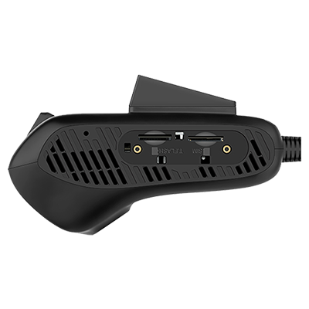
LIGHTMETRICS / 3D EXPLORATION
21
What makes a product look accurate
Geometry and presentation both contribute to perceived quality.
Shape
Silhouette, proportions, openings and part placement.
Surface
Roughness, metalness, lens appearance and fine texture.
Presentation
Lighting, reflections, camera lens and exposure.
Product reference: shape and detail review
Notes:
Project lesson: a beautiful render of the wrong shape still misrepresents the product. A few images cannot reveal hidden surfaces or exact dimensions. Reference-based reconstruction requires assumptions. For higher fidelity, request additional orthographic views, measurements or CAD when available. This is a practical inference from image-based modeling, not a claim that an image uniquely determines geometry.
Sources:

Slide 22
LIGHTMETRICS / 3D EXPLORATION
22
Performance is a design constraint
A useful viewer loads promptly and stays responsive on target phones.
Delivery
Measure model, texture and JavaScript download size.
Rendering
Watch draw calls, pixel resolution, shadows and transparent layers.
Optimization
Compress assets, simplify unseen detail and limit unnecessary effects.
Measurement
Test loading, interaction smoothness and memory on real devices.
Notes:
Set a budget based on the actual audience and devices. There is no universal polygon or megabyte limit that guarantees success. GPU texture memory can be much larger than the compressed download. Reusing geometry and materials can reduce overhead. Consider rendering only when the scene changes, and pause animation when it is offscreen.
Sources:
https://developer.mozilla.org/en-US/docs/Web/API/WebGL_API/WebGL_best_practices

Slide 23
LIGHTMETRICS / 3D EXPLORATION
23
The complete viewer experience
The page must work before, during and after the 3D scene loads.
Before loading
Show a useful poster image and readable product information.
While loading
Provide progress or a clear loading state.
During interaction
Explain rotate, pan and zoom. Offer a reset view action.
When unavailable
Keep a static image and an understandable retry or fallback.
For every visitor
Use labeled HTML controls, keyboard access and reduced motion.
Notes:
A canvas alone does not expose the product information as ordinary accessible page content. Keep important descriptions in HTML. Avoid trapping touch scrolling. Test pointer, keyboard and touch separately. Keyboard and motion accessibility are implementation responsibilities even when a library supplies basic camera controls.
Sources:
https://modelviewer.dev/docs/
https://threejs.org/docs/pages/OrbitControls.html
https://developer.mozilla.org/en-US/docs/Web/API/WebGL_API/WebGL_best_practices

Slide 24
LIGHTMETRICS / 3D EXPLORATION
24
Publishing on Webflow or any website
Host the viewer assets, then connect them to the page.
Embed a component
Use model-viewer or Spline Viewer inside the page.
Embed an iframe
Host a complete viewer separately and point an iframe at its URL.
Integrate JavaScript
Mount Three.js directly for deeper page and UI integration.
Test the published page
Check asset paths, HTTPS, sizing, cross-origin rules and mobile controls.
Notes:
An iframe is often the simplest way to isolate an existing viewer. Direct integration gives closer access to page state and layout. Webflow supports custom HTML, CSS and JavaScript embeds subject to its product capabilities. Some code needs the published page to behave fully. Do not embed localhost in a public site. Use the deployed HTTPS viewer URL.
Sources:
https://help.webflow.com/hc/en-us/articles/33961332238611-Custom-code-embed
https://docs.spline.design/exporting-your-scene/web/exporting-as-spline-viewer
https://modelviewer.dev/docs/

Slide 25
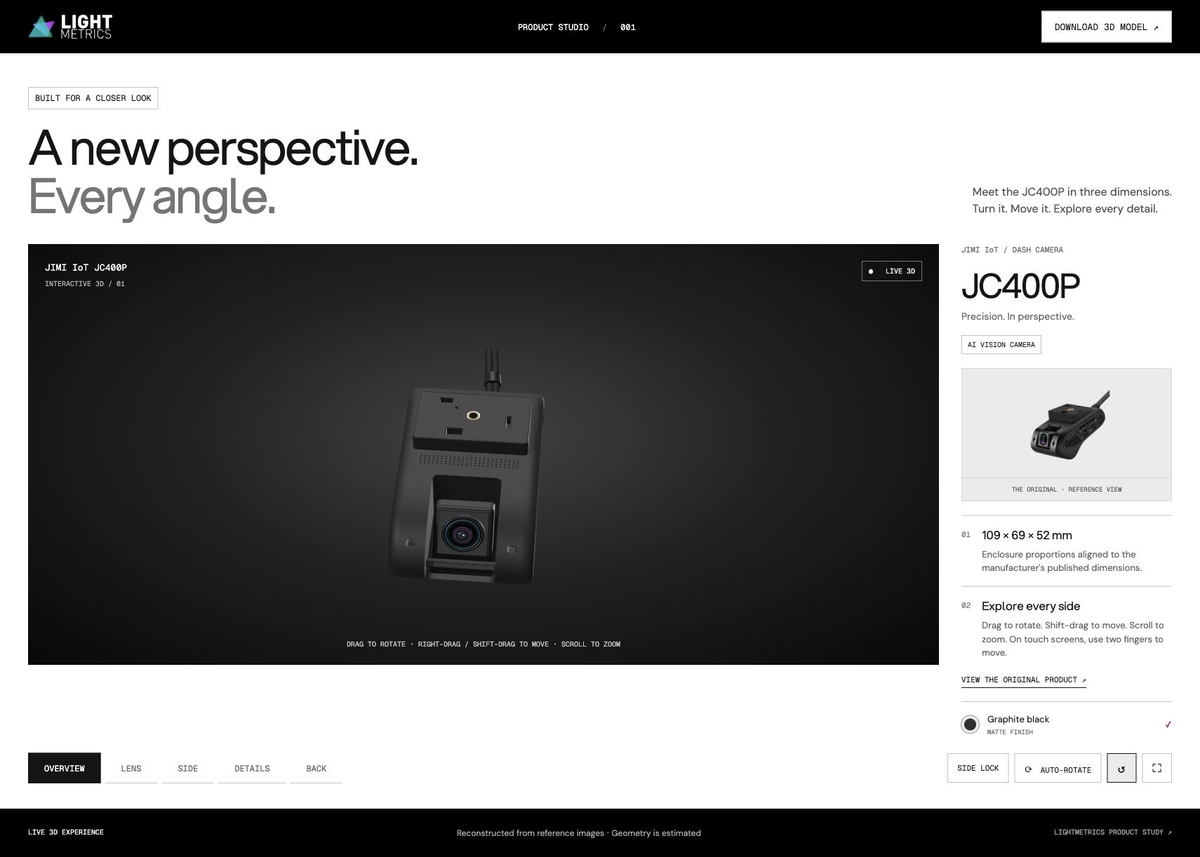
LIGHTMETRICS / 3D EXPLORATION
25
Your LightMetrics camera viewer
Recommended route: keep Three.js and refine the source asset.
Current implementation
A procedural Three.js model with OrbitControls and a GLB export path.
Art improvement
Refine the body and side grille against the supplied product references.
Web improvement
Keep rotate, pan, zoom and reset controls in the LightMetrics theme.
Existing project capture, not a new implementation
Notes:
Local source reviewed: src/main.js imports createCameraModel from model.js, constructs the scene and uses OrbitControls. It imports GLTFExporter for download. This deck does not claim the current model was authored in Blender or exactly matches the product. Proposed next phase: approve the refined GLB in the existing viewer before replacing production assets. Screenshot is the project’s saved initial-view capture.
Sources:

Slide 26
LIGHTMETRICS / 3D EXPLORATION
26
A practical learning path
Each discipline can begin with a small, shared product example.
Beginner
Load a sample GLB, rotate it and learn the six basic terms.
Designer
Specify initial view, control behavior and a mobile fallback.
Artist / motion designer
Export one model and one animation clip. Compare the browser result.
Developer
Build loading and error states, connect controls and measure performance.
Intermediate team
Add one hotspot or variant, then test with real users and devices.
Notes:
Suggested practice sequence rather than a fixed training schedule. Avoid starting with a large scene or many effects. A shared reference model makes disagreements about geometry, lighting and interaction easier to identify. The code appendix shows minimal integration patterns, not complete production applications.
Sources:

Slide 27
LIGHTMETRICS / 3D EXPLORATION
27
Example: a simple product embed
For developers and designers working with custom HTML.
<!-- After loading the model-viewer module -->
<model-viewer
src="/models/camera.glb"
poster="/images/camera.webp"
alt="Interactive view of the camera"
camera-controls
touch-action="pan-y"
style="width:100%; height:480px">
</model-viewer>
The component handles the viewer. Your page still supplies layout, content and fallback behavior.
Notes:
Install and bundle @google/model-viewer, or load a version-pinned module URL following the official quick-start instructions. The /models and /images paths below must exist on the published host. Give the element a visible CSS size. This illustrative fragment assumes the component has already been registered. AR is deliberately omitted so the example focuses on browser viewing.
Sources:
https://modelviewer.dev/docs/

Slide 28
LIGHTMETRICS / 3D EXPLORATION
28
Example: loading a GLB in Three.js
A small fragment inside an initialized Three.js scene.
import { GLTFLoader } from
"three/addons/loaders/GLTFLoader.js";
import { OrbitControls } from
"three/addons/controls/OrbitControls.js";
const controls = new OrbitControls(camera, renderer.domElement);
controls.enablePan = true;
new GLTFLoader().load("/models/camera.glb",
gltf => scene.add(gltf.scene),
undefined, error => console.error("Model failed", error));
renderer.setAnimationLoop(() => {
controls.update();
renderer.render(scene, camera);
});
Model loading, camera framing and material lighting are separate responsibilities.
Notes:
Assumptions: a renderer, scene and camera already exist, and suitable lighting is configured. The camera must frame the model at its real scale. This fragment is illustrative and has not been packaged as a runnable app. Production work also needs resizing, loading state, cleanup and accessibility. For a static scene, use an on-demand rendering strategy if appropriate.
Sources:
https://threejs.org/docs/pages/GLTFLoader.html
https://threejs.org/docs/pages/OrbitControls.html

Slide 29
LIGHTMETRICS / 3D EXPLORATION
29
Example: embedding a hosted viewer
An iframe can reuse a complete viewer across multiple pages.
<iframe
src="https://your-domain.example/viewer/"
title="Interactive camera product viewer"
loading="lazy"
allow="fullscreen"
style="width:100%; height:640px; border:0">
</iframe>
Use a public HTTPS URL for deployment. localhost works only on your own machine.
Notes:
Replace the example URL with the real deployed viewer URL. Use a dedicated viewer layout if the hosted page includes its own header or surrounding content. Fullscreen permission does not grant WebXR permissions. If immersive AR is required, review the appropriate permission policy separately. Check that hosting headers permit embedding.
Sources:
https://help.webflow.com/hc/en-us/articles/33961332238611-Custom-code-embed
https://developer.mozilla.org/en-US/docs/Web/API/WebXR_Device_API/Permissions_and_security

Slide 30
LIGHTMETRICS / 3D EXPLORATION
30
Official resources: assets and rendering
A starting library for continued learning.
Blender glTF export
docs.blender.org / glTF 2.0
glTF resources
khronos.org/gltf
Three.js fundamentals
threejs.org / creating a scene
Loading and controls
GLTFLoader and OrbitControls documentation
Browser graphics
MDN WebGL API and WebGPU API
Notes:
Direct links:
https://docs.blender.org/manual/en/5.1/addons/import_export/scene_gltf2.html
https://www.khronos.org/gltf/
https://threejs.org/manual/pages/creating-a-scene.html
https://threejs.org/docs/pages/GLTFLoader.html
https://threejs.org/docs/pages/OrbitControls.html
https://developer.mozilla.org/en-US/docs/Web/API/WebGL_API
https://developer.mozilla.org/en-US/docs/Web/API/WebGPU_API
https://threejs.org/manual/pages/webgpurenderer
https://developer.mozilla.org/en-US/docs/Web/API/WebGL_API/WebGL_best_practices
Sources:
https://docs.blender.org/manual/en/5.1/addons/import_export/scene_gltf2.html
https://www.khronos.org/gltf/
https://threejs.org/manual/pages/creating-a-scene.html
https://developer.mozilla.org/en-US/docs/Web/API/WebGL_API
https://developer.mozilla.org/en-US/docs/Web/API/WebGPU_API

Slide 31
LIGHTMETRICS / 3D EXPLORATION
31
Official resources: viewers and publishing
Use the documentation for the versions you actually deploy.
Product viewer
modelviewer.dev
Visual authoring
Spline Viewer documentation
React integration
r3f.docs.pmnd.rs
Application engines
babylonjs.com and developer.playcanvas.com
Website embedding
Webflow Custom code embed guide
Notes:
Direct links:
https://modelviewer.dev/
https://modelviewer.dev/docs/
https://docs.spline.design/exporting-your-scene/web/exporting-as-spline-viewer
https://r3f.docs.pmnd.rs/getting-started/introduction
https://www.babylonjs.com/
https://developer.playcanvas.com/user-manual/editor/
https://help.webflow.com/hc/en-us/articles/33961332238611-Custom-code-embed
https://developer.mozilla.org/en-US/docs/Web/API/WebXR_Device_API/Permissions_and_security
Research checked 9 October 2026. Browser support, pricing and export capabilities may change.
Sources:
https://modelviewer.dev/
https://docs.spline.design/exporting-your-scene/web/exporting-as-spline-viewer
https://r3f.docs.pmnd.rs/getting-started/introduction
https://www.babylonjs.com/
https://developer.playcanvas.com/user-manual/editor/
https://help.webflow.com/hc/en-us/articles/33961332238611-Custom-code-embed

Slide 32
LIGHTMETRICS / 3D EXPLORATION
32
The recommended starting point
One approved model. One useful interaction. One tested website.
For LightMetrics
Refine the camera asset, then keep the existing Three.js viewer.
For a simple new product embed
Try model-viewer before building custom infrastructure.
For more ambitious experiences
Select the engine after prototyping the hardest interaction.
Notes:
Recommendations are tailored to the project and the comparisons in this guide. The final choice should account for maintainers, device support and the required interaction. Accurate geometry and a considerate user experience matter more than adding effects.
Sources:

