Slide 1

Teamcenter CoPilot – GenAI-powered Assistant
Enhancing productivity with intelligent AI-driven support
Notes:
AI-generated content may be incorrect. ---

Slide 2
Overview
Notes:
Introduction

Slide 3

Introduction
GenAI Assistant for PLM
Teamcenter CoPilot uses generative AI to improve productivity and efficiency in PLM tasks.
Seamless Integration
Designed to integrate with Teamcenter, providing contextual and department-aware support.
Automation and Security
Facilitates knowledge retrieval, automates code generation, and ensures secure handling of data.
User-Centric Design
Focuses on scalability, security, and user-friendly features for modern engineering environments.
Notes:
The Teamcenter CoPilot is a GenAI-powered assistant developed to enhance the productivity and efficiency of Product Lifecycle Management (PLM) teams. Designed with advanced artificial intelligence capabilities, it aims to streamline various PLM-related tasks by offering intelligent support and automation. The assistant is tailored to integrate seamlessly with Siemens Teamcenter, providing contextual and department-aware functionalities. Prepared by Naveen Aswal in September 2025, this system is envisioned to transform how PLM teams interact with data, documents, and code within the Teamcenter ecosystem. The CoPilot leverages generative AI to facilitate knowledge retrieval, automate code generation, and ensure secure handling of sensitive information. Its design emphasizes scalability, security, and user-centric features, making it a valuable tool for modern engineering and manufacturing environments.

Slide 4
Functional Capabilities
Notes:
Use Cases

Slide 5
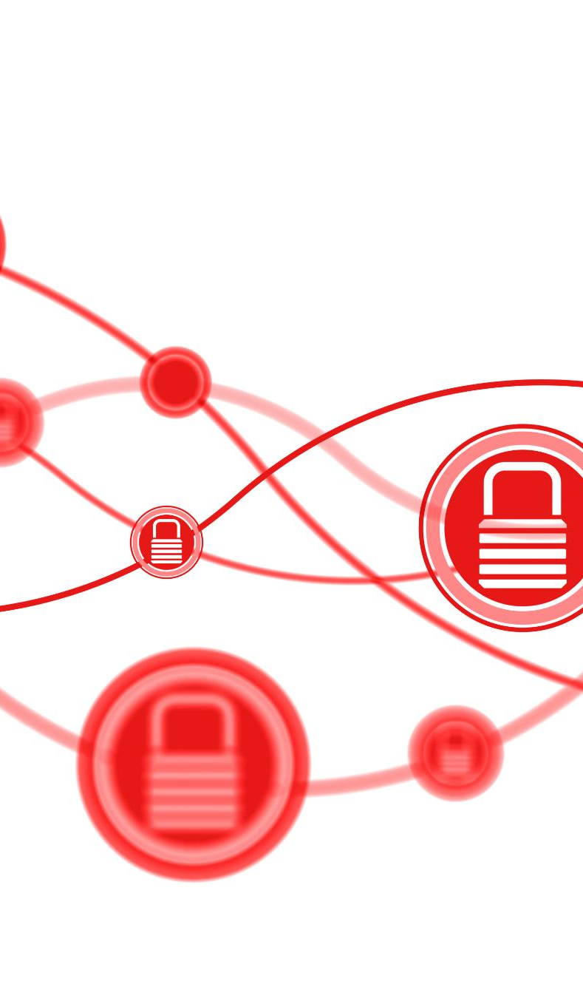
Use Cases
Knowledge Retrieval
Enables quick access to relevant information in large, siloed data environments, improving decision-making.
Code Generation
Provides tailored code templates and snippets to reduce development time and minimize errors.
Secure Knowledge Segregation
Ensures sensitive data is compartmentalized by department to maintain integrity and compliance.
Document Upload Integration
Allows users to upload and query documents within the Teamcenter framework for better data integration.
Notes:
Teamcenter CoPilot supports a variety of use cases that cater to the diverse needs of PLM teams. One of its primary functions is knowledge retrieval, allowing users to access relevant information quickly and efficiently. This is particularly useful in environments where data is vast and often siloed. Another significant use case is code generation, where the assistant provides templates and snippets tailored to specific tasks, reducing development time and errors. Secure knowledge segregation ensures that sensitive information is compartmentalized based on departmental access, maintaining data integrity and compliance. Additionally, the system supports document upload capabilities, enabling users to integrate and query documents within the Teamcenter framework. These use cases collectively enhance operational efficiency, reduce manual effort, and foster a more intelligent and responsive PLM environment.

Slide 6
System Specifications
Notes:
System Requirements

Slide 7
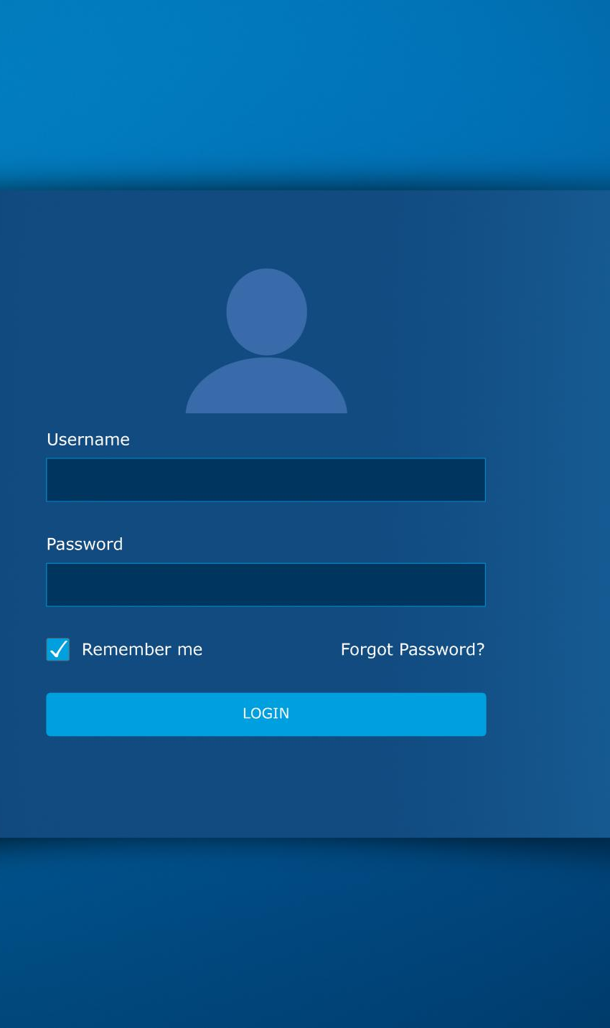
System Requirements
Functional Department-aware Querying
The system tailors query responses based on the user’s departmental context for relevant information retrieval.
Secure Document Upload
Ensures all uploaded documents are secured with stringent security protocols to protect sensitive data.
Code Generation Templates
Supports templates that facilitate rapid development and easy customization for enhanced productivity.
User Interface and Feedback
Streamlit UI includes a progress bar that enhances user experience through real-time feedback.
Notes:
The Teamcenter CoPilot system is built with a robust set of functional and non-functional requirements to ensure optimal performance and security. Key functional requirements include department-aware querying, which allows the system to tailor responses based on the user's departmental context. Secure document upload is another critical feature, ensuring that all uploaded content is handled with stringent security protocols. The system also supports code generation templates, facilitating rapid development and customization. Integration with the EuronAI LLM provides advanced language model capabilities for intelligent completions. On the non-functional side, the system includes a Streamlit UI with a progress bar to enhance user experience and provide real-time feedback. These requirements are designed to support a scalable, secure, and user-friendly environment that aligns with the operational needs of PLM teams.

Slide 8
Technical Architecture
Notes:
Technology Stack & Architecture

Slide 9

Technology Stack & Architecture
Frontend and Backend
Streamlit powers the interactive frontend while Python provides robust backend processing and integration.
Storage and Search
AWS S3 ensures secure document storage, and FAISS enables efficient vector-based search by department.
AI Models and Embeddings
HuggingFace embeddings improve semantic search accuracy, complemented by GPT-4.1-nano for intelligent completions.
Deployment and Code Generation
Docker and EC2 enable scalable deployment, while Jinja2 templates facilitate ITK/SOA code generation.
Notes:
The technology stack of Teamcenter CoPilot is composed of modern and scalable components that ensure high performance and reliability. The frontend is developed using Streamlit, providing an interactive and user-friendly interface. The backend is powered by Python, enabling robust processing and integration capabilities. For document storage, the system utilizes AWS S3, ensuring secure and scalable data management. FAISS is employed for vector search, allowing efficient retrieval of information based on departmental segmentation. HuggingFace embeddings are used to enhance semantic understanding and search accuracy. The EuronAI GPT-4.1-nano model is integrated for generating intelligent completions, while Jinja2 templates facilitate code generation for ITK/SOA. Deployment is managed through Docker and EC2, providing flexibility and scalability. This architecture supports a seamless and efficient operation tailored to the needs of PLM teams.

Slide 10
Roadmap
Notes:
Future Enhancements

Slide 11
Future Enhancements
Multi-language Support
Introducing German and Japanese support to improve accessibility for global teams.
Role-Based Access Control
Implementing RBAC to enhance security by assigning permissions based on user roles.
SAP Integration
Enabling metadata synchronization and data consistency through SAP platform integration.
Automated CI/CD and Offline Support
Adopting CI/CD automation and offline embedding pipeline for seamless updates in limited connectivity environments.
Enhanced Analytics Dashboard
Providing deeper insights with Streamlit dashboard for better system usage and performance visualization.
Notes:
The future roadmap for Teamcenter CoPilot includes several enhancements aimed at expanding its capabilities and improving user experience. Multi-language support is planned, with initial focus on German and Japanese, to cater to global teams and improve accessibility. Role-based access control (RBAC) will be introduced to ensure that users have appropriate permissions based on their roles, enhancing security and compliance. Integration with SAP is also on the horizon, enabling metadata synchronization and improving data consistency across platforms. The system will adopt CI/CD practices for automated retraining and deployments, ensuring that updates and improvements are delivered seamlessly. An offline embedding generation pipeline is planned to support environments with limited connectivity. Additionally, an enhanced analytics dashboard in Streamlit will provide deeper insights and better visualization of system usage and performance. These enhancements will further solidify Teamcenter CoPilot as a comprehensive and intelligent assistant for PLM teams.

