Slide 1
TICKET BOOKING SYSTEM
Prepared by,
Naveen Srinivas V (23CSR145)
Rithish R (23CSR178)
Menaha R (23CSR130)

Slide 2
PROBLEM STATEMENT:
In today’s fast-paced world, booking tickets for travel, events, and entertainment is often time-consuming and inefficient. Many existing systems lack user-friendly interfaces, real-time availability updates, and seamless payment options. This leads to issues such as double bookings, long waiting times, and difficulties in managing cancellations or refunds

Slide 3
OBJECTIVE:
Develop a web-based Ticket Booking System that allows users to browse available tickets, book seats, make payments, and manage reservations easily. The system should support multiple types of bookings (e.g., bus, train, movie, concert, sports events) and provide real-time availability updates.

Slide 4
SOFTWARE TOOLS USED:
FRONT END:
HTML
CSS
REACTJS
BACK END :
NODE JS
DATABASE:
MONGODB

Slide 5
IMPLEMENTATION DETAILS:
Users can view available tickets Users can book tickets and select seats Bookings update in real-time Data is securely stored in MongoDB
Manage Events & Bookings: Add, edit, or remove events/movies/concerts.
Analytics & Reports: Track total bookings, revenue, and seat occupancy rates. User Management: View, edit, or block users. Notifications & Alerts: Send automated emails/SMS for booking confirmations

Slide 6
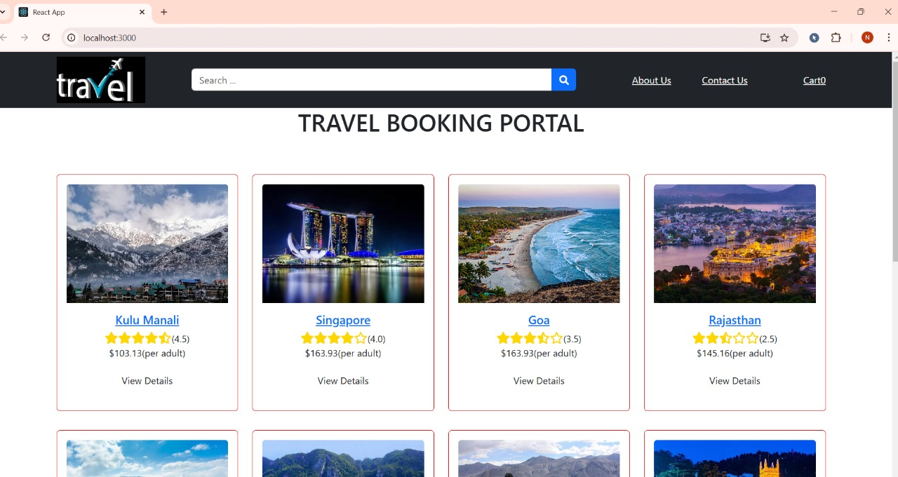
OUTPUT:

Slide 7
THANK YOU

