Slide 1

Wells Fargo Technology Hackathon 2025
Seagulls
- sky is the limit
Gen AI for Platform Support – Integrated platform Environment
Seª_{g}ullsV25
Trivia – each letter used in SeagullsV25 is written using different font, font size, style and font color ☺
Jarvis- One stop AI solution for Platform Support

Slide 2
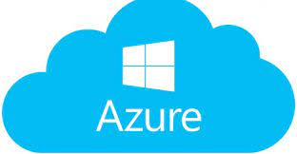

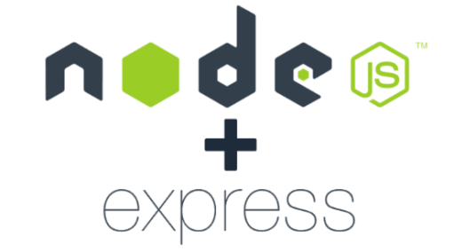







Jarvis- Diversified Technology Stack
Public Cloud

Slide 3
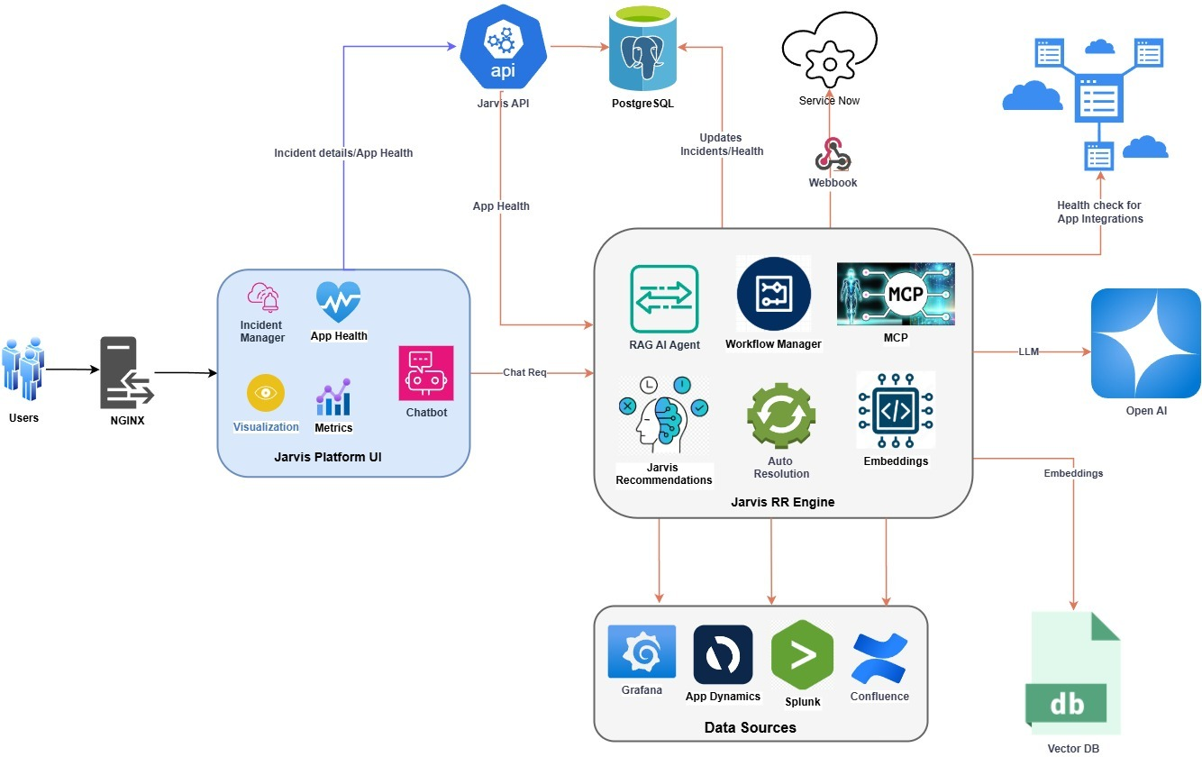
Jarvis- Architecture

Slide 4
“Jarvis” summary

Slide 5
Demo

