Slide 1

Wells Fargo Technology Hackathon 2025
Seagulls
- sky is the limit
Gen AI for Platform Support – Integrated platform Environment
Seª_{g}ullsV25
Trivia – each letter used in SeagullsV25 is written using different font, font size, style and font color ☺
Jarvis- One stop AI solution for Platform Support

Slide 2
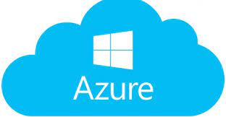
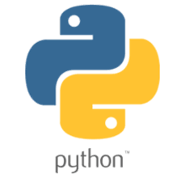
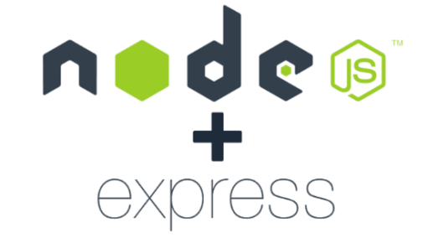


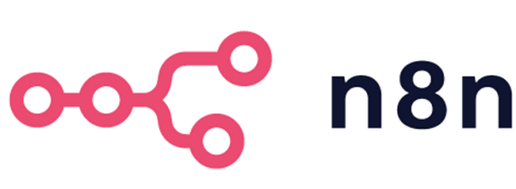
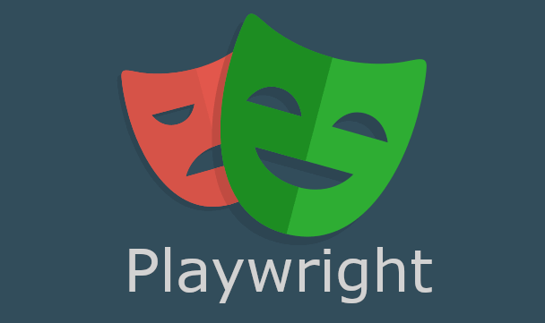
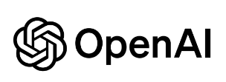
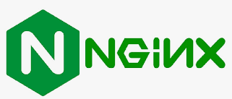

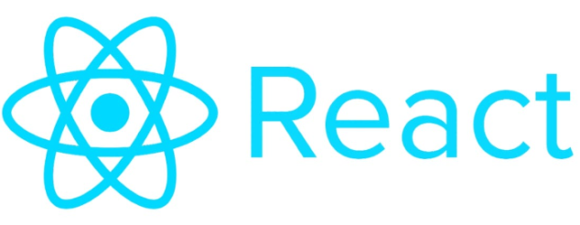
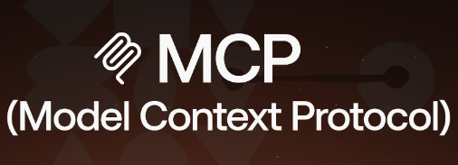
Jarvis- Diversified Technology Stack

Slide 3
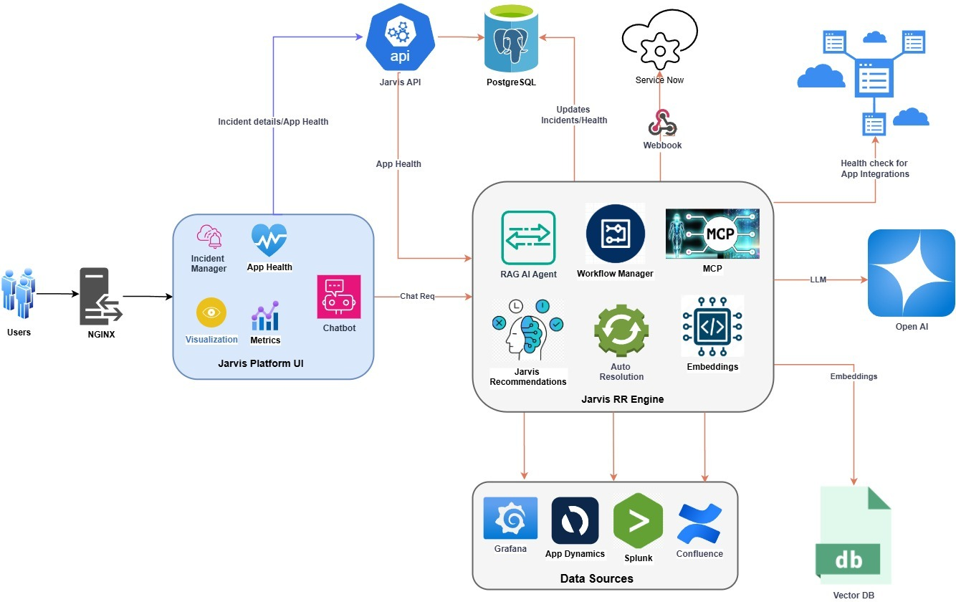
Jarvis- Architecture

Slide 4

“Jarvis” summary
Problem Statement:
Develop a gen-AI enabled Integrated platform environment that provides an integrated console to platform support
Novelty:
Self healing and auto updates in Servicenow with GenAI automated Incident resolution workflow
Real time data sync of new Incidents and data source updates to Vector database
Configurable workflows for RAG and datasync
Multi agent orchestration to segregate responsibilities
Application and dependency health dashboard
Portfolio health view for managers and Leadership
Metrics around the Platform capabilities
Integrated customized toolkit(eg : Docker) with framework supported workflows
Solution:
GenAI workflows for key capabilities of platform
Webhook at ServiceNow to trigger GenAI workflow for proactive recommendations ,RCA Summary and resolutions
Integrated UI with AI chat assistant to manage,traige,resolve incidents and additional capabilities to support day to day work
Leverage the data from enterprise tools Servicenow,Grafana,Splunk,confluence etc.
MCP used for seamless integration and efficient context management
APIs to easily integrate with UI and GenAI workflow

Slide 5
Demo

Slide 6
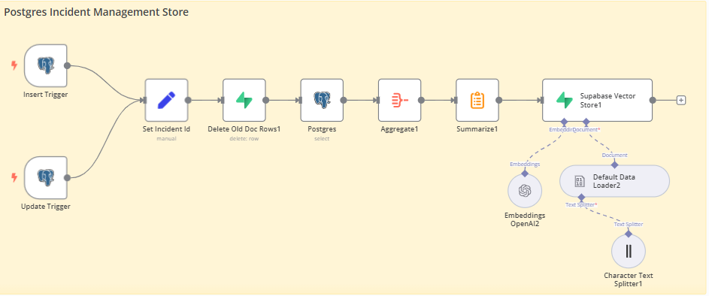
Demo

