Slide 1
EQUITY RESEARCH · DATA WORKFLOW
From raw financial data to a usable stock screener
A practical path from company records to interactive analysis

Slide 2
THE RESEARCH LENS
Four ratios turn a flat dataset into an equity-research lens
Each measure reframes company inputs as a screening question. Interactive filters turn those measures into decisions a researcher can test.
VALUATION
VALUATION
PROFITABILITY
LEVERAGE
P/E
P/B
ROE
Debt-to-Equity
Price relative to earnings
Price relative to book value
Income generated by equity
Debt relative to equity
02

Slide 3
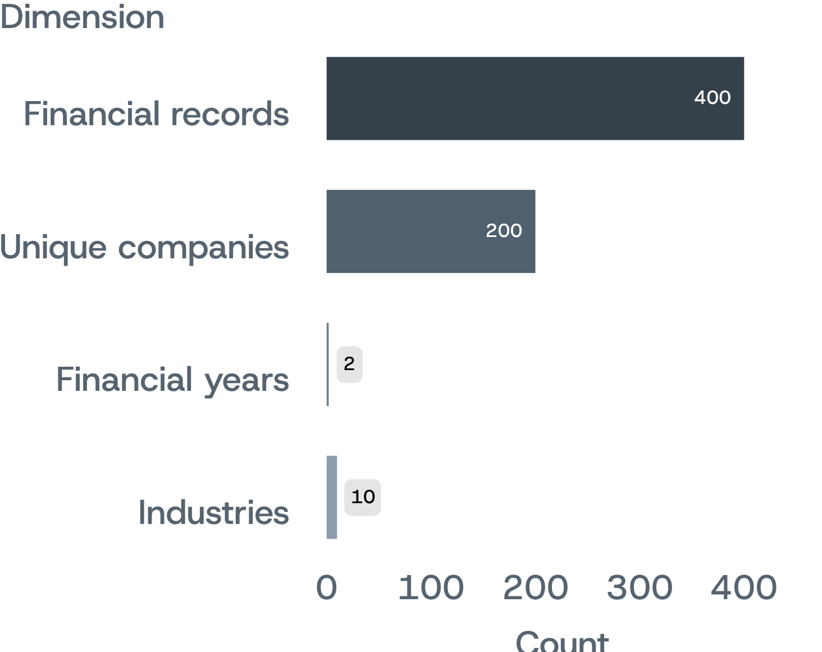
DATASET SCOPE
The project covers 200 companies across two financial years
400 financial records span 10 industries and FY2025 and FY2026. Inputs include price, EPS, book value, income, equity, debt and shares outstanding.
The company breadth and year coverage support cross-sectional and year-over-year comparison.
03

Slide 4
VALIDATION BEFORE CALCULATION
The workflow is designed to catch bad inputs before they become bad ratios
01
02
03
04
05
Load
Inspect
Check EPS
Calculate
Publish
Read the financial CSV with Python and Pandas.
Review rows, columns and missing values.
Identify zero or negative earnings.
Compute and verify the four ratios.
Send the final dataset to the interactive dashboard.
04

Slide 5
FOUR QUESTIONS, FOUR MEASURES
Each ratio answers a different research question
VALUATION
VALUATION
PROFITABILITY
LEVERAGE
P/E
P/B
ROE
D/E
What do investors pay for earnings?
How does price compare with book value?
How effectively does equity generate income?
How much debt sits behind equity?
Price per unit of earnings.
Debt per unit of equity.
Market price relative to book value.
Net income in relation to equity.
05

Slide 6
EDGE CASE · EARNINGS PER SHARE
If EPS ≤ 0,
P/E is not meaningful.
The screener returns N/A instead of forcing a misleading number.
43
Range checks
Valid P/E values exclude those records.
records with EPS less than or equal to zero
06

Slide 7
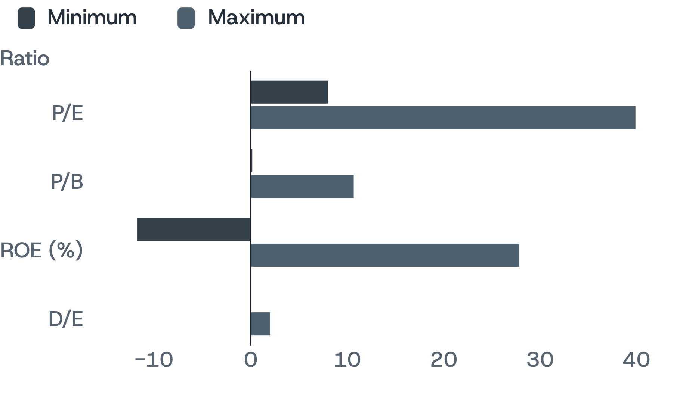
VERIFIED RATIO RANGES
The calculated ranges show the spread the dashboard needs to expose
P/E range uses valid positive-EPS records only.
Distinct scales and a negative ROE floor call for separate controls and views.
07

Slide 8
SCREEN · REVIEW · RESET
The dashboard turns analysis into an interactive screening loop
Move from broad context to a focused set of matching company records, then reset and test another hypothesis.
01
02
03
04
05
Scope
Value
Quality
Review
Repeat
Choose financial year and industry.
Set maximum P/E and P/B.
Set minimum ROE and maximum D/E.
Explore KPIs, charts and matching records.
Reset filters and test a new hypothesis.
08

Slide 9
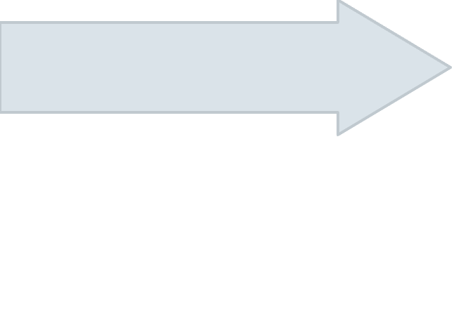
SEPARATION OF CONCERNS
The architecture keeps calculation separate from exploration
Preparation produces a ratio-enriched CSV; the dashboard explores that output without mixing screening choices into the calculation stage.
Interactive dashboard and user-defined screening
Final CSV with ratio columns
Ratio calculation with NumPy
Python / Pandas data checking
Raw financial data
09

Slide 10

CONCLUSION · NEXT STEPS
What the project proves — and where it can go next
The project demonstrates an end-to-end path from CSV inputs to an interactive equity-research tool, with explicit handling for non-positive EPS.
Year and industry context remain available for analysis. The separation between calculation and exploration gives future work a clear base.
Next: automated refresh, historical trends, more ratios, market-performance metrics and database connectivity.
10

