Slide 1
Hotel Booking status prediction

Slide 2
CONTEXT:
Problem statement
Visualization
Procedure
Models
Suitable choice of the Models
Conclusion

Slide 3
1)Problem statement:
In addition to some additional criteria that were included in our data set, this issue statement discusses the hostel status, which basically displays how many people are cancelling their bookings at various locations.
Now we must analyse the supplied data and develop a classification model.
The Link of the data set is :https://raw.githubusercontent.com/Premalatha-success/Datasets/main/hotel_bookings.csv

Slide 4
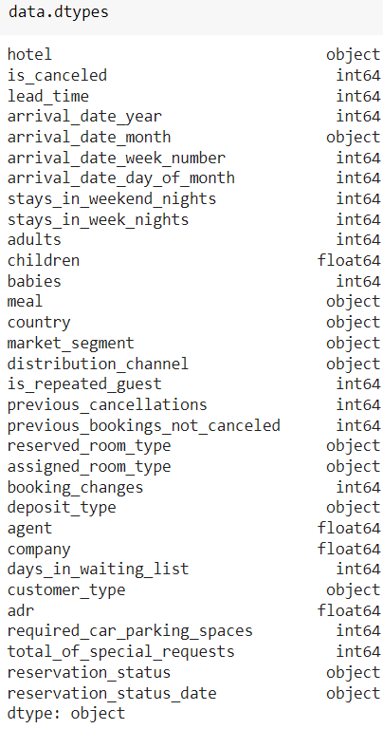
Data Discussion
Formatting the data set

Slide 5
2)Visualization.

Slide 6
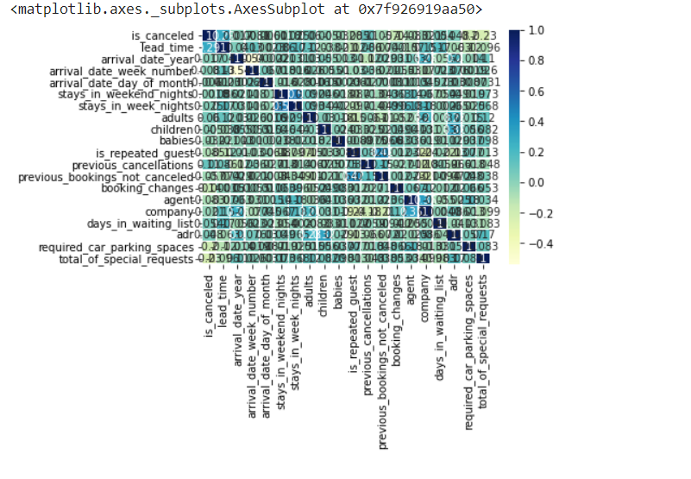
Correlation of the given data set

Slide 7
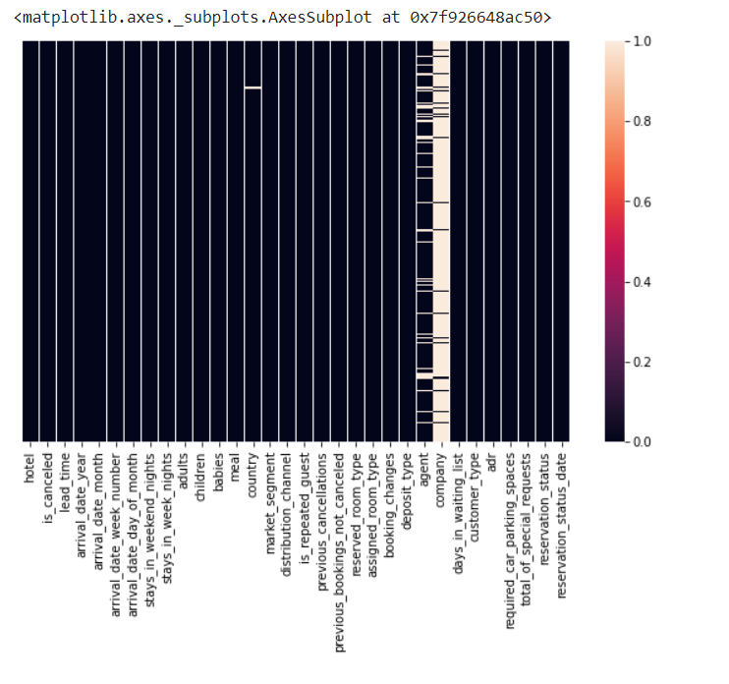
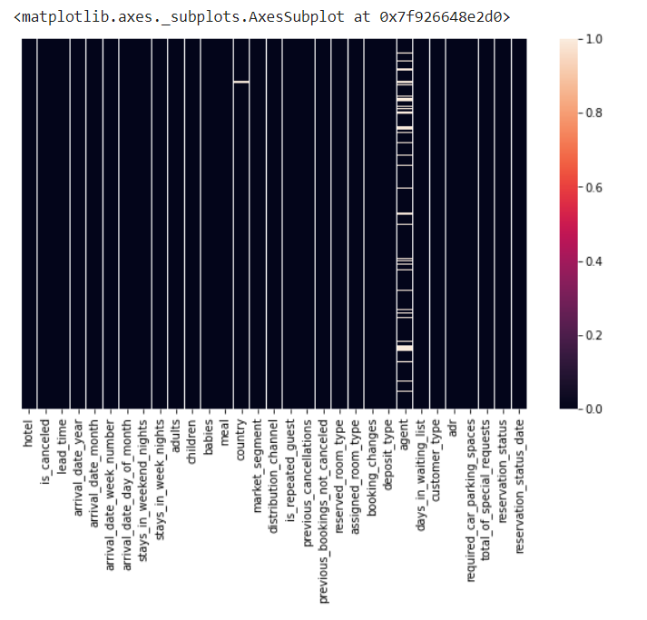
heat map:
Before
After

Slide 8
3)Procedure
4 steps to do this project
1: Import the packages numpy,pandas, matplotlib,seaborn,sklearn,train test split,metrics 2:Load the Dataset
3:Explore the data-shape,visualisation
4:X,y—>train data test data Fit the model with training data predict with the Test data

Slide 9
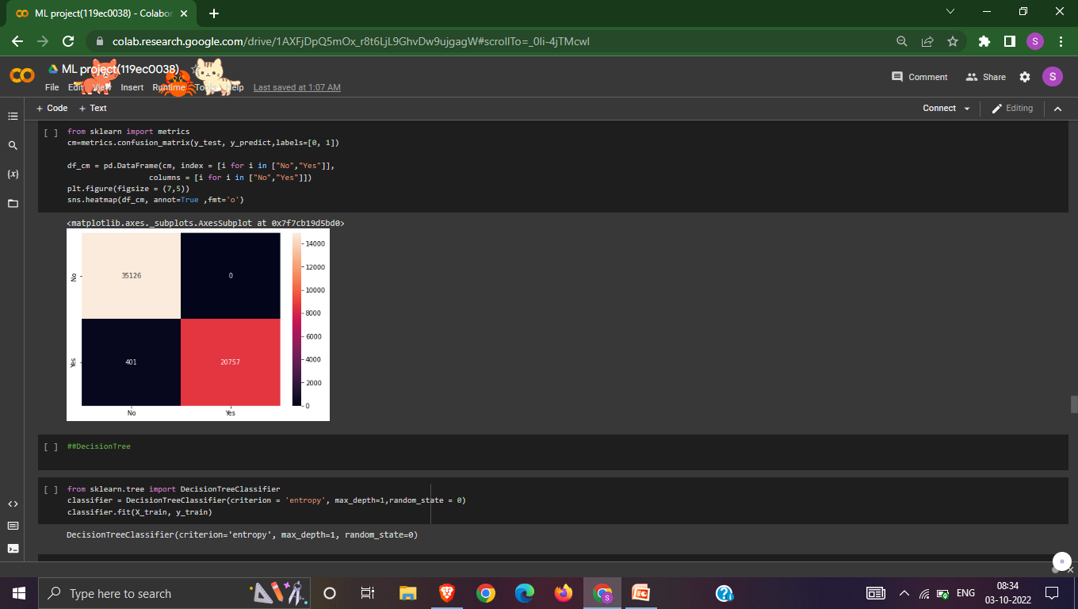

4)ModeLs
logistic regression
DecisionTree

Slide 10
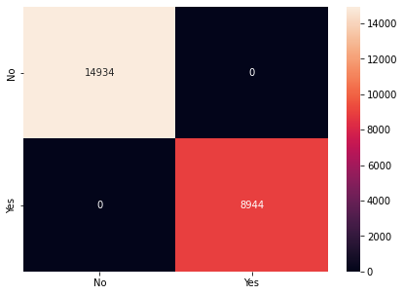
Bagging
AdaBoost

Slide 11
Gradient Boosting Classifier

Slide 12
5)suitable choice of the Models
I experimented with all five of the categorised ML algorithms, but in the end I settled on the Gradient Boosting classifier because it runs quickly, has a 100% accuracy rate, and has no confusion matrices (Q1 and Q3).
It is based on the hypothesis that the overall prediction error is minimised when past models are combined with the best viable upcoming model.

Slide 13
6) Conclusion
Following the visualisation of features in the data set using training and testing data.
For logistic regression
Training:0.990053605829634
Testing: 0.9892369545188039

Slide 14
DecisionTree
Training:0.990053605829634
Testing:0.9892369545188039

Slide 15
Random Forest
Training: 0.9999895301113996
Testing: 0.9997487226735907
Bagging
Training:1.0
Testing:1.0

Slide 16
Ada Boosting
Training:1.0
Testing:1.0
Gradient Boosting
Training:1.0
Testing:1.0

