Slide 1
Product Sales Analysis
Phase-3

Slide 2
INTRODUCTION
Product sales analysis is a critical component of business intelligence and data-driven decision-making.
It involves the examination and interpretation of sales data to gain insights into a company's product performance, customer behavior, and market trends.

Slide 3
1.Data Source
The dataset for the above mentioned project was obtained from kaggle website
Kaggle is an popular dataset providing source where obtained datasets are with high quality and less errors.

Slide 4
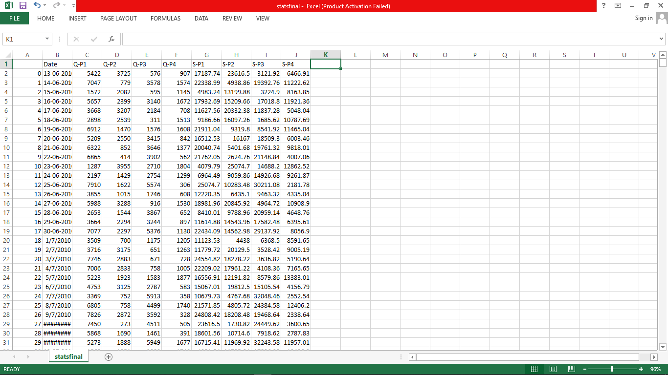
Imported Dataset

Slide 5
Necessary Steps to Follow
1.Import the Necessary Libraries
Start by importing the required libraries.
Program:
import pandas as pd
import numpy as np
import mathplotlib .pyplot as plt
Import seaborn as sns
2. Load the Dataset:
Read the dataset such as a CSV file, into a Pandas Dataframe.
Replace ‘statsfinal.csv' with the actual filename of your dataset.
Program:
data = pd.read_csv(‘' C:/Users/Public/Documents/statsfinal.csv’)

Slide 6
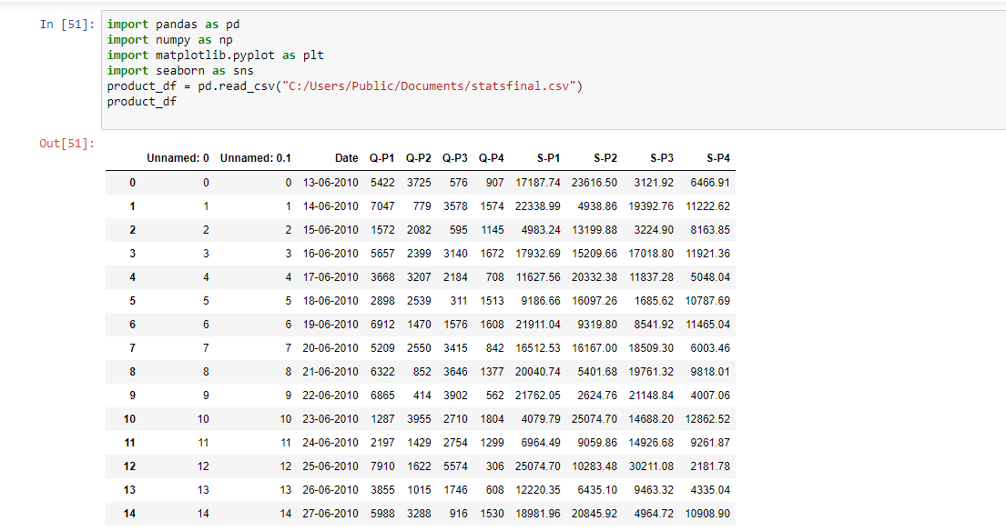
Load the Dataset

Slide 7
Load and Preprocess the Dataset Using Python
To clean a Dataset by preprocessing steps
you can load and preprocess your dataset using Python
Save the preprocessed data to a CSV file

Slide 8
3.Explore the Data:
Before preprocessing, it's essential to get an overview of the dataset.
Program:
# Display the first few rows of the dataset
print(data.head())
# Get basic information about the dataset
print(data.info())
# Check for missing values
print(data.isnull().sum())
# Summary statistics
print(data.describe())

Slide 9
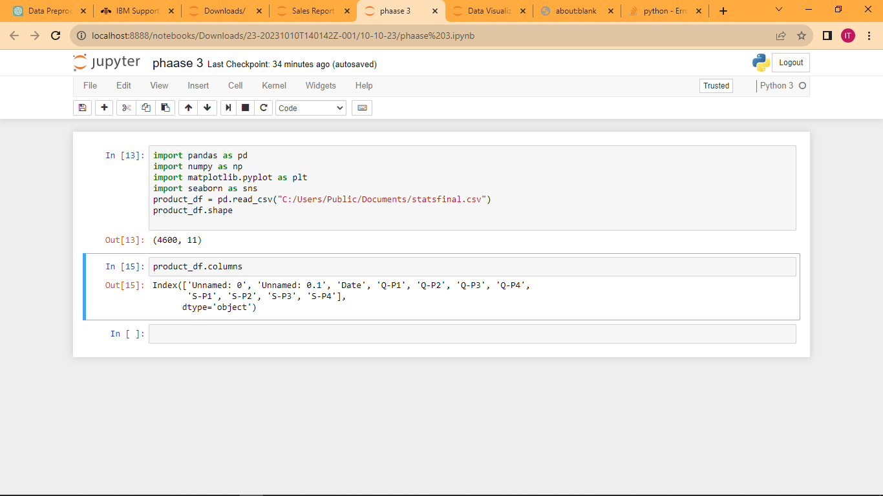
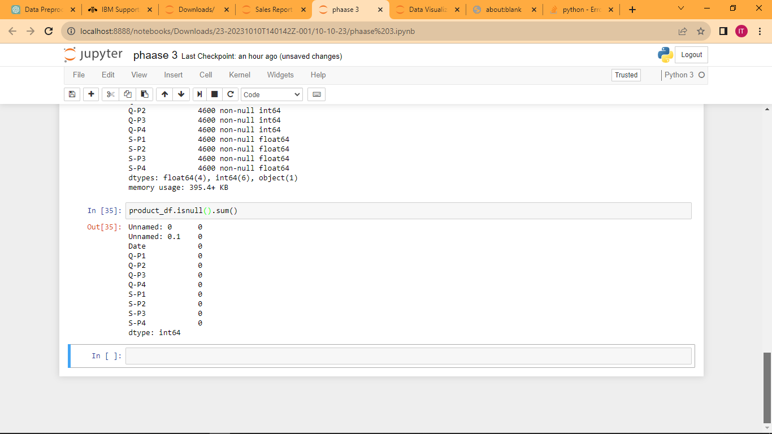
Program:

Slide 10
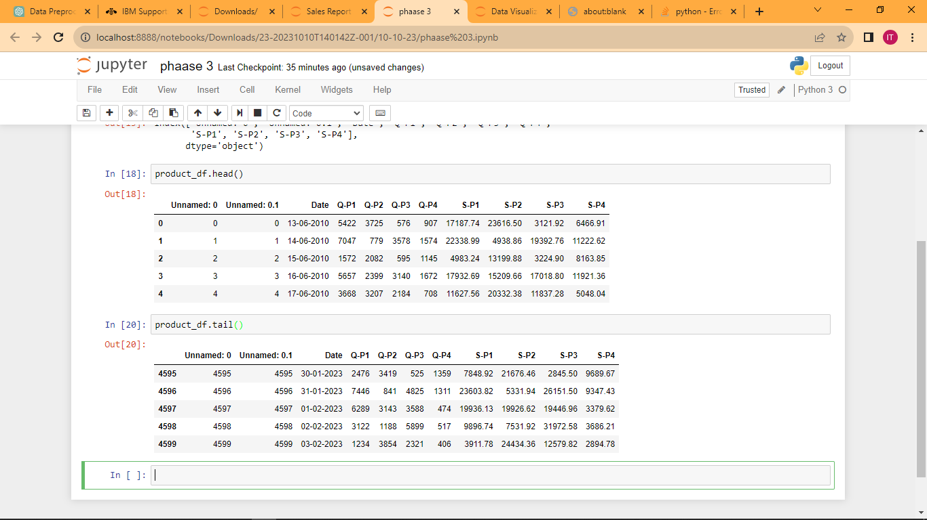
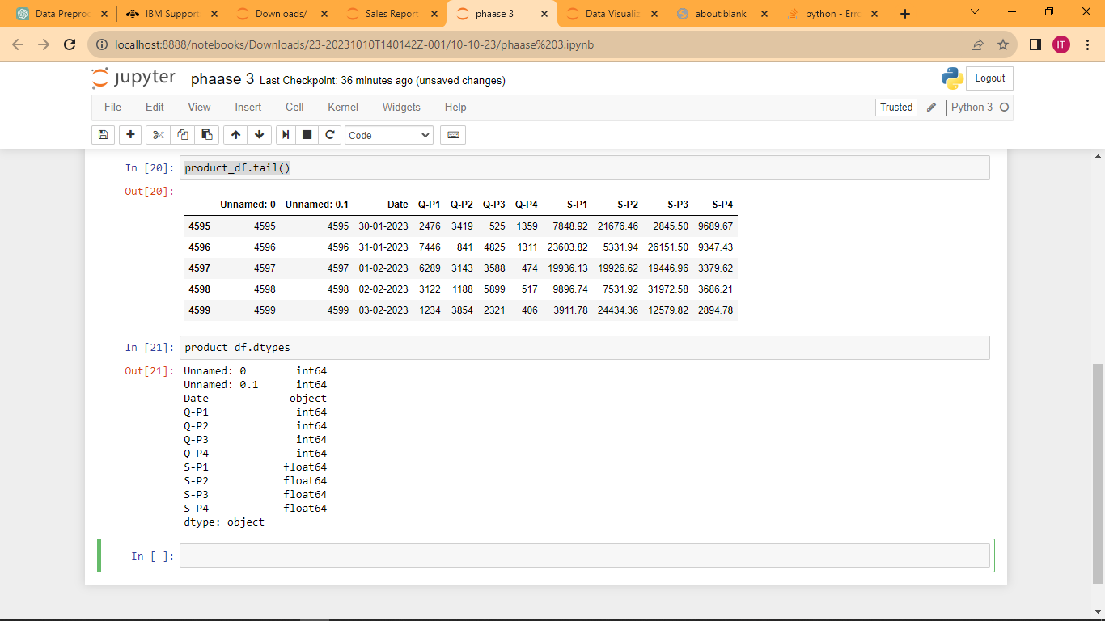

Slide 11
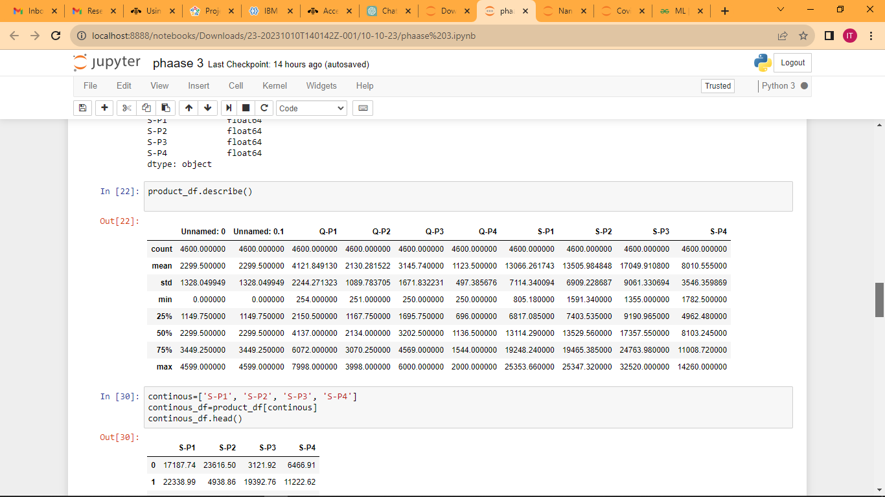
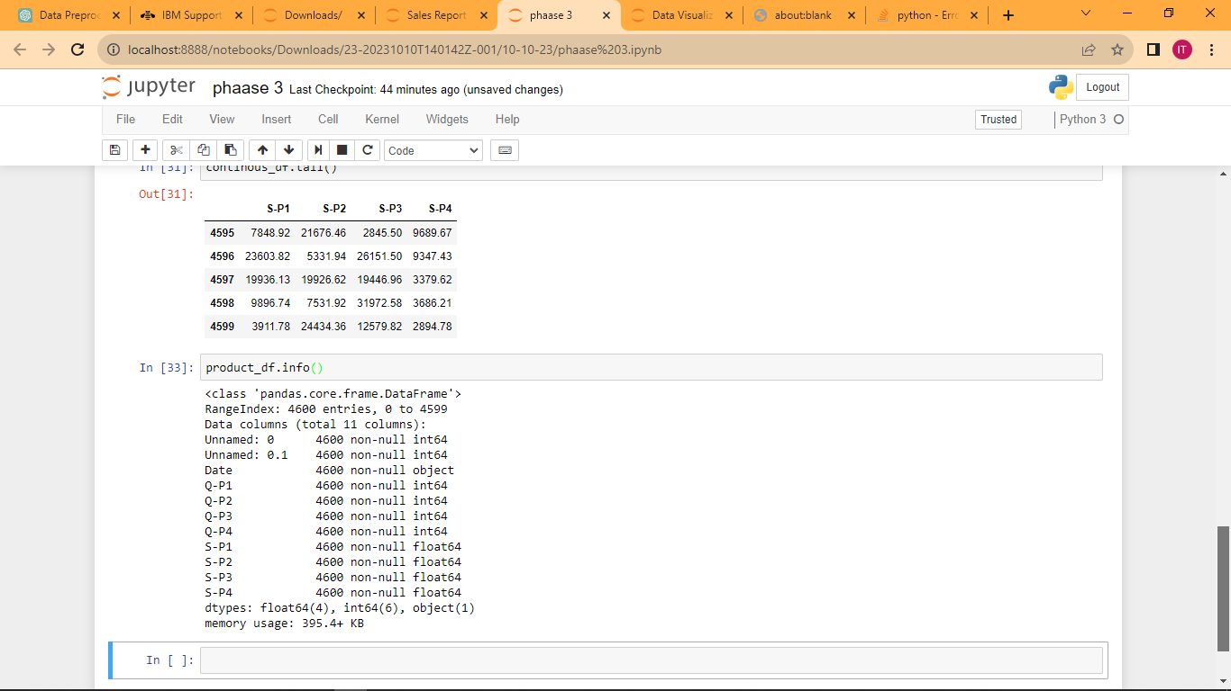

Slide 12
In This Dataset have 9 Columns
'Date', 'Q-P1', 'Q-P2', 'Q-P3', 'Q-P4', 'S-P1', 'S-P2', 'S-P3', 'S-P4
Q-P1 and Q-P2 and Q-P3 and Q-P4 are discrete variable
S-P1 and S-P2 and S-P3 and S-P4 are continuous variable
Continuous Variable:
A continuous variable is a type of variable in statistics and mathematics that can take on an infinite number of values within a given range
Discrete Variable:
A discrete variable, in the context of statistics and mathematics, is a type of variable that can take on a finite or countable number of distinct values

Slide 13
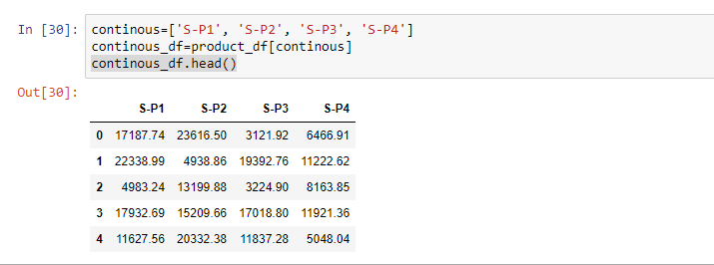
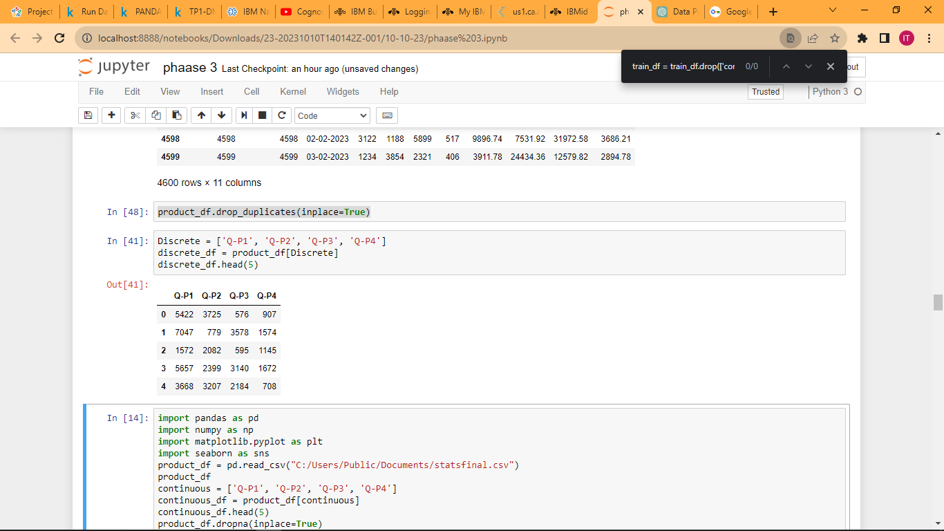
Continuous Variable:
Discrete Variable:

Slide 14
4.Feature Engineering
Create new features or modify existing ones if needed for your analysis.
This step depends on the specifics of your analysis.
Program:
data['year'] = pd.to_datetime(data['date']).dt.year
data['month'] = pd.to_datetime(data['date']).dt.month
5.Data Transformation:
Transform data to make it suitable for analysis.
You might need to encode categorical variables, normalize or scale numerical features, and perform other transformations.

Slide 15
Challenges involved in loading and preprocessing a product sales dataset
Data Volume:
Large datasets can be challenging to load and process efficiently, as they may not fit into memory. You may need to implement data loading strategies like data streaming or batch processing
Missing Data:
Sales datasets often contain missing values, which must be dealt with appropriately. Imputing missing values or deciding how to handle records with missing data is an important preprocessing step.

Slide 16
Data Integration:
Your sales data comes from multiple sources or systems, integrating the data into a single coherent dataset can be challenging.
You'll need to establish data mappings and standardize the data formats.
Data Validation:
Ensuring data accuracy and consistency is crucial.
You may need to implement data validation checks to identify and handle data that doesn't meet predefined criteria.

Slide 17
Preprocessing the dataset:
Data preprocessing is the process of cleaning, transforming, and
integrating data in order to make it ready for analysis.
This may involve removing errors and inconsistencies, handling
missing values, transforming the data into a consistent format, and
scaling the data to a suitable range.
Visualisation and Pre-Processing of Data:
Visualizing and preprocessing data are crucial steps in product sales analysis.
Let's start with data visualization using Python and the Matplotlib and Seaborn libraries, and then we'll discuss data preprocessing

Slide 18
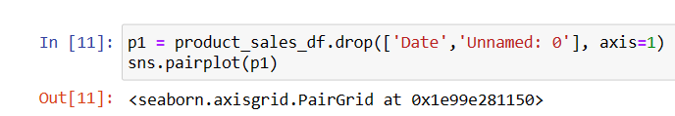
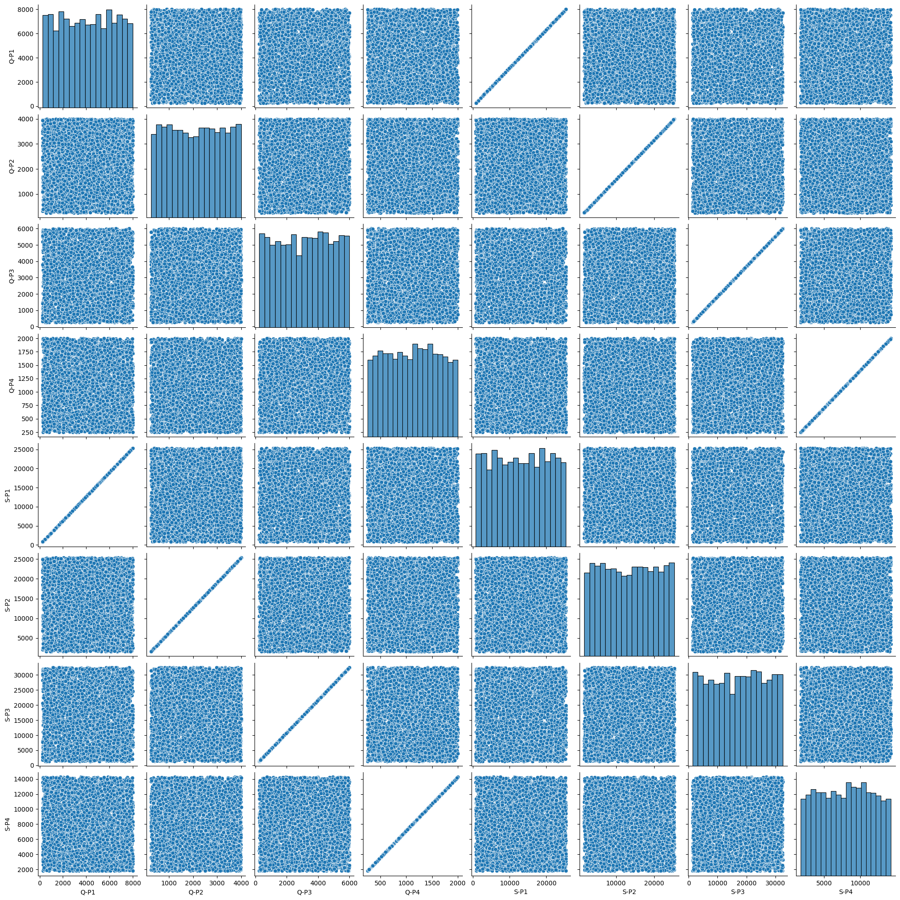
Visualize continuous numeric variables

Slide 19
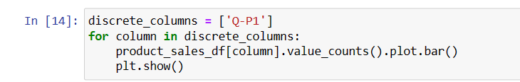
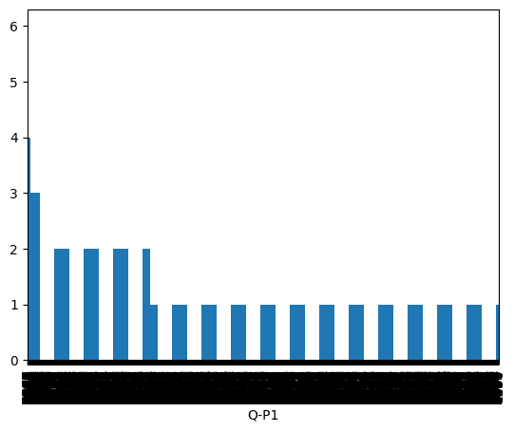
Visualize discrete numeric variables

Slide 20
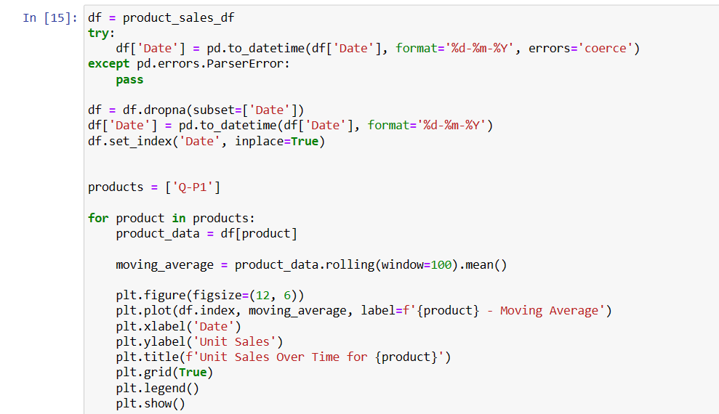

Slide 21
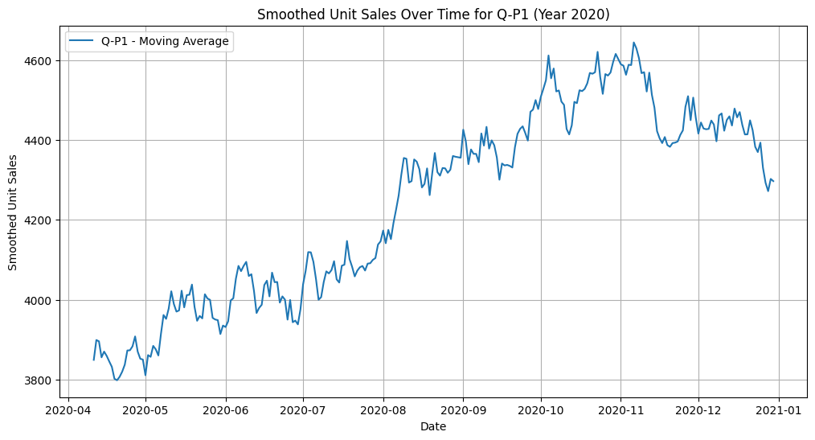

Slide 22
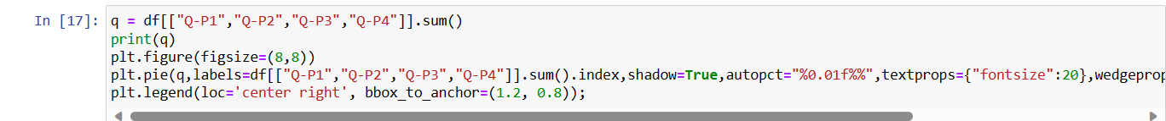
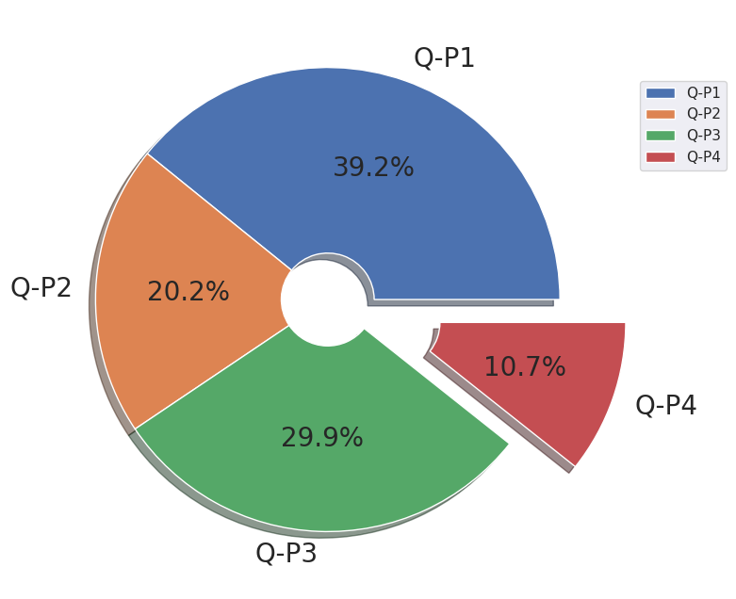

Slide 23
Conclusion:
The analysis of product sales provides valuable insights into a business's performance, enabling data-driven decision-making and strategic planning
product sales analysis is an essential tool for businesses to adapt and thrive in a dynamic market. It empowers businesses to make informed decisions, optimize their product offerings, and create a customer-centric approach that leads to sustained growth and profitability.
Sales analysis is not just about the past; it's also about looking ahead. It informs business strategy, helps in setting sales targets, and provides a basis for forecasting future sales.

