Slide 1
PRODUCT SALES ANALYSIS

Slide 2
PROBLEM DEFINITION:
To analyze and improve product sales performance, this project aims to gather, process, and interpret sales data to gain insights into key metrics such as revenue, profit margins, product popularity, and customer behavior.
The objective is to identify trends, opportunities, and areas for optimization in order to enhance overall product sales and profitability.

Slide 3
PROJECT DEFINITION:
The product sales analysis project aims to comprehensively assess and analyze the sales performance of a company's product portfolio over a specific period.
It involve collecting, organizing, and interpreting sales data to provide actionable insights and recommendations for optimizing product sales strategies, identifying top-performing products, and addressing areas of improvement.
Ultimately, the project's goal is to enhance revenue generation and maximize profitability through data-driven decision-making.

Slide 4
DESIGN THINKING
ANALYSIS OBJECTIVES
Define the specific insights you want to extract from the sale data, such as identifying top-selling products, analyzing sales trends, and understanding customer preferences
DATA COLLECTION
Determine the sources and methods for collecting sales data, including transaction records , product information and customer demographics

Slide 5
DESIGN THINKING
VISUALIZATION STRATEGY
Plan how to visualize the insights using IBM cognos to create interactive dashboards and reports
ACTIONABLE INSIGHTS
Identify how the derived insights can guide inventory management and marketing strategies

Slide 6
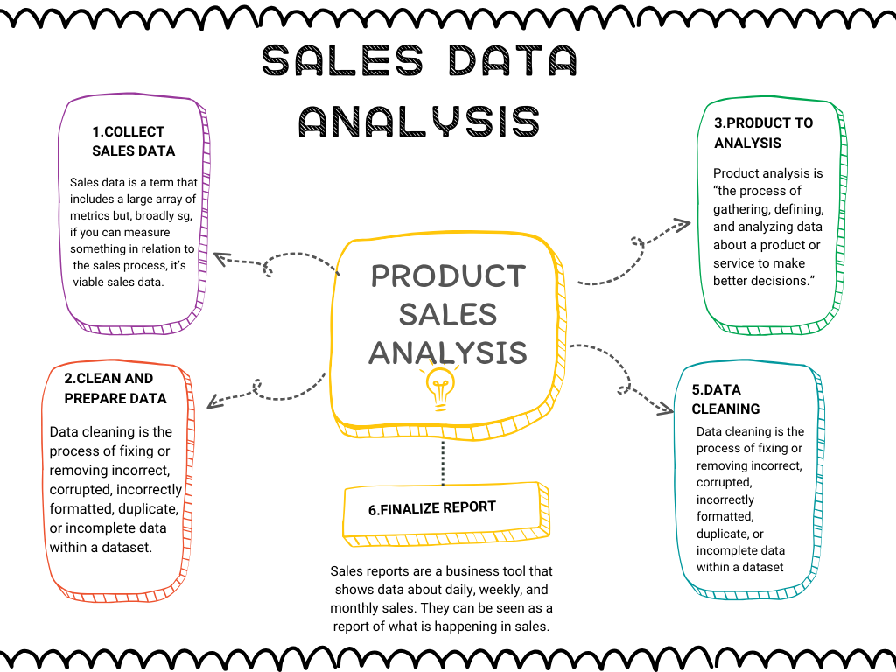
FLOW CHART

