Slide 1
Superstore Sales and Profitability Dashboard
Data Storytelling using Tableau/Power BI
Dataset: Sample Superstore

Slide 2
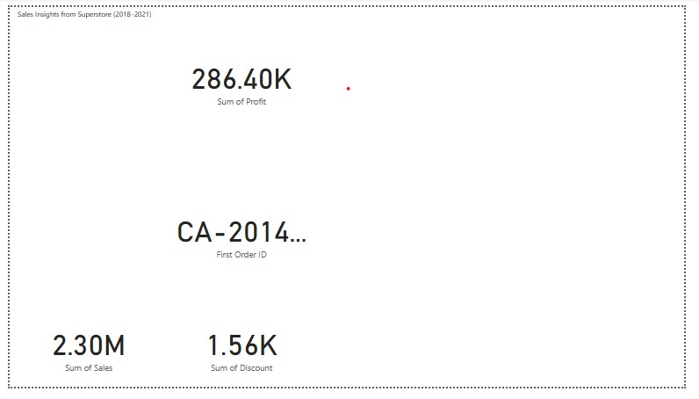
Overview Dashboard
High-level summary of key KPIs: Sales, Profit, Orders, and Profit Ratio. Useful to gauge business performance at
a glance.

Slide 3
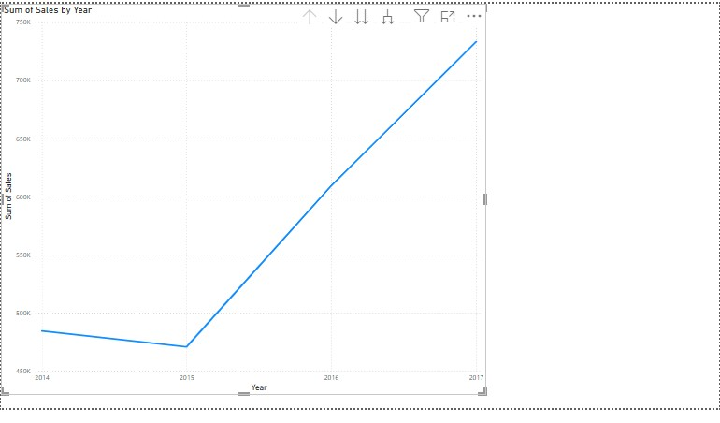
Sales Trend Over Time
Sales show seasonal peaks in Q4 and dips in Q1. Indicates strong year-end performance but potential for growth in
early months.

Slide 4
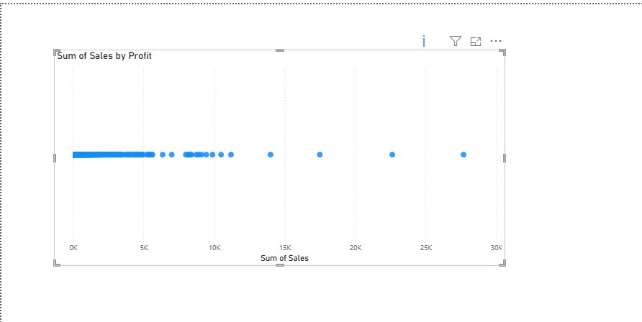
Profitability Analysis
Identifies profit leakage despite strong sales. Visualizes sub-categories or products affecting net profit.

Slide 5
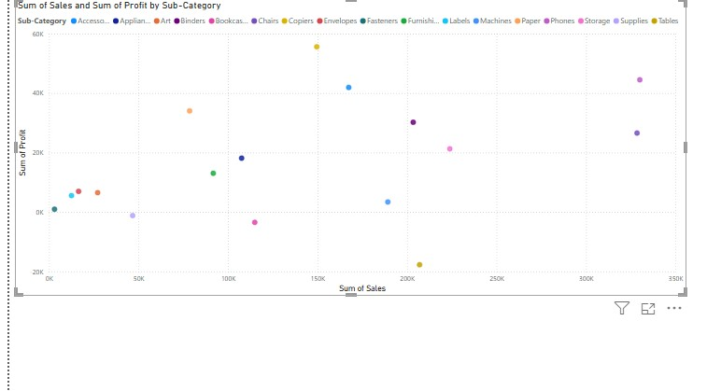
Profit-to-Sales Ratio
Helps analyze operational efficiency. Low ratios point to high discounts or cost of goods sold.

Slide 6
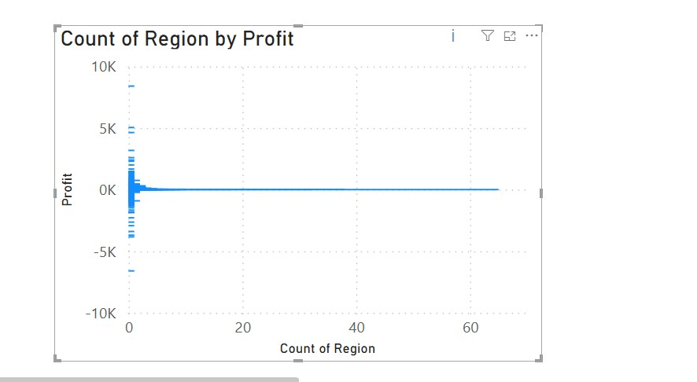
Sales by Region
Breaks down performance by geographical region. West may dominate in sales, but others may lag.

Slide 7
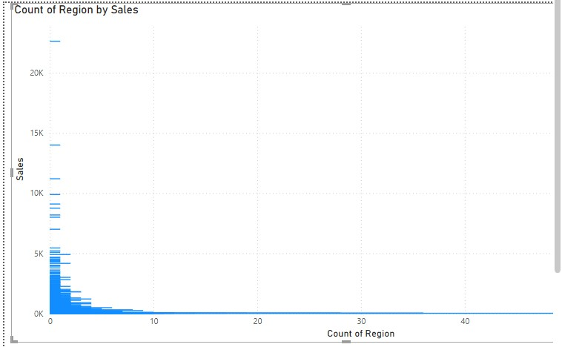
Sales or Profit by Region
Shows regions that are sales-heavy vs. profit-efficient. Helps target operational improvements.

Slide 8
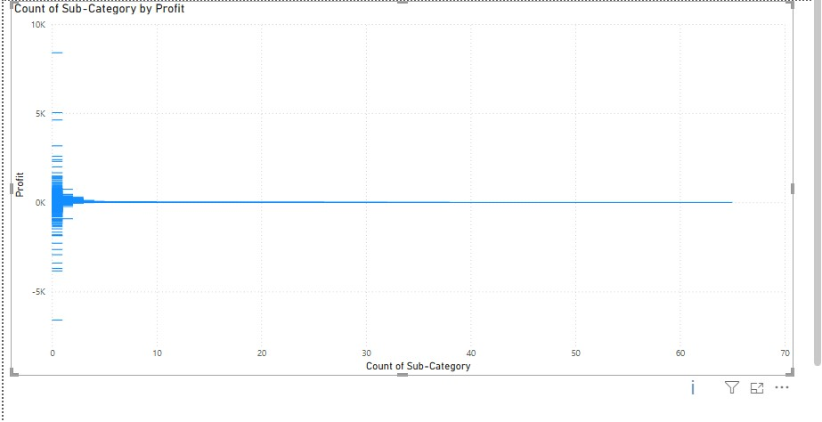
Segment Analysis
Analyzes customer segments like Consumer, Corporate, and Home Office. Corporate often brings higher revenue per order.

Slide 9
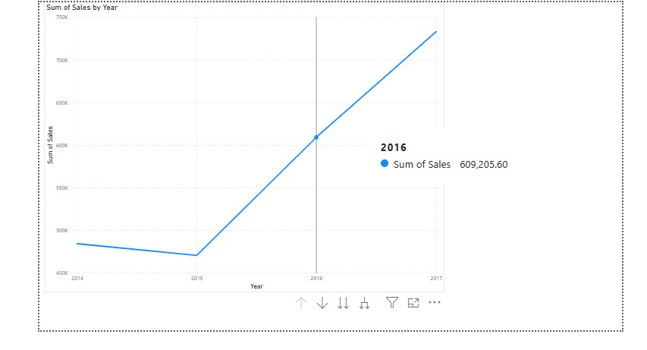
Trend Over Time
Supports forecasting. Sales trend upward, but profit margins show instability.

Slide 10
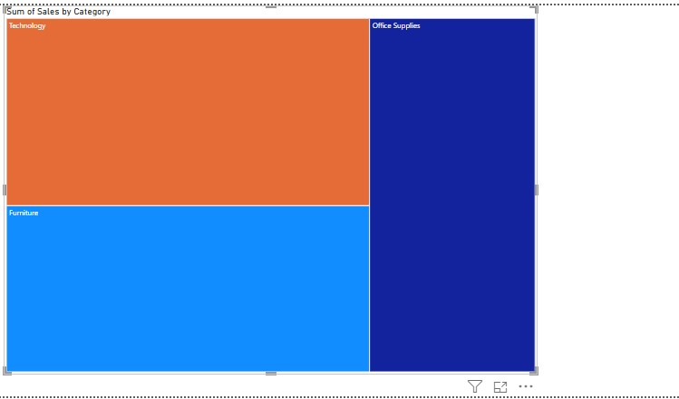
Top-Performing Categories
Highlights categories driving the most revenue or profit. Helps prioritize marketing and inventory.

Slide 11
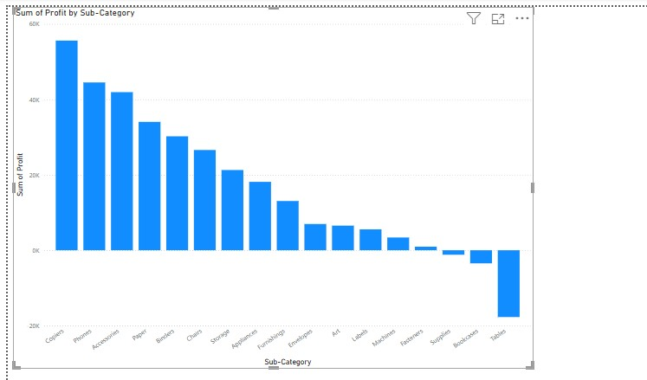
Loss-Making Sub-Categories
Pinpoints categories consistently generating losses. Key for cost-cutting or repositioning.

