Slide 1
Travel Cost & Package Recommender System
An AI-powered travel package suggestion system based on user preferences

Slide 2
Project Members
Data Science Team:
- Anitha Sirigireddy
- Bapathi Naveen Kumar Reddy
- Ganesh Sura
Full Stack Team:
- Shreyas Kandekar
- Rajoli Srinivas
- Malli Prudhvi

Slide 3
Project Overview
Goal: Recommend top 5 personalized travel packages.
Inputs: From City, Destination, Trip Duration, Budget, etc.
Outputs: Top 5 packages with details like type, cost, duration, and accommodation.
Tech Stack:
- Data Science: Python, pandas, scikit-learn, Streamlit, Power BI
- Full Stack: Flask, React, HTML, CSS, Bootstrap, Vercel, Render

Slide 4
Data Science Workflow
1. Data Collection
2. Data Validation & Cleaning
3. Exploratory Data Analysis (EDA)
4. Predictive Modelling
5. Recommendation Model (Cosine Similarity)
6. Streamlit Deployment

Slide 5
Data Collection
Dataset: Travel dataset with 22,342 records and 11 features.
Key Columns: From_City, Destination, Duration, Budget, Type, Season, etc.
Objective: Prepare structured data for travel recommendation modeling.

Slide 6
Data Validation & EDA
Validated data types, removed duplicates, standardized text.
Performed Univariate and Bivariate analysis (Budget, Duration, Season, Type).
Visualized distributions and relationships using Matplotlib and Seaborn.

Slide 7
Key Insights
• Popular destinations: Goa, Delhi, Jaipur
• Average Trip Cost: ₹49K
• Common Duration: 4–6 days
• Winter season had the most bookings
• Luxury packages had the highest budgets

Slide 8
Null Values & Outliers Handling
No missing values found.
Outliers detected in the Budget column.
Handled using percentile capping (5th–95th).
Python functions: outlier_detect(), outlier_replacement().

Slide 9
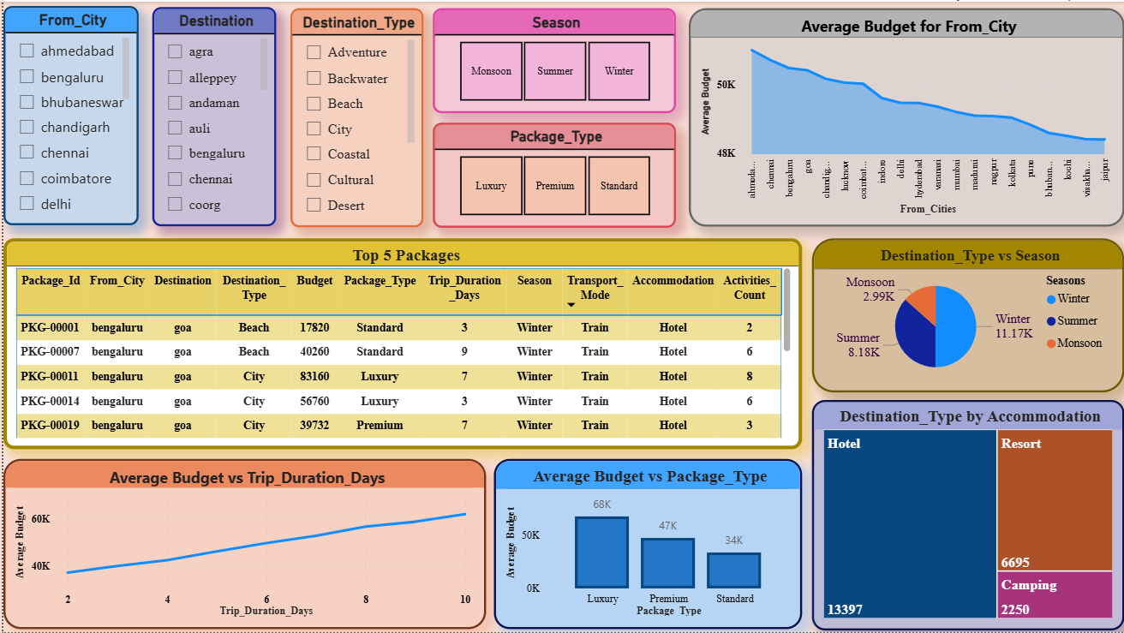
Power BI Dashboard Overview

Slide 10
Data Preprocessing
1. Encoding : Converting Categorical data to Numerical Data. > One Hot Encoding
2. Scaling : Transforming all Numerical features to a common scale.
> Min-Max Scaler

Slide 11
Recommendation System
Algorithm: Cosine Similarity
Features: Destination_Type, Budget, Duration, Season, Accommodation_Type, etc.
Process:
- Convert user input into a feature vector
- Compute similarity with dataset features
- Return top 5 recommendations
Output: Ranked travel packages based on similarity.

Slide 12
Streamlit & Git Deployment
Developed interactive app using Streamlit.
Users input preferences and get top 5 travel packages.
Code hosted on GitHub and integrated with full stack team.
Model deployment-ready and tested.

Slide 13
Full Stack Workflow
Developed a complete web-based recommender system integrating Data Science and Full Stack modules.
Frontend: React.js (for interactive user input and results display).
Backend: Flask API (to process input and connect to the ML model).
Model: Cosine Similarity algorithm for recommendations.
Deployment: Backend(Flask) → Render, Frontend(React) → Vercel.
Focused on scalability, integration, and seamless user experience.

Slide 14
Backend Development – Flask API
Designed RESTful endpoints for model communication.
Used Flask for lightweight and fast integration.
Implemented CORS for frontend-backend interaction.
Loaded trained model and handled user inputs.

Slide 15
Frontend Development – React Interface
Developed interactive UI using React + Vite.
Features:
Capture user preferences
Display top 5 packages
Extract complete package details
Integrated with Flask API using Fetch.

Slide 16
System Architecture
Frontend (React)
↓ (Fetch API)
Backend (Flask)
↓ (Model Interface)
Machine Learning Model (Cosine Similarity)

Slide 17
Integration & API Testing
Tools used: Postman, Flask CORS, JSON Validator.
Verified endpoint connectivity (/recommend).
Tested latency and model response times.
Checked cross-origin requests between React (Vercel) and Flask (Render).
Ensured 200 OK responses and consistent JSON output.

Slide 18
User Interface Screens
Home Page: Project intro & form inputs.
Destination Selector: Drop-down with top cities.
Recommendation Results: Top 5 packages displayed with cost & duration.
Error Handling: Displays messages for invalid inputs.
Responsive Design: Works across devices.

Slide 19
Deployment & Hosting
Backend (Flask) deployed on Render Cloud Platform.
Frontend (React) deployed on Vercel.
Environment variables used for secure model connections.
Continuous Integration (CI/CD) for updates.
Final system is globally accessible and lightweight.

Slide 20
Full Stack Summary
Designed and deployed a complete recommender web app.
Achieved full end-to-end communication between frontend, backend, and model.
Focused on performance, reliability, and usability.
Future enhancements:
Add Google Maps API integration.
Include user reviews & filter options.
Implement authentication for personalized suggestions.

Slide 21
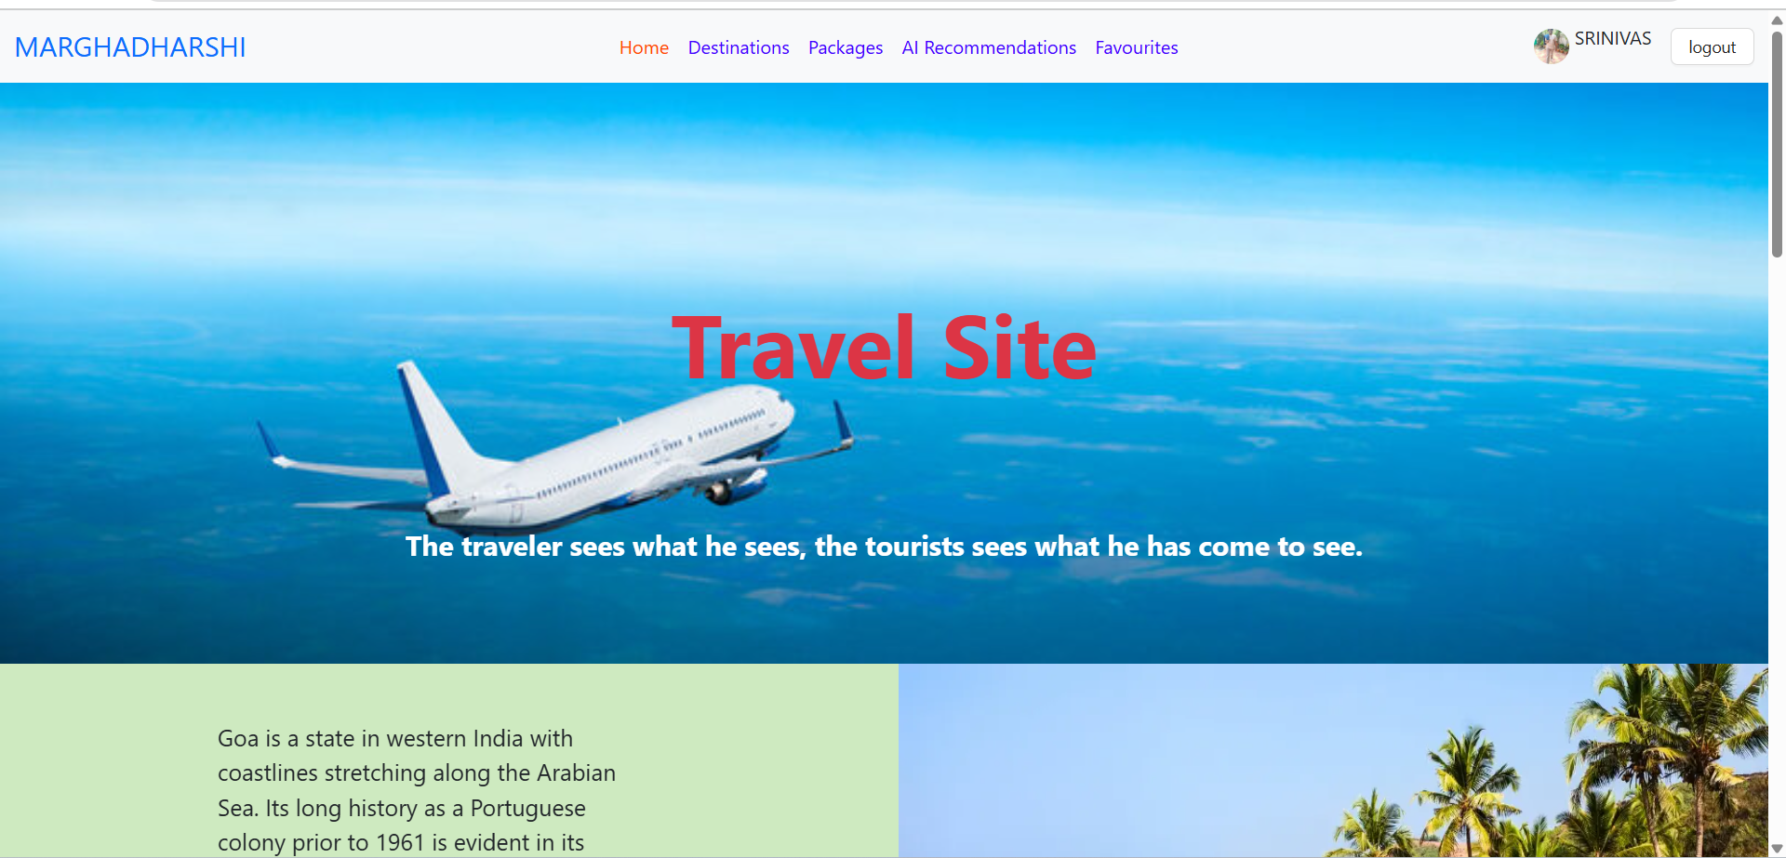
MARGHADHARSHI

Slide 22
App Features & Outcome
Features:
- Smart travel recommendations
- Responsive design
- Power BI dashboard for insights
- Error handling and scalability
Outcome:
- Successfully built a data-driven recommender system.
- Fully deployed and integrated for real-time use.

Slide 23
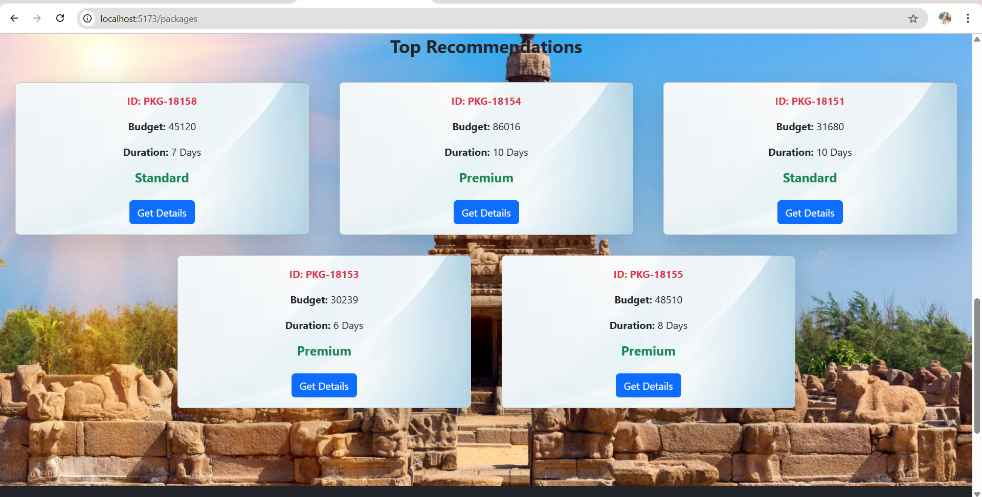
Top 5 Packages

Slide 24
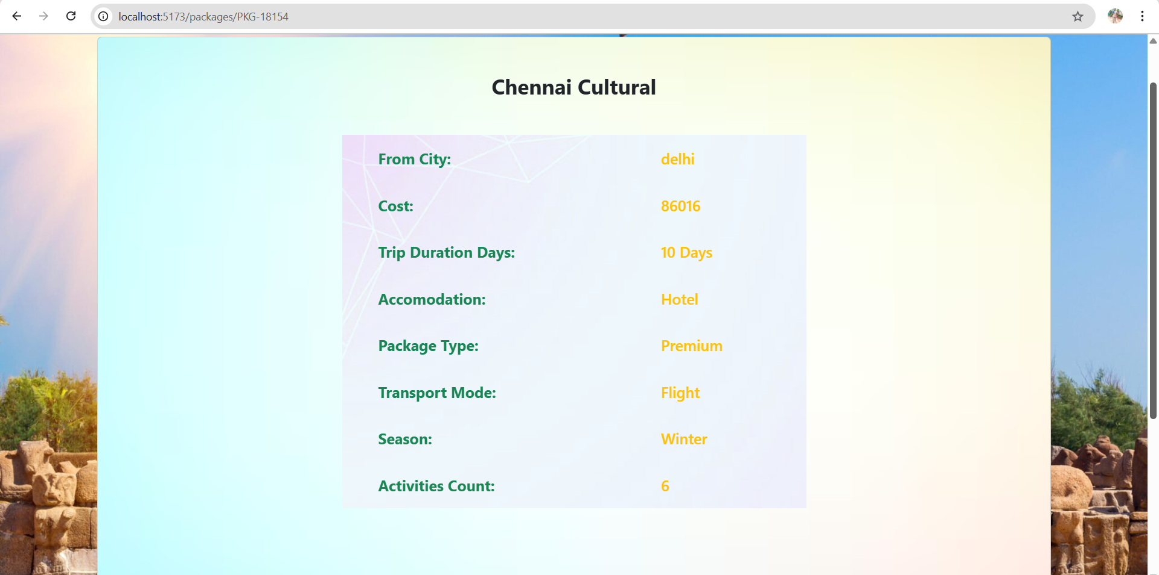
Final Package

Slide 25
THANK YOU
- MARGHADHARSHI

