Slide 1
Efficient Email Phishing Detection Using Machine Learning

Slide 2
Submitted in partial fulfillment of the requirements for the degree
of
BACHELOR OF TECHNOLOGY
in
COMPUTER SCIENCE AND ENGINEERING
by
D. NAVEEN 22541A05B1
G. TEJASRI 22541A0524
M. RUTHU 22541A0560
B. VISHNU VARDHAN 22541A05A4
S. MAHESH 22541A05E9
Under the Supervision of
Mrs. B.VASANTHI
Assistant Professor(M.Tech)
Department of CSE,
SRI SARATHI INSTITUTE OF ENGINEERING AND TECHNOLOGY,
Nuzvid-521201, Krishna Dist. AP

Slide 3
CONTENTS
Abstract
Existing system
Existing System Limitations
Proposed system
Proposed system Advantages
Software requirements
Hardware requirements
ML Models
Architecture
Dataflow Diagram
UML diagrams
Sample screens
Conclusion
Future enhancement

Slide 4
Abstract
Phishing emails are a major cybersecurity threat that target sensitive user data. This project develops an intelligent detection system using Machine Learning techniques. It analyzes email content, headers, and URLs to detect suspicious patterns. The system classifies emails as phishing or legitimate in real time to improve email security.

Slide 5
Existing System
Traditional email security methods include keyword-based spam filters that detect suspicious words commonly used in spam messages. Another method is blacklist-based blocking, where known malicious senders and URLs are automatically prevented from reaching users. Organizations also rely on manually created rules defined by administrators to filter unwanted emails.

Slide 6
Limitations of Existing System
Cannot detect new phishing patterns.
High false positive and false negative rates.
Requires frequent manual updates.
Limited intelligence and adaptability.

Slide 7
Proposed System
Machine learning–based intelligent detection is used to accurately identify phishing emails by learning patterns from data. The system performs automated feature extraction and model training to improve detection efficiency without manual intervention. It enables real-time phishing classification, ensuring quick and reliable identification of malicious emails.

Slide 8
Advantages
High detection accuracy.
Fast and automated processing.
Adapts to evolving phishing techniques.
Reduces human effort and security risks.

Slide 9
Software Requirements
Language: Python
Libraries: Scikit-learn, Pandas, NumPy, NLTK
Frontend: HTML, CSS, JavaScript
Framework: Django
Database: MySQL

Slide 10
Hardware Requirements
Processor: Ryzen 3, Intel i3 or above
RAM: Minimum 4 GB
Storage: 256 GB or higher
OS: Windows / Linux / macOS

Slide 11
Machine Learning Models
Logistic Regression
Naive Bayes Classifier
Support Vector Machine (SVM)
Random Forest Classifier

Slide 12
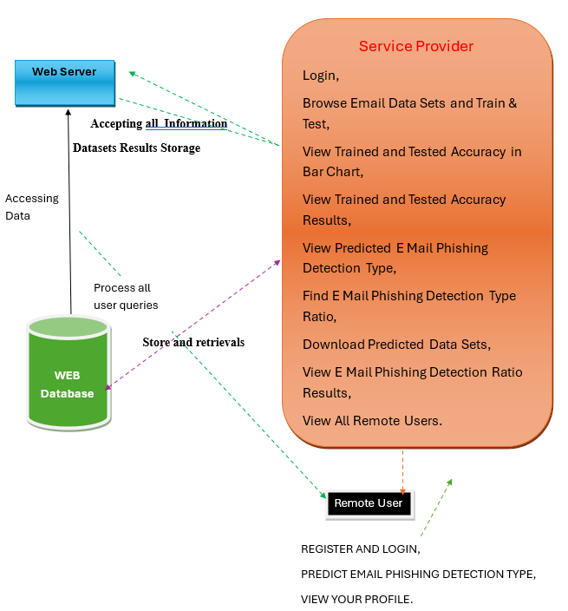
System Architecture

Slide 13
Data Flow Diagram (DFD)
Email Input
Preprocessing
Feature Extraction
Model Training
Classification
Result

Slide 14
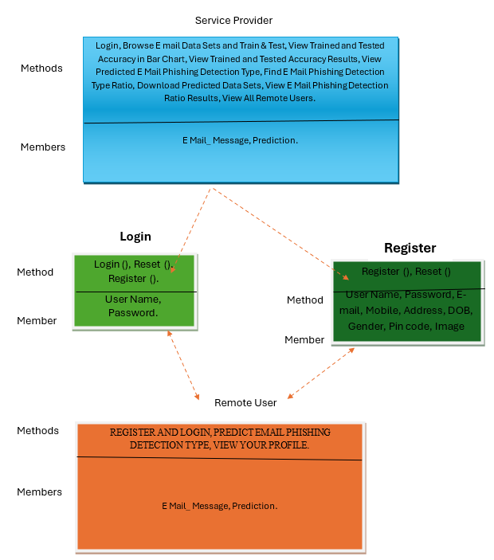
UML Diagrams

Slide 15

Sample Screens

Slide 16
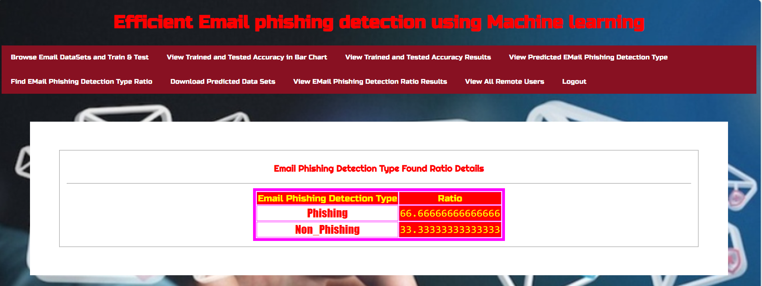
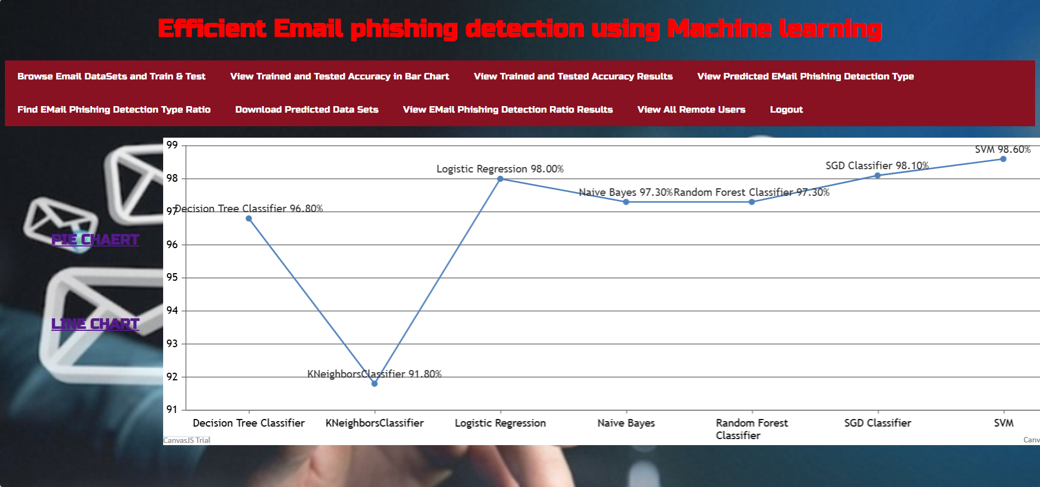

Slide 17
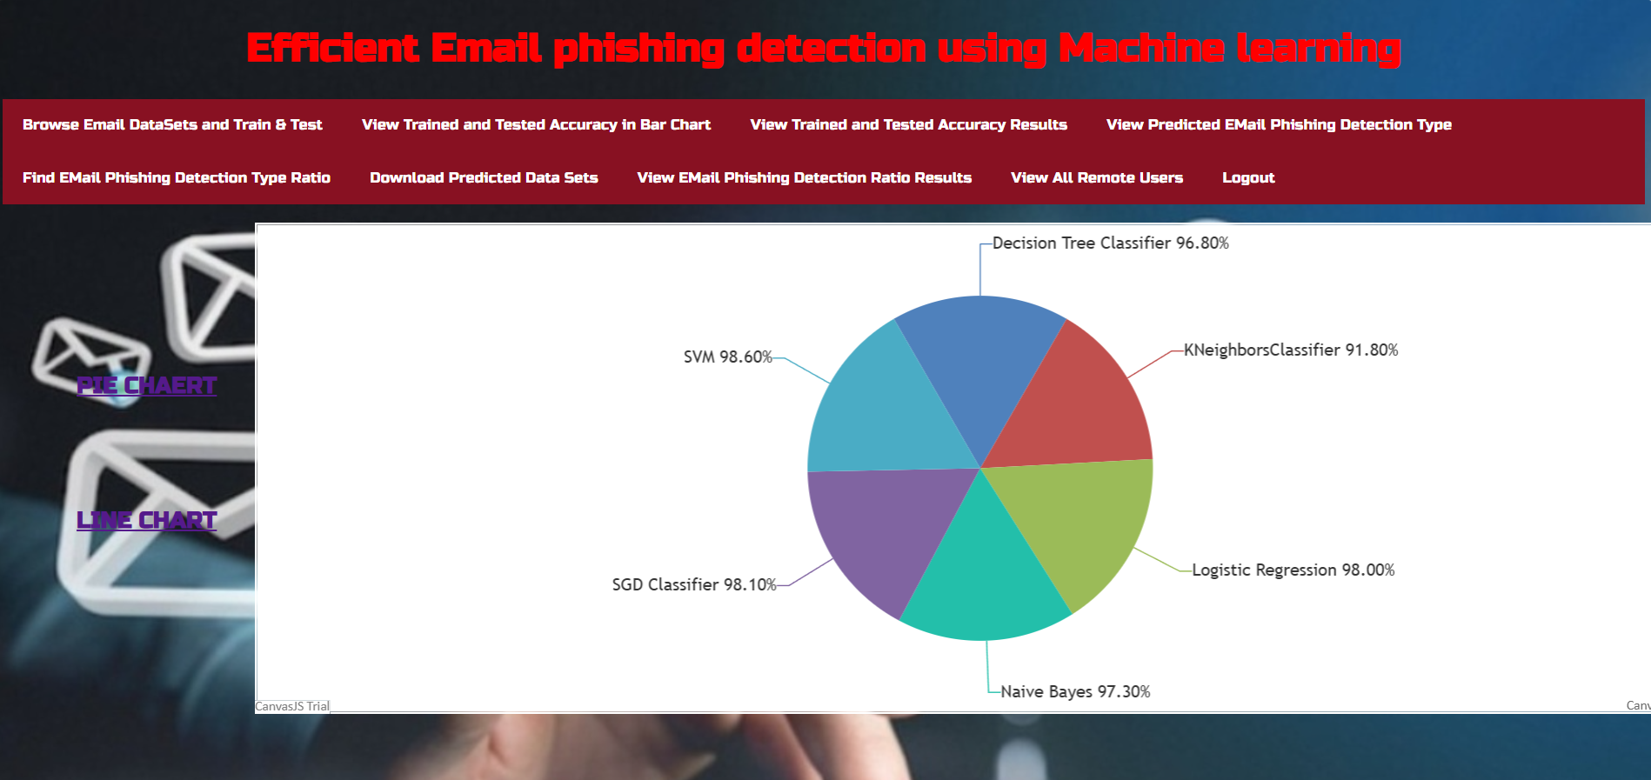

Slide 18
Conclusion
ML models successfully detect phishing emails with high accuracy.
System provides reliable real-time threat detection.
Improves cybersecurity awareness and protection.

Slide 19
Future Enhancements
Deep Learning– based advanced models.
Integration with enterprise mail servers.
Browser extension for real-time protection.
Multilingual phishing detection support.

Slide 20
Thank You

