Slide 1
DATACOM
Internship Presentation
CLOUD
JOB
SIMULATION
Introduction to Cloud Job Simulation
Azure • GitHub
DevOps • Automation
Naveen Kumar
Cloud Computing | Roll No. CS-23411631
September 2026

Slide 2
02
About the Job Simulation
The company scenario, my role and the purpose of the tasks
ORGANISATION
CLIENT SCENARIO
MY ROLE
PROJECT STAGE
Datacom
WCD Bank
Junior DevOps Engineer
Implementation
The workplace scenario
What the simulation covered
WCD Bank was moving its applications, data and IT infrastructure from on-premises data centres to cloud-based services. Datacom was brought in as the subject-matter expert to support the cloud journey.
• Cloud environment setup
• Azure / Microsoft Entra ID
• Git & GitHub
• GitHub Actions and YAML
The simulation placed me in the implementation phase, where I had to learn the tools and complete practical tasks with guidance from the team.
2 | Naveen Kumar • CS-23411631

Slide 3
03
Task 1 — Register an Application
Setting up the environment and creating a cloud application identity
The brief
What I learned from it
The first task focused on getting the basic tools ready and registering an application in Azure. The goal was to understand identity, access and authentication rather than only creating an account.
Identity
The application needs an identity in the cloud.
1
Main steps
Permissions
Access can be limited to the resources it needs.
2
• Create / use GitHub account
• Install and configure Visual Studio Code
• Create an Azure free account
• Register the application with Microsoft Entra ID
• Review permissions, client ID and authentication
Authentication
Authentication helps control how the application connects.
3
This task made the idea of cloud access much more concrete for me.
3 | Naveen Kumar • CS-23411631

Slide 4
04
Task 2 — Create a GitHub Actions Workflow
From a repository to a simple automated workflow
The brief
Why it mattered
The second task introduced GitHub as a DevOps tool. I created a repository, worked with it locally, understood variables and then created a GitHub Actions workflow using YAML.
The task showed me how version control and automation fit together. Instead of repeating development steps manually, a workflow can define them once and run them consistently.
Workflow
My takeaway
01
Repository
02
Git
Create a new GitHub repository.
Clone the repository to the local machine.
Repository → Workflow → Automation
03
Variables
04
Actions
This was my first practical exposure to GitHub Actions and YAML-based automation.
Understand values used by the workflow.
Create the first YAML workflow.
4 | Naveen Kumar • CS-23411631

Slide 5
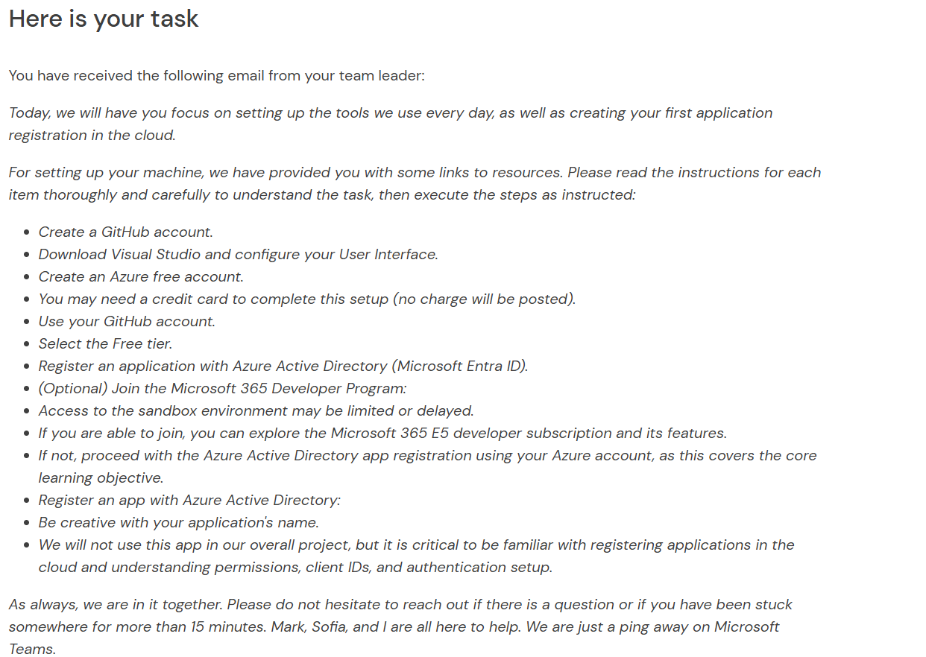
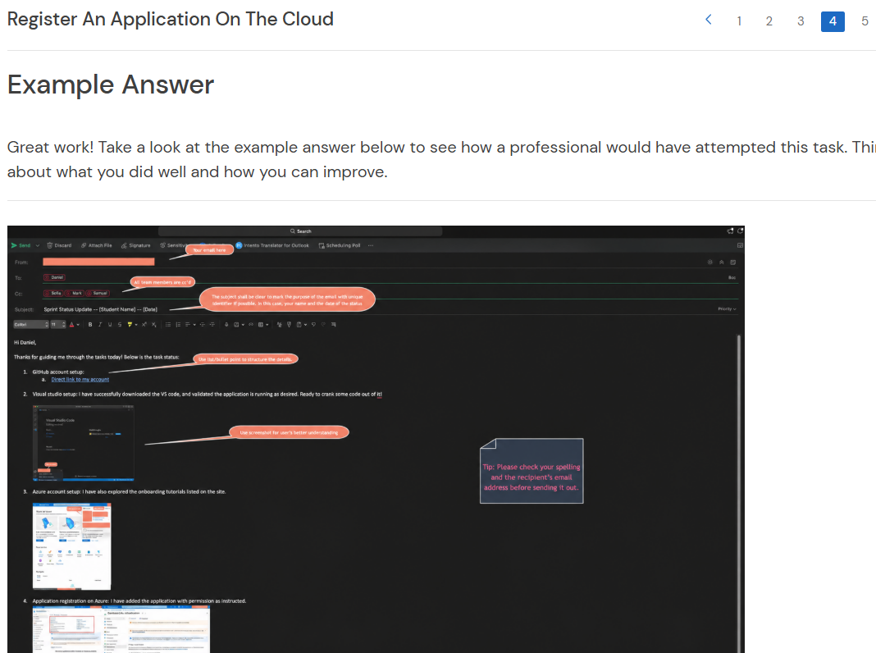
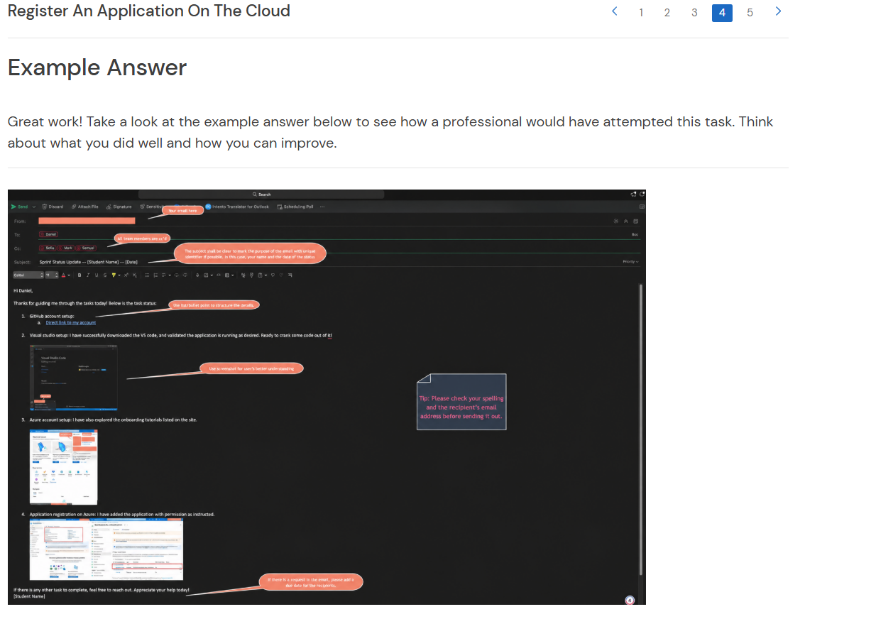
05
Practical Work & Evidence
Selected screenshots from the tasks I completed
Environment setup
Azure / cloud setup
Application registration
The screenshots support the two core areas of the simulation: cloud application setup and practical DevOps tooling.
5 | Naveen Kumar • CS-23411631

Slide 6
06
Reflections & Learnings
What changed for me after completing the simulation
The simulation helped me move from knowing cloud and DevOps as concepts to seeing how the tools connect in a practical workflow.
Cloud understanding
Technical practice
Working approach
I got a clearer picture of how organisations move infrastructure to cloud services and manage application access.
I worked with Azure, Microsoft Entra ID, Git, GitHub and GitHub Actions instead of only reading about them.
I learned to follow technical instructions carefully, test each step and ask for help when something is unclear.
Personal takeaway
Cloud is not just infrastructure — identity, source control and automation are part of the same working picture.
6 | Naveen Kumar • CS-23411631

Slide 7
CONCLUSION
A practical first step into cloud and DevOps
The Introduction to Cloud Job Simulation gave me a realistic view of junior DevOps work. I completed practical tasks around cloud application registration and GitHub Actions, while building confidence with tools, documentation and problem solving.
CORE AREAS
Azure / Entra ID • Git & GitHub • GitHub Actions • YAML • Cloud fundamentals
Naveen Kumar
THANK YOU
Cloud Computing | Roll No. CS-23411631

