Slide 1
FACE DETECTION
DIGITAL IMAGE PROCESSING
Student Name | Roll Number
Naveen Kumar B S | 20201CSE0587
Shashidhar | 20201CSE0583
Kishore Kumar R | 20201CSE0592
Tejaswini P | 20201CSE0546
Shreyas S | 20201CSE0806
Under the Supervision of,
Mr.Pakruddin B
Assistant Professor
School of Computer Science Engineering
Presidency University

Slide 2
Introduction
Face detection is a fundamental task in computer vision that involves locating and identifying human faces within images or videos.
It has a wide range of applications, from security systems and surveillance to facial recognition in social media platforms and digital photography.
MATLAB provides powerful tools and libraries for implementing face detection algorithms efficiently.
In this project, we aim to develop a real-time face detection system using MATLAB. The code utilizes the vision.CascadeObjectDetector object to detect faces within a live video stream captured from a webcam.
Additionally, we employ the vision.VideoPlayer object to display the video feed with annotated bounding boxes around detected faces.

Slide 3
KEY COMPONENTS OF CODE
Face Detector Initialization: This object is trained to detect faces based on a predefined cascade classifier.
Webcam Initialization: This allows us to process real-time data for face detection.
Video Player Initialization: This provides a visual representation of the face detection process.
Main Loop: Within a while loop, the code continuously captures video frames from the webcam.
Face Annotation: Bounding boxes are drawn around detected faces.
Real-Time Display: The annotated video frames are displayed in real-time.
Loop Termination: The while loop continues until a specified number of frames.

Slide 4
Objectives
Real-Time Face Detection
Multiple Face Detection
Performance Optimization
Robustness
False Positive Reduction
Face Recognition Integration
User Interface

Slide 5
Implementation
To implement real-time face detection in MATLAB, begin by initializing webcam and video player objects and utilizing vision.CascadeObjectDetector for face detection.
Extend this functionality to detect multiple faces by iterating through bounding box arrays. For performance optimization, experiment with different detection algorithms and consider parallel processing or GPU acceleration.
Enhance robustness by applying techniques like histogram equalization and face landmark detection. Implement post-processing filters to reduce false positives and integrate face recognition algorithms within detected regions.
Design a user-friendly interface using App Designer or GUIDE, and evaluate performance metrics such as detection rate and processing time. Integrate with external systems via APIs for additional functionalities. Document the project thoroughly, including implementation details, algorithms used, and performance evaluation results.

Slide 6
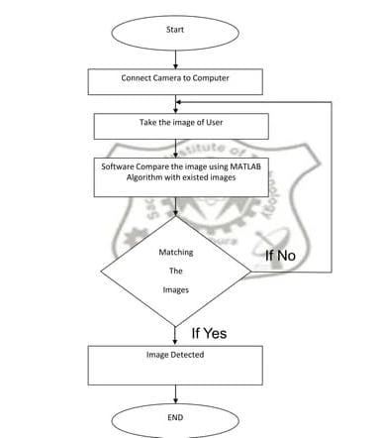
Flowchart:

Slide 7
Applications
Biometrics: Using a face as a biometric is proved to be a successful approach since it is the way humans recognize each other.
Identification System: A face could be used to examine if a person exist or not in the list of individuals. Based on that information the system can allow respectively deny access.
Crowd surveillance: Face detection is used to detect and analyze crowds in frequented public or private areas. Use cases include crowd estimation and real-time alerting for law enforcement.
Photography: Some recent digital cameras use face detection for autofocus. Mobile apps use facial recognition to detect regions of interest in slideshows.
Face recognition: A face recognition system is designed to verify and identify people from a digital image or video frame, often as part of access control or identification verification solutions.

Slide 8
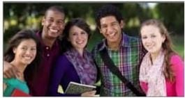
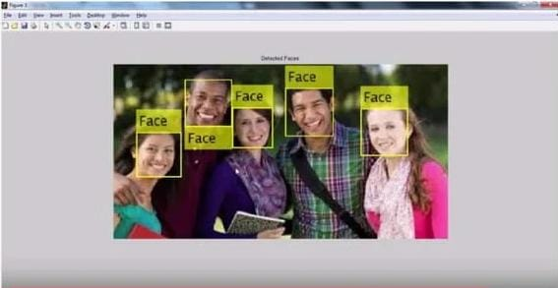
Original Image: Detected Faces:

Slide 9
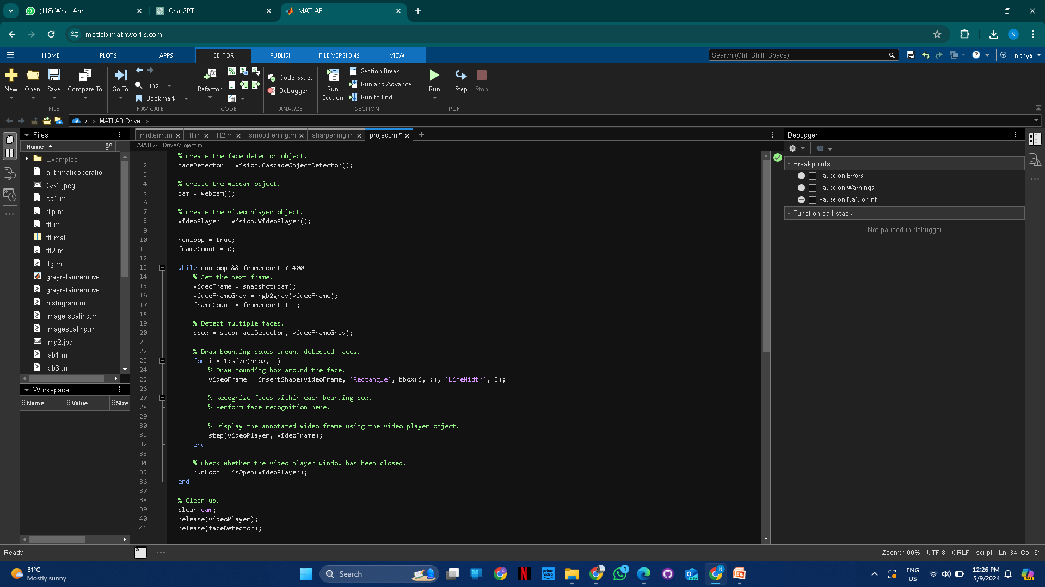
CODE

Slide 10
CONCLUSION
In conclusion, the implementation of real-time face detection using MATLAB encompasses a series of steps aimed at achieving accurate and efficient detection of human faces in live video streams.
By leveraging tools such as vision.CascadeObjectDetector and integrating multiple face detection capabilities, the system can handle various scenarios, including multiple faces and diverse facial orientations.
Performance optimization techniques, such as parallel processing and algorithm selection, contribute to real-time processing with minimal latency. Robustness is enhanced through the application of preprocessing methods and post-processing filters to handle variations in lighting and reduce false positives.
Integration of face recognition adds another layer of functionality, enabling the system to recognize known faces within the detected regions. A user-friendly interface and thorough documentation ensure usability and transparency, while performance evaluation metrics validate the system's accuracy and efficiency. Overall, the implementation of real-time face detection in MATLAB showcases the versatility and power of computer vision techniques in practical applications.

Slide 11
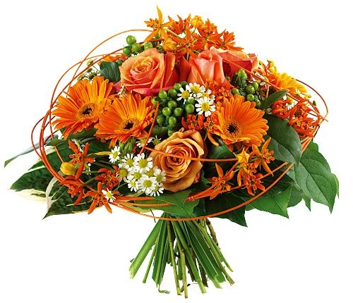
Thank You

