Slide 1

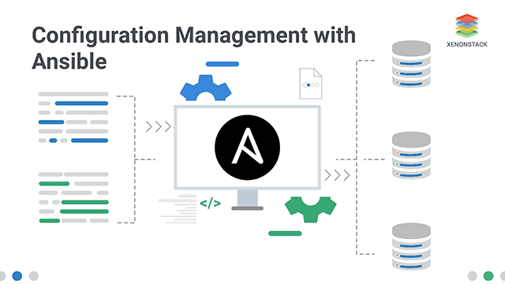
ANSIBLE
PROJECT
GAME CHANGERS
MENTORS:
Mr Bobby
Mr Surya Ashok
Team Members:
B .Teja
M .Naveen
J .Hemanth
R .Sai Krishna

Slide 2

Overview
01. Introductions
06. Working
02. Architecture
07.Advantages
03. Master & Slave
08. Technologies Used
04. Features
09. Conclusions
05. Problems

Slide 3
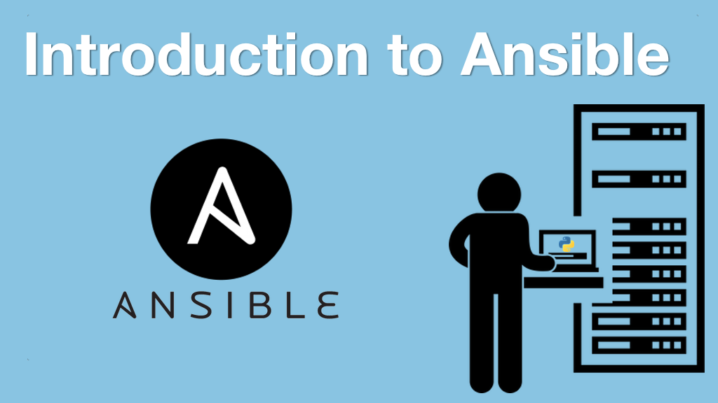
The University Name | Thesis For Science | 08 January 2023 | Page 3-30
Introduction
Ansible is an open source Automation Tool used for the Configuration management, Application Deployment and Task automation.
Originally written by Michael De Haan and acquired by Red Hat in 2015
Ansible is a game changer in how you manage the infrastructure. It allows users to automate repetitive tasks.
Ansible allows you to configure not just one computer, but potentially a whole network of computers at once.
It is widely used by the system administrators, developers, and DevOps engineers to automate and manage complex IT infrastructure

Slide 4
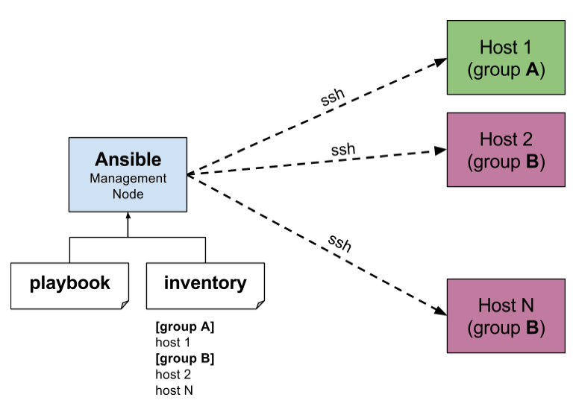
Architecture of Ansible
The machine where ansible install is called local machine
The local machines consists of module and inventory.
Basically, a module is a command or set of similar commands meant to be executed on the client-side. And it is the collection of configuration code files the configuration code files are called as playbooks
Inventory is a file containing data about the ansible client servers (Host file / Inventory file)
Playbook: It consists of code in YAML format, which describes tasks to be executed

Slide 5
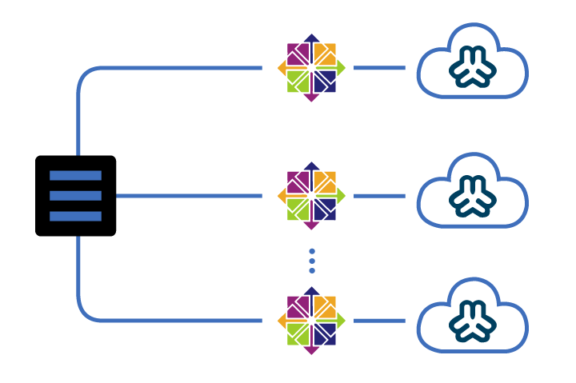
MASTER & SLAVE
01.
02.
Master
Slave
The control node is a computer that runs Ansible There must be at least one control node, although a backup control node may also exist
A managed node is any device being managed by the control node.

Slide 6
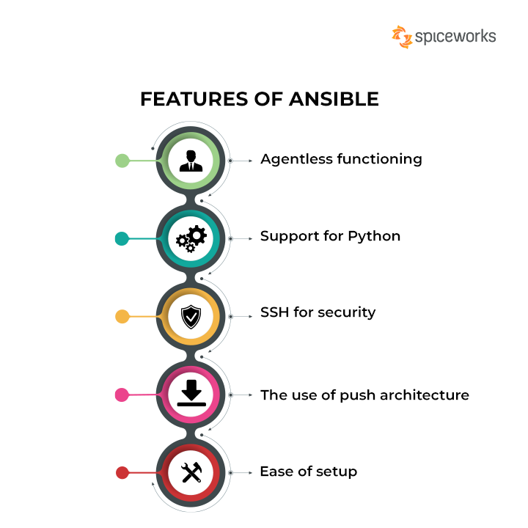







Slide 7

The University Name | Thesis For Science | 08 January 2023 | Page 7-30
Problems
01.
Time Complexity
It takes more time to install a software or configure something while working with number of servers, with Ansible the task will completed so easy and within less time
02.
Manual Implementation
Without ansible, the installations and configurations should made to each and every server manually, when ANSIBLE comes into play it will automate tasks.

Slide 8

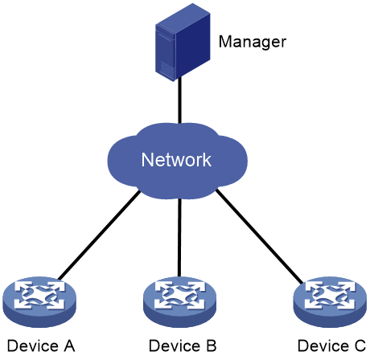
The University Name | Thesis For Science | 08 January 2023 | Page 8-30
How Ansible Works
Ansible works by connecting to nodes (clients, servers, or whatever you're configuring) on a network, and then sending a small program called an Ansible module to that node.
Ansible executes these modules over SSH and removes them when finished. The only requirement for this interaction is that your Ansible control node has login access to the managed nodes.
SSH keys are the most common way to provide access, but other forms of authentication are also supported.

Slide 9

Advantages of Ansible
Simple and easy to learn: Ansible uses YAML syntax, which is easy to read and write. The simplicity of the language makes it easy for beginners to learn and use.
Efficient and fast: Ansible uses SSH to communicate with the remote hosts, making it a lightweight and fast automation tool. It also uses a push-based approach, which means it can execute tasks in parallel, making it more efficient.
Powerful. App deployment. Configuration management. Workflow orchestration. Orchestrate the app lifecycle.
Note: Workflow orchestration: it handles multiple automated tasks to execute a single significant process or workflow.
Human readable automation: No special coding skills needed. Tasks executed in order. Get productive quickly.

Slide 10



Technologies & Languages Used
AWS
YAML
HTML

Slide 11

Conclusion
We can conclude that Ansible provides a simple and powerful package for configuration management and automation
Its an excellent choice for Project Configuration Management provide a simple and efficient way to manage complex IT infrastructure.
Moreover its an open source tool which can be accessed by everyone with free of cost

Slide 12
THANK YOU
TEAM
GAME CHANGERS

