Slide 1
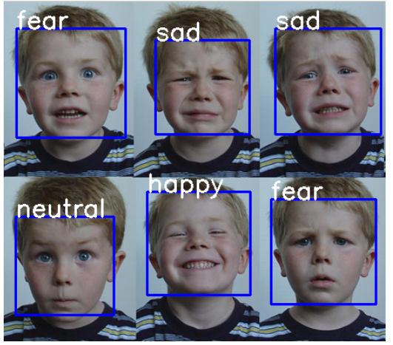
FER: Facial Emotion Recognition
Course: IML
Instructor:
Dr.Muneendra Ojha

Slide 2
Introduction to the Problem
Facial Emotion Recognition is a project that uses machine learning algorithms to detect emotions from facial expressions. This project aims to develop an application that can detect emotions from real-time images. It uses Machine and Deep Learning Techniques like Convolutional Neural Networks to train the model.

Slide 3
Introduction to the Problem
The Human facial expressions are important for visually expressing a lot more information. Facial expression recognition is essential in the field of human-machine interaction. Automated facial recognition systems have many applications, including understanding of human behavior, diagnosing mental disorders, and synthetic human expression. Identifying facial expressions through computers with high detection rates is still a challenging task.
In this project, we have used a variety of intensive deep learning techniques (convolutional neural networks) to identify the main seven human emotions: ANGER, DISGUST, FEAR, HAPPY, NEUTRAL, SAD, SURPRISE.

Slide 4
Objectives
Our objective is to predict the expression of the human face in real-time as fast and as accurately as possible.
Accuracy: Our goal is to predict the expression of a face in the image as accurately as possible. The higher the test accuracy, the better our model will perform in the real world.

Slide 5
Background/Literature survey
Various approaches have been proposed for facial feature representations [1, 2]. Two representative ones are the local binary pattern (LBP) [5] and Gabor. It is found that spatiotemporal LBP [3] and Gabor [2] have been widely used in EmotiW 2013, especially since LBP is also used as a baseline algorithm in EmotiW 2014. Some researchers have recently attempted to extract robust features on the lower-level still images, e.g., Gaborimages, rather than on the pixel level. The Gabor magnitude and LBP operator were used as the first and second layers, respectively. The ﬁrst layer enhanced facial features, while the second layer used local structural information and a histogram of sub-regions to describe the facial features. Some temporal extensions of Gabor-based LBP are established in [4], which combined motion and appearance features extraction with a prior Ga-bor wavelet ﬁltering.

Slide 6
Dataset Preparation:
The dataset used in this project is the FER2013 (Facial Expression Recognition 2013 Dataset) dataset from Kaggle. The dataset contains 35,685 examples of 48x48 pixel grayscale images of faces divided into train and test datasets. Images are categorized based on the emotion shown in the facial expressions (happiness, neutral, sadness, anger, surprise, disgust, fear). The faces have been automatically registered so that the face is more or less centred and occupies about the same amount of space in each image. The task is to categorize each face based on the emotion shown in the fa- cial expression into one of seven categories (0-Angry, 1-Disgust, 2=Fear, 3-Happy, 4-Sad, 5-Surprise, 6-Neutral).

Slide 7
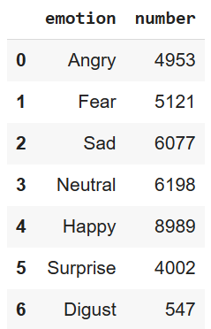
Understanding Data
Getting class labels
surprise', 'angry', 'fear', 'disgust', 'happy', 'neutral', 'sad’
Number of images per category
Image size = 48

Slide 8
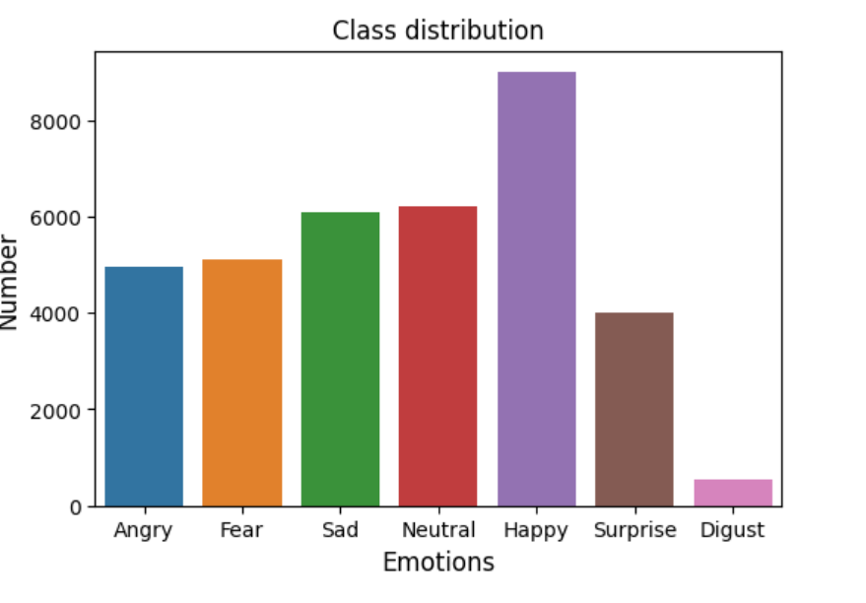
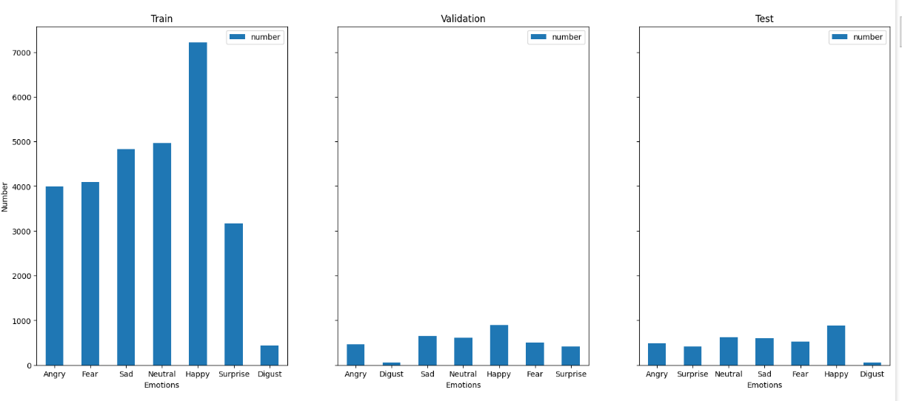
Understanding the Data

Slide 9
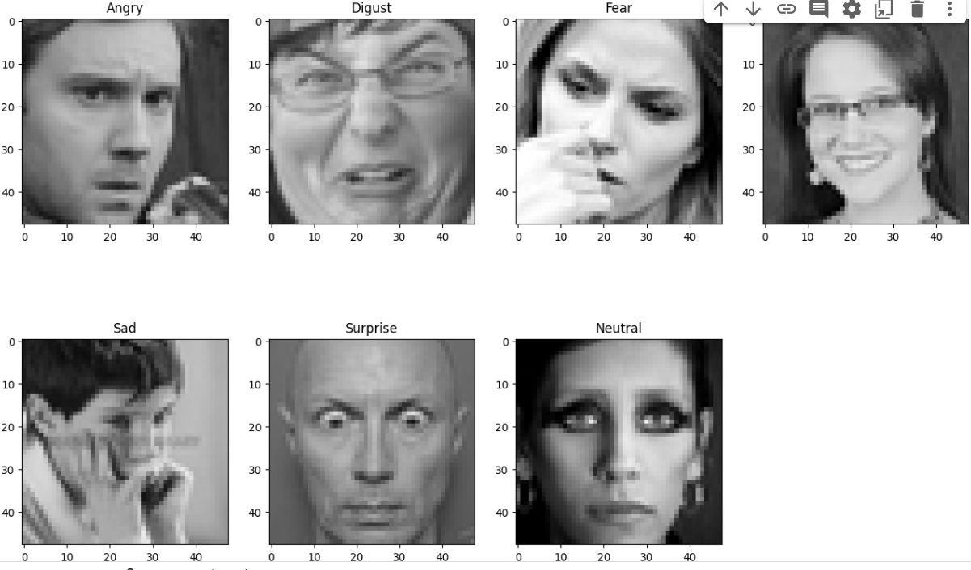
Loading Data and Data(Img) Augmentation
CRNO function converts the pixel strings to lists of integers, reshapes and normalizes the grayscale images, and performs one-hot encoding for the labels explain this one by one
Viewing the image after data processing:

Slide 10
Model
Convolution Neural Network :
A Convolutional Neural Network (CNN or ConvNet) is a type of artificial neural network designed specifically for processing and analyzing visual data, such as images and videos. CNNs have proven to be highly effective in tasks like image classification, object detection, and image segmentation. They are also widely used in various other domains, including natural language processing and speech recognition.
Input Layer: Accepts the raw image data.
Convolutional Layer: Detects low-level features like edges and textures.
Pooling Layer: Downsample the feature maps.
Fully Connected Layer: Combines features for classification.
Output Layer: Provides class predictions or other desired outputs.

Slide 11
Model Training
Module 1:
Two Conv2D layers with 2num_features filter each, followed by Batch Normalization and ReLU activation.
MaxPooling2D layer with a pool size of (2, 2) and strides of (2, 2). This reduces the spatial dimensions.
Flatten Layer:
Flattens the output of the last convolutional module to prepare it for the fully connected layers.
Dense Layers:
Dense 1: Fully connected layer with 2*2*2*num_features neurons, followed by Batch Normalization and ReLU activation.
Dense 2: Fully connected layer with 2*2num_features neurons, followed by Batch Normalization and ReLU activation.
Dense 3: Fully connected layer with 2*num_features neurons, followed by Batch Normalization and ReLU activation.

Slide 12
Model training
Output Layer:
Dense layer with num_classes neurons and a softmax activation function. This layer produces the final output probabilities for each class.
Compilation:
Categorical cross-entropy is used as the loss function.
The Adam optimizer is employed with a learning rate of 0.001, beta parameters, and epsilon for numerical stability.
The accuracy metric is monitored during training

Slide 13
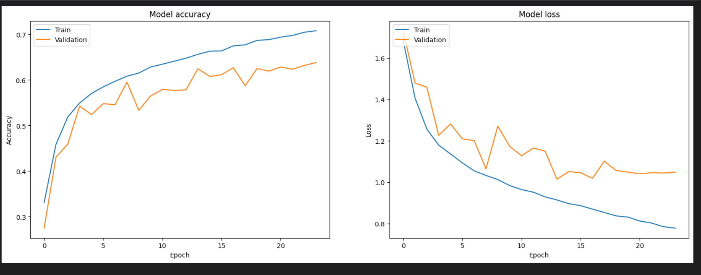
Visualize Training Performance

Slide 14
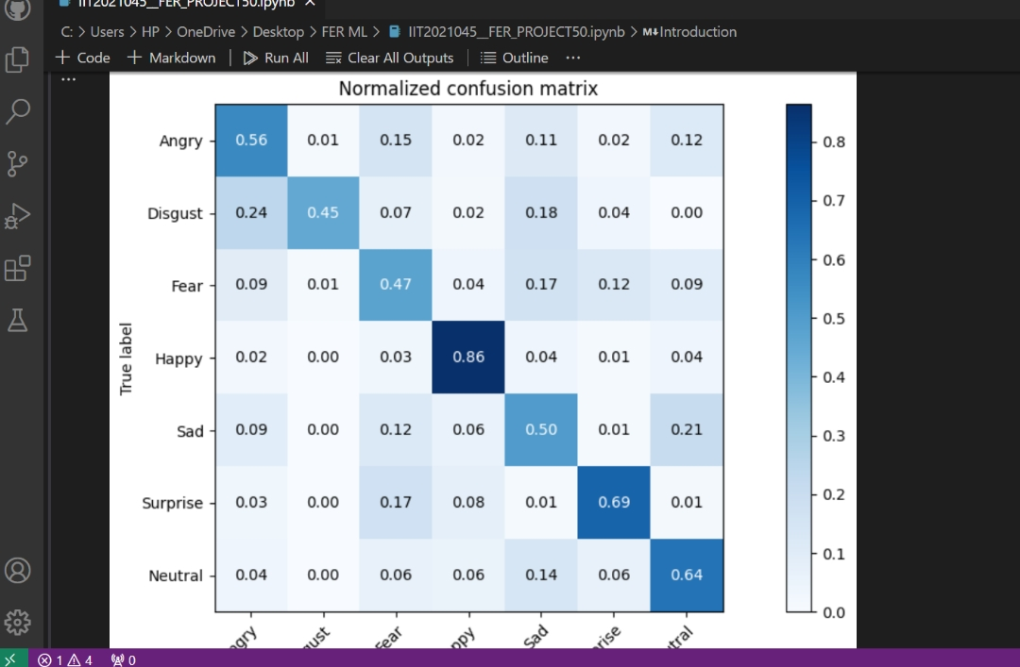
Analysis using confusion matrix

Slide 15
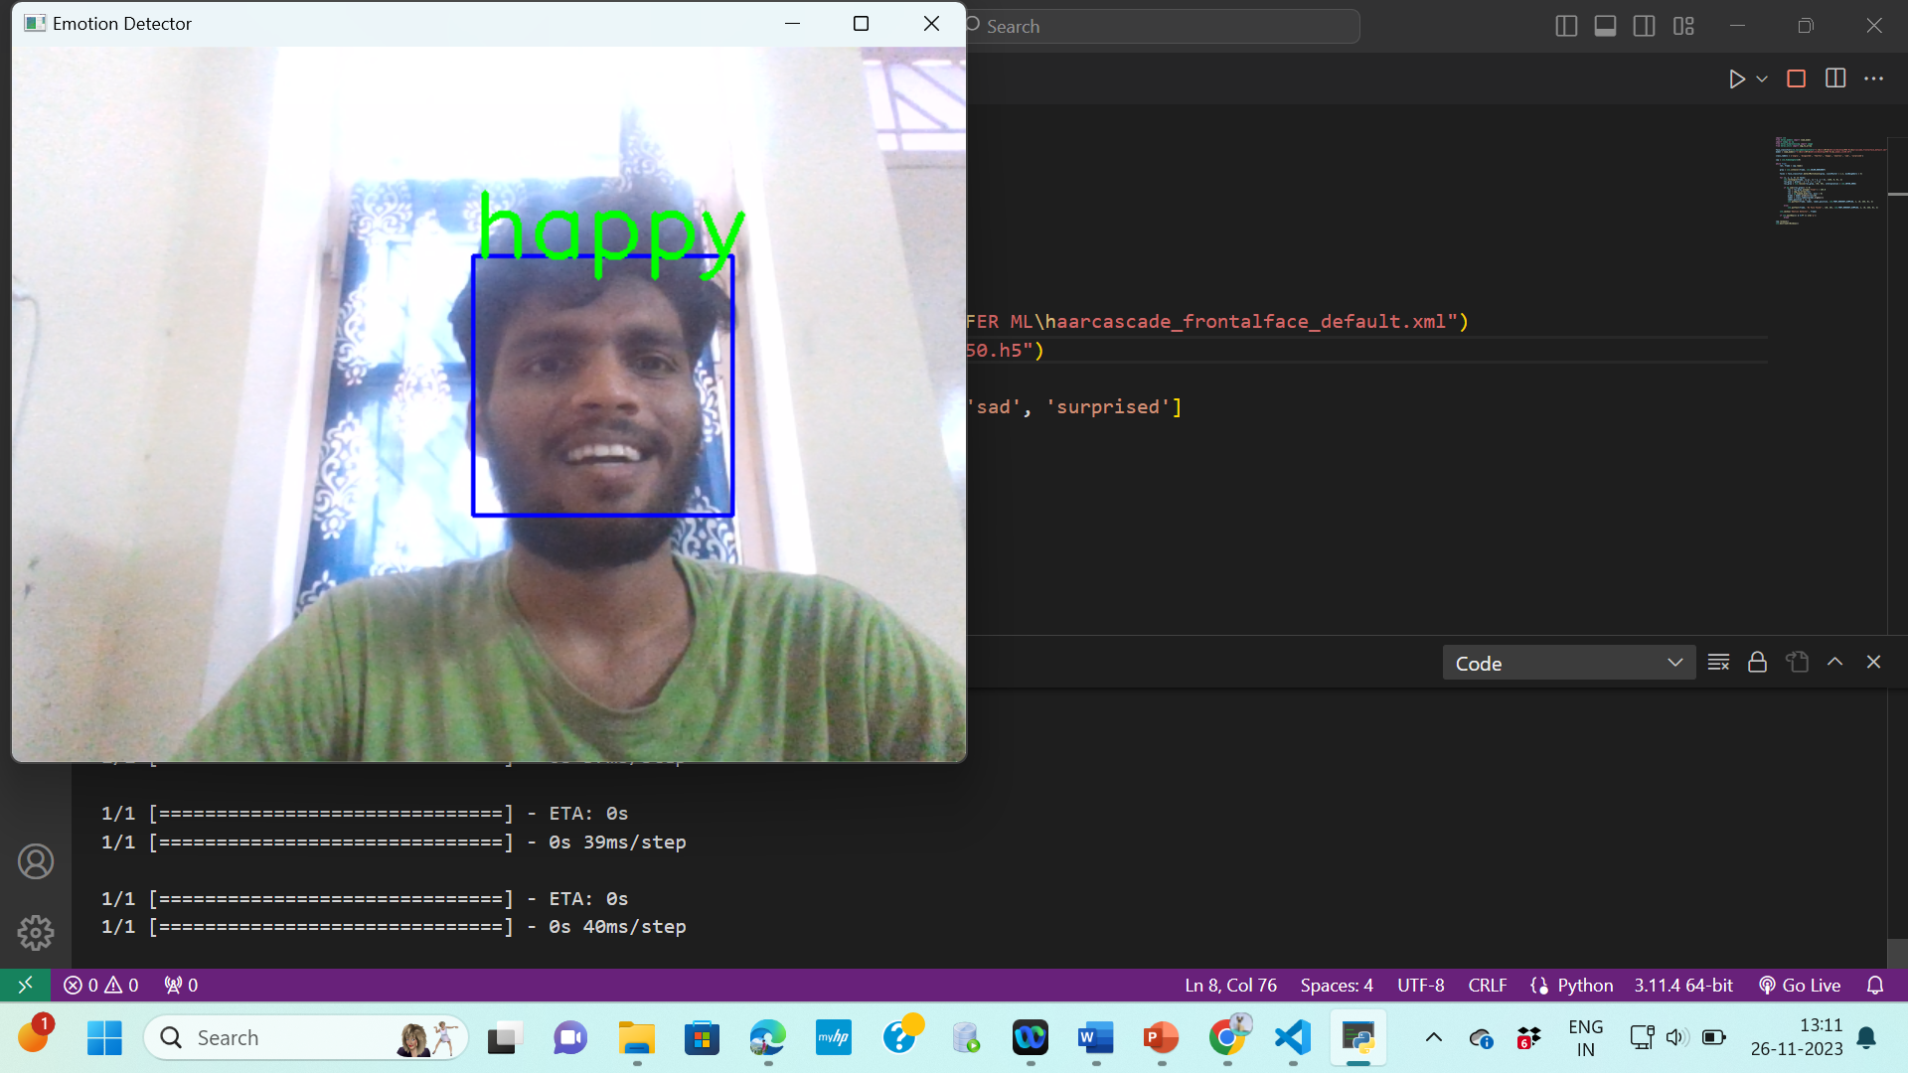
Outcome/Results
The primary output is the classification of the emotional state being expressed by the person in the image or video frame

Slide 16
Evaluation results
Using 3 convolution layers:
CNN Model Accuracy on test set: 0.6400
Using 2 convolution layers:
CNN Model Accuracy on test set: 0.6484
Precision: 0.6466
Recall: 0.6484
F1 Score: 0.6409

Slide 17
Conclusion
The implemented CNN model demonstrated promising results, achieving an accuracy of 64.84% on the test set. Precision, recall, and F1 score metrics further indicated the effectiveness of the model in classifying emotions. The project's significance lies in its potential applications, including human-machine interaction, understanding human behavior, and aiding in the diagnosis of mental disorders.
The exploration of various deep learning techniques and the incorporation of a well-prepared dataset contributed to the project's success. The comprehensive evaluation, including the analysis using confusion matrices, provided valuable insights into the model's performance.deep-learning

Slide 18
Feature Scope
(i) To further fine tuning model using grid_search, specifically:
a. Different optimizer such as Adam, RMSprop, Adagrad.
b. experimenting dropout with batch-normalization.
c. experimenting different dropout rates.
(ii) To collect more data and train the model with balance dataset.
Emotion recognition is significant for machine learning and artificial intelligence. The future innovation in emotion recognition will allow machines to understand how people feel, which is the first step for them to fulfil our needs………….…
https://visionify.ai/the-future-of-emotion-recognition-in-machine-learning-and-ai/

Slide 19
References
[1]. B. Fasel and J. Luettin, "Automatic facial expression analysis: A survey," Pattern Recognition, vol. 36, pp. 259-275, 2003.
[2]. Z. Zeng, M. Pantic, G. Roisman, and T. Huang, "A survey of affect recognition methods: audio, visual and spontaneous expressions," IEEE Transactions on Pattern Analysis and Machine Intelligence, vol. 33, no. 1, pp. 39-58, 2009.
[3]. G. Zhao and M. Pietikäinen, "Dynamic texture recognition using local binary pattern with application to facial expressions," IEEE Transactions on Pattern Analysis and Machine Intelligence, vol. 29, no. 6, pp. 915-928, 2007.
[4]. T. Almaev and M. Valstar, "Local Gabor binary patterns from three orthogonal planes for automatic facial expression recognition," in Proceedings of the Humaine Association Conference on Affective Computing and Intelligent Interaction, 2013, pp. 356-361.
[5]. T. Ojala, M. Pietikäinen, and T. Mäenpää, "Multiresolution gray-scale and rotation invariant texture classification with local binary pattern," IEEE Transactions on Pattern Analysis and Machine Intelligence, vol. 24, no. 7, pp. 971-987, 2002.

Slide 20
THANK YOU
IIT2021045 Naveen Banoth

