Slide 1

Project: Predicting Health Treatment in Tech Company
Submitted By
NAVEEN VERMA (EBEON0522601833)
1

Slide 2

ABSTRACT
Health plays significant role in living organisms. Diagnosis and prediction of Health related diseases requires more precision, perfection and correctness because a little mistake can cause fatigue problem or death of the person, there are numerous death cases related to health and their counting is increasing exponentially day by day. To deal with the problem there is essential need of prediction system for awareness about diseases. Machine learning is the branch of Artificial Intelligence(AI), it provides prestigious support in predicting any kind of event which take training from natural events. In this paper, we calculate accuracy of machine learning algorithms for predicting health disease, for this algorithms are k-nearest neighbor, Decision Tree, Logistic Regression, support vector machine(SVM),Naive Bayes Classifier, Random Forest and XGBoost by using Kaggle repository dataset. For implementation of Python programming Anaconda(jupyter) notebook is best tool, which have many type of library, header file, that make the work more accurate and precise.
2

Slide 3
Contents
Table of Contents
CHAPTER PARTICULARS PAGE NO.
Chapter 1 Introductions: Problem Statement & Gaps in Existing Systems 4
Chapter 2 Study of Existing Systems 6
Chapter 3 Methodology:
(i).Datasets
(ii).Data Cleaning Preprocessing 8
(iii). Machine Learning Algorithms
(iv).Implementation Steps
Chapter 4 Analysis of the Result 46
Chapter 5 Conclusions 47
3

Slide 4
Chapter - 1
INTRODUCTION
Mental health includes our emotional, psychological, and social well-being. It can affect our interactions with the world, work performance and our physical health. Nowadays, mental health topic attracts more and more attentions. A positive attitude towards seeking for treatment is important for people with mental health conditions. There are many factors that may affect this attitude. This dataset includes information about attitude about mental health in the tech workplace, individual's geographic and demographic information, and supports from workplace. We can get insights about which factors would affect the attitude and how we can do to improve the situation. In the United States, approximately 70% of adults with depression are in the workforce. Employees with depression will miss an estimated 35 million workdays a year due mental illness. Those workers experiencing unresolved depression are estimated to encounter a 35% drop in their productivity, costing employers $105 billion dollars each year. So, we can predict the health treatment at their early stage by applying machine learning algorithms on this massive amount of data to extract features that we will extract from datasets. Various machine learning techniques like logistic regression, naïve bayes, support vector machine, k nearest neighbor etc.
4

Slide 5
Problem Statement :
Mental health affects your emotional, psychological and social well-being. It affects how we think, feel, and act. The impact of mental health to an organization can mean an increase of absent days from work and a decrease in productivity and engagement. So, Develop a model that can predict whether a employee seek treatment or not. Identify the key features that lead to mental health problems in tech space.
Gaps in Existing Systems :
Gaps is that in previous analysis used 7 models. And I am also used 7 but 2 models are different.
Previous Analysis Models. Logistic Regression, Decision Tree Classifier, K-Nearest Neighbor, Random Forest Classifier, Ada Boost Classifier, Gradient Boosting Classifier, XGB Classifier.
New Replace Analysis Models.
Logistic Regression, Decision Tree Classifier, K-Nearest Neighbor, Random Forest Classifier, SVM (Support
Vector Machine), Naives Bayes Classifier, XGBoost accuracy.
5

Slide 6
Chapter - 2
Study of Existing Systems
Our Predictor (Y, Positive or Negative Health treatment) is determined by 22 features (X):
age (#)
Gender : 1= Female, 2=Male, 3= Transgender (Ordinal)
self_employed : 1=Yes, 2=No (Binary)
family_history : 1=Yes, 2=No (Binary)
work_interfere : 1=Sometimes, 2=Often, 3=Rarely, 4=Never (Ordinal)
no_employees : 1=01-May, 2=1-5, 3=6-25, 4=26-100, 5=100-500, 6=500-1000, 7=More than 1000, 8=Jun-25 (Ordinal)
remote_work : 1=Yes, 2=No (Binary)
tech_company : 1=Yes, 2=No (Binary)
Benefits : 1=Yes, 2=No, 3= Don't know (Ordinal)
care_options : 1=Yes, 2=No, 3=Not sure (Ordinal)
wellness_program : 1=Yes, 2=No, 3= Don't know (Ordinal)
seek_help : 1=Yes, 2=No, 3= Don't know (Ordinal)
Anonymity : 1=Yes, 2=No, 3= Don't know (Ordinal)
6

Slide 7
14. Leave : 1=Very difficult, 2=Somewhat difficult, 3=Very easy, 4=Somewhat easy, 5=Don't know
(Ordinal)
15. mental_health_consequence : 1=Yes, 2=No, 3= Maybe (Ordinal)
phys_health_consequence : 1=Yes, 2=No, 3= Maybe (Ordinal)
coworkers : 1=Yes, 2=No, 3= Some of them (Ordinal)
supervisor : 1=Yes, 2=No, 3= Some of them (Ordinal)
mental_health_interview : 1=Yes, 2=No, 3= Maybe (Ordinal)
phys_health_interview : 1=Yes, 2=No, 3= Maybe (Ordinal)
mental_vs_physical : 1=Yes, 2=No, 3= Don't know (Ordinal)
obs_consequence : 1=Yes, 2=No (Binary)
Note: Our data has 3 types of data:
Continuous: Which is quantitative data that can be measured
Ordinal Data: Categorical data that has a order to it (0,1,2,3,etc)
Binary Data: Data whose unit can take on only two possible states(0&1)
7

Slide 8
Chapter - 3
Methodology
Data Cleaning and Preprocessing :
The datasets which were collected from UCI machine learning repository and Kaggle website contain unfiltered data which must be filtered before the final data set can be used to train the model. Also, data has some categorical variables which must be modified into numerical values for which we used Pandas library of Python. In data cleaning step, first we checked whether there are any missing or junk values in the dataset for which we used the isnull() function. Then for handling categorical variables we converted them into numerical variables.
Machine Learning Algorithms :
a) Logistic Regression :
Logistic regression is often used a lot of times in machine learning for predicting the likelihood of response attributes when a set of explanatory independent attributes are given. It is used when the target attribute is also known as a dependent variable having categorical values like yes/no or true/false, etc. It’s widely used for solving classification problems. It falls under the category of supervised machine learning. It
8

Slide 9
efficiently solves linear and binary classification problems. It is one of the most commonly used and easy to implement algorithms. It’s a statistical technique to predict classes which are binary. When the target variable has two possible classes in that case it predicts the likelihood of occurrence of the event. In our dataset the target variable is categorical as it has only two classes-yes/no.
b) Random Forest :
Random Forest is the most famous and it is considered as the best algorithm for machine learning. It is a supervised learning algorithm. To achieve more accurate and consistent prediction, random forest creates several decision trees and combines them together. The major benefit of using it is its ability to solve both regression and classification issues. When building each individual tree, it employs bagging and feature randomness in order to produce an uncorrelated tree forest whose collective forecast has much better accuracy than any individual tree’s prediction. Bagging enhances accuracy of machine learning methods by grouping them together. In this algorithm, during the splitting of nodes it takes only random subset of nodes into an account. When splitting a node, it looks for the best feature from a random group of features rather than the most significant feature. This results into getting better accuracy. It efficiently deals with the huge datasets. It also solves the issue of overfitting in datasets. It works as follows: First, it’ll select random samples from the provided dataset. Next, for every selected sample it’ll create a decision tree and it’ll receive a forecasted result from every created decision tree. Then for each result which was predicted, it’ll perform voting and through voting it will select the best predicted result.
9

Slide 10
c) Naive Bayes :
It is a probabilistic machine learning algorithm which is mainly used in classification problems. It is simple and easy to build. It deals with huge datasets efficiently. It can solve complicated classification problems. The existence of a specific feature in a class is assumed to be independent of the presence of any other feature according to naïve bayes theorem. It’s formula is as follows : P(S|T) = P(T|S) * P(S) / P(T) Here, T is the event to be predicted, S is the class value for an event. This equation. will find out the class in which the expected feature for classification.
d) Support Vector Machine (SVM) :
It is a powerful machine learning algorithm that falls under the category of supervised learning. Many people use SVM to solve both regression and classification problems. The primary role of SVM algorithm is that it separates two classes by creating a line of hyperplanes. Data points which are closest to the hyperplane or points of the data set that, if deleted, would change the position of dividing the hyperplane are known as support vectors. As a result, they might be regarded as essential components of the data set. The margin is the distance between hyperplane and nearest data point from either collection. The goal is to select the hyperplane with the maximum possible margin between it and any point in the training set increasing the likelihood of a new data being properly classified. SVM’s main objective is to find a hyperplane in N-dimensional space which will classify all the data points. The dimension of a hyperplane is actually dependent on the quantity of input features. If input has two features in that case the hyperplane will be a line and two dimensional plane.
10

Slide 11
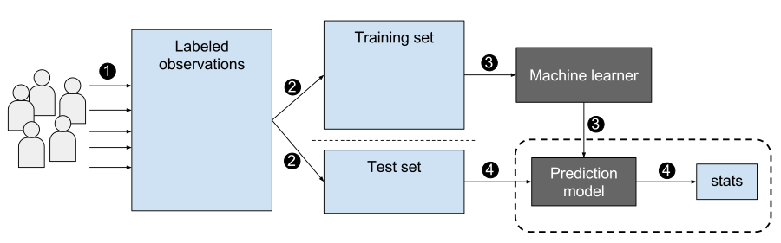
e) K Nearest Neighbor (KNN) :
KNN is a supervised machine learning algorithm. It assumes similar objects are nearer to one another. When the parameters are continuous in that case knn is preferred. In this algorithm it classifies objects by predicting their nearest neighbor. It’s simple and easy to implement and also has high speed because of which it is preferred over the other algorithms when it comes to solving classification problems. The algorithm classifies whether or not the employee has health problem by taking the health treatment dataset as an input. It takes input parameters like age, Gender, etc. and classify person with health treatment. Algorithm takes following steps :-
Step 1: Select the value for K.
Step 2 : Find the Euclidean distance of K no. of neighbors.
Step 3 : Based on calculated distance, select the K nearest neighbors in the training data which are nearest to
unknown data points.
Step 4 : Calculate no. of data points in each category among these K neighbors.
Step 5 : Assign new data points to the category which has the maximum no. of neighbors.
Step 6 : Stop.
11

Slide 12
Implementation Steps:
As we already discussed in the methodology section about some of the implementation details. So, the language used in this project is Python programming. We’re running python code in anaconda navigator’s Jupyter notebook. Jupyter notebook is much faster than Python IDE tools like PyCharm or Visual studio for implementing ML algorithms. The advantage of Jupyter notebook is that while writing code, it’s really helpful for Data visualization and plotting some graphs like histogram and heatmap of correlated matrices. Let’s revise implementation steps :
Dataset collection.
Importing Libraries : Numpy, Pandas, Scikit-learn, warnings, Matplotlib and Seaborn libraries were used.
Exploratory data analysis : For getting more insights about data.
Data cleaning and preprocessing : Checked for null and junk values using isnull() and isna().sum() functions of python. In Preprocessing phase, we did feature engineering on our dataset. As we converted categorical variables into numerical variables using function of Pandas library. Both our datasets contains some categorical variables.
Model selection : We first separated X’s from y’s. X’s are features or input variables of our datasets and y’s are dependent or target variables which are crucial for predicting treatment. Then using by the importing model_selection function of the sklearn library, we splitted our X’s and y’s into train and test split using train_test_split() function of sklearn. We splitted 70% of our data for training and 30% for testing.
12

Slide 13
f) Applied ML models and created a confusion matrix of all models.
g) Deployment of the model which gave the best accuracy.
Library
import pandas as pd
import numpy as np
import matplotlib.pyplot as plt
import seaborn as sns
import warnings
warnings.filterwarnings('ignore’)
from sklearn.model_selection import train_test_split
from sklearn.metrics import plot_confusion_matrix
from sklearn.metrics import classification_report
13

Slide 14
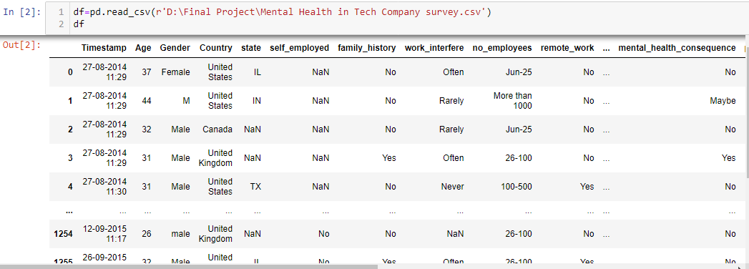
Data Wrangling
14

Slide 15
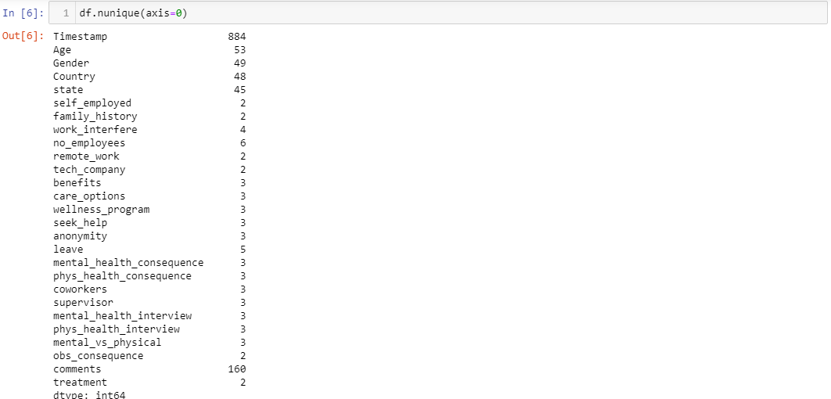
Number of unique value for each variable
15

Slide 16
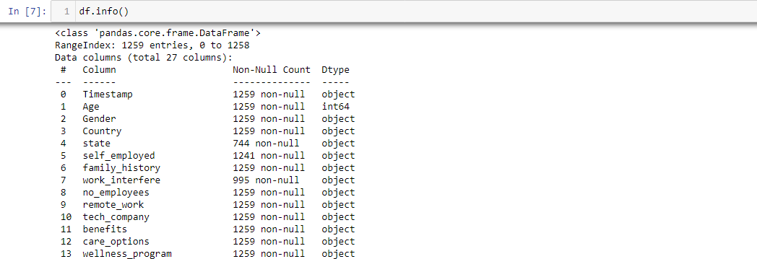
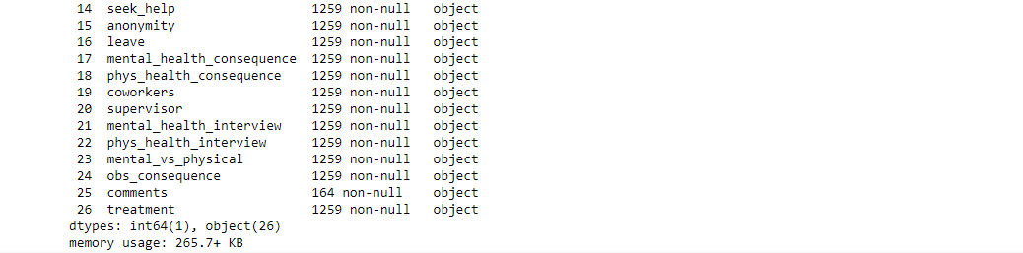
Check null values and Dtypes
16

Slide 17
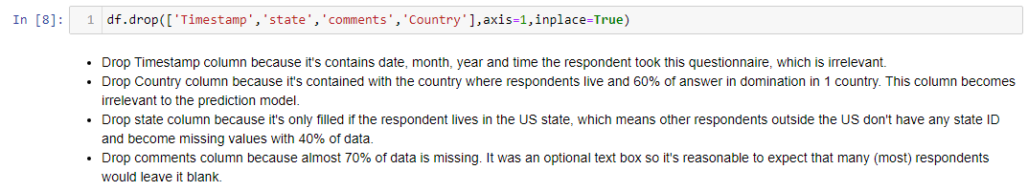
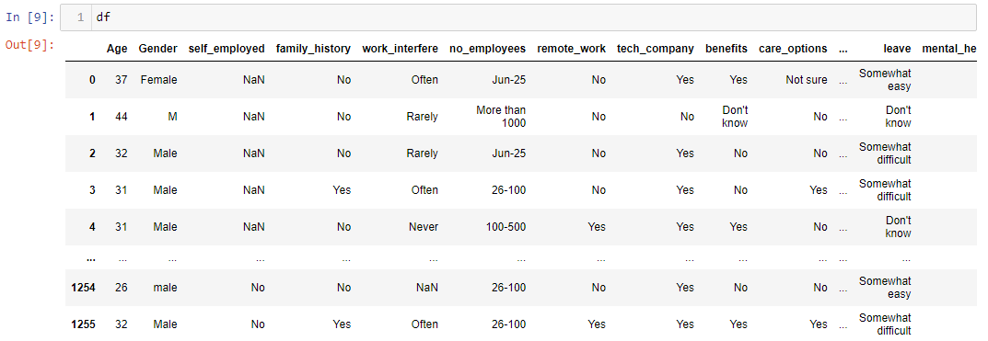
Drop unnecessary columns
17

Slide 18
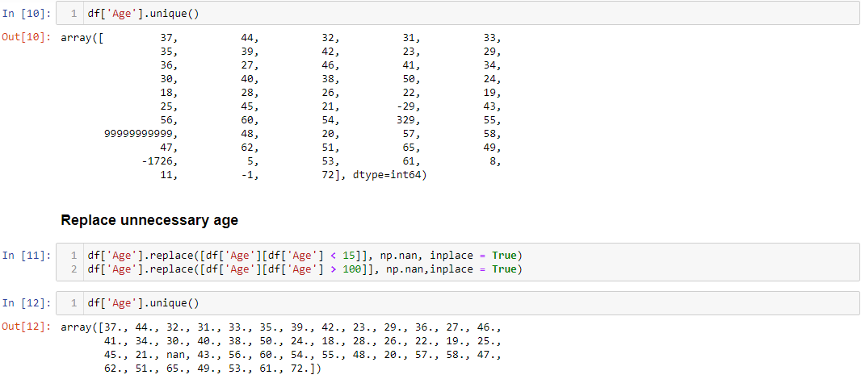
Replace unnecessary age
18

Slide 19
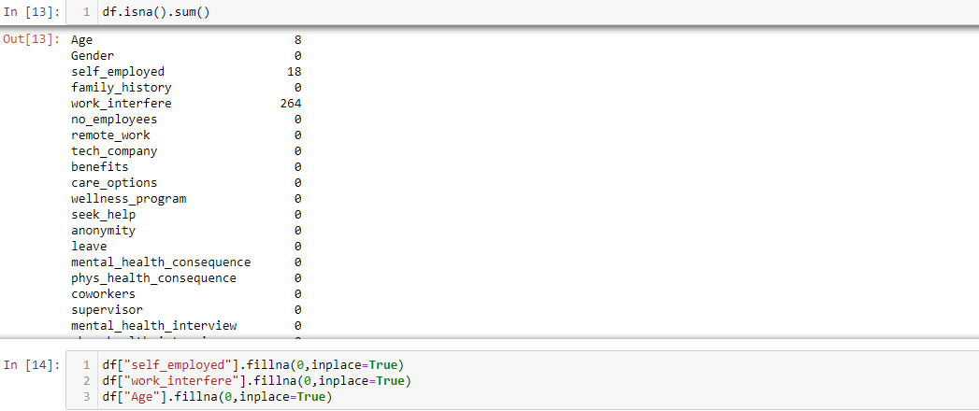
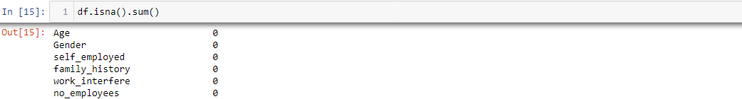
Sum of all null values and fill
19

Slide 20
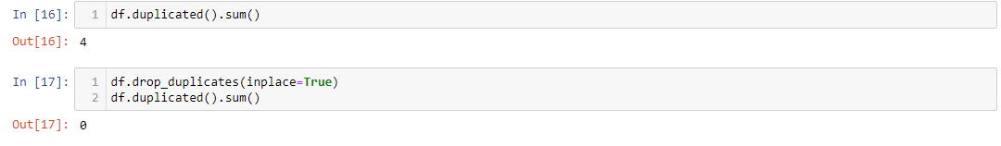
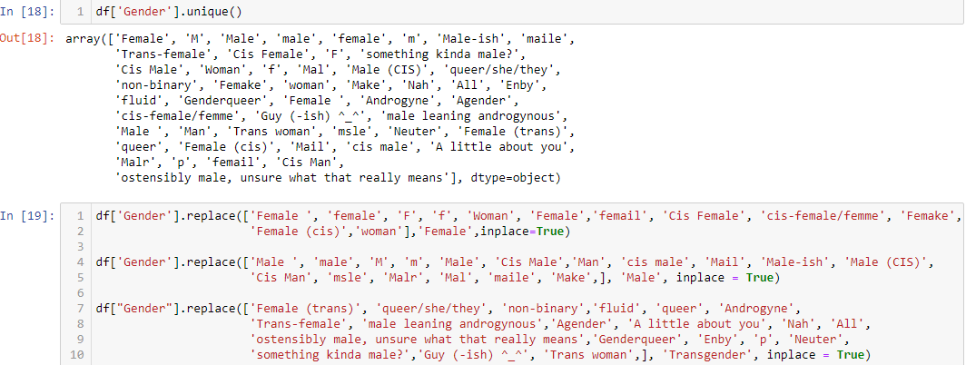
Check Duplicate value and drop
Check unique value and rename
20

Slide 21
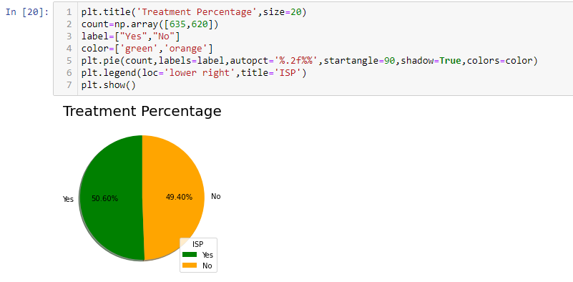
Exploratory Data Analysis
Check percentage of treatment
Treatment Percentage of Yes is = 50.60%
Treatment Percentage of No is =49.40%
21

Slide 22
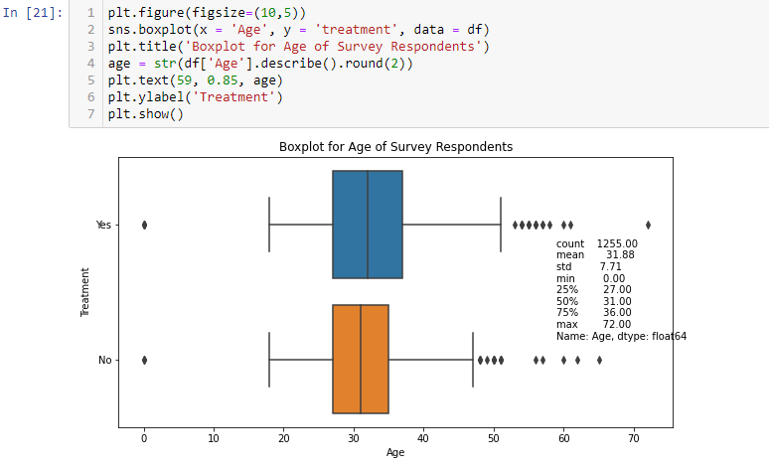
BOX Plots
From the boxplot, there is no statistically significant difference of ages between respondents that get treatment and no treatment.
22

Slide 23
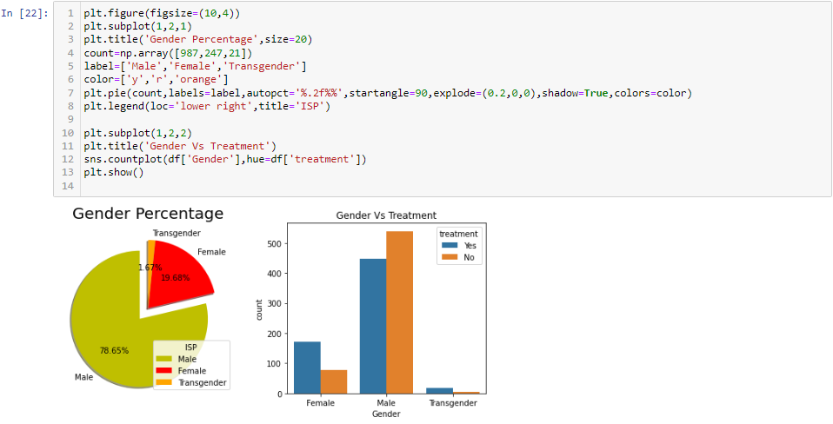
Check percentage of gender and count with treatment
Almost 78.65% of respondents are male, not surprisingly, especially in the tech field. The very large gap between men and women causes higher competitive pressure for women than men. Based on the plot, female that want to get treatment is high around 70%. Maybe some of them get sexual harrassment or racism at work because female are scarce in the tech industry.
23

Slide 24
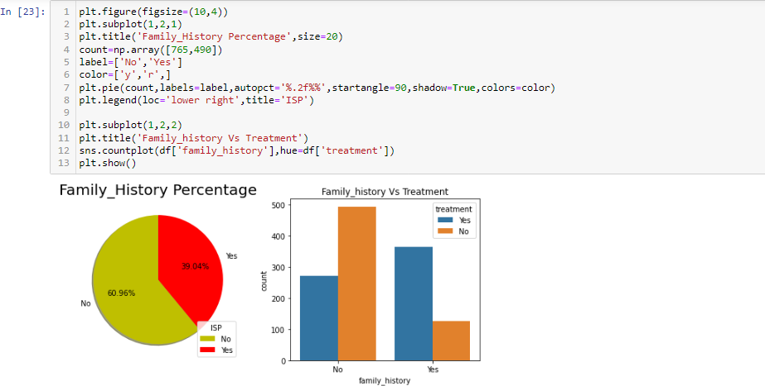
Check percentage of Family_history and count with treatment
From 39.04% of respondents who say that they have a family history of mental illness, the plot shows that they significantly want to get treatment rather than without a family history. This is acceptable, remember the fact that people with a family history pay more attention to mental illness. Family history is a significant risk factor for many mental health disorders.
24

Slide 25
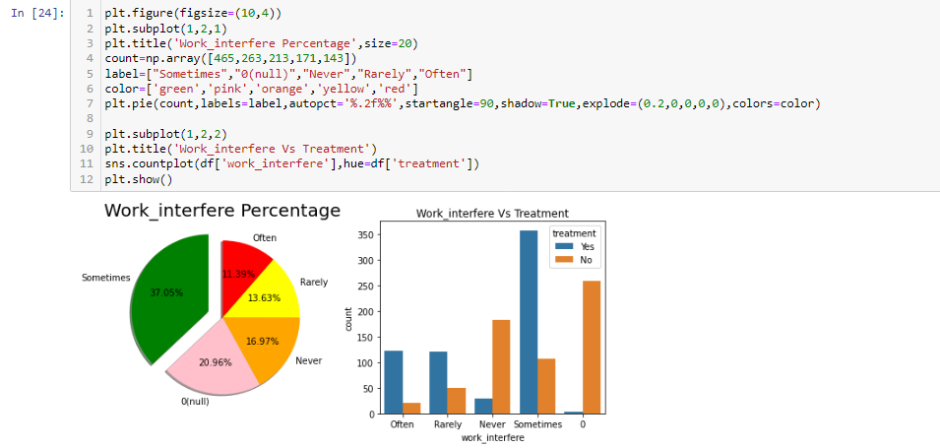
Check percentage of Work_interfere and count with treatment
Mental health conditions sometimes become an interfere while working about 37.05%. The plots prove that almost 80% want to get treatment.
25

Slide 26
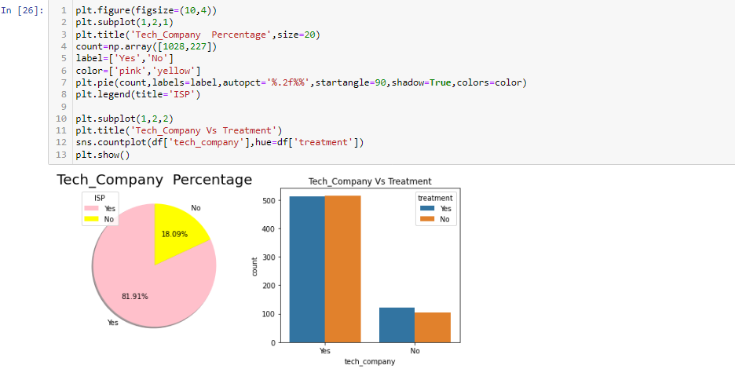
Check percentage of Tech_company and count with treatment
Even the main target of the survey is the tech field, there are 18% of companies belong to the non-tech field. But it can be seen from the plot whether the company belongs to the tech field or not, mental health still becomes a big problem. I think the environment affects a lot of employees and some of them can't take it for granted like abuse at the workplace.
However, I found that the number of employees in the technology field that want to get treatment is slightly lower than no treatment. But the non-technical field is the opposite.
26

Slide 27
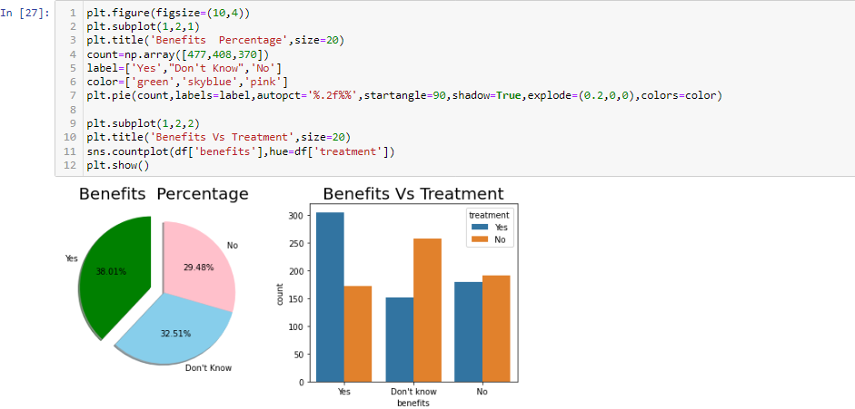
Check percentage of Benefits and count with treatment
Only 38% of respondents know about mental health benefits that the company provides for them.
For employees who know the benefits, almost 60% of the employees want to get treatment. Surprisingly, there is an employee who doesn't know and says that the company doesn't provide still want to get treatment. I assume that maybe the company can't provide it properly because of budgeting or financial struggling.
27

Slide 28
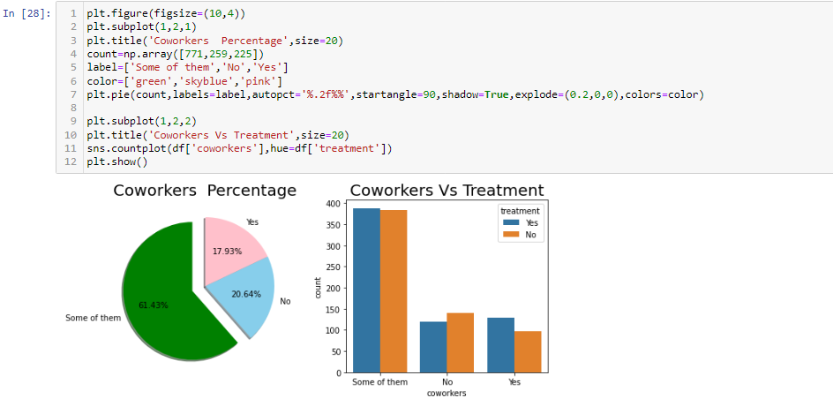
Check percentage of Coworkers and count with treatment
From 17% of respondents who say yes to discuss it with coworkers, 60% of them want to get
treatment.
About 61% of respondents decide to discuss some of them with coworkers. Employees who do that and want to get treatment are half of them. Let's see if the respondent will discuss it with a supervisor or not.
28

Slide 29
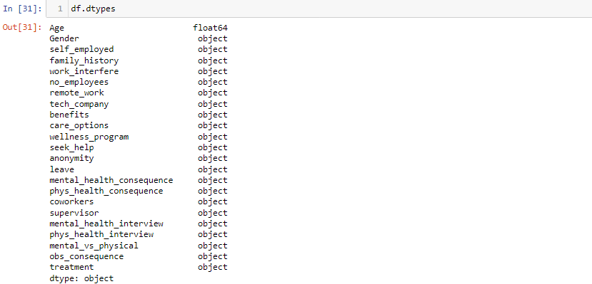
PreProcessing
Check dtypes
Dtypes of 22 columns are object and 1 is float. For applying machine learning convert all columns dtypes into integer.
29

Slide 30
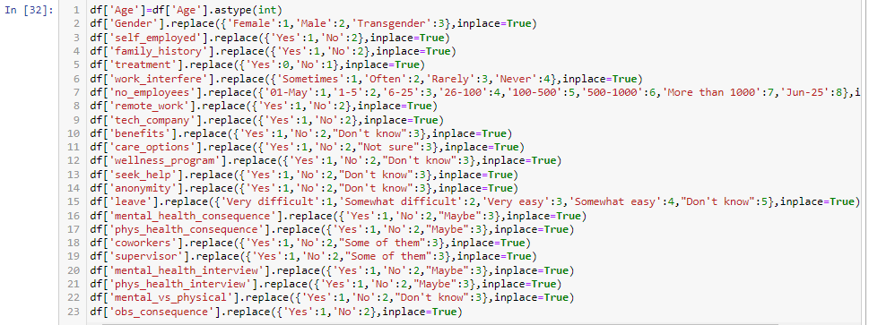
Convert dtype object to int
30

Slide 31
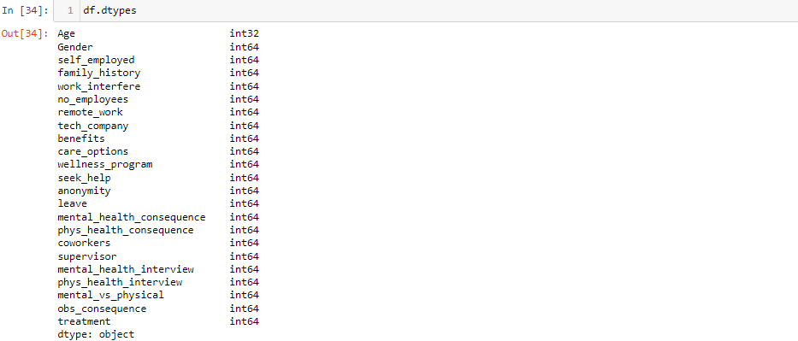
Check dtypes for integer
31

Slide 32
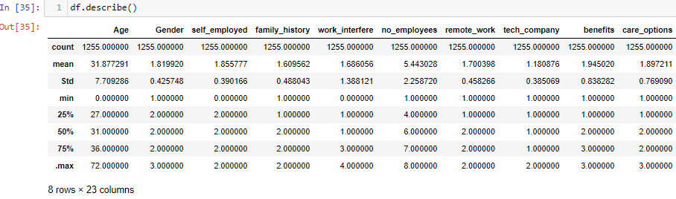
Summarizes the count, mean, standard deviation, min and max for numeric variables
32

Slide 33
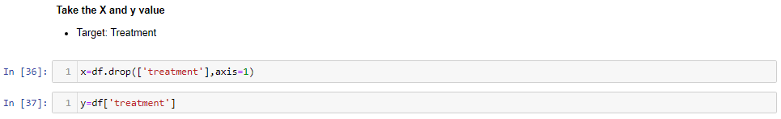
Machine Learning and Predictive Analytics
Assign the 22 features to X, & the last column to our classification predictor, y.
Split the data set into Training set and Test set.
Modeling/Training
We will now train various Classification Models on the Training set & see which yields the highest accuracy.
We will compare the accuracy of
33

Slide 34
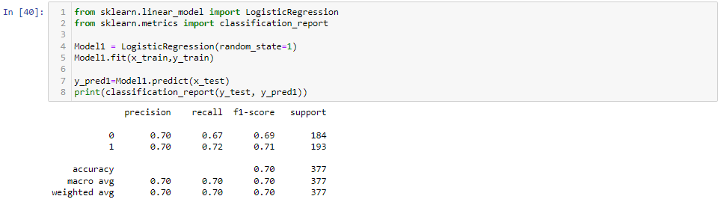
Logistic Regression
Decision Tree
Random Forest
K-NN (K-Nearest Neighbors)
SVM (Support Vector Machine)
Naives Bayes Classifier
XGBoost
Note: These are all supervised learning models.
Model 1 : Logistic Regression
Overall Accuracy = 70%
34

Slide 35
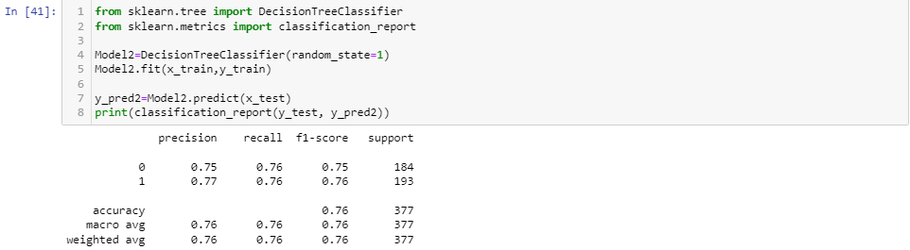
Model 2 : Decision Tree Classifier
Overall Accuracy = 76%
35

Slide 36
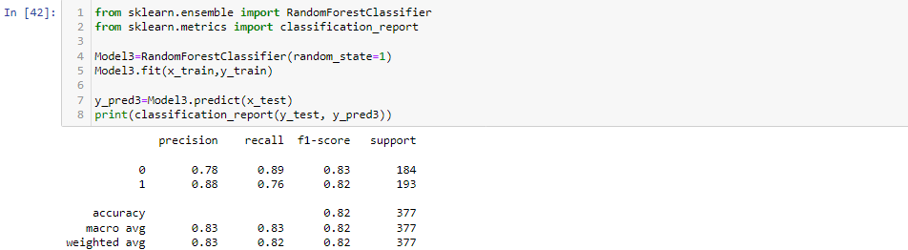
Model 3 : Random Forest
Overall Accuracy =82%
36

Slide 37
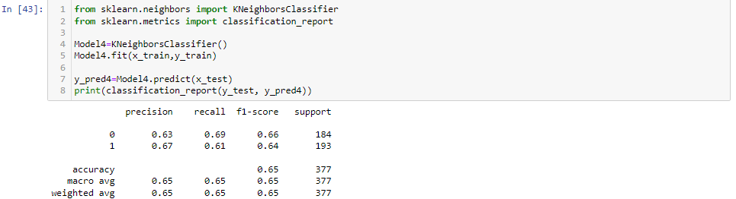
Model 4 : K-NN (K-Nearest Neighbors)
Overall Accuracy =65%
37

Slide 38
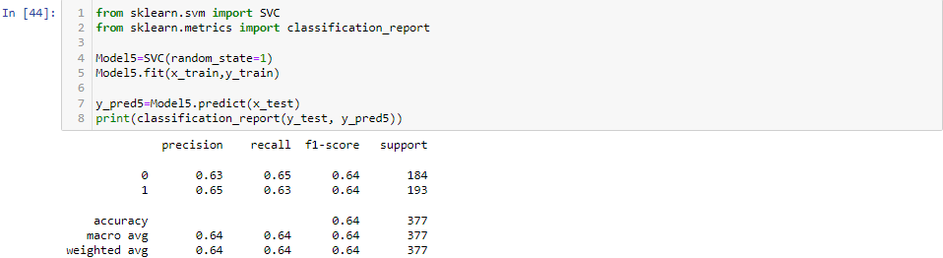
Model 5 : SVM (Support Vector Machine)
Overall Accuracy =64%
38

Slide 39
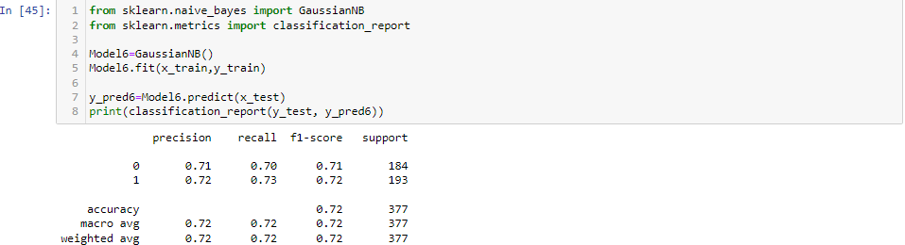
Model 6 : Naives Bayes Classifier
Overall Accuracy =72%
39

Slide 40
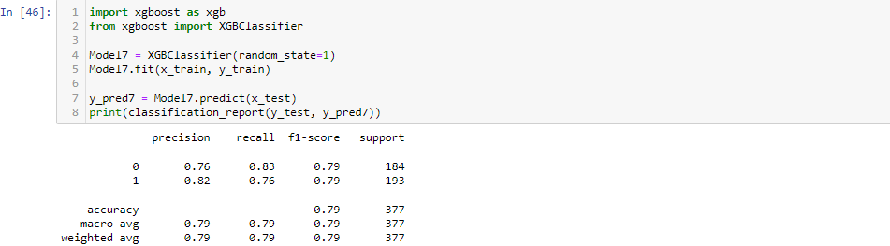
Model 7 : XGBoost
Overall Accuracy =79%
40

Slide 41
From comparing the 7 models, we can conclude that Model 3: Random Forest yields the highest accuracy. With an accuracy of 82%.
We have precision, recall, f1-score and support:
Precision: “How many are correctly classified among the class”
Recall: “How many of this class you find over the whole number of element of this class”
F1-score: Harmonic mean of precision and recall values. F1 score reaches its best values at 1 and worst value at 0. F1 Score = 2*((precision * recall) / precision + recall))
Support: Samples of the true response that lie in that class.
Measuring Model Performance
While there are other ways of measuring model performance (precision, recall, F1 Score, ROC Curve, etc), let's keep this simple and use accuracy as our metric. To do this are going to see how the model performs on new data (test set).
Accuracy is defined as: (fraction of correct predictions): correct predictions / total number of data points
41

Slide 42
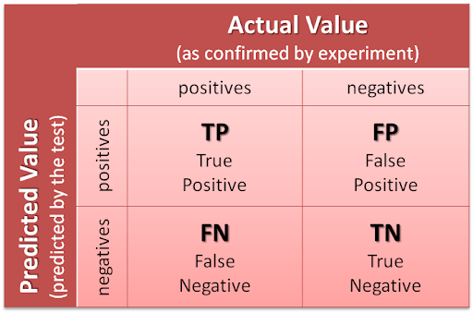
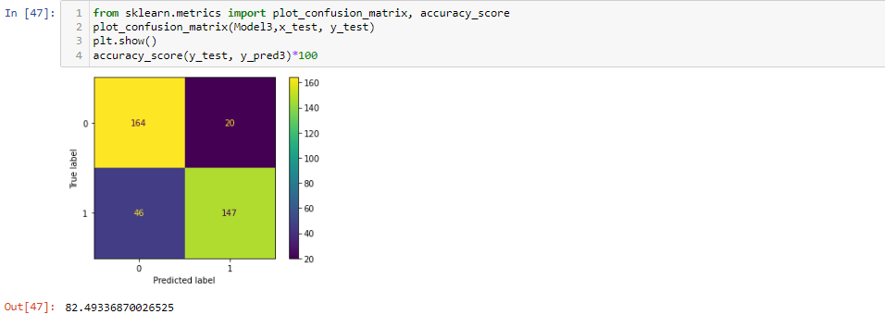
Confusion Matrix
42

Slide 43
Confusion Matrix
164 is the amount of True Positives in our data, while 147 is the amount of True Negatives. 20 & 46 are the number of errors.
There are 20 type 1 error (False Positives)- You predicted positive and it’s false.
There are 46 type 2 error (False Negatives)- You predicted negative and it’s false.
Hence if we calculate the accuracy its # Correct Predicted/ # Total. In other words, where TP, FN, FP and TN represent the number of true positives, false negatives, false positives and true negatives.
(TP + TN)/(TP + TN + FP + FN). (164+147)/(164+147+20+46) = 0.82 = 82% accuracy
Note: A good rule of thumb is that any accuracy above 70% is considered good, but be careful because if your accuracy is extremly high, it may be too good to be true (an example of Overfitting). Thus, 82% is the ideal accuracy.
43

Slide 44
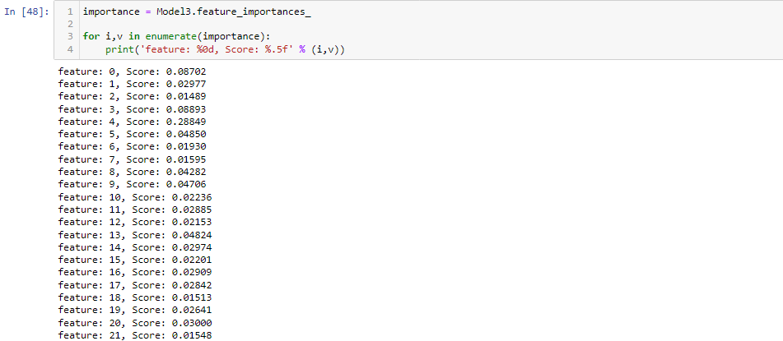
Feature Importance
Feature Importance provides a score that indicates how helpful each feature was in our model.
The higher the Feature Score, the more that feature is used to make key decisions & thus the more important it is.
44

Slide 45
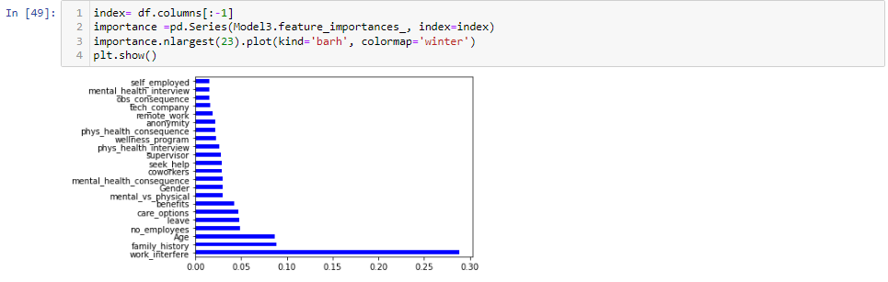
From the Feature Importance graph above, we can conclude that the top 4 significant features were.
Work_interfere
Age
family_history
care_options
45

Slide 46
Chapter – 4
Analysis of the Result
We used precision, F1-score, recall and accuracy evaluation metrics for evaluating our models. False Positive(FP) is when a model incorrectly predicts a positive outcome. False Negative(FN) is when a model incorrectly predicts the negative outcome. True Positive(TP) is when model correctly predicts a positive outcome. True Negative(TN) is when a model correctly predicts a negative outcome.
Precision=TP/(TP+FP)
Recall = TP / (TP + FN)
Machine Learning Models Accuracy
Logistic Regression
70%
Decision Tree
76%
Random Forest
82%
KNN
65%
SVM
64%
Naive Bayes
72%
XGBoost
79%
46

Slide 47
Conclusions
Our Random Forest algorithm yields the highest accuracy, 82%. Any accuracy above 70% is considered good, but be careful because if your accuracy is extremely high, it may be too good to be true (an example of Overfitting). Thus, 82% is the ideal accuracy.
Out of the 22 features we examined, the top 4 significant features that helped us classify between a positive & negative Diagnosis were Work_interfere, Age, family_history, care_options.
Our machine learning algorithm can now classify employees with health treatment. Now
we can properly diagnose employee, & get them the help they needs to recover.
Here is access to the data set & code from my GitHub page:
https://github.com/Naveen8221/Final-Project
Chapter – 5
47

