Slide 1
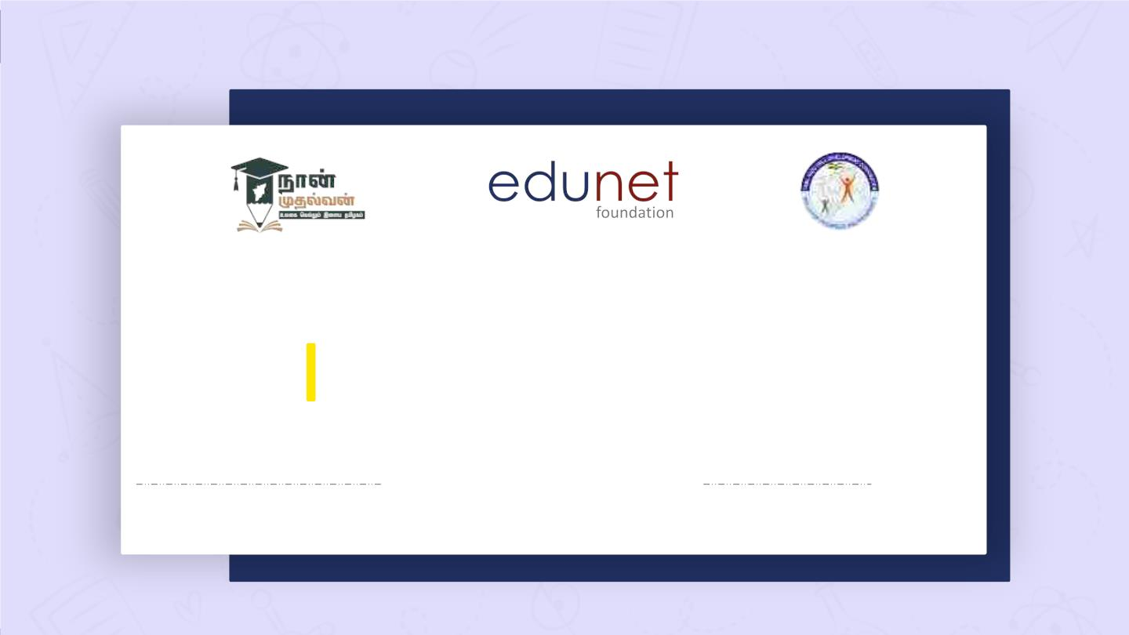
NEXT GEN EMPLOYABILITY PROGRAM
Creating a future-ready workforce
Team Members
College Name
Student Name : Naveen P
Student ID :712221205021
Park College of Engineering
and technology

Slide 2

CAPSTONE PROJECT SHOWCASE
Project Title
Notes Sharing Web Application using Django Framework
Abstract | Problem Statement | Project Overview | Proposed Solution |
Technology Used | Modelling & Results | Conclusion

Slide 3
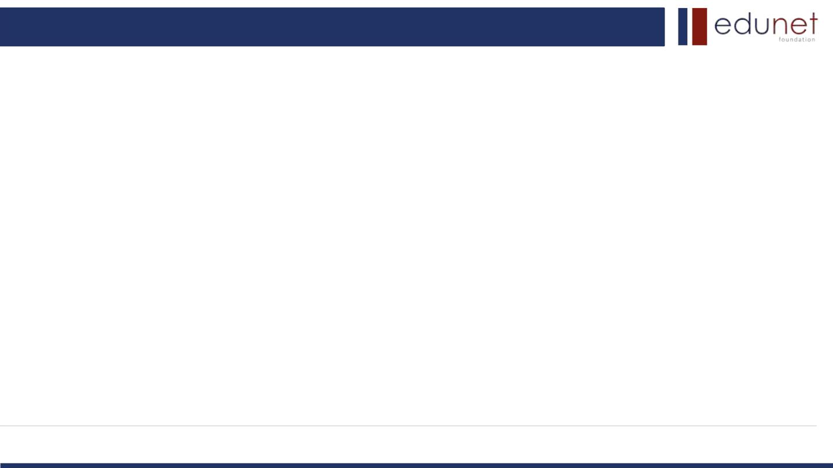
Next Gen Employability Program
Abstract
This project focuses on the development of a Notes Sharing Web Application using the
Django framework. The application facilitates users to create, share, and manage their notes
efficiently. The technology stack employed includes HTML, CSS, and JavaScript for the
frontend, while Python, Django, and SQL are utilized for the backend functionality.
The frontend development involves crafting an intuitive user interface (UI) using HTML for
structure, CSS for styling, and JavaScript for dynamic interactions. The UI allows users to
seamlessly navigate through the application, create new notes, edit existing ones, and share
them with other users.
On the backend, Django provides a robust framework for building scalable web
applications.
Source :

Slide 4
Next Gen Employability Program
Abstract
Python, being the primary language of Django, is used for implementing the core
functionality of the application. Django's built-in features such as authentication, routing, and
ORM (Object-Relational Mapping) streamline the development process.
SQL is employed as the database management system to store and manage the notes
data efficiently. Through Django's ORM, SQL queries are seamlessly integrated into the
application logic, enabling smooth interaction between the backend and the database.
Overall, this project aims to demonstrate the integration of frontend and backend
technologies to develop a functional and user-friendly Notes Sharing Web Application using
the Django framework.
Source :

Slide 5

Next Gen Employability Program
1.Problem Statement
The problem statement for this project is to develop a collaborative notes sharing web
application using the Django framework that addresses the following challenges:
1.Lack of real-time collaboration features in existing note-taking applications.
2. Absence of an intuitive and user-friendly interface for creating, editing, and organizing
notes.
3. Insufficient customization options for note formatting and organization.
4. Security and privacy concerns when sharing sensitive information or collaborating on
notes.
5. Inefficient data management and retrieval methods in existing solutions.
By addressing these challenges, the project aims to provide users with a comprehensive
and secure platform for sharing notes and collaborating with others in real-time, thereby
enhancing productivity and knowledge sharing in various domains.
Source :

Slide 6
Next Gen Employability Program
Project Overview
Title: Notes Sharing Web Application using Django Framework
Objective: Develop a modern and intuitive web application for seamless notes sharing and
real-time collaboration.
Features:
1. User-friendly Interface: Intuitive interface for creating, editing, and organizing notes.
2. Real-time Collaboration: Simultaneous editing and sharing of notes among multiple
users.
3. Customization Options: Flexible formatting and organization features for personalized
note-taking.
4. Secure Data Management: Implementation of robust security measures to protect user
data and ensure privacy.
Source :

Slide 7
Next Gen Employability Program
Project Overview
5. Django Framework: Utilization of Django framework for efficient backend development
and database management.
Technology Stack:
Frontend: HTML, CSS, JavaScript
Backend: Python, Django, SQL
Outcome: A comprehensive notes sharing platform that enhances productivity and facilitates
knowledge dissemination through seamless collaboration.
Source :

Slide 8
Next Gen Employability Program
Proposed Solution
• Real-time Collaboration: Implement WebSocket technology for real-time communication
between users, enabling simultaneous editing and sharing of notes.
• Intuitive User Interface: Design a modern and user-friendly interface using HTML, CSS,
and JavaScript for easy note creation, editing, and organization.
• Customization Features: Provide rich formatting options and organizational tools to
personalize note-taking experience.
• Robust Security Measures: Implement authentication, authorization, and encryption
techniques to ensure data privacy and secure collaboration.
Source :

Slide 9
Next Gen Employability Program
Proposed Solution
• Django Framework Integration: Utilize Django's powerful features for backend
development, including ORM for database management and built-in security
functionalities.
Outcome:
A collaborative notes sharing web application that offers seamless real-time
collaboration, intuitive user experience, extensive customization options, and robust security
measures to enhance productivity and knowledge sharing.
Source :

Slide 10
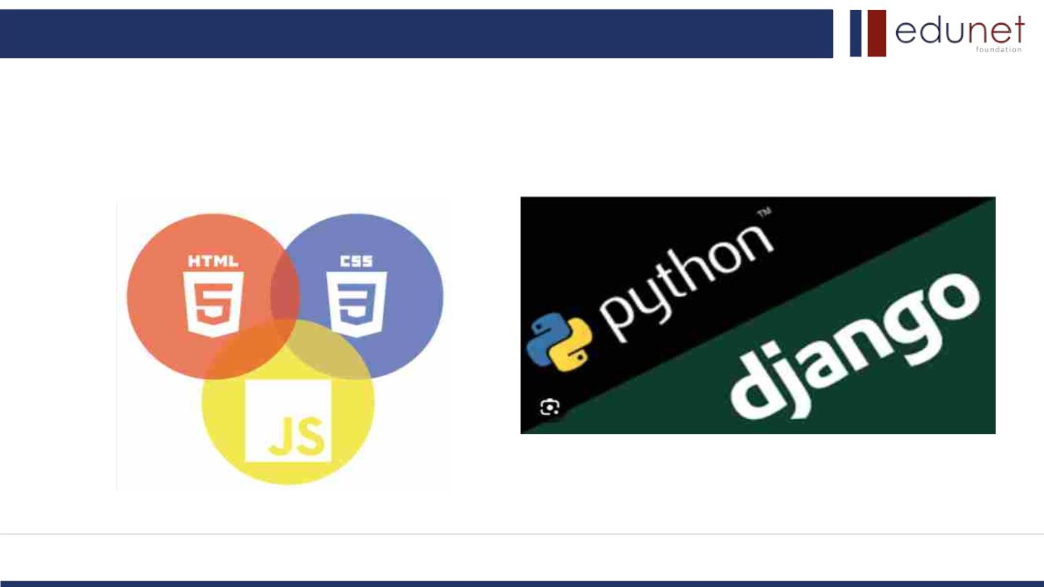
Next Gen Employability Program
Technology Used
Front-end
Back-end
Source :

Slide 11
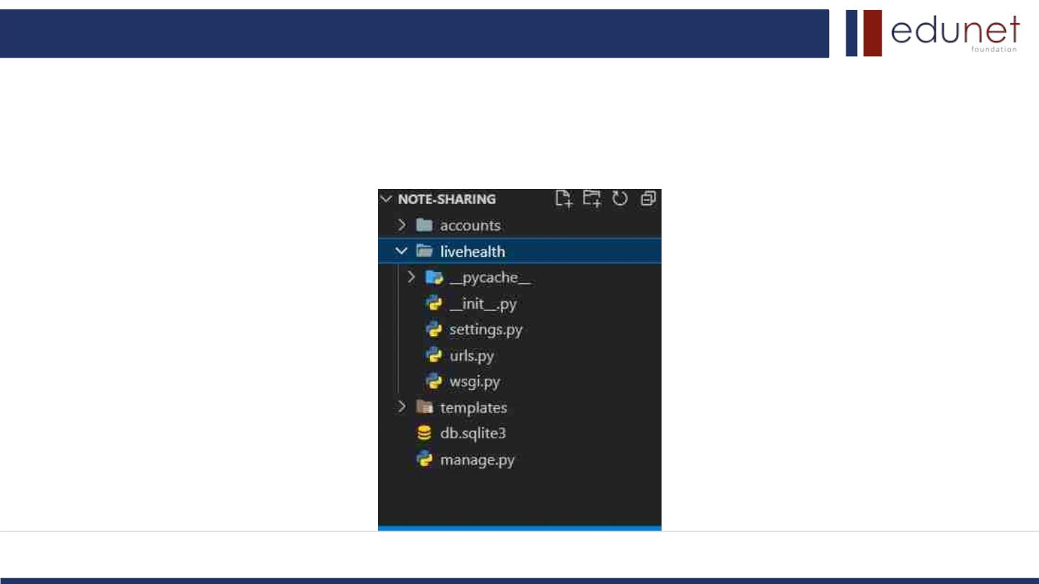
Next Gen Employability Program
Modelling & Results
Folder Structure :
Source :

Slide 12
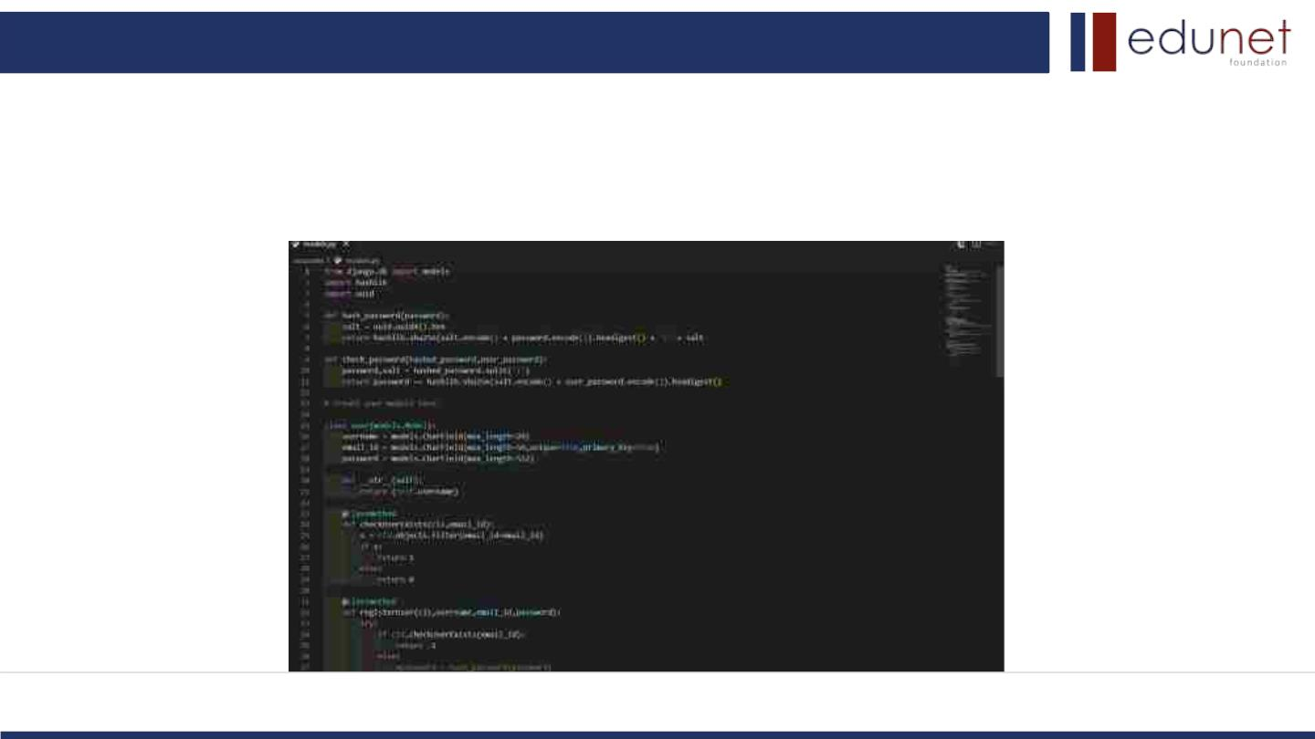
Next Gen Employability Program
Modelling & Results
models.py :
Source :

Slide 13
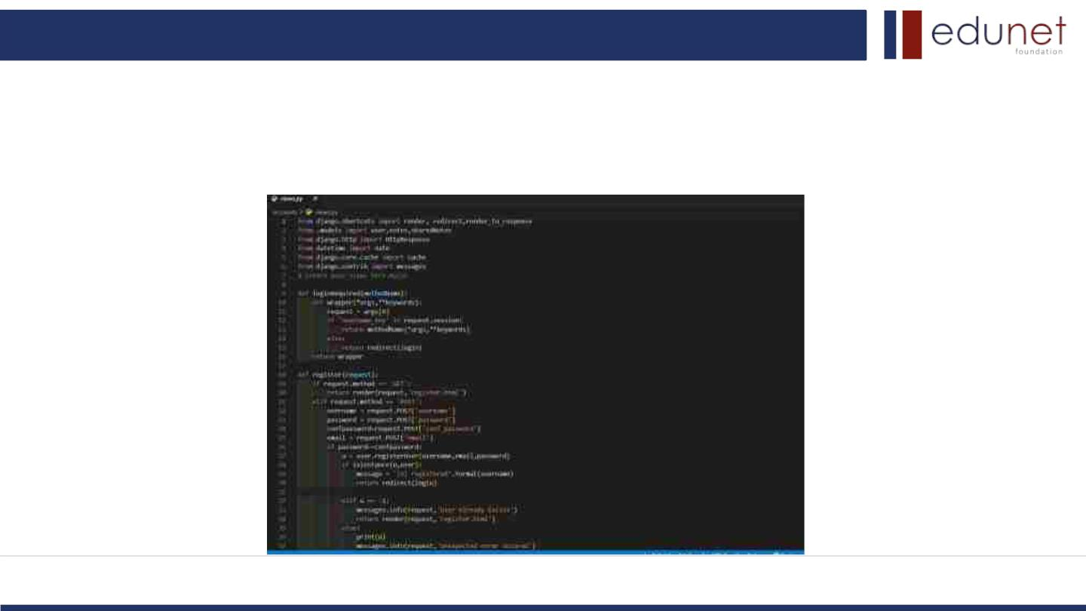
Next Gen Employability Program
Modelling & Results
views.py :
Source :

Slide 14
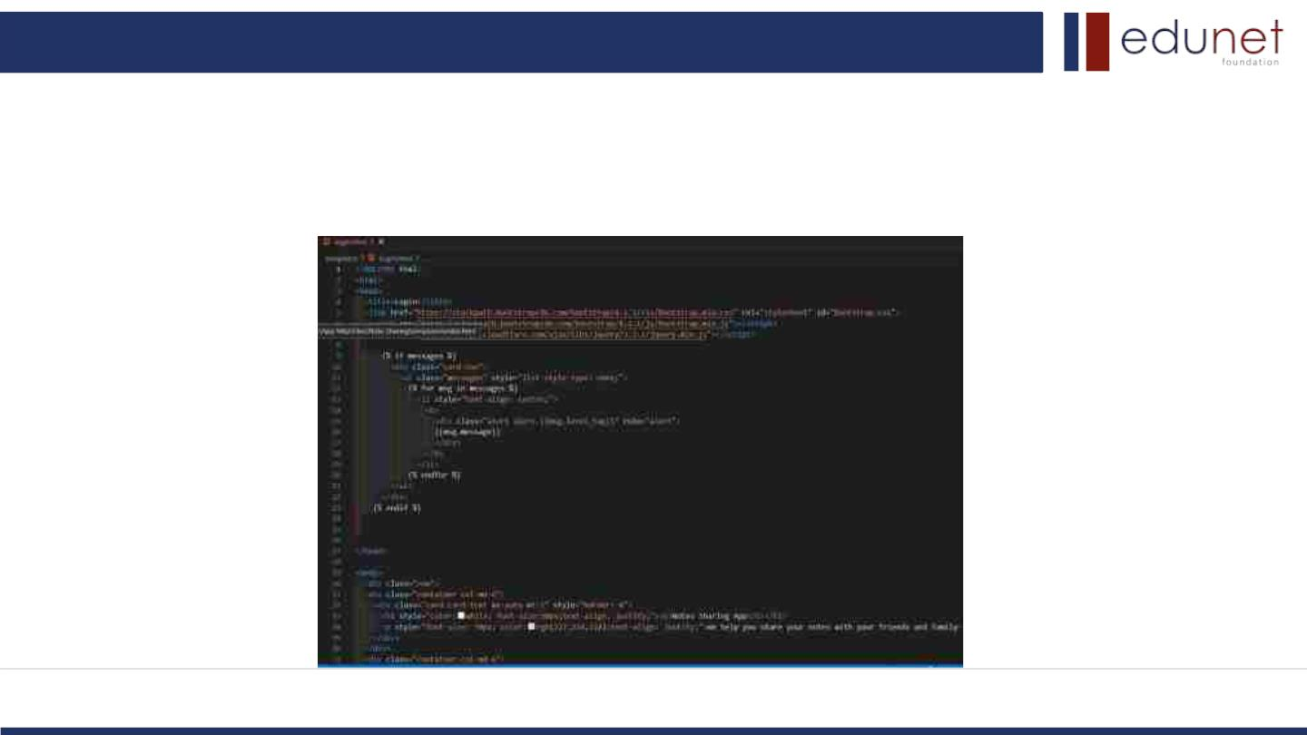
Next Gen Employability Program
Modelling & Results
Login.html :
Source :

Slide 15
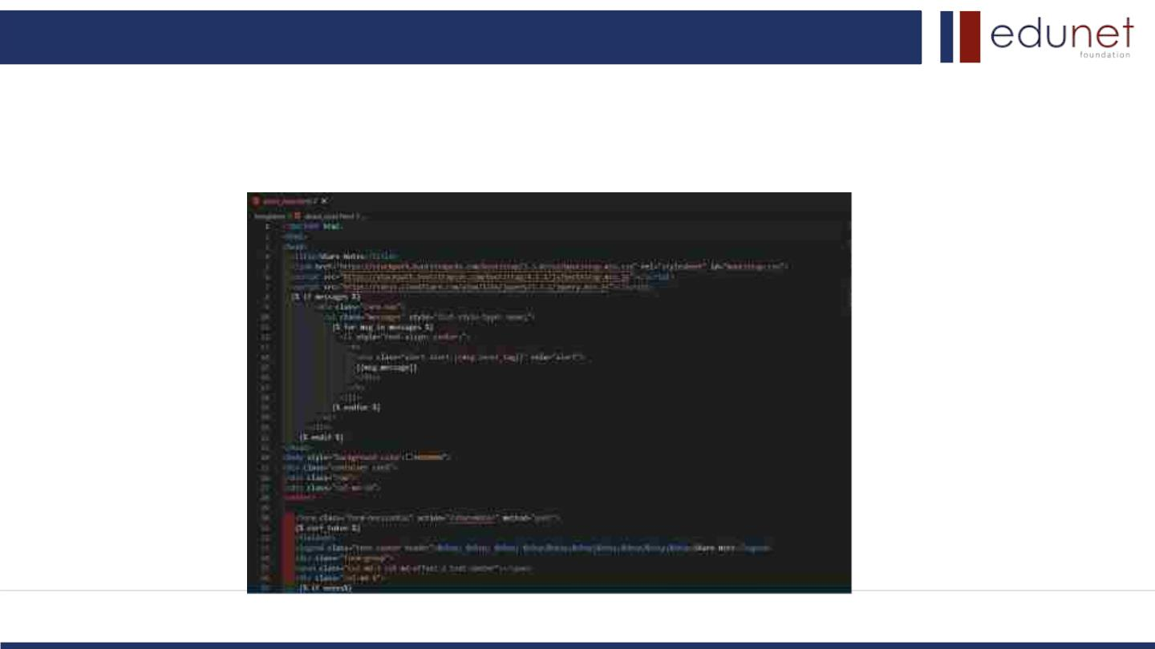
Next Gen Employability Program
Modelling & Results
Share_note.html :
Source :

Slide 16
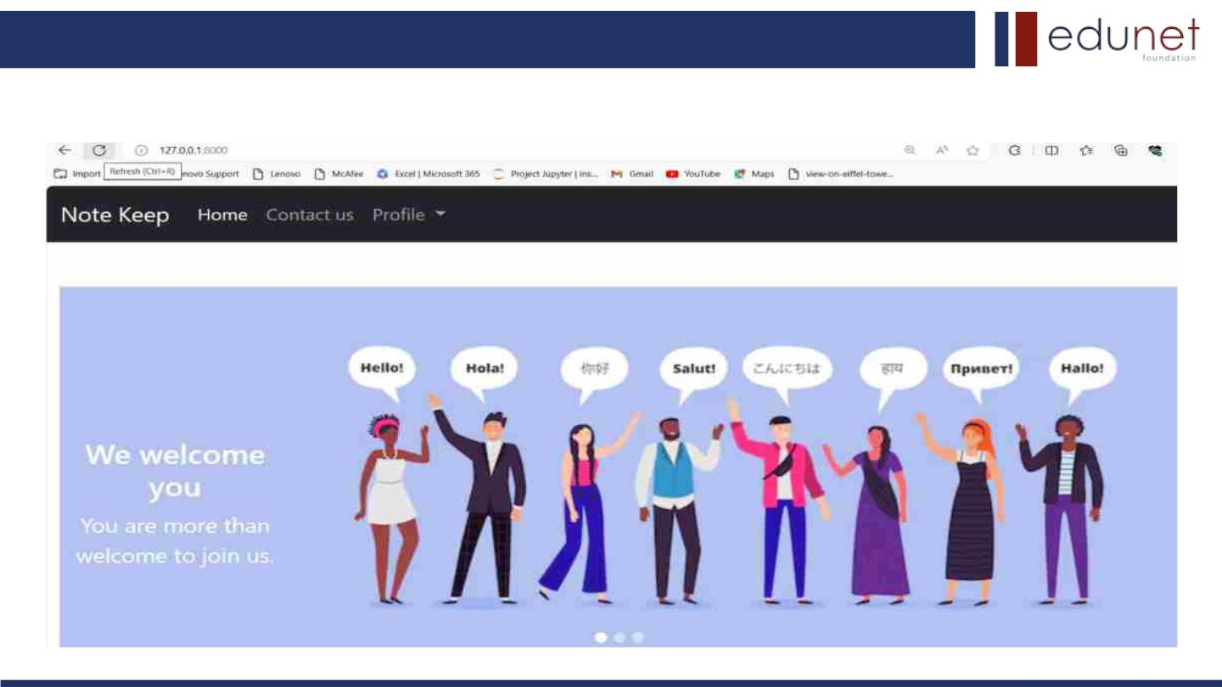
Next Gen Employability Program
Homepage

Slide 17
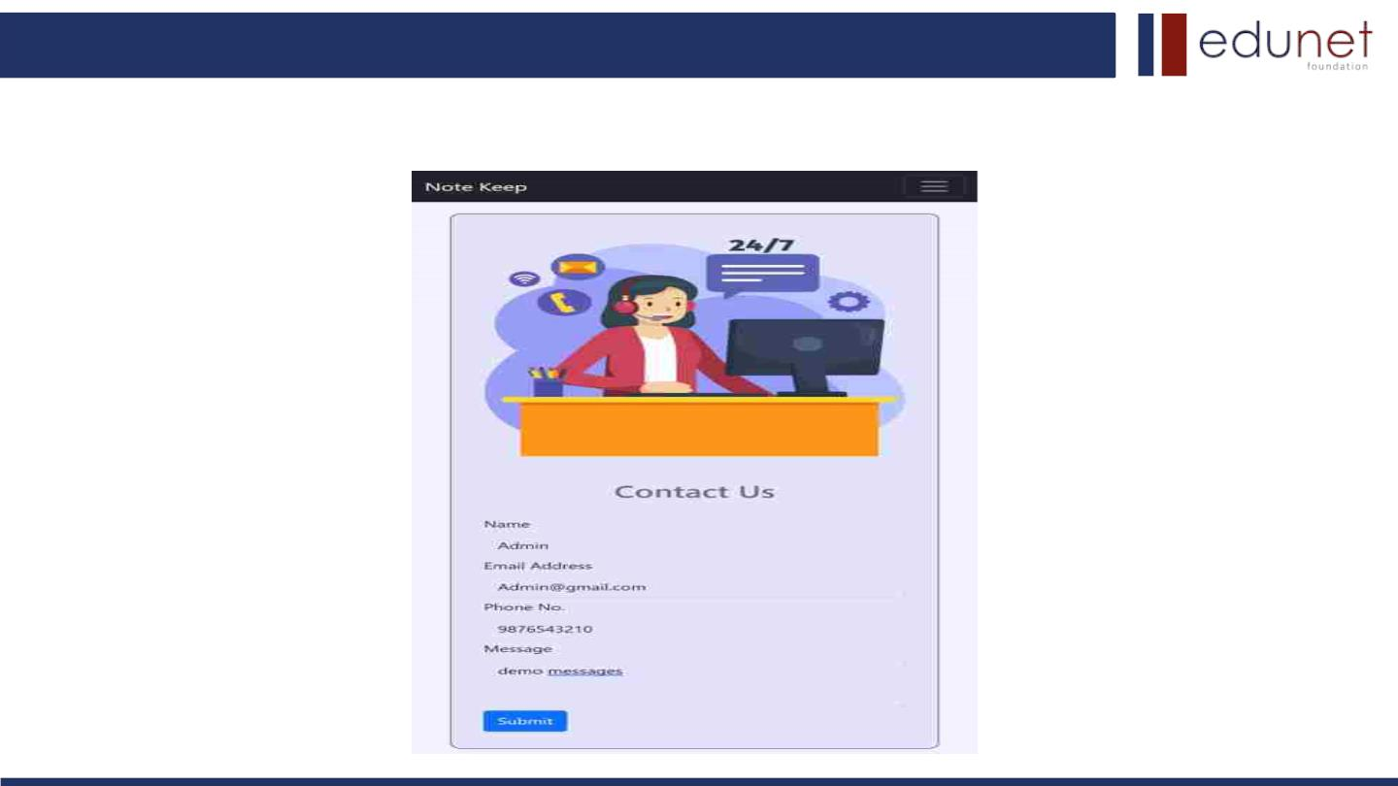
Next Gen Employability Program
About-Us-Page

Slide 18
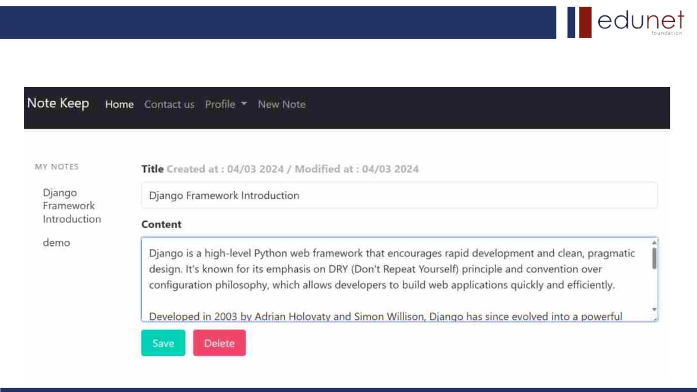
Next Gen Employability Program
Service-Page

Slide 19
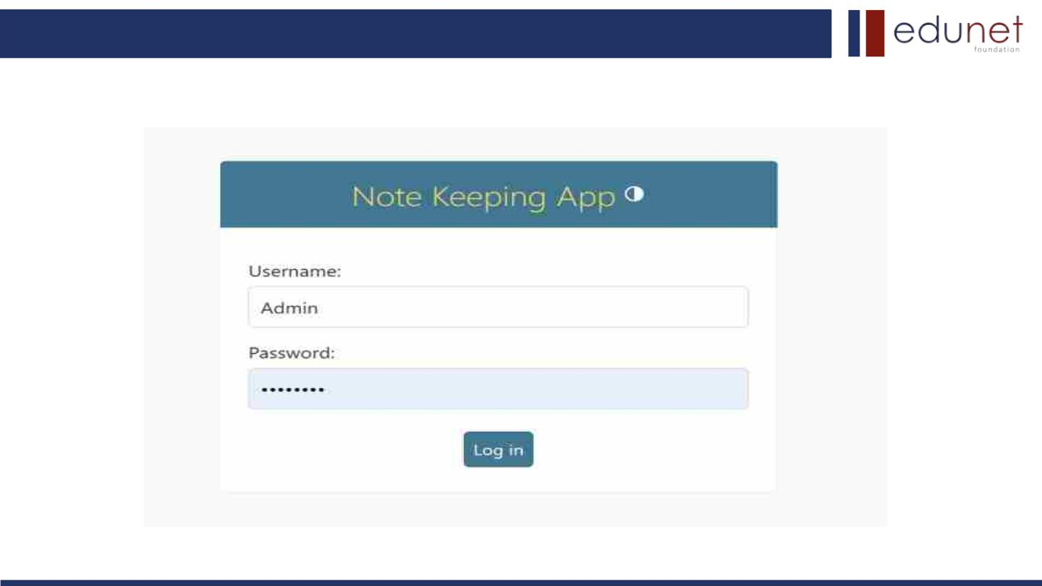
Next Gen Employability Program
Login-Page

Slide 20
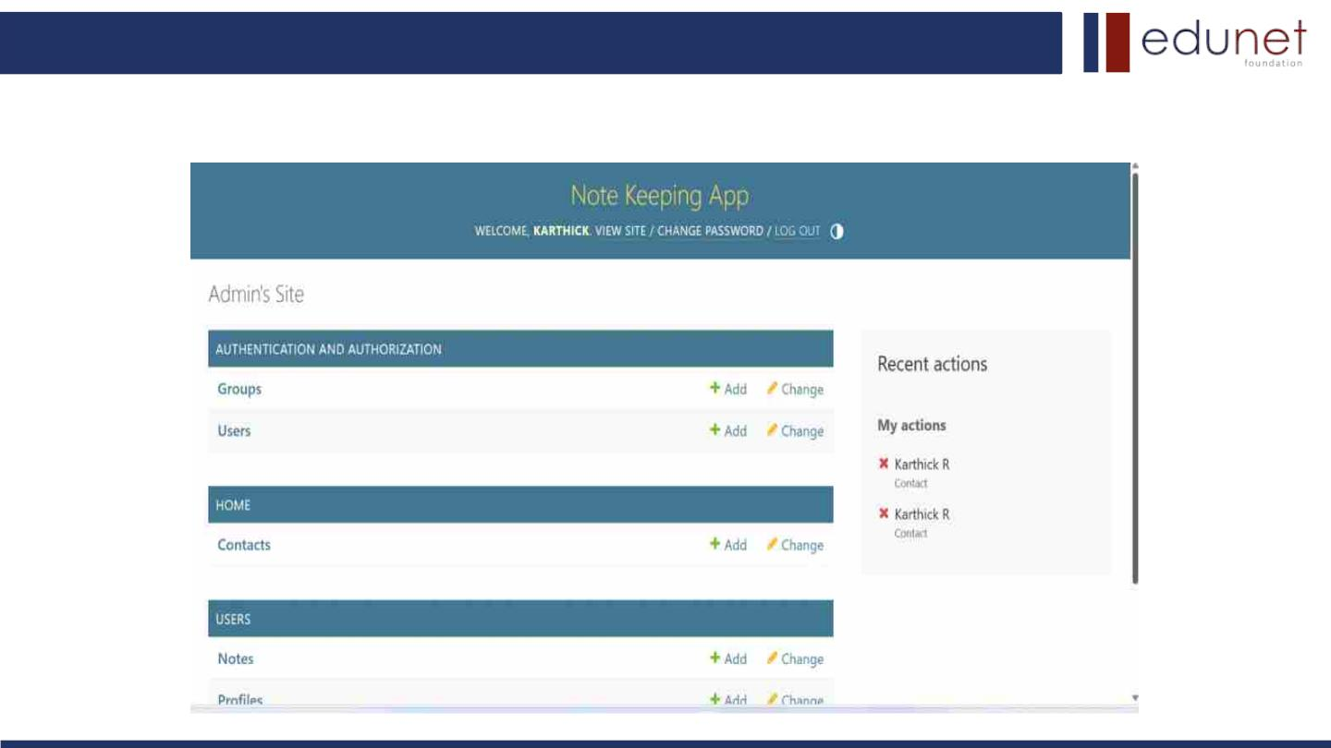
Next Gen Employability Program
Admin-Page

Slide 21
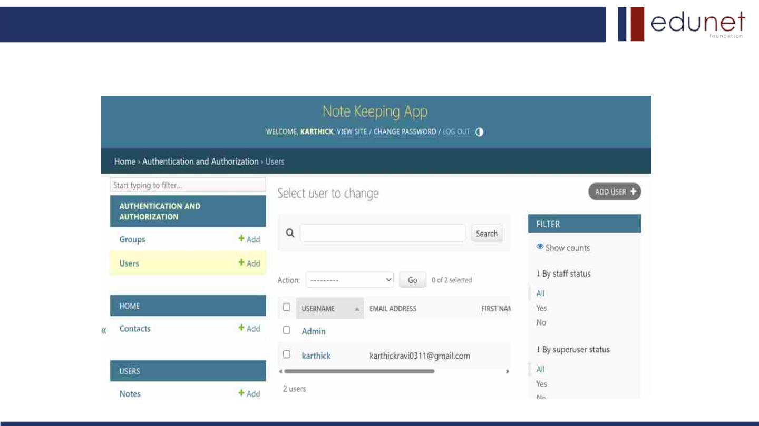
Next Gen Employability Program
Add/Update User-Page

Slide 22
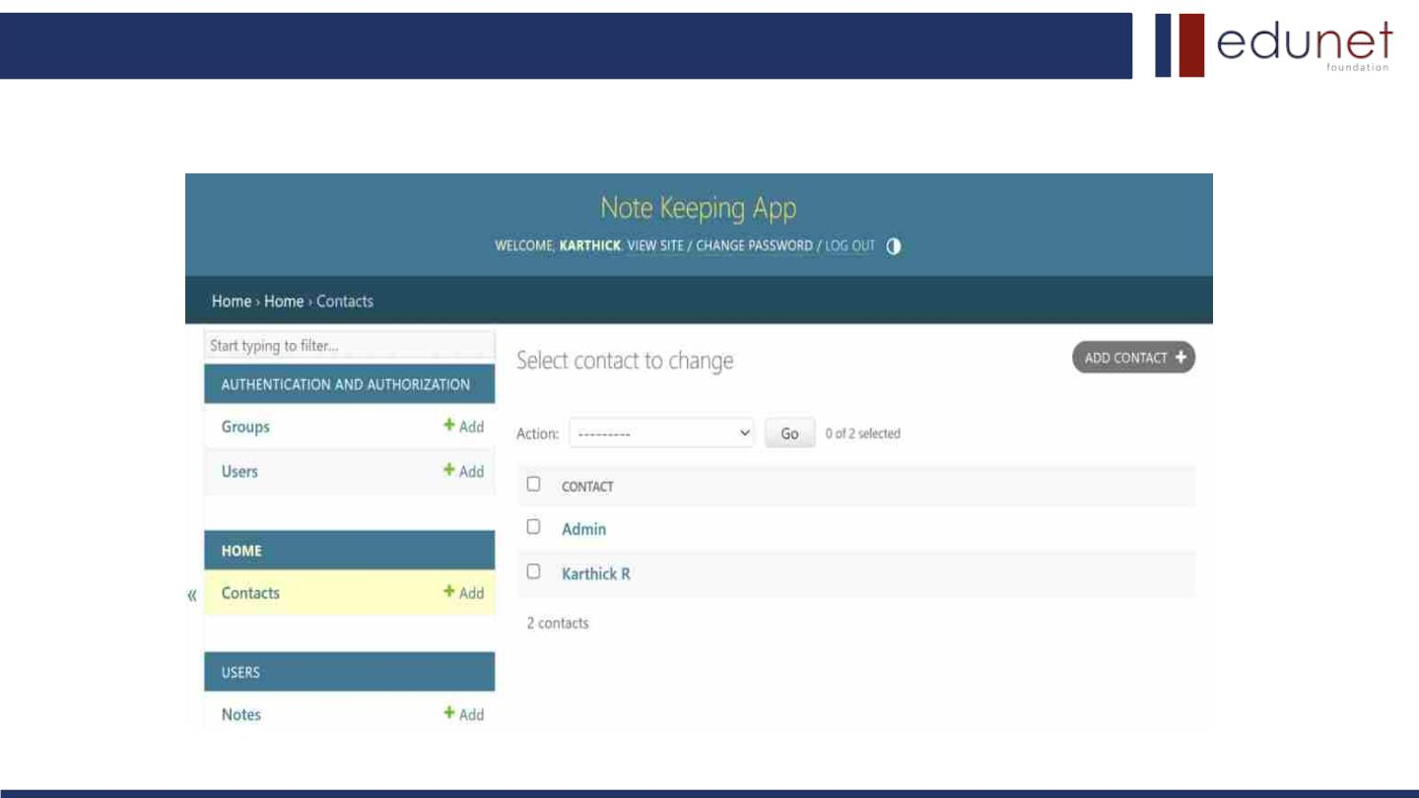
Next Gen Employability Program
Add/Update Contact-Page

Slide 23
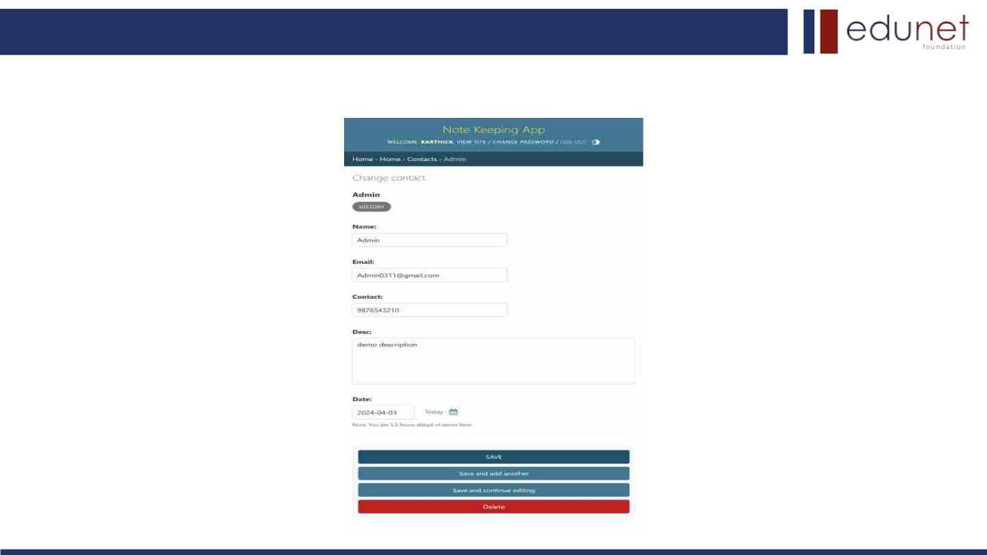
Next Gen Employability Program
Update profile-Page

Slide 24
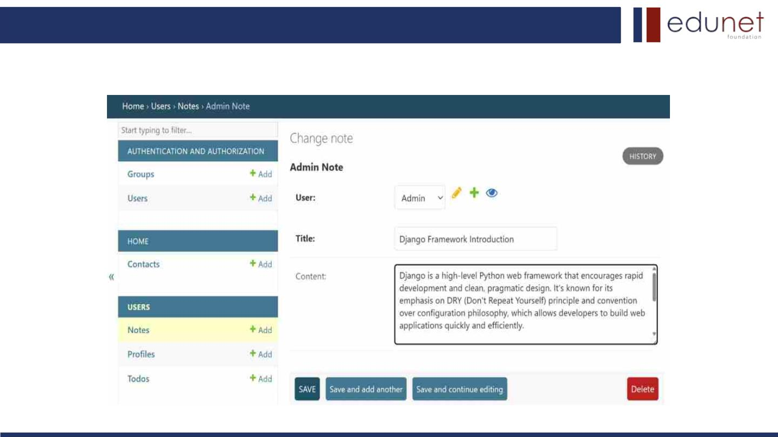
Next Gen Employability Program
Add Notes-Page

Slide 25

Next Gen Employability Program
Future Enhancements
• Mobile Application: Develop a companion mobile app for the notes sharing platform to
extend accessibility and convenience for users on-the-go.
• Enhanced Collaboration Tools: Integrate additional collaboration features such as real-
time chat, version history tracking, and commenting to further facilitate teamwork and
communication among users.
• Offline Mode: Implement offline functionality to allow users to access and edit notes
even when they're not connected to the internet, with automatic synchronization once
connectivity is restored.
• Advanced Search and Filtering: Enhance search capabilities with advanced filtering
options, tag-based organization, and full-text search functionality to quickly locate and
retrieve relevant notes.
• Multi-language Support: Add support for multiple languages to cater to a global user
base and enhance accessibility for non-English speakers.

Slide 26
Next Gen Employability Program
Conclusion
In conclusion, the development of a collaborative notes sharing web application using
the Django framework presents a promising solution to address the challenges of real-time
collaboration and seamless information sharing. By leveraging modern technologies such as
HTML, CSS, JavaScript, Python, Django, and SQL, the project aims to provide users with
an intuitive, secure, and feature-rich platform for managing and sharing their notes
effectively.
Overall, the collaborative notes sharing web application represents a significant step
forward in facilitating knowledge dissemination, enhancing productivity, and fostering
collaboration among users. Through continuous iteration and improvement, the platform
endeavors to meet the evolving needs of its users and remain a valuable tool for individuals
and teams across various domains.
Source :

Slide 27
Next Gen Employability Program
Thank You!

