Slide 1
Vehicle Price Estimation
Data Cops - Team Members
Naveen Kumar Reddy Veeramreddy
Baaghi Sai Keerthi
Uttam Sai Mohan Kammila
Sai Ram Reddy Kathi

Slide 2
Project analysis slide 2
Introduction
Objective
Goal of the project is to develop a predictive model to estimate the prices of cars in Australian Market.
Analyze various features like Brand, Fuel Consumption, Transmission, Kilometers driven, Vehicle Condition and others.
Scope
Exploratory Data Analysis of various features in the data.
To develop simple linear regression model, regression model with interaction and quadratic terms.
To analyze the residuals of the model predictions.

Slide 3
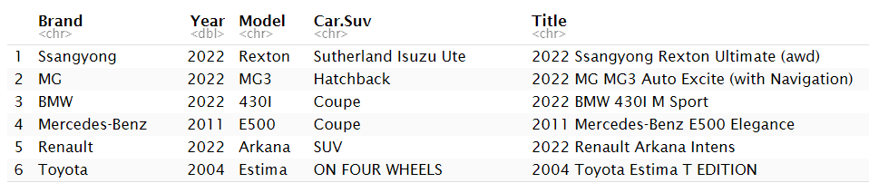
Project analysis slide 2
Data Description
Dataset contains 16734 records, 18 independent variables and dependent column price.
Head of the raw data looks as follows

Slide 4
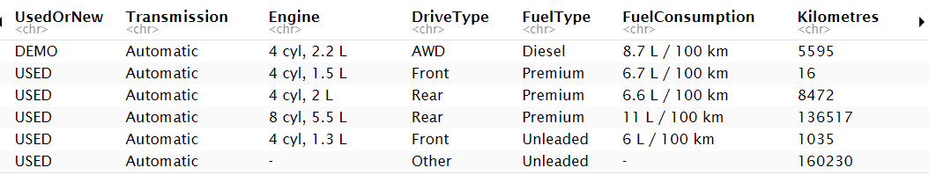
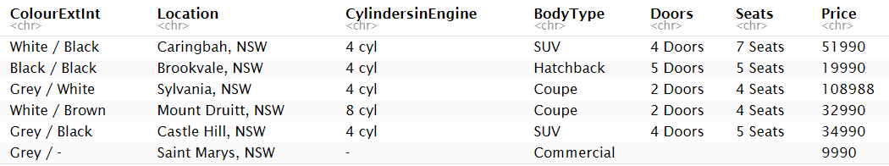
Project analysis slide 2
Data Description

Slide 5
Project analysis slide 2
Data Pre-processing
Removed Columns: Dropped columns including Model, Car/SUV, Title, Cylinders in Engine, and Color Ext/Int to focus on relevant attributes and to avoid sparse data matrix.
Split Attributes: Separated combined fields into distinct columns for clearer analysis:
Engine info into Cylinders & Engine Displacement.
Location into City & State.
Cleaned Numeric Data: Removed textual information from variables like Cylinders, Engine Displacement, Liters per 100km, Doors, and Seats.
Cleaned Price & Kilometers: Removed quotation marks and converted to numeric values for accurate computations.
Handled Missing Values: Removed rows with NA or "-" values to ensure data integrity.

Slide 6
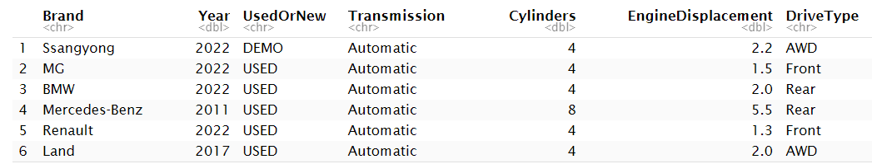
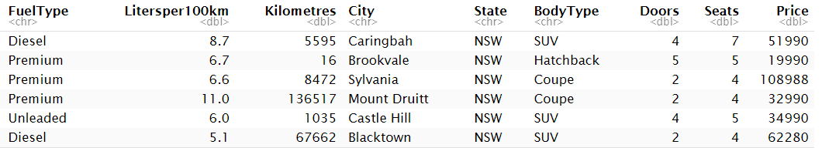
Project analysis slide 2
Data Pre-processing
After Data cleaning, we left over with 14,197 Rows and 15 independent Columns (7 quantitative and 8 qualitative variables) and Price column.
Initially it was 16734 rows and 18 independent columns and target variable Price.
Data after processing looks as below:

Slide 7
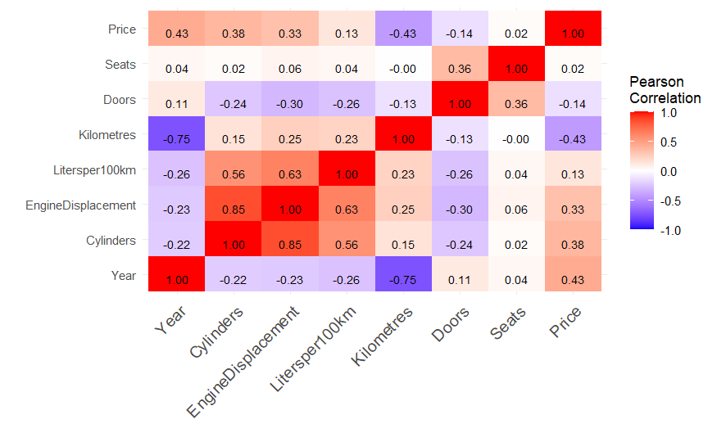
Project analysis slide 2
Correlation Matrix
Heat map to show the correlation between all the numerical variables.

Slide 8
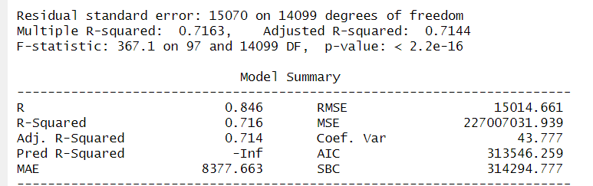
Project analysis slide 2
Linear Model
Linear Model Summary

Slide 9
Project analysis slide 2
Linear Model
We have used all the features from processed data to train simple linear model.
Multiple R-squared: 0.716
Explains 71.6% of the variance in vehicle prices using the predictors.
Adjusted R-squared: 0.714
Adjusted for the number of predictors, confirming the model's goodness of fit.
From the t-test we could say that
Brand, Year, UsedOrNew status, Transmission type, Cylinder count, Engine Displacement, Drive Type (Front, Rear), Fuel Types (Hybrid, Leaded, Premium, Unleaded), Kilometres, and several body types (Hatchback, Sedan, SUV, Ute/Tray) significantly affect vehicle prices.
Doors and some other variables turned out to be not so significant based on the t-test.

Slide 10
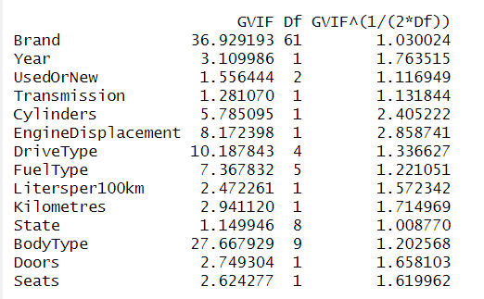
Project analysis slide 2
Multicollinearity
We have used GVIF to check multicollinearity instead of VIF as we have categorical variables in our data.
Adjusted GVIF values around 2.5 considered not to be much collinear.
So, we have only one variable i.e., Engine Displacement which has moderate multicollinearity, and all other variables has little to no multicollinearity.

Slide 11



Project analysis slide 2
Systematic Variable Selection
Forward Selection Summary
Backward Elimination Summary
Combination Summary

Slide 12
Project analysis slide 2
Systematic Variable Selection
Stepwise AIC Optimization: Employed forward selection, backward elimination and combination stepwise regression methods to identify significant predictors based on the Akaike Information Criterion (AIC).
Final Model Features: Consolidated model includes Brand, Year, Engine Displacement, Kilometres, DriveType, Cylinders, FuelType, BodyType, UsedOrNew, Transmission, Liters per 100km, Seats, and State.
Doors is the least significant in the prediction of the price.
Model Statistics
Adjusted R-Squared: 0.7144
Indicates the proportion of variance explained by the model, adjusted for the number of predictors.

Slide 13



Project analysis slide 2
Second order model
Model 1: Basic Quadratic Terms Summary
Model 2: Selected Interactions Summary
Model 3: Quadratic Terms with Key Interactions Summary

Slide 14
Project analysis slide 2
Second order model
Model 1: Basic Quadratic Terms
Introduced quadratic terms for Year and Kilometres to capture non-linear effects.
Adjusted R-squared: 0.7344, indicating a good fit with the inclusion of polynomial terms.
Model 2: Selected Interactions
Added interaction terms for Engine Displacement with Fuel Type, and Kilometres with Year, identifying significant cross-effects.
Adjusted R-squared: 0.7438, showing improved fit over basic quadratic model.
Model 3: Quadratic Terms with Key Interactions
Combined quadratic terms with selected interaction terms for a more complex model.
Adjusted R-squared: 0.7552, demonstrating the highest explanatory power among the three models.

Slide 15
Project analysis slide 2
Results
Performance of model on the test data after splitting the data into train and test into 80% and 20% respectively.
Model Performance Metrics
RMSE: 16,098.20
MSE: 259,151,995.25
MAE: 8,398.04
Model Accuracy
R-squared on Test Set: 0.642
Adjusted R-squared on Test Set: 0.629

Slide 16
Project analysis slide 2
Regularization
Ridge, Lasso and Elastic Net models show similar performance with slight variations.
Ridge Regression has a marginally lower RMSE and MAE, suggesting better prediction accuracy.
All of them performed comparatively poor than linear model and second order models.
Model | RMSE | MAE | R-Squared | Adjusted R-Squared
Lasso | 16,856.38 | 11,222.77 | 0.5185 | 0.2844
Ridge | 16,806.29 | 11,108.41 | 0.5214 | -0.0140
Elastic Net | 16,854.71 | 11,220.12 | 0.5186 | 0.2731

Slide 17
Project analysis slide 2
Transformation
Log Transformation of Price
The response variable (Price) has been log-transformed to improve normality and stabilize variance across the range of values based on the residual analysis.
Performance Metrics
Adjusted R-squared: A substantial increase to 0.866, indicating that 86.6% of the variability in the log of the Price is explained by the model.
Residual Standard Error: Reduced to 0.2369, showing that the model's predictions are close to the true log prices.

Slide 18
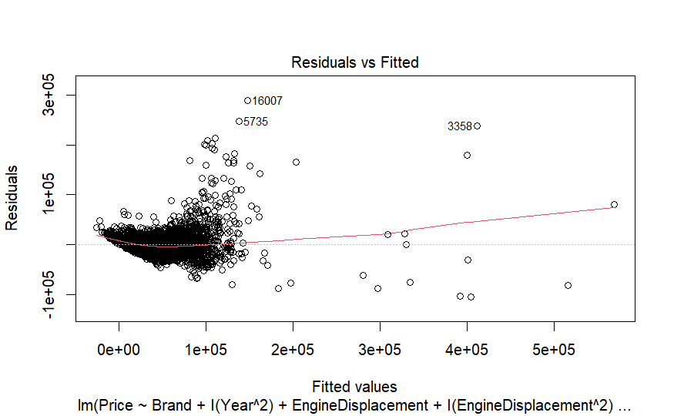
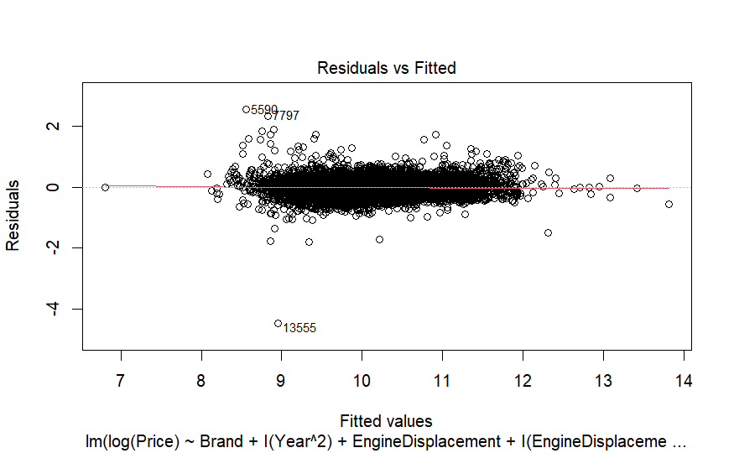
Project analysis slide 2
Residual Analysis
Analyzed the residuals before and after the logarithmic transformation.
Residuals followed all the assumptions including homoscedasticity.

Slide 19
Project analysis slide 2
Conclusion
Log transformation of price significantly improved model performance, reducing residual variance and skewness.
Engine displacement, brand, year, and vehicle condition emerged as significant predictors of car prices.
We have implemented Linear Model, Second Order model, Variable Transformation and Residual Analysis.

Slide 20
Project analysis slide 2
Future Work
Enhance Complexity: Explore a variety of interaction and quadratic terms to refine the model's accuracy.
Global Expansion: Incorporate data from multiple countries to develop a globally applicable vehicle pricing model.
Data Augmentation: Increase the dataset size and integrate more diverse features for improved generalizability.
Dig deeper and conduct a comprehensive analysis of outliers detected in the process.

Slide 21
Thank You

