Slide 1
Leveraging Hidden Patterns in Open-Ended Health Workers’ Notes to Improve Prediction of Patient Readmission

Slide 2
Authors
Naveen Kumar Reddy Veeramreddy
Ankita Mishra
Navika Maglani
Sameer Shaik
Kelly McCabe
Jacob Furst
Daniela Stan Raicu
Roselyne Tchoua
Jamshid Sourati

Slide 3
Problem, Goal & Hypothesis
Problem: How to effectively incorporate contact notes in the model to improve predictability?
Goal: Extract features from unstructured text (community health worker contact notes) and integrate it with tabular data (demographics + SDOH) to improve patient readmission predictability with a limited set of patient samples without compromising interpretability.
Hypothesis: Including unstructured notes in the predictive model will improve ROC-AUC over tabular-only baseline.

Slide 4
Literature Review
Bold text represents comparison/ similarities with literature
Red colored text represents differentiators/ key contributions
Comparison Aspect | Yang et al. (MIT Paper) | Ashfaq et al | Sundararaman et al | Bonnier et al | Our work
Data type | SDOH Alone, Structured EHR Data, Unstructured EHR Data | Structured data | Structured + free-text discharge summaries | Mixed tabular (numeric + categorical) and free-form English text | Tabular (Demographic + SDOH), Health worker notes (2613 samples)
Data source | MIMIC-IV | Halland-Sweden (2012-16 CHF) | MIMIC-III | Eight public benchmarks (Non-medical) | SUHI
Pre-processing | Tabular EHR → median/constant imputation, one-hot cat, z-score num Text → section extraction ➜ TF-IDF (11,751 terms) after lemmatize & stop-word filter | Code-grouping → PV-DBOW embeddings + feature scaling | Structured → derivations (LOS, prior admits/ICU, etc.); Text → natural + domain stop-word removal, trigram TF matrix; Novel 2-step feature pick: keep trigrams unique to readmit vs non-readmit classes; SMOTE | Text → WordPiece (DistilBERT) or basic_english tokenizer; Categorical → learned embeddings (or one-hot for non-Transformer baselines) | Feature Extraction: TF-IDF with min/max document-frequency tuning, BERT base, LLM Summarization (before TF-IDF/BERT)
Models | logistic regression, random forest, XGBoost (best) | Cost-sensitive LSTM | Logistic Reg (main), SVM & RF checked | Tabular-Text Transformer (TTT) - dual streams (tabular & text) | XGBoost, AdaBoost, Random Forest
Results | SDOH-only AUROC - 0.57; tabular-only AUROC - 0.67; adding SDOH to tabular did not improve | AUC 0.77 / F1 0.51 | Mixed w/ targeted FS AUC 0.97, Precision 0.99, Recall 0.87, F1 0.93 | accuracy ( r ≈ -0.95) | ROC-AUC (Engaged): 0.71 - All patients, 0.74 -Patients with notes
Contributions | Demonstration that SDOH features enable more actionable insights | Unified sequential cost-aware framework + economic analysis | Domain‐stop-word noise cut, class-imbalance-oriented trigram selection for unstructured notes | New TTT architecture | Improved ED readmission predictability leveraging health worker notes with limited samples

Slide 5
Methodology
Dataset & Pre-processing
Data source: Sinai Urban Healthcare Institute (SUHI)
Pre-processing: Handling missing values and contact notes concatenation
Feature extraction (Vectorization of contact notes followed by dimensionality reduction to integrate them with tabular data)
Customized TF-IDF (thresholding terms with lower frequencies - less than 20 occurrences of a specific term in the entire corpus)
BERT + PCA (dimensionality reduction with PCA considering explained variance>= 0.95 is applied on BERT embeddings of concatenated notes)
Machine Learning Models (Classifiers trained on extracted features integrated with tabular data to predict readmission)
Machine Learning Classifiers: Random Forest, AdaBoost and XGBoost
Split the data into train (80%) and test (20%)
Grid-search & Cross-validation on train data (To find generalizable optimal hyperparameters) for 5 random seeds
Generative LLM Summarization (concatenated contact notes summarization)
Repeat step 2&3 on the summarized notes

Slide 6
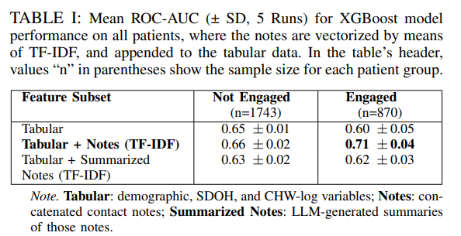
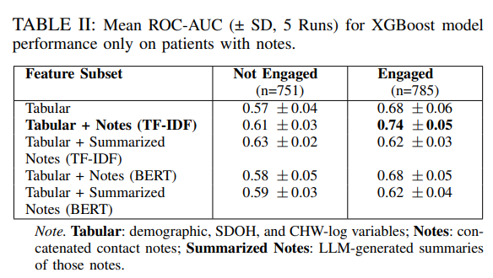
Results
Best combination: XGBoost classifier + TF-IDF feature extraction
Engaged patients: AUC increased from 0.60 (tabular only) to 0.71 (tabular+Notes (TF-IDF) showing 11 percentage points increase by adding notes (Table 1)
Generative LLM Summaries & BERT feature extraction approaches comparatively under-performed.

Slide 7
Discussion
Structured data often miss nuances about patients (as it limits the user responses with pre-defined questions based on general trend, e.g.: SDOH types like Transportation, Housing); Unstructured data can capture user specific concerns and helps in improving predictability.
TF-IDF beat contextual BERT embeddings because CHW notes are short/telegraphic.
Generative LLMs did not improve as the notes itself are summarized by health workers.
Feature Importance Analysis revealed the following as key terms with actionable insights and can be further explored by creating n-grams:
'readmitted', 'admit', 'appointment', 'contact', 'resource', 'medical', 'family', 'pcp', 'lvm’, 'provide'

Slide 8
Limitations & Future Work
Limitations: In the current analysis important features are words rather than sentences limiting the potential of actionable insights for CHWs as the meaning of words vary significantly based on the context. LLM summarization did not improve the performance of pipeline. Dataset does not include date time aspect w.r.t notes to distinguish between the notes collected before and readmission of patients. Future Work: Explore n-grams as features to find actionable insights from the feature importance analysis. Explore domain-tuned LLM embeddings to consider semantically similar words and n-grams Comprehensive prompting of LLM to avoid extensive summarization. Remove target-leaking terms (“readmitted”) to avoid the information leakage. Consider the contact notes that are collected only before the readmission of the patient.

Slide 9
High level Comparison summary
Comparison Aspect | Naveen | Ankita
Primary Goal | Improve interpretability while boosting AUC by incorporating contact notes. | NLP framework that classifies contact notes as food-related
Best Model | XGBoost + TF-IDF, +11 pp (all patients - engaged). | Doc2Vec + vocabulary list 3
Key Features | terms ( resource, medical, family, pcp, lvm ) among dominating top-20 features.
Next-Step Priority | N-gram level analysis, Fine-tuning, Remove leakage tokens; Temporal filtering. | Imputation of missing data for 30-day readmission prediction; extend framework to include all SDOH features

