Slide 1
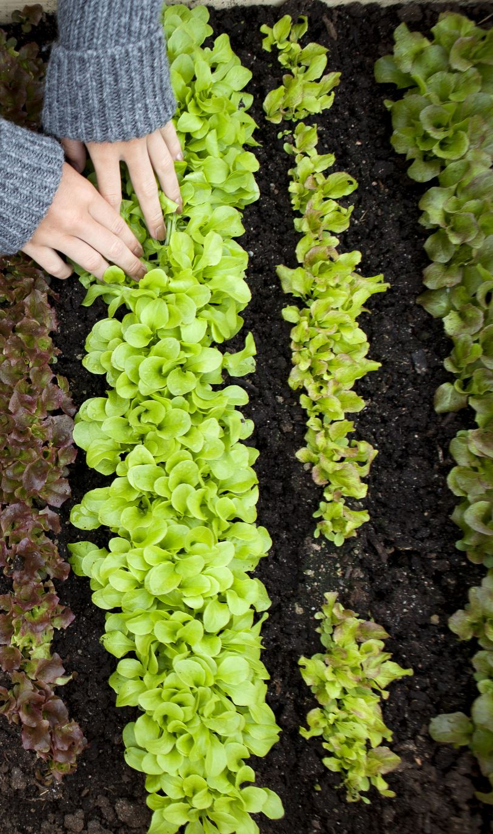


Composting Training PROGRAM PARTNERSHIP
Environmental Advisory Committee Proposal
By Fernando Da Silva, Diego Moreno and Cesar Abarca

Slide 2
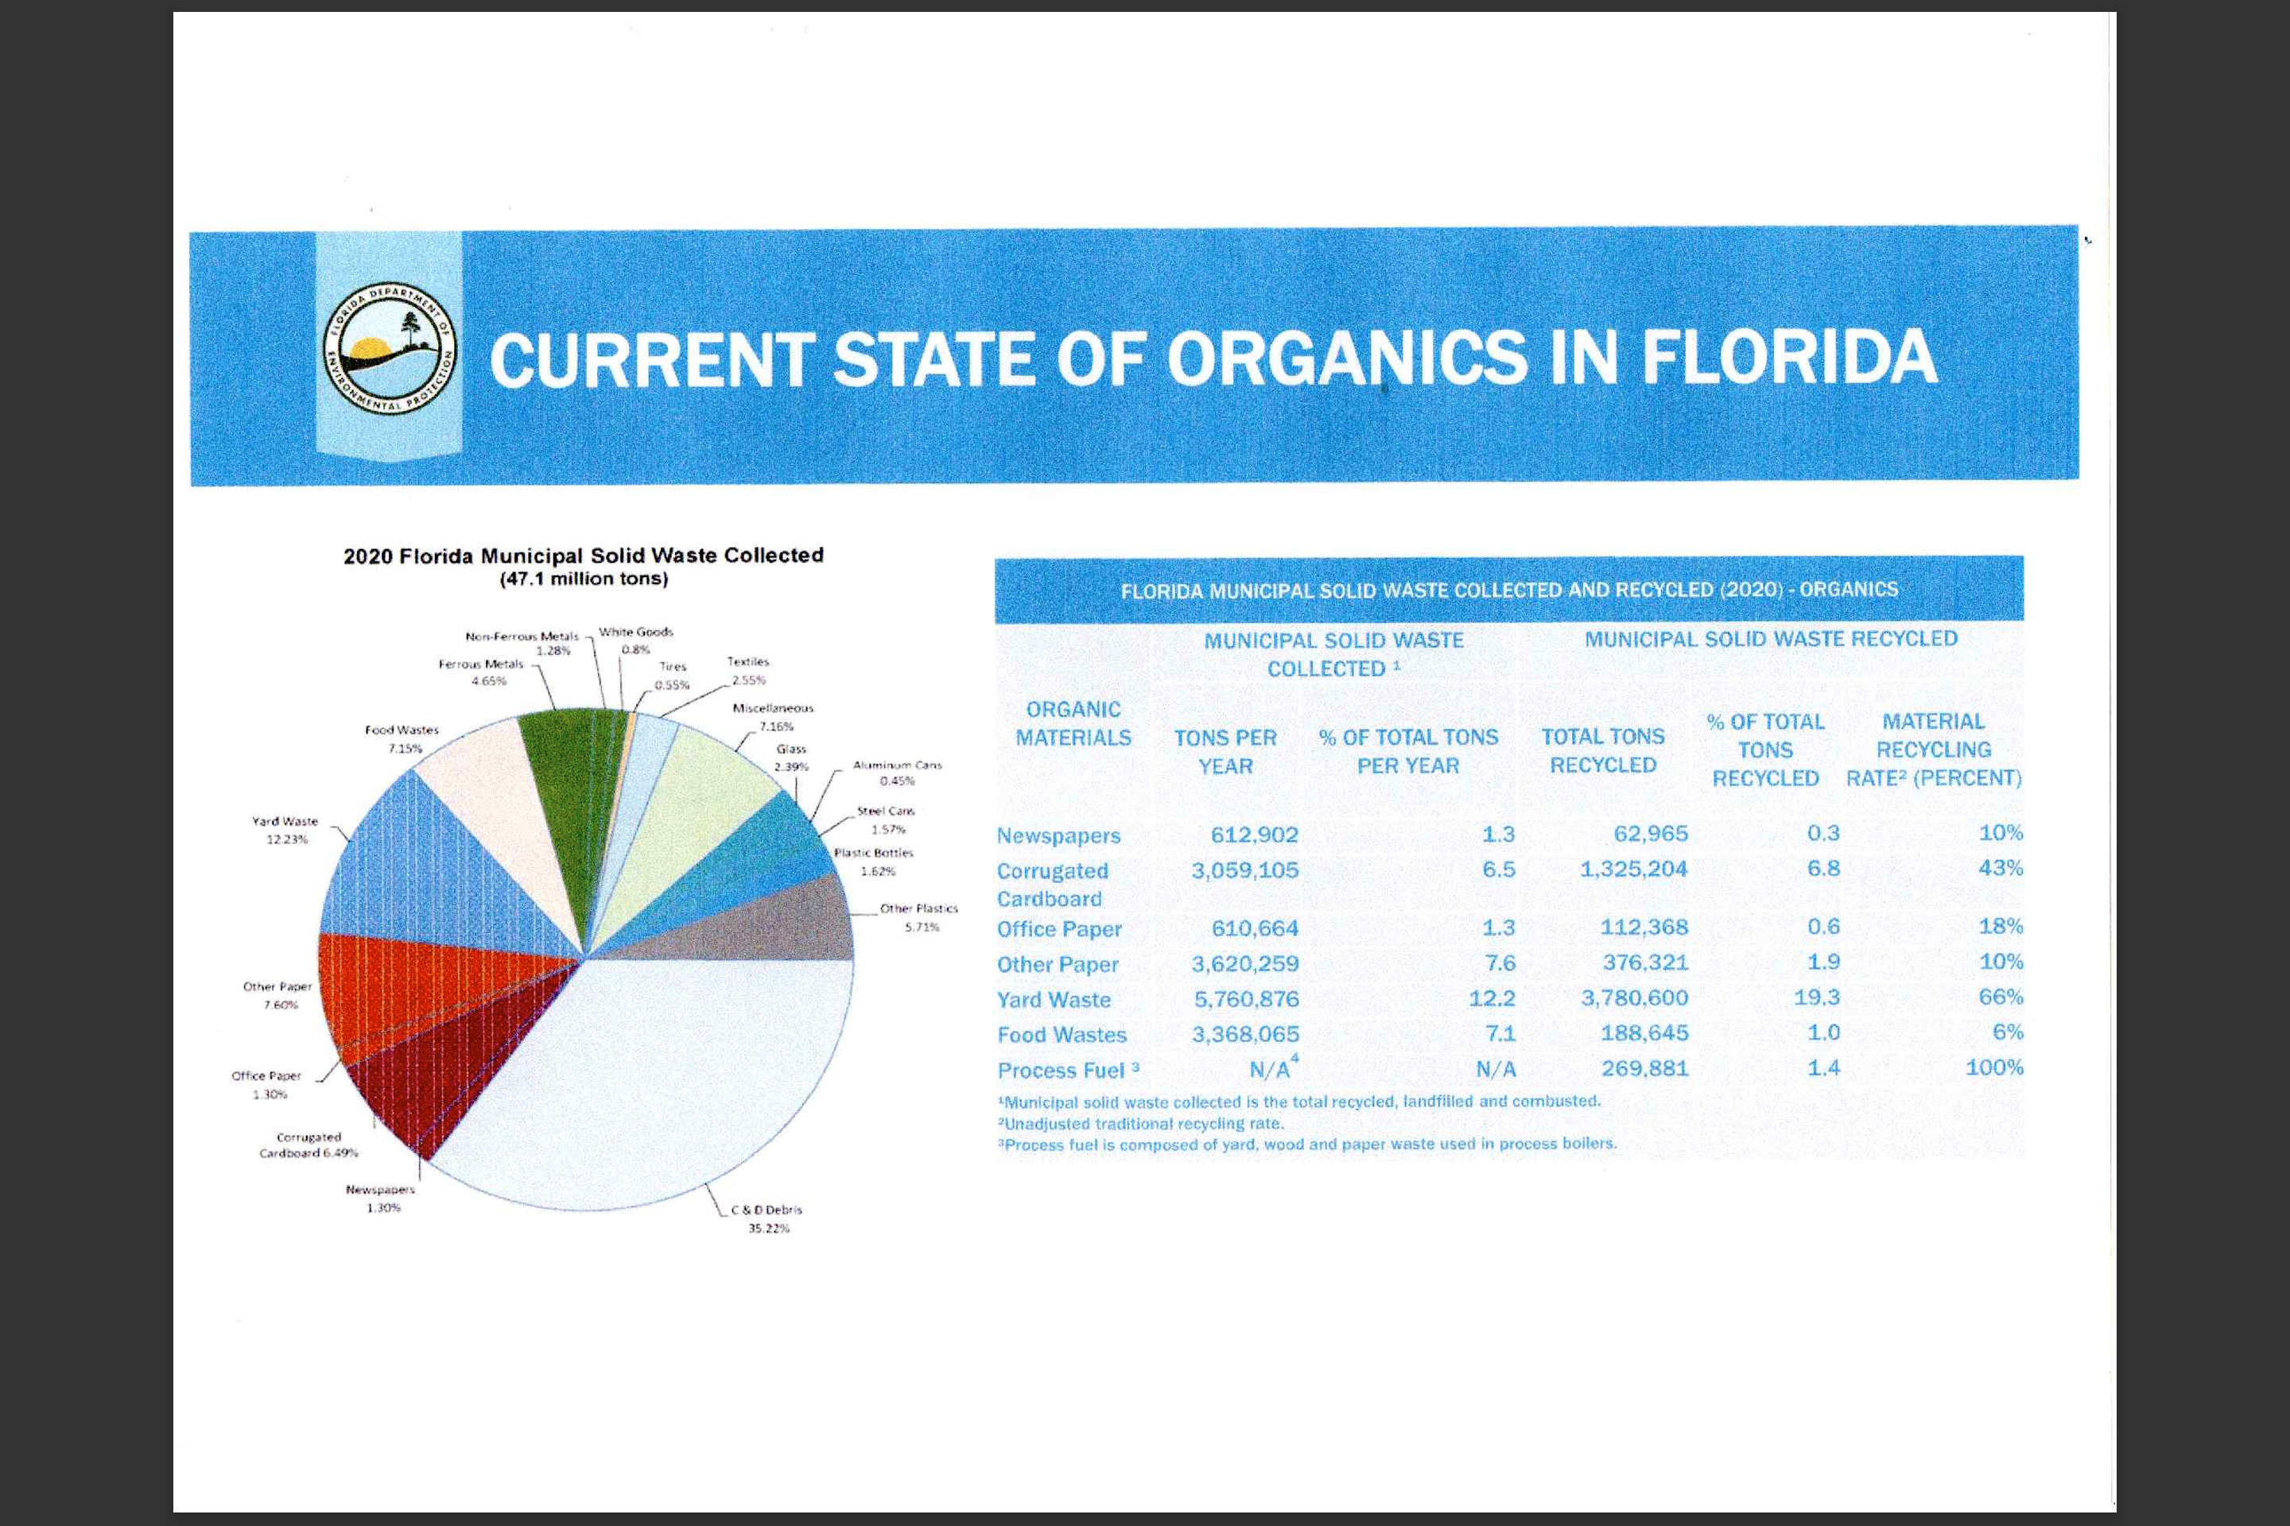





Composting Training Program Partnership
Universidad of Florida and City of Doral
Food Waste is just 1 % Recycled
Lauren O’Connor
Florida Department of Environmental Protection
Recycle Florida Today Conference and Exhibition June 28, 2022

Slide 3
Objectives
Raise Awareness on the importance of this PARTNERSHIP PROGRAM as part of the Miami-Dade Zero Waste Master Plan to reduce waste creation and divert waste from landfills and incinerators using technologies that can reuse, repurpose, recycle, and recover materials in an environmentally, socially, and economically sustainable way.
City of Doral integration with Miami-Dade Zero Waste Master Plan (Alignment)

Slide 4
Commitment
The environmental advisory committee supports the composting project in the context of the existing rules.
Composting require Training and Infraestructure.
Learn step-by-step the process of turning leaves, branches, paper plates, and other recyclable materials into rich organic soil called compost.
Presented by a University of Florida/Miami-Dade Cooperative Extension Service Master Gardener. Registration is required. Ages 12 yrs.+
University of Florida’s last training held was on March 30, 2024
For more information contact 305-535-4219 or capleyb@mdpls.org.
We are in favor of a win-win formula acepted by all of us: EAC, City of Doral, Miami Dade County, Deparment of Sustainablilty and DOWNTOWN DORAL SCHOOL as a pilot program to be extended to other schools..

Slide 5
What is the estimated impact of this project.-Future
What will be the impact of your project?
What are the next steps if the pilot program is successful?
How many household schools are we going to engage?
How will this partnership program position our City and the University of Florida before our constituents?
How will Miami Dade County perceive a City of Doral initiative aligned with their policies?

Slide 6


Conventional Recycling and Composting MDC Investing
RECYCLING
COMPOSTING
CONTAINERS
Regulation and Legal context
Traiining
WM
BUDGET
MDC
Procuring Consultants to develop a ZWMP-9/16/2023
PLAN
DSWM
BUDGET?
CONTAINERS? FREE COMPOSTERS
Legal context?
Regulations
DSWM
PLAN?
107 AVE
Collection
& Processing
WM
Training
Program
UN. Florida
Collection
& Processing
Indep. providers
DFO
Academy
City of Doral
DFO
Academy
Sustainability
City of Doral
DFO: Debris Free Ocean

Slide 7
Composting Partnership Program Institutional approach
Training Program
107 AVE
Alignment
DSW
Community Service
Leadership

Slide 8
Partnership Program Strategy FOCUS
University of Florida
Training-Education and Lab
Free Composter bin
Strategy &
Coordination
Sust. Dpto
City Of Doral
Promoters
Collection and Processing

Slide 9

COMPETITIVE PROFILE

Slide 10
Why University of Florida: Competitive Profile
UF IFAS Extension is a partnership 60% UF/40% MDC-Parks Department
https://sfyl.ifas.ufl.edu/who-we-are/about-extension/
Extension is a partnership between state, federal, and county governments to provide scientific knowledge and expertise to the public.
The University of Florida (UF) and Florida A&M University (FAMU) administer the Florida Cooperative Extension Service.
At the University of Florida, Extension is located in the Institute of Food and Agricultural Sciences (IFAS), along with the College of Agricultural and Life Sciences (CALS) and the Florida Agricultural Experiment Station, and is called UF/IFAS Extension.

Slide 11
Why University of Florida: /Competitive Profile Programs
Residential Composting Programs
Home Composting Workshop for Residents of MDC
Florida-Friendly LandscapingTM Program
Master Gardener Program
Landscape Irrigation Rebate Program
Barrel / Water Conservation Program

Slide 12

Why University of Florida: Competitive Profile
Worked under the strategic initiative of Miami-Dade County Policy
Institutional relationship
Structured courses:
Syllabus
Hand outs
Expert Instructors
Focused on Education in the area
Web and In-Person Programs
Experience in Education-1431 persons trained
Field Trip for the Students
Nice Customer Service
Insurance
Excellent Customer Service!!!!!!
It is Free!!!!

Slide 13
Why the University of Florida: Customer Service
Excellent customer service; I called them, and they asked me to answer the questions below:
Hello Cesar,
It was nice to talk to you a little while ago. Just a few follow-up questions about the Composting training you were requesting -
You said you were hoping to train schools on composting - do you have the contacts for these schools? Also, would we be training the kids, the teachers, or both?
Do you want free composters or just the training?
Would this be done during the weekday or on a weekend?
What are your goals with this training?
Best,
Dalton Goolsby
305-679-0236

Slide 14
Composting Partnership Program Summary
Leardership
Institutional
Capability of managing Scale
Focus on Training
Strong Competitive Profile
Experience Coordinating with different Institutions

Slide 15
EAC Recommendation:
APPROVE THIS COMPOSTING PARTNERSHIP PROGRAM WITH THE UNIVERSITY OF FLORIDA!!!!

Slide 16
EAC-Action Plan
Approval
Pass this recommendation to OUr Council LIAISON Maureen Porras
Prepare Presentation document to include in the Council Agenda for approval
Invite Laura Vázquez, UF Program Director, to present the University of Florida Program to the City of Doral Council
Prepare an operational plan to trigger implementation
Work with UF the program for City of Doral
Coordinate with Promoters and Collection and Process Provider’s participation
Include in the City of Doral a program link similar to Miami Dade County’s

Slide 17

Miami Dade County
City
of
Doral
University
of Florida
Environmental
Advisory
Committee
Miami Dade
County

