Slide 1
PartSelect Chat Agent
AI-Powered Multi-Agent RAG System
Naveen Alampally
Instalily AI Case Study | November 2025

Slide 2
Project Overview
Conversational AI agent prototype for PartSelect
Assists users with:
  Appliance parts search
  Compatibility checking
  Installation guidance
  Router Agent: Intent classification
  Product Search Agent: Semantic search using ChromaDB + SQLite filtering
  Troubleshooting Agent: Symptom-based diagnostics and part recommendations
Built using multi-agent RAG architecture with semantic search

Slide 3
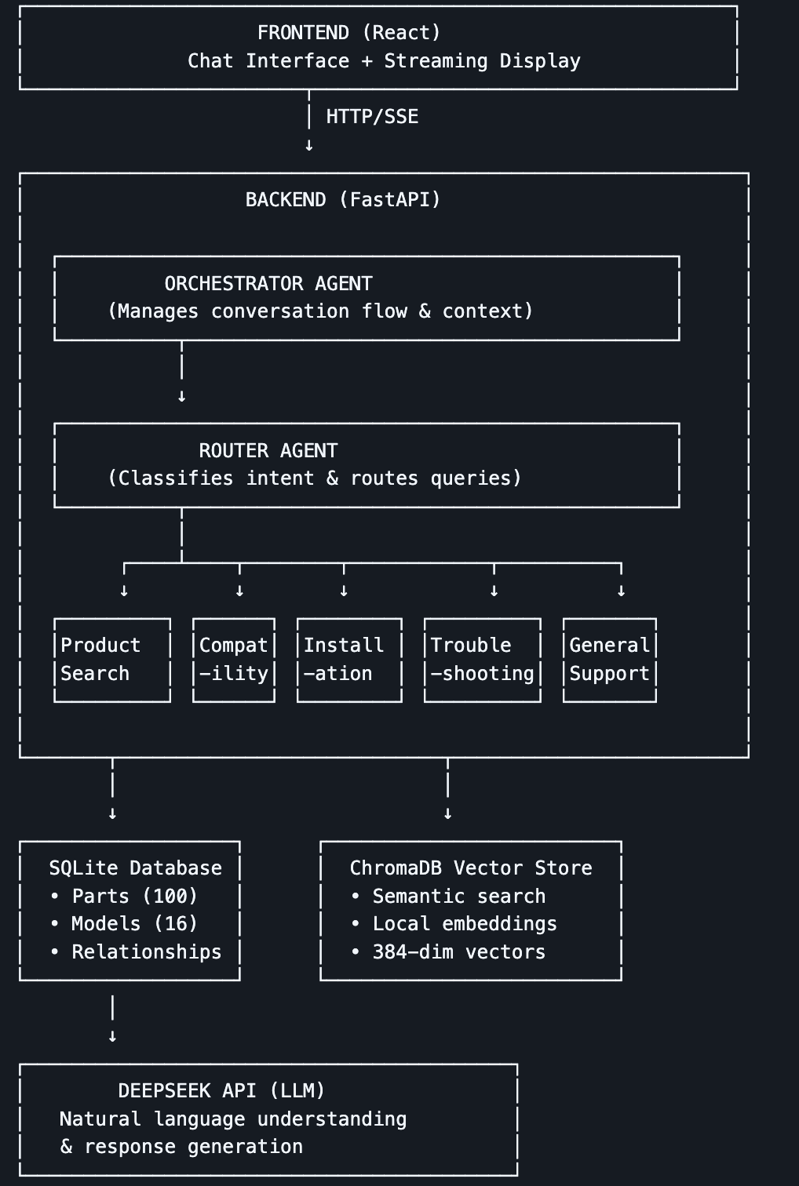
Architecture

Slide 4
For this case study, the system uses a small sample dataset (JSON) of 100 refrigerator and dishwasher parts instead of live-scraped data.
Why sample data?
  When scraping real data using Selenium, we encountered issues with unwanted data like "common_symptoms": ["John W", "Verified Purchase"] appearing in results
  BeautifulSoup attempts were blocked by the site's bot detection
  Sample data ensures clean, controlled, and reproducible testing
  The backend architecture is modular and can later integrate with a real API, database, or scraper without code restructuring

Slide 5
Example Queries
  Product Search:
    "Show me dishwasher spray arms"
    "Find refrigerator ice makers under $100"
  Compatibility Check:
    "Is PS57956370 compatible with WRF555SDFZ?"
    "Which models work with refrigerator water inlet valve PS55946236?"
  Installation Help:
    "How do I install Refrigerator Door Gasket?"
    "Show installation steps for dishwasher pump PS61911325"
    "How long does it take to install a spray arm?"
  Troubleshooting:
    "My ice maker isn't making ice"
    "Dishwasher won't drain properly"
    "Refrigerator is too warm"

Slide 6
Future Scope
Integration with Live APIs
  Connect to PartSelect’s real-time inventory and pricing APIs.
Enhanced Personalization
  Use user history and preferences for tailored suggestions.
  Implement recommendation systems powered by ML.
Voice & Multimodal Support
  Add voice-based interaction and image-based part identification.
Scalability & Performance
  Migrate to cloud-native architecture (AWS/GCP/Azure).
  Implement caching and load balancing for high traffic.
Security & Compliance
  Add authentication
Analytics & Insights
  Dashboard for tracking user queries and agent performance.

