Slide 1
Smart Transportation System
Using IBM Watson
By - (ANAN)
Dachepalli Naveen
Vasana Achyuth
Avadhanam Neeraj Mani Sai
Potnuru Anil Kumar

Slide 2
Abstract:- As a population was increasing daily,there is a drastic change in utilizing and managing the basic goods and facilities.One of the problem we are facing is Transportation issues.We are solving this by our project which is aiming to track your GPS(Global Positioning System) location,by we are able to get traffic related information,tracking your location,getting latitude and longitude position,track the vehicles etc..
There will be a smart device through which we can get the GPS location and this data is sent to cloud and where this data is access through the node red UI.The data which is in Node red UI is read into app which we can be created using MIT app inventor

Slide 3
Out line:
smart tracking system using GPS module
Area’s of interested but not limited to
Hardware and software
Block diagram
Gps module
Connections
Working:
Serial monitor
IBM could
NODE RED
MIT app
Conclusion

Slide 4
Area’s Of Interested But Not Limited To
Human mobility
Travel behaviour
Network economics
Traffic prediction and flow control(ex:van technology)
Live vehicle tracking

Slide 5
HARD WARE:
GPS module
NODE MCU
SOFT WARE:
Ardunio IDE
NODE RED
MIT A2 App campanion

Slide 6
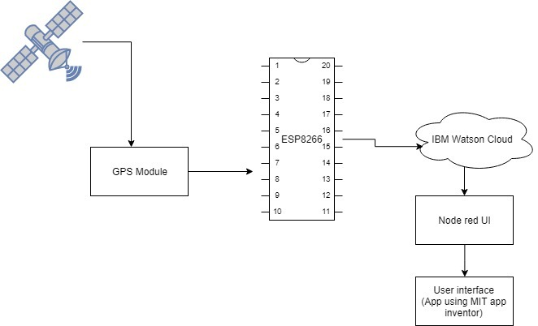
Block Diagram:

Slide 7
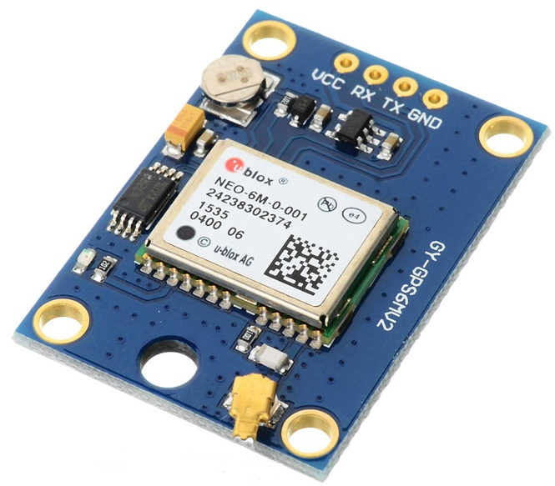
PinDescription: VCC: Power Supply 3.3 – 6 V GND:Ground TX: Transmit data serially which gives information about location, time etc. RX: Receive Data serially. It is required when we want to configure GPS module prototype: GGA (generalized gradient approximation)protocol
GPS Module

Slide 8
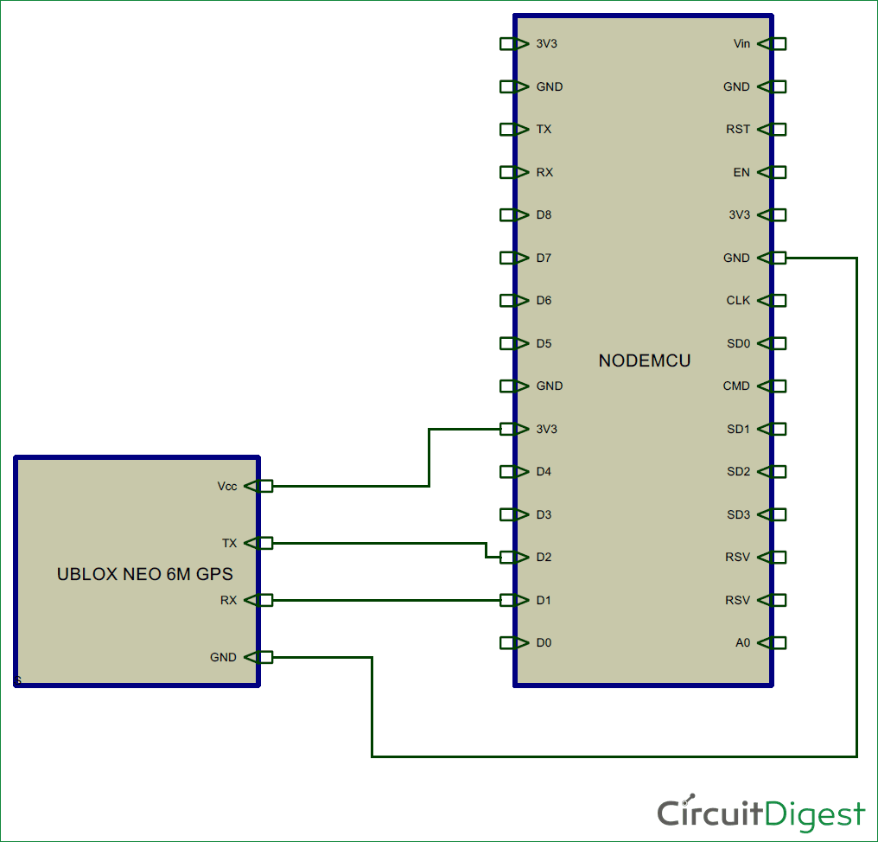
Connections:

Slide 9
Working

Slide 10
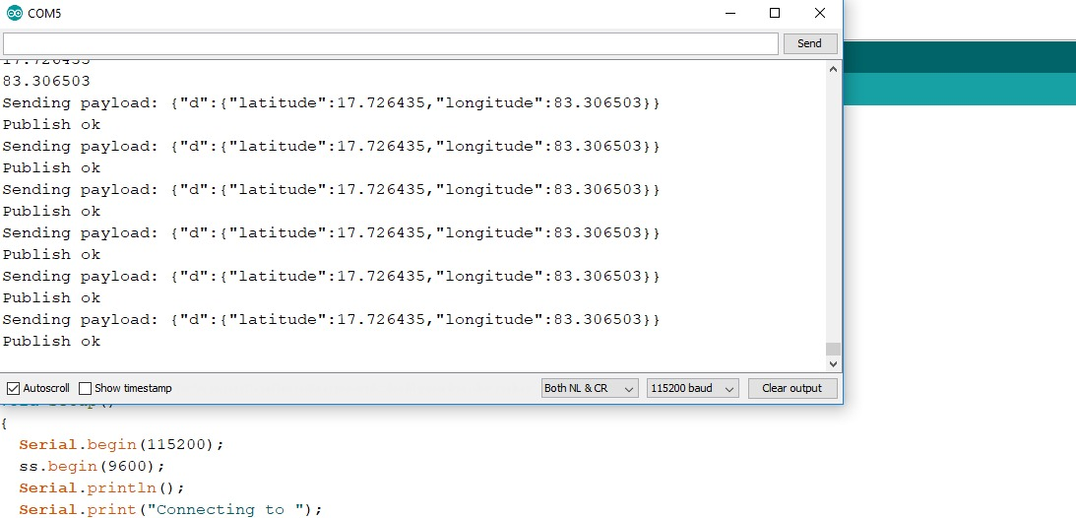
Serial Monitor:

Slide 11
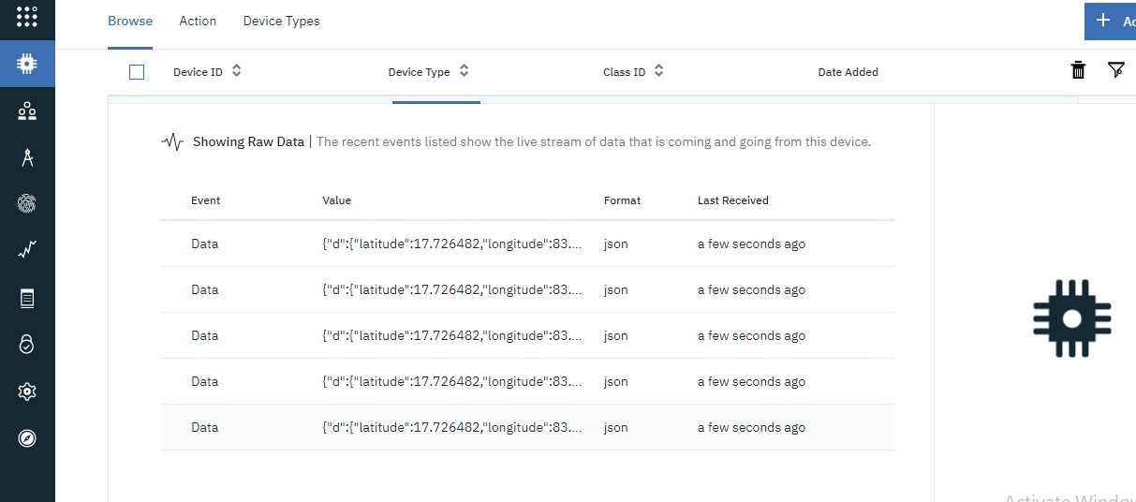
IBM Cloud:

Slide 12
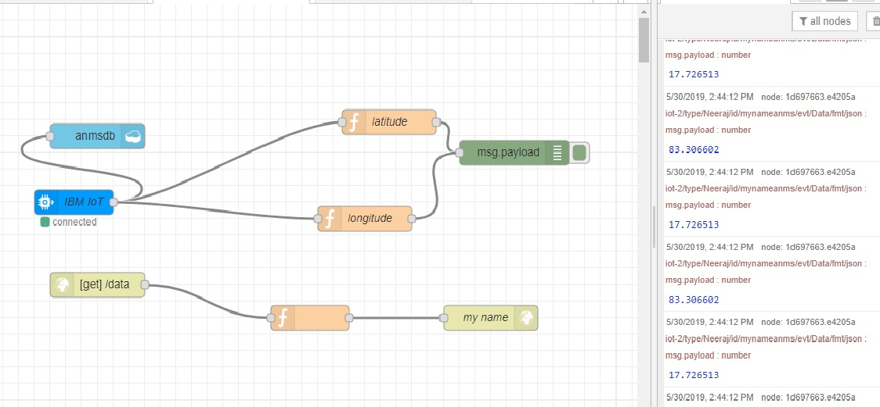
NODE RED:

Slide 13
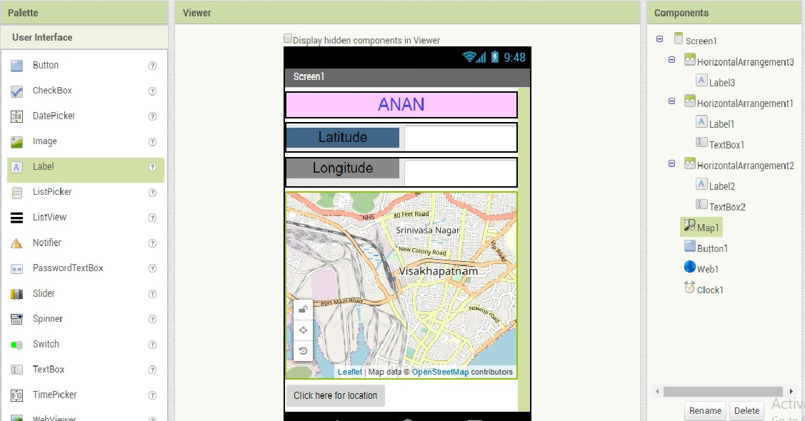
MIT Inventor:

Slide 14
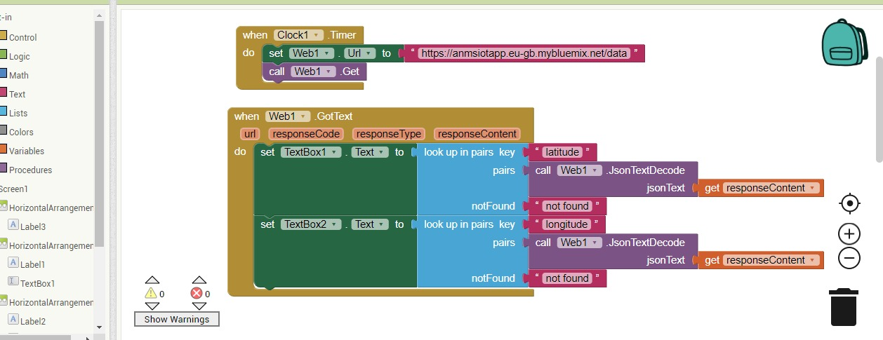

Slide 15
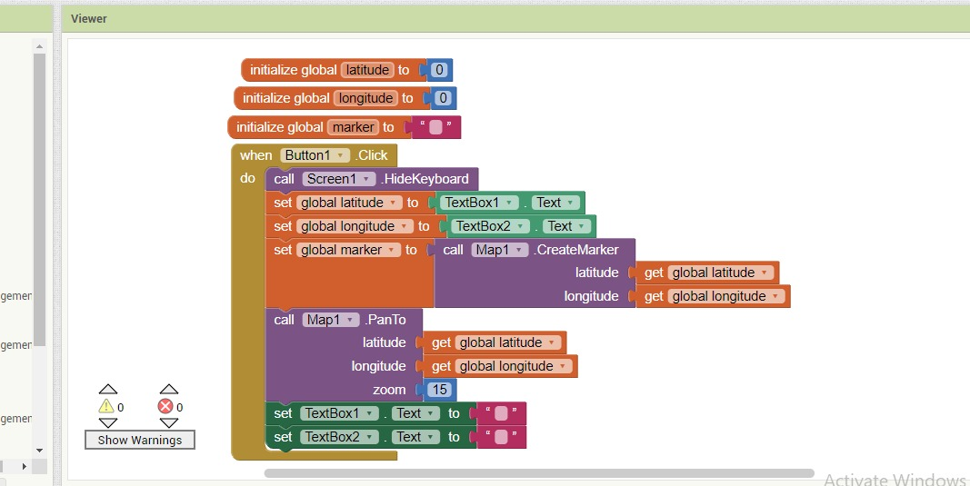

Slide 16
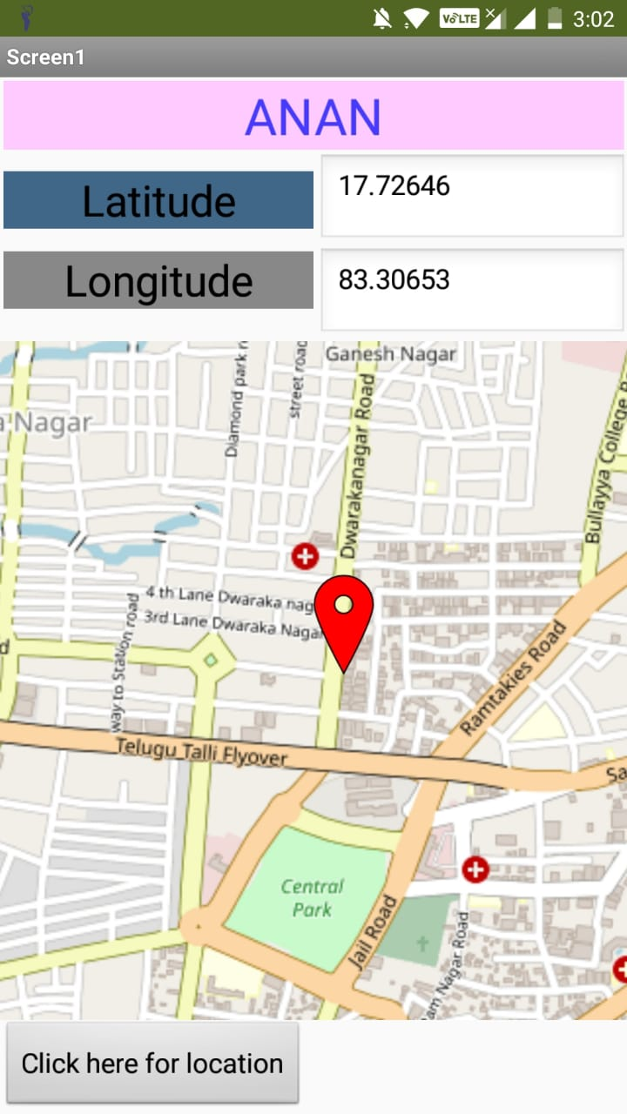
Output

Slide 17
Conclusion :-
In this project we are getting GPS location through app.Here GPS module send signals through transmitter to GPS satellite and get the location through receiver and it communicates with Node MCU through UART protocol and this received data is loaded into the cloud and app.By this are getting the live updates of our location and we can manipulate this data and used for many purposes.
Future Scope :-
This project has a huge future scope that we can implement Multimodal dynamic routing,Scheduling,Inteligent mobility information services for citizens,Innovative transportation solutions many.

Slide 18
THANK YOU

