Slide 1
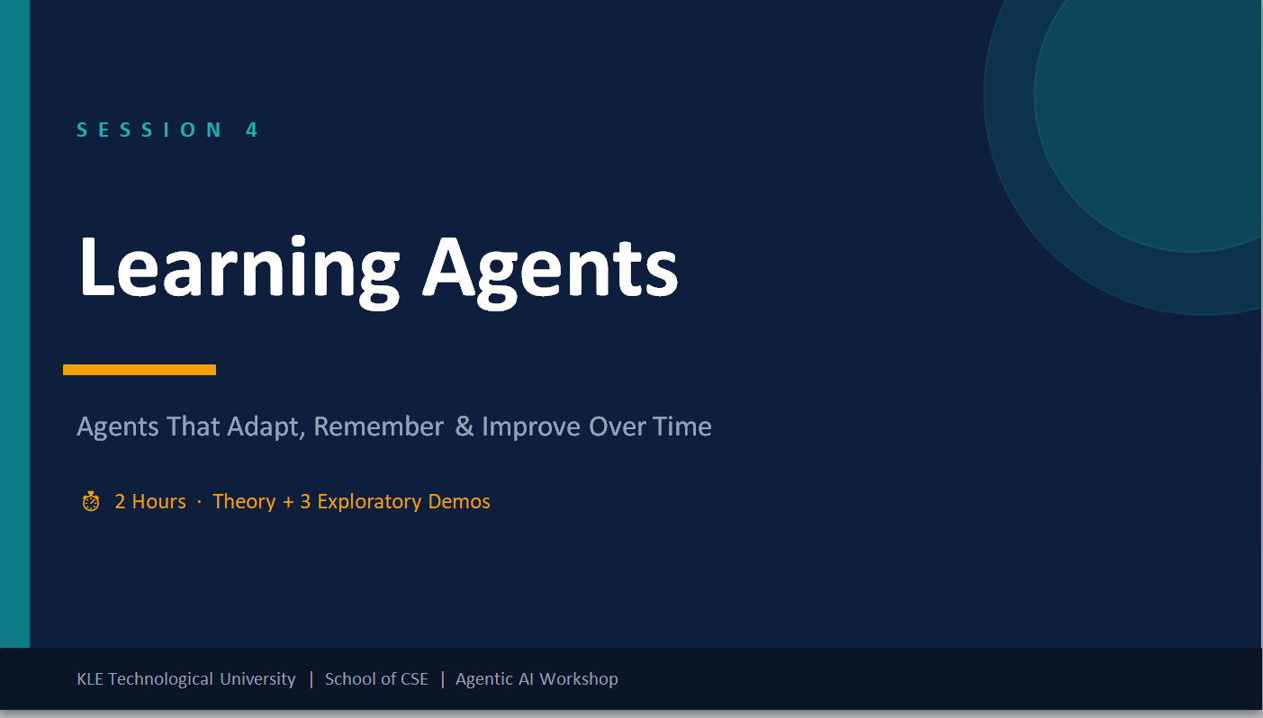
🤖

Slide 2
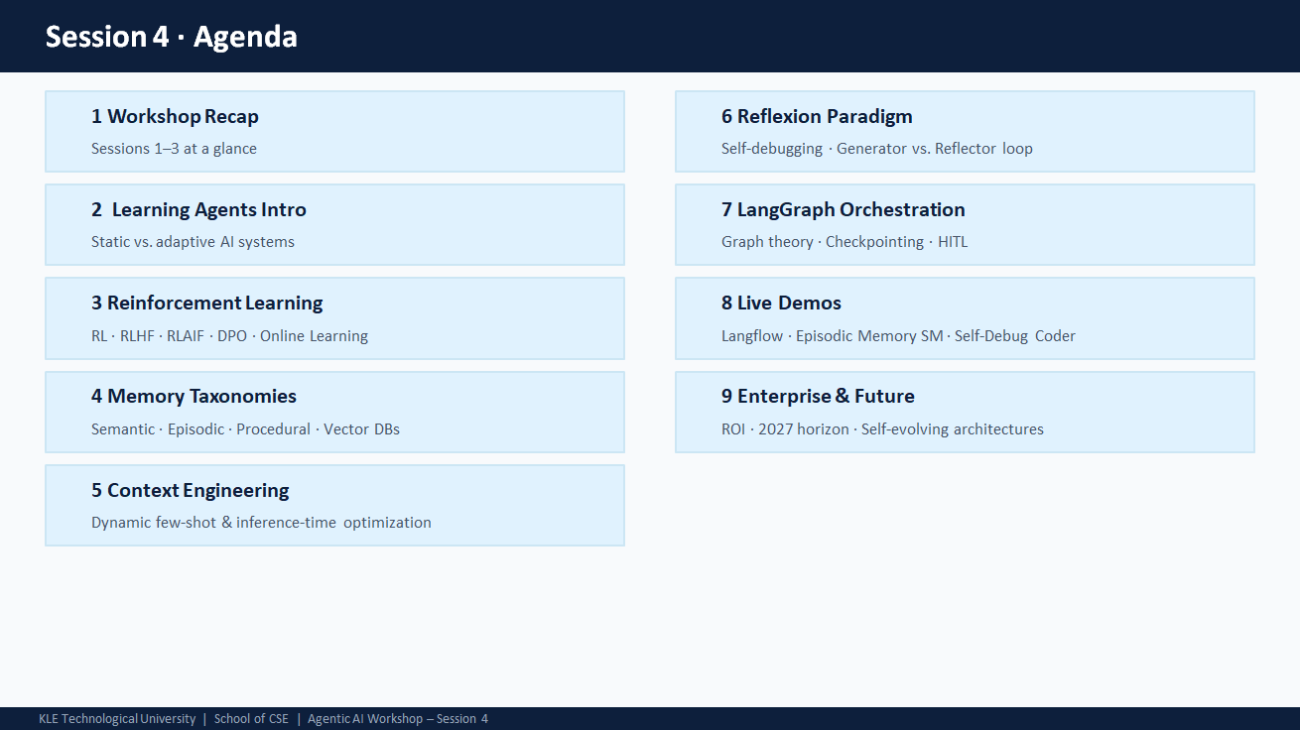

Slide 3


Slide 4
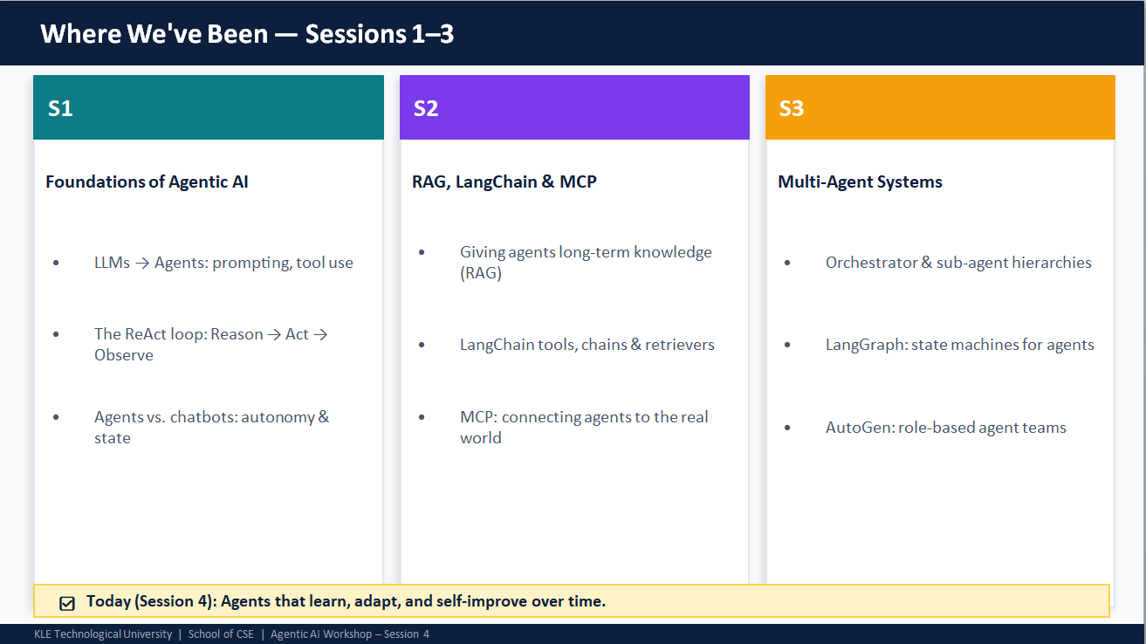

Slide 5
What We'll Cover In this session
Agenda
🧠
🎮
💬
📚
Learning Agents
Reinforcement Learning
Human Feedback (RLHF)
Memory Types
What makes an AI truly 'learn'?
Training AI like training a pet
Humans guide the AI's taste
How AI remembers things
🔍
🪞
🗺️
🚀
Context Engineering
Reflexion
LangGraph
Real World & Future
Picking the right examples
AI learns from its own mistakes
A GPS-style map for AI decisions
Where this is all heading
KLE Technological University · Cloud And Networking Lab. Agentic AI Workshop · Session 4 – Simplified

Slide 6
🧠
What is a Learning Agent?
Static AI vs. AI that grows smarter over time
KLE Technological University . Cloud And Networking Lab · Agentic AI Workshop · Session 4 – Simplified

Slide 7
Static AI vs. Learning Agent
Section 1
❌ Static AI
✅ Learning Agent
Like a printed encyclopedia.
• Always gives the same answer to the same question
• Has no memory of past conversations
• Cannot fix its own mistakes
• Frozen — never updates after training
Like a student who studies and improves.
• Remembers past interactions
• Learns from feedback (good or bad)
• Corrects its own errors automatically
• Gets smarter with each use
💡 Analogy: A static AI is like a DVD — the same movie every time. A Learning Agent is like Netflix — it learns your taste and improves recommendations!
KLE Technological University · Cloud And Networking Lab. Agentic AI Workshop · Session 4 – Simplified

Slide 8
🎮
Reinforcement Learning
Teaching AI using rewards and mistakes
KLE Technological University · Cloud And Networking Lab. Agentic AI Workshop · Session 4 – Simplified

Slide 9
Reinforcement Learning — Training Like a Dog
Section 2 · RL
🐕 Dog Training Analogy: Sit → Treats = Good. Bark = No treat. Over many tries, the dog learns the best behaviour to get rewards.
🤖 Agent
🌍 Environment
🏆 Reward
The AI that takes actions (like playing a video game or answering a question).
The world the agent interacts with — a game, a website, a conversation.
A score signal: +1 for a good move, -1 for a bad one. The agent learns to maximise this.
→
→
⚠️ The Problem with Simple RL in Language
RL works brilliantly for games (chess, Go) where the reward is clear: win = +1, lose = -1.
But language is messy. How do you give a 'score' for a helpful reply? Old metrics like BLEU/ROUGE measure word overlap — not real quality. This is where Human Feedback steps in.
KLE Technological University · Cloud And Networking Lab . Agentic AI Workshop · Session 4 – Simplified

Slide 10
RLHF — When Humans Become the Scoreboard
Section 2 · RLHF
💡 Analogy: Imagine two chefs both make soup. You taste both and say 'Chef A's soup is better.' They learn your taste. That's RLHF — humans compare AI responses to teach it what 'good' looks like.
1
2
3
4
Supervised Fine-Tuning
Human Preference Pairs
Train a Reward Model
Optimise with PPO
→
→
→
First, feed the AI thousands of example conversations written by humans. It learns the basics — grammar, format, helpfulness.
Show humans two AI answers. They pick the better one. Repeat thousands of times. This builds a 'taste database'.
A second AI studies those human choices and learns to predict which answers humans prefer — automatically.
The main AI is tweaked to produce responses that score highly on the Reward Model — while not straying too far from what it already knows.
Powers: ChatGPT · Claude · Gemini · Llama 3
KLE Technological University · Cloud And Networking Lab. Agentic AI Workshop · Session 4 – Simplified

Slide 11
RLAIF & DPO — Cheaper, Faster Alignment
Section 2 · Advanced
🤖 RLAIF — AI Grades Itself
⚡ DPO — Skip the Middleman
Problem: hiring humans to label millions of responses is very slow and expensive.
RLAIF solution: use a capable AI as the judge instead of humans!
The AI reads pairs of responses, picks the better one, and generates thousands of preference labels per hour.
Risk: the judge AI may carry its own biases into the labels.
RLHF needs 3 steps: train a base model → train a reward model → run PPO. That's expensive!
DPO collapses this into just 2 steps — no separate reward model needed.
Think of it like skipping the referee: instead of 'score this answer', you directly say 'prefer Answer A over Answer B' and the model adjusts itself.
Result: faster, cheaper, stable — great for smaller organisations.
KLE Technological University · Cloud And Networking Lab. Agentic AI Workshop · Session 4 – Simplified

Slide 12
📚
Memory Types
How AI stores and recalls what it knows
KLE Technological University · Cloud And Networking Lab . Agentic AI Workshop · Session 4 – Simplified

Slide 13
Three Kinds of AI Memory — Like Your Own Brain!
Section 3 · Memory
💡 Analogy: Your brain also has 3 memory types: facts you know (Semantic), events you remember (Episodic), and skills like riding a bike (Procedural). AI works the same way!
📖
📅
⚙️
Semantic Memory
Episodic Memory
Procedural Memory
General Knowledge
Past Experiences
Skills & Habits
Facts the AI knows about the world.
Example: 'The Eiffel Tower is in Paris.'
Stored like a library — the AI searches for the most relevant fact using similarity.
Specific events or past interactions.
Example: 'Last Tuesday, user asked to fix a TypeError — here's what worked.'
Stored with timestamps, retrieved to re-use successful past strategies.
Learned routines and best practices.
Example: 'Always validate JSON before sending to an API.'
Like muscle memory — automatically applies the right technique for a task type.
KLE Technological University · Cloud And Networking Lab . Agentic AI Workshop · Session 4 – Simplified

Slide 14
Vector Databases — The AI's Super-Organised Filing Cabinet
Section 3 · Storage
How It Works
Memory Eviction — When to Forget
Words and sentences are converted to lists of numbers called 'vectors' that capture meaning.
'King' and 'Queen' will have similar numbers. 'Cat' and 'Car' will be very different.
When you ask a question, the AI searches for the most similar vectors — like finding the closest shelf in the filing cabinet.
🕐
LRU
Least Recently Used — delete what hasn't been accessed in a long time (like clearing old files)
⏳
TTL
Time-To-Live — memories expire automatically after a set time (like a coupon with an expiry date)
⭐
Importance Score
Keep memories that were very useful; let minor ones fade (like remembering exam answers, forgetting grocery lists)
📝
Summarisation
Compress old details into a short summary (like taking notes instead of keeping every textbook)
KLE Technological University · Cloud And Networking Lab . Agentic AI Workshop · Session 4 – Simplified

Slide 15
🔍
Context Engineering
Showing the AI the right examples at the right time
KLE Technological University · Cloud And Networking Lab . Agentic AI Workshop · Session 4 – Simplified

Slide 16
Context Engineering — Smarter Prompts, Zero Extra Training
Section 4
❌ Static Prompting
How Dynamic Context Works
Same examples for every user, every task. Like giving every student the exact same textbook exercises regardless of what they struggle with.
① Convert your question into a vector (number list)
② Search memory for the most similar past questions
③ Retrieve the top 3–5 most relevant past answers
✅ Dynamic Context Engineering
④ Score them by relevance + recency + quality
Retrieve the most relevant past examples for THIS specific question. Like a tutor who looks at your history and gives you the exact exercises you need.
⑤ Inject the best ones into the prompt as examples
⑥ AI answers → log the new result → add to memory
💡 Analogy: Result: significantly better answers with zero extra training. Smart retrieval beats bigger models!
KLE Technological University · Cloud And Networking Lab .Agentic AI Workshop · Session 4 – Simplified

Slide 17
🪞
Reflexion
AI that reads its own mistakes and tries again
KLE Technological University · Cloud And Networking Lab. Agentic AI Workshop · Session 4 – Simplified

Slide 18
Reflexion — The AI Writes Its Own Report Card
Section 5
💡 Analogy: Imagine a student who fails a test, writes down WHY they got each answer wrong, then uses those notes on the next attempt. That's Reflexion — the AI critiques itself in plain English, not code.
🎭
🪞
💾
Actor (Tries to Solve)
Evaluator (Judges It)
Memory (Learns from It)
Attempts the task — writes code, drafts an answer, or takes an action.
Runs it in a safe sandbox.
Receives a result: ✅ pass or ❌ fail + error message.
Reads the error message.
Writes a plain-language critique:
'The off-by-one error happened because I started the loop at 1, not 0.'
No code changes yet — just reflection.
Stores the written critique.
Next time Actor tries, this critique is injected as a reminder:
'Do NOT repeat this approach — here's why it failed.'
Learning without retraining!
→
→
🔁 Loop repeats up to 5 times. Guardrails: if the same error repeats, flag it as unsolvable and ask a human for help.
KLE Technological University · Cloud And Networking Lab . Agentic AI Workshop · Session 4 – Simplified

Slide 19
🗺️
LangGraph
A GPS-style map for AI decisions — not just a straight line
KLE Technological University · Cloud And Networking Lab . Agentic AI Workshop · Session 4 – Simplified

Slide 20
LangGraph — Flowchart Thinking for AI
Section 6
💡 Analogy: Think of it like a GPS: it doesn't just say 'go straight'. It has decision points ('turn left if traffic is bad'), saves your position if you stop, and can ask you to confirm before a risky turn.
🔵 Nodes
➡️ Edges
🔀 Conditional Edges
Individual steps: ask a question, use a tool, write a reply. Each node does one job.
Arrows connecting steps. The output of one node flows into the next.
Decision arrows: 'if result is an error → retry; if result is correct → finish'.
💾 Checkpointing
👤 Human-in-the-Loop
🔁 Cycles / Loops
Saves progress at every step. If the server crashes, the AI picks up exactly where it left off — no lost work.
The AI pauses before sensitive actions (sending an email, making a purchase) and waits for your approval.
Unlike a simple pipeline, LangGraph can loop back — essential for Reflexion retry patterns.
KLE Technological University · Cloud And Networking Lab . Agentic AI Workshop · Session 4 – Simplified

Slide 21
🚀
Enterprise & The Future
Real-world challenges and what's coming by 2027
KLE Technological University · Cloud And Networking Lab . Agentic AI Workshop · Session 4 – Simplified

Slide 22
Why Real-World Deployments Often Fail
Section 7 · Enterprise
💡 Analogy: A demo in a lab is like a toy car. Production is the real highway. The car needs safety belts, fuel efficiency, and real traffic handling — not just looking cool on the kitchen floor.
🪤 The Demo Trap
🗑️ Bad Data = Bad AI
AI looks impressive in controlled demos. In production, messy real-world data, edge cases, and latency requirements cause failures. Demos ≠ production.
60% of AI failures trace back to poor data quality. If you feed garbage in, garbage comes out — doubly so for learning agents whose training data must be curated.
💸 Cost Reality
🔐 Safety & Compliance
RLHF fine-tuning and large memory stores are expensive. You must measure: (time saved × errors reduced) vs. (infrastructure + labelling cost).
In finance, healthcare, and legal industries, AI must have audit logs, human approval gates, and constitutional constraints baked in from day one — not added later.
KLE Technological University · Cloud And Networking Lab . Agentic AI Workshop · Session 4 – Simplified

Slide 23
The 2027 Horizon — Where This Is All Heading
Section 7 · Future
🧬
🤖
Self-Evolving AI
Physical AI (Robots)
Agents that add their own new tools, memory modules, and update their own fine-tuned weights — without any human help. AI that upgrades itself.
Learning agents inside robots and self-driving cars. They learn from physical world interactions — bumping into walls, handling fragile objects — and improve continuously.
🏛️
⚡
Multi-Agent Governance
On-Device AI Chips
Fleets of AI agents sharing ethical rules (a 'constitution'). They review each other's work, specialise in different areas, and democratise AI alignment.
Ultra-efficient chips running always-on learning agents locally on your phone or laptop — fast, private, no cloud needed.
KLE Technological University · Cloud And Networking Lab . Agentic AI Workshop · Session 4 – Simplified

Slide 24
Key Takeaways — What to Remember
Summary
🎯
Alignment matters
RLHF and RLAIF turn raw AI power into safe, helpful behaviour. Learning to align AI is as important as making it powerful.
🧠
Memory is the superpower
Semantic + episodic + procedural memory backed by vector databases is what separates a basic chatbot from a true learning agent.
🔄
Context beats prompting
Dynamically retrieving the right past examples beats any static prompt — and requires zero extra training.
🪞
Reflexion enables autonomy
The Generator–Evaluator–Memory loop is the most practical way to build self-correcting agents today.
🗺️
Graphs beat chains
LangGraph's graph model with checkpointing and human approval gates is the production-ready way to orchestrate complex agents.
KLE Technological University · Cloud And Networking Lab . Agentic AI Workshop · Session 4 – Simplified

Slide 25
🎉
Thank You!
Session 4 – Learning Agents (Simplified Edition)
RL & RLHF
Memory
Reflexion
LangGraph
Future
Questions & Discussion
KLE Technological University · Cloud And Networking Lab . School of CSE · Agentic AI Workshop

